Slide 1



Flexibility Hub (about fitness)
Prepared By :
Name : Raiyani Princy
Roll No : 117
Branch : CE
Batch : A4
Enrollment No : 23002170110152

Slide 2

Introduction
Flexibility Hub Yoga is an online yoga platform designed for individuals of all fitness levels.
Offers a variety of yoga classes, programs, and personalized guidance to promote health and Flexibility.
Features include beginner-friendly content, free trials, and certified instructors.

Slide 3
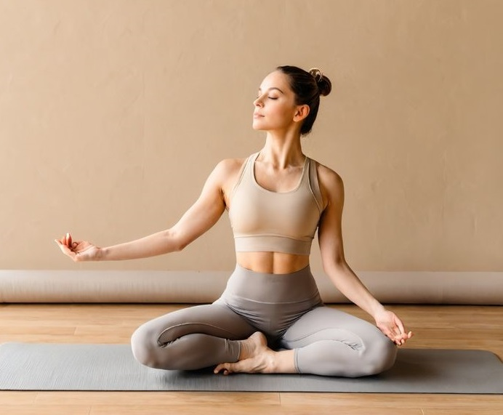
Features of website :
A fixed-top navbar with links to different pages(Home, Classes, Progreams ,Teachers ,AboutUs) and user actions (Sign Up ,Log in).
Displays categories likeYoga , Pilates , Meditation , and Guided Programs using Bootstrap cards.
A Bootstrap carousel to showcase user testimonials.
Buttons for action like ”Browse Classes”,”Follow the Program”,etc…
footer Contains links to important pages , contact information.

Slide 4
Merits :
DeMerits :
Improve Blood Flow circulation and oxygen supply.
Reduce Strees and mental Pease.
Keeps you fresh and active all day.
Help with deeper and restful sleep.
Helps connected with your self.
Increases Sharpens concentration and memory.
Wrong posture can cause injury.
Some poses may not suit everyone.
Incorrect techniques may cause harm.
People with certain health condition, like herniated disc may find some poses to harmful.

Slide 5
Future Scope :
Global Reach: Accessible to anyone worldwide with an internet connection.
Custom Programs: Future development of more specific yoga programs.
Mobile App: Potential development of a mobile app for easy access.
Expansion of Teacher Network: Adding more yoga experts to expand the variety of Teachings.
Playlist Expansion: More curated playlists to suit different yoga moods and styles.

Slide 6
Conclusion :
Flexibility Hubs offer convenient , accessible solutions for improving flexibility and overall fitness.
Future advancements like AI , VR , and wearable integration will enhance personalization and user engagement.
Global accessibility and innovative features will make flexibility training available to a wider audience.
Flexibility Hubs are poised to become an essential tool in a comprehensive , balanced fitness journey.

Slide 7
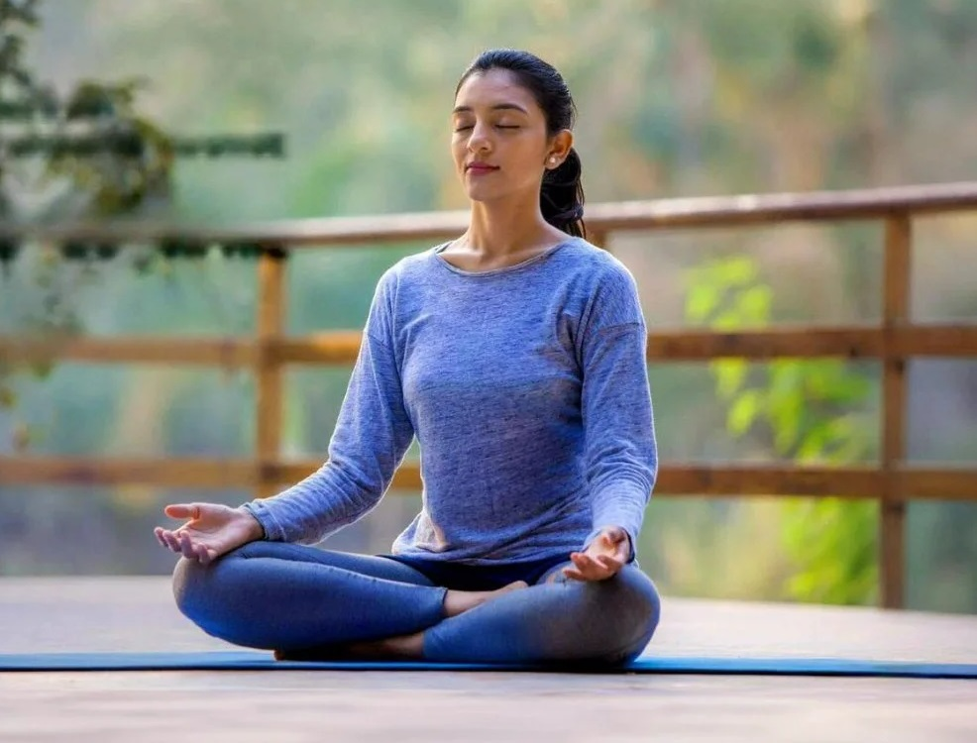
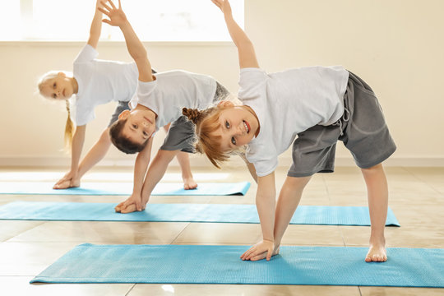
Thank you

