Slide 1


Library Management System
BY:-
NAME :-RAIYANI PRINCY
ENROLLMENT NO:-23002170110152
ROLL NO:- 147
BATCH :- D-5
BRANCH :- CE

Slide 2

INTRODUCTION
Online book purchase
Check books avaibility

Slide 3
Flow chart
Start
No
Sign up
Yes
Password Match?
yes
No
Login
Enter same Password

Slide 4
Purchase Books
Continue purchase
Yes
exit
No
exit

Slide 5

MERIT
Quick book purchase issues
Save time

Slide 6
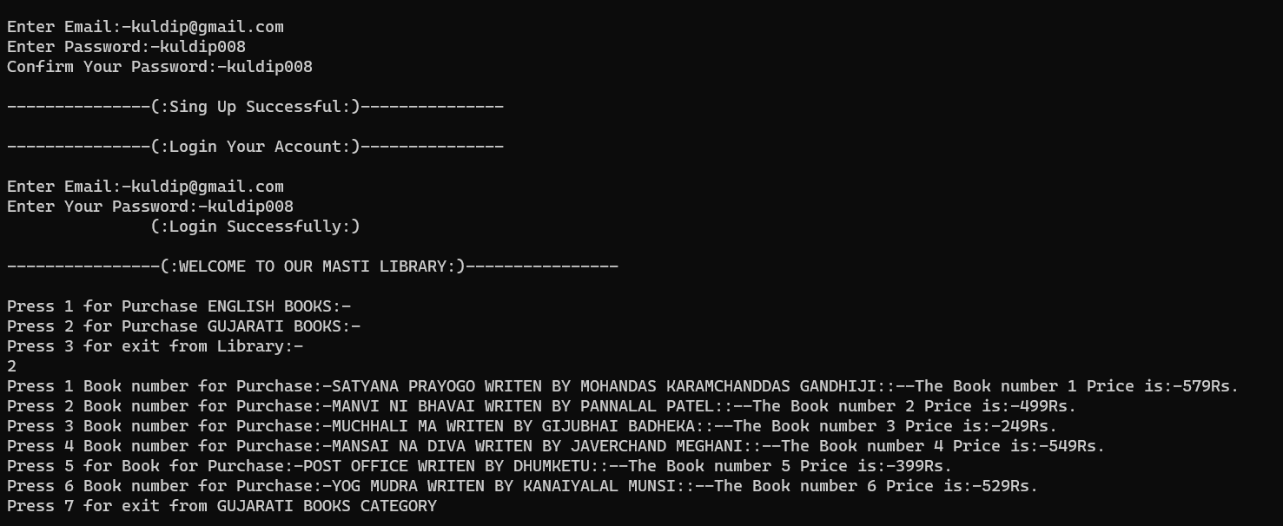
OUTPUT

Slide 7
THANK YOU…..!!!

