Slide 1
ARC
Assisted Routing & Coordination
Explainable emergency-response coordination
for a Toronto dispatcher
NorthStar · Open Agent Hackathon 2026
Notes:
Decision-support simulation. Operational data and incident requirements are synthetic. Primary track: The Agent That Can Explain Why.

Slide 2
The dispatcher’s decision
Which available unit can serve this incident,
and which appropriate destination can receive it?
Availability, destination operations and roads arrive through different feeds.
A recommendation needs its supporting evidence and rejected alternatives.
ARC / NorthStar
02
Notes:
Product problem statement, not a quantified clinical-impact claim. Operational precedent: https://www.juvare.ca/emresource/ . No claim that a hospital-status dashboard is a new category.

Slide 3
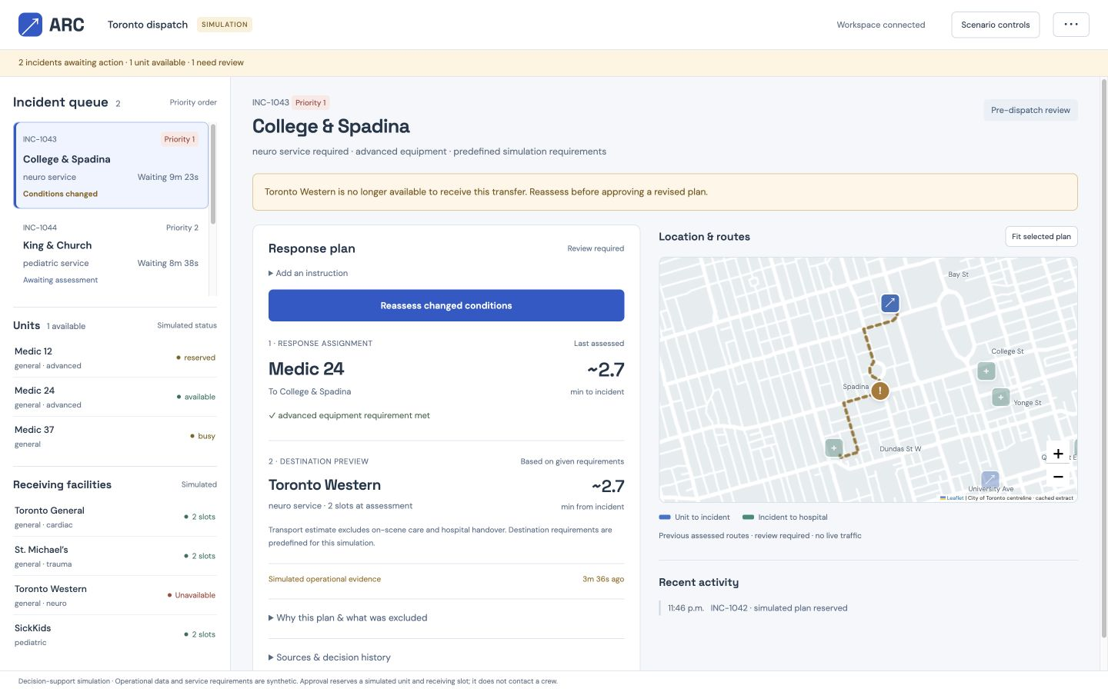
The ARC workspace
Synthetic operations are labelled. Toronto street geometry is cached locally.
ARC / NorthStar
03
Notes:
Actual application screenshot. Basemap: City of Toronto Centreline, Open Government Licence Toronto. https://gis.toronto.ca/arcgis/rest/services/cot_geospatial/MapServer/2

Slide 4
Agent workflow and architecture
01
02
03
04
05
Nemotron
→
Zetaris
→
Explicit rules
→
Nemotron
→
Dispatcher
Select evidence tools
Federate distinct feeds
Check eligibility + routes
Compose cited explanation
Approve exact proposal
Meterless World Model retains typed resource history and recommendation relationships.
SQLite reserves resources atomically after approval. OSRM calculates both driving legs.
ARC / NorthStar
04
Notes:
Editable architecture diagram. Implemented source: app.py, decision.py, integrations.py, scripts/world-model.mjs. The actual World Model reference is vendored from Meterless commit 1742dec56a66e58eef9dda2d2b865823758ca8cd. SQLite is not claimed as a Meterless engine.

Slide 5
A changed condition requires a new decision
Baseline
Medic 12 to St. Michael’s
A simulated closure crosses the destination approach.
Reassessment
Medic 12 to Toronto General
ARC / NorthStar
05
Notes:
Observed in actual acceptance test. The prior proposal is rejected if approved after scenario version changes. ARC excludes routes that cross the closure circle and chooses a remaining feasible pair. It does not compute a closure-aware detour. Driving estimates are not ambulance ETAs.

Slide 6
Sponsor technology in the working feature
Zetaris
One product query combines fleet, hospital operations and closure REST sources.
Nightshift + NVIDIA
Nemotron selects evidence tools and cited explanation facts. Runtime receipts identify the winning NVIDIA model.
Meterless World Model
Actual upstream reference persists typed entities, provenance and relationships. Prior state explains resource changes.
ARC / NorthStar
06
Notes:
Evidence: Integration evidence view, artifacts/live-validation.json, artifacts/world-model-conformance.txt. Sources: https://meterless.ai/engines.html and https://github.com/Meterless/Meterless/tree/1742dec56a66e58eef9dda2d2b865823758ca8cd/engines/world-model . No standalone provider connectivity test is represented as engine compliance.

Slide 7
Verification and failure behavior
29
8 / 8
decision and workspace checks
upstream engine conformance checks
Changed or expired evidence blocks approval. Concurrent proposals cannot reserve the same unavailable unit.
Stale data, no destination and integration failures produce explicit blocked states.
ARC / NorthStar
07
Notes:
Checks include 21 Python tests and 8 workspace behavior tests for queue ordering, evidence expiry and incident-bound background results. They cover constraints, alternatives, state transitions, citation/tool validation and real World Model persistence. Live acceptance exercises actual product APIs, sponsors, closure reassessment and approval. Results in artifacts/checks.txt and artifacts/live-validation.json. No production accuracy or saved-lives metric is claimed.

Slide 8
What the prototype proves
A dispatcher can inspect, challenge and approve
a recommendation tied to the evidence used.
Current scope
Toronto simulation. Synthetic operational feeds. Static road-network estimates. Human approval.
Next validation
Dispatcher interviews, authorized live feeds, validated protocols and production access controls.
ARC / NorthStar
08
Notes:
Submission track: The Agent That Can Explain Why. Clinical validity, real emergency response and traffic-aware ambulance ETAs are not established. Cursor rule conflict remains a team action before submission. Never claim full eligibility before resolving it.

