Slide 1



Movie Data Analysis
Raizel Bernstein

Slide 2
Recommendations for Microsoft
Music, Sport, History, Biography, News, Game-Show, Documentary, and Shorts have the highest ratings (consumers like those genres the most)
Western, Action, Thriller, Sci-Fi, Horror, and Adult have the lowest ratings (consumers dislike those genres the most)
Just because people like a certain genre (seen in favorable ratings) doesn’t mean that genre generates the most money
Action, Adventure, Animation, Fantasy, Family, and Sci-Fi movies generate the most revenue

Slide 3
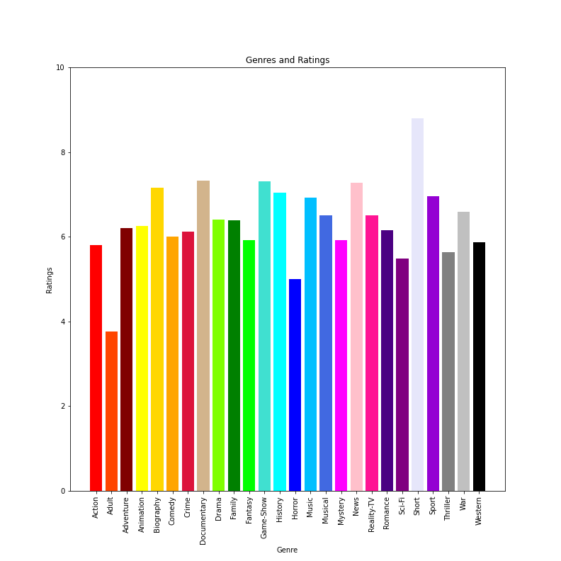
Which genres have the highest ratings?

Slide 4
Which genres have the lowest ratings?

Slide 5
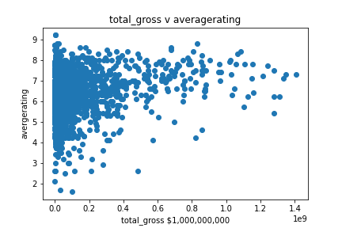



Slide 6
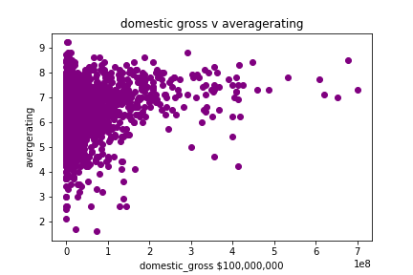
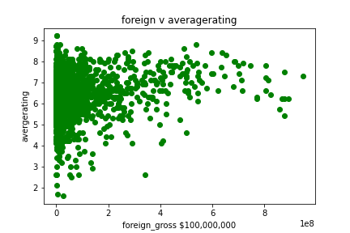

Slide 7
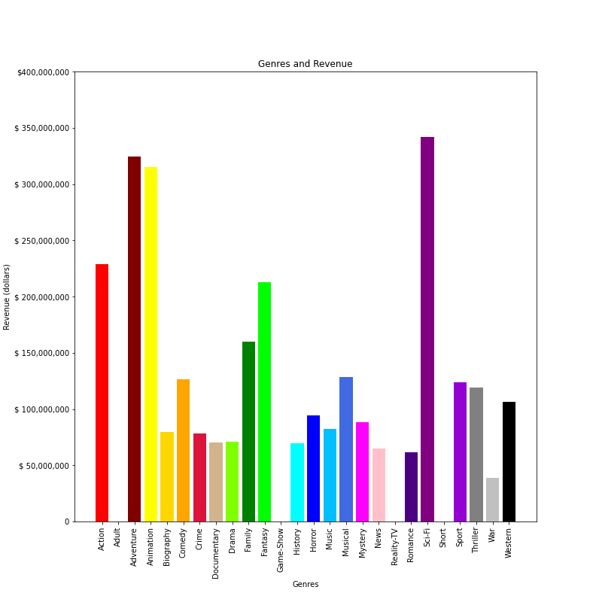
Each Genres Rating
Money Made From Each Genre

Slide 8
Further develop project
Not Accounted for in the Data:
Movies cast
Advertising for the movie
Time of year movies released
Was the movie released during a pandemic
Outliers could have skewed the data – extract outliers
all sample sizes included – in the future I’d adhere to a minimum data size requirement so the mean is more reliable

