Slide 1
Data Analysis
Model Development
Simple & Multiple Linear Regression

Slide 2
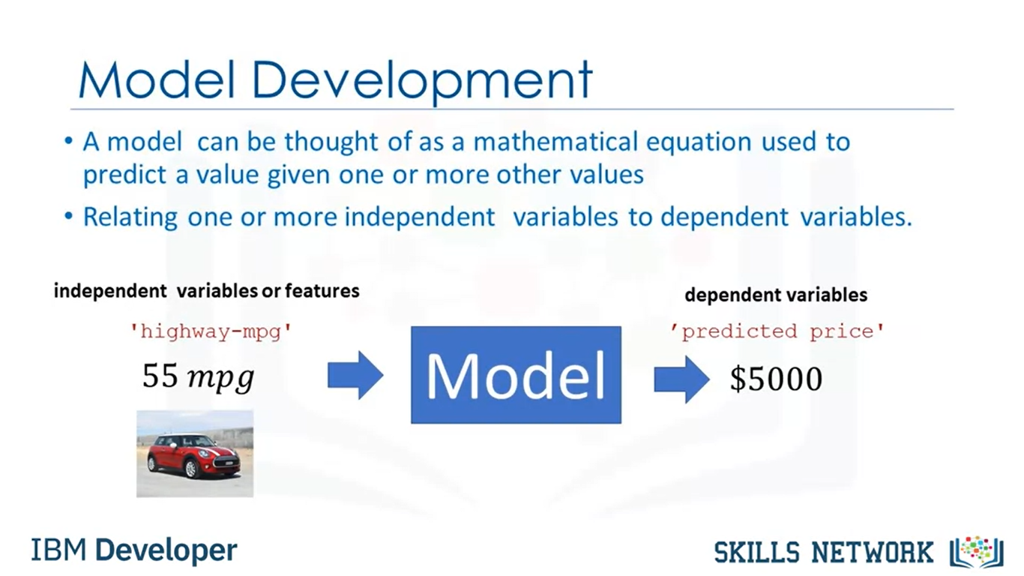

Slide 3
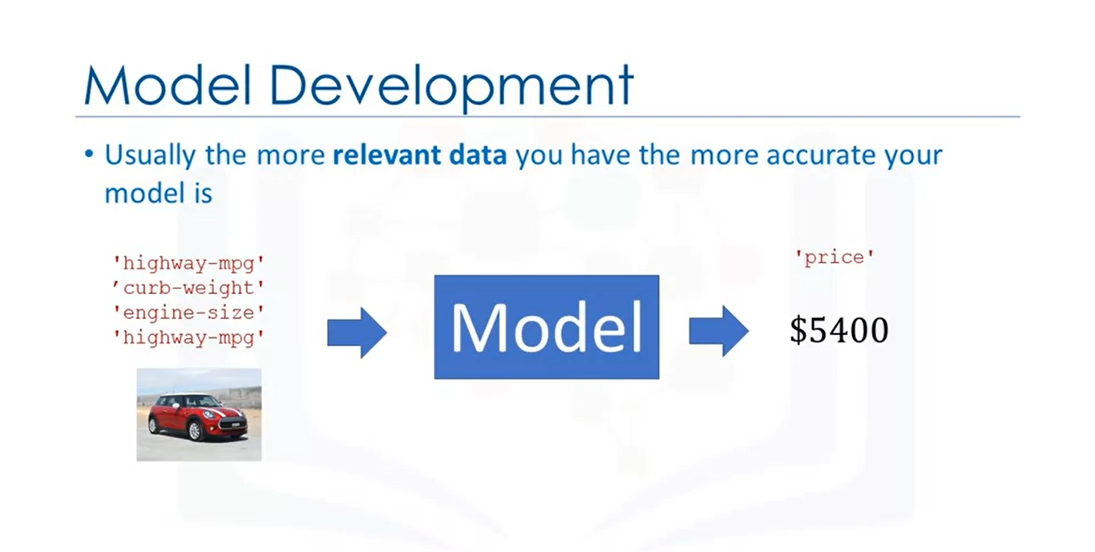

Slide 4
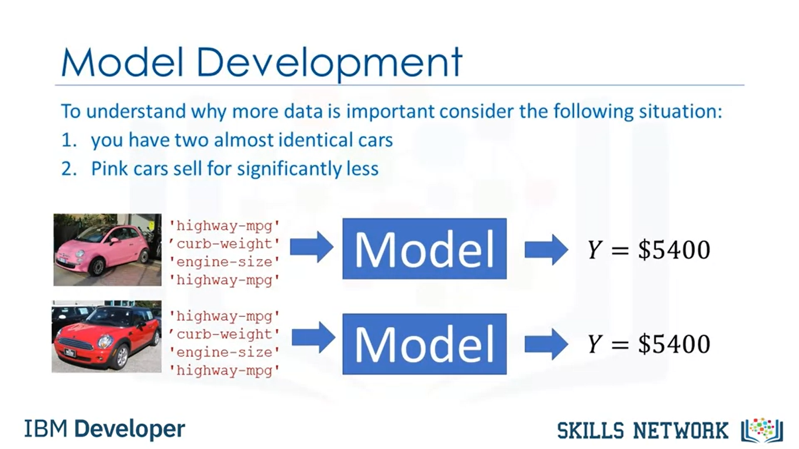

Slide 5
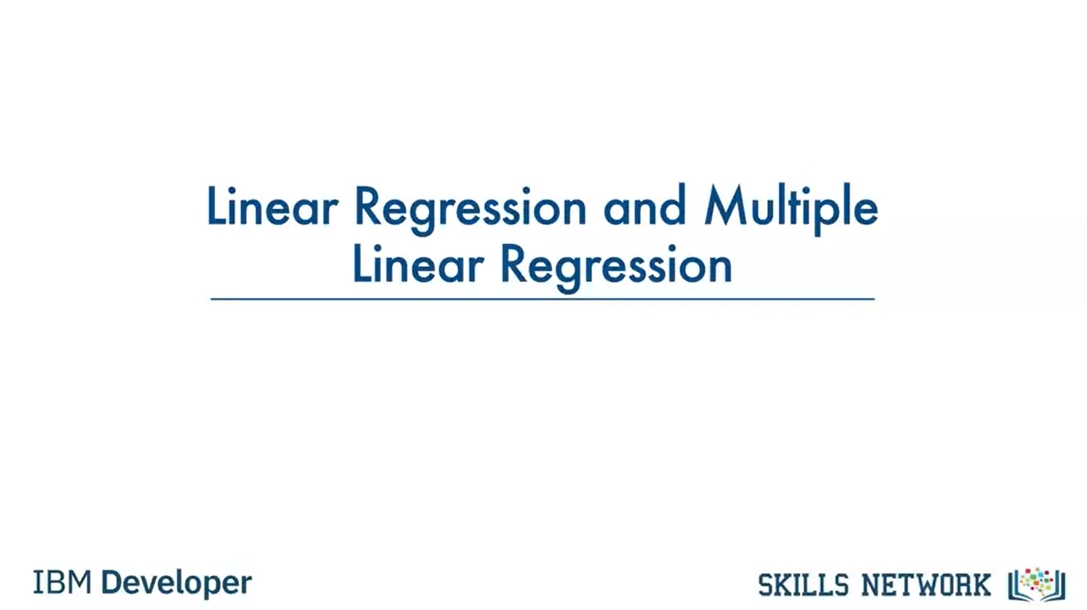

Slide 6
What is regression
A regression is a statistical technique that relates a dependent variable to one or more independent (explanatory) variables. A regression model is able to show whether changes observed in the dependent variable are associated with changes in one or more of the explanatory variables.
Regression models are used to describe relationships between variables by fitting a line to the observed data. Regression allows you to estimate how a dependent variable changes as the independent variable(s) change.

Slide 7
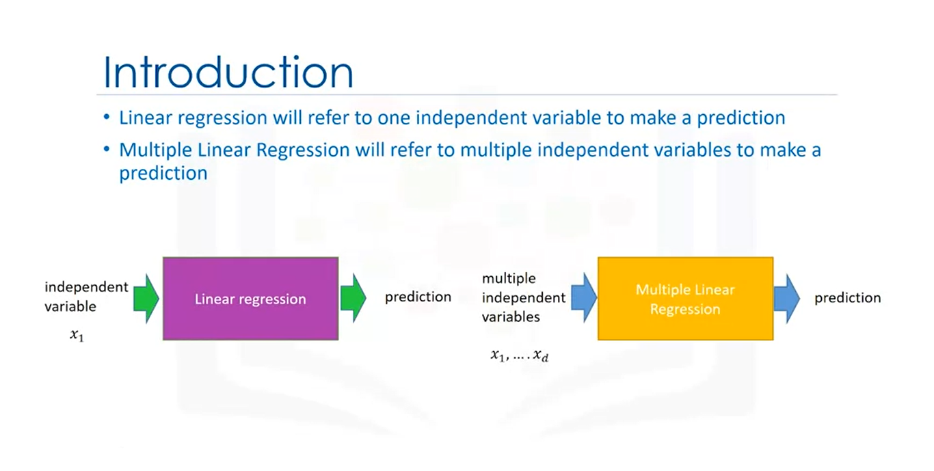
Notes:
Simple linear regression or SLR is a method to help us understand the relationship between two variables.
The predictor independent variable x and the target-dependent variable y.

Slide 8
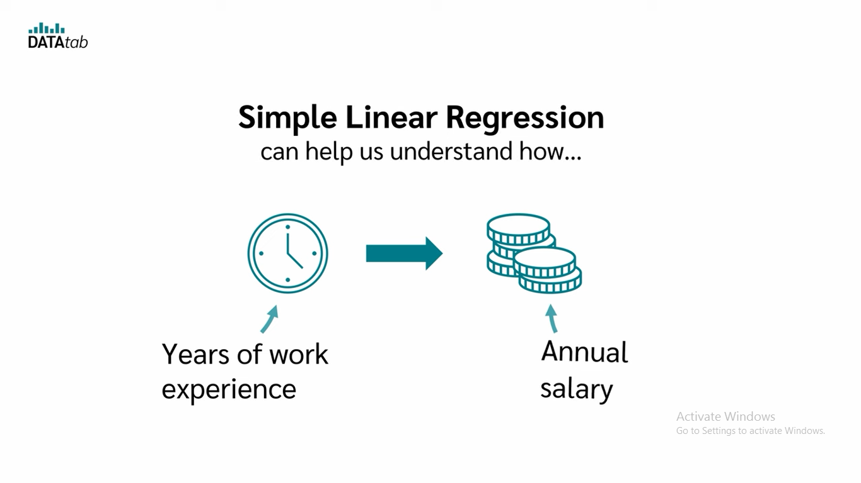
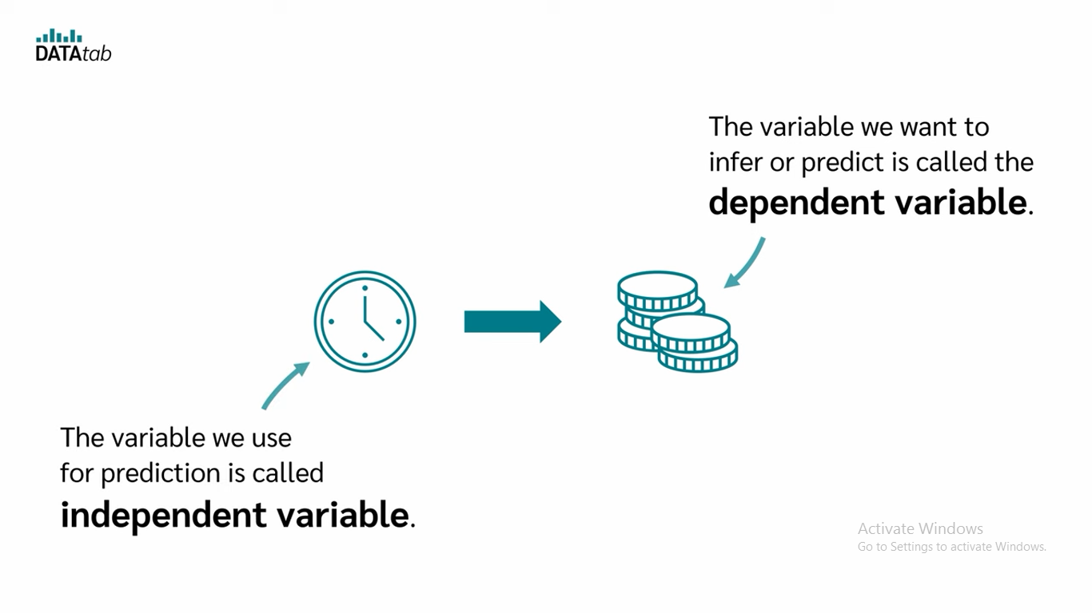

Slide 9

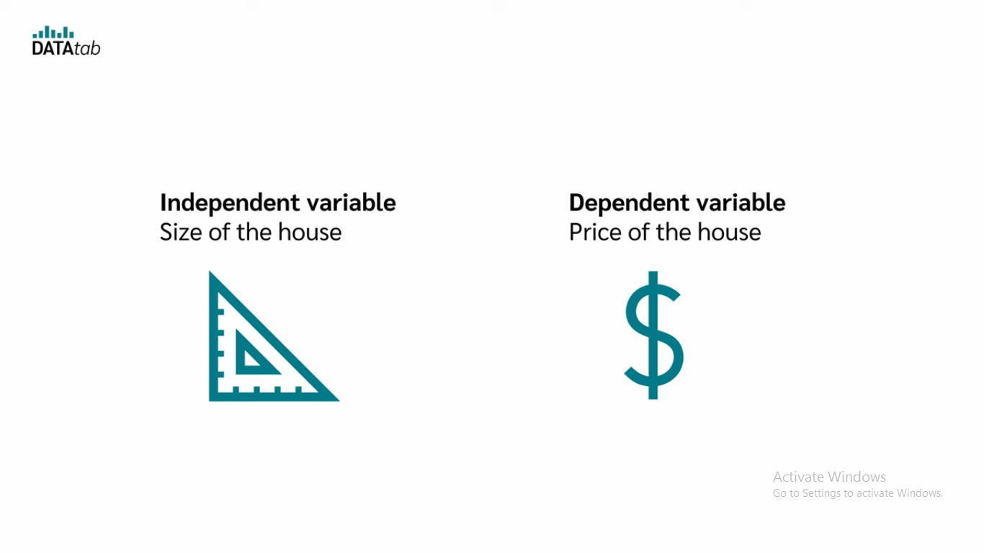

Slide 10
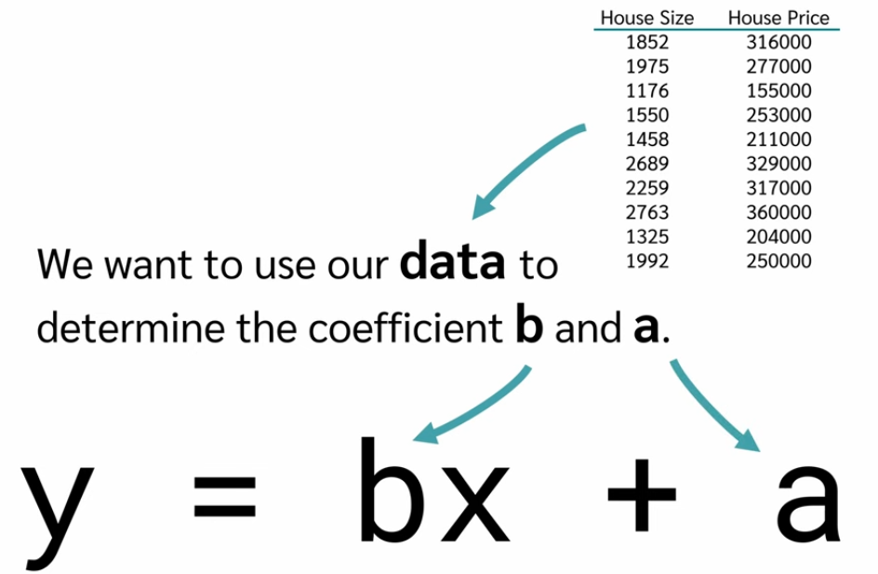
As mentioned above, linear regression is a predictive modeling technique. It is used whenever there is a linear relation between the dependent and the independent variables.
Y = b0 + b1* x
It is used in estimating exactly how much of y will change, when x changes a certain amount.

Slide 11
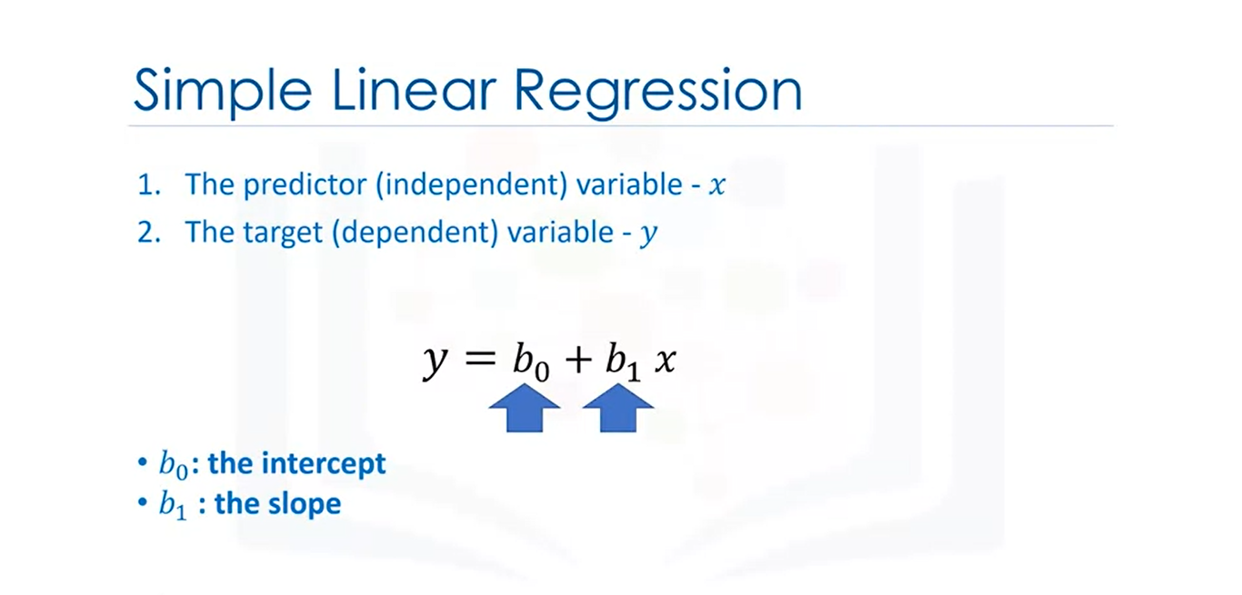
Notes:
We would like to come up with a linear relationship between the variables shown here.
The parameter b_0 is the intercept.
The parameter b_1 is the slope.
When we fit or train the model, we will come up with these parameters.
Let's clarify the prediction step. It's hard to figure out how much a car costs,
but the highway miles per gallon is in the owner's manual.
If we assume there is a linear relationship between these variables, we can use this relationship to formulate a model to determine the price of the car.

Slide 12
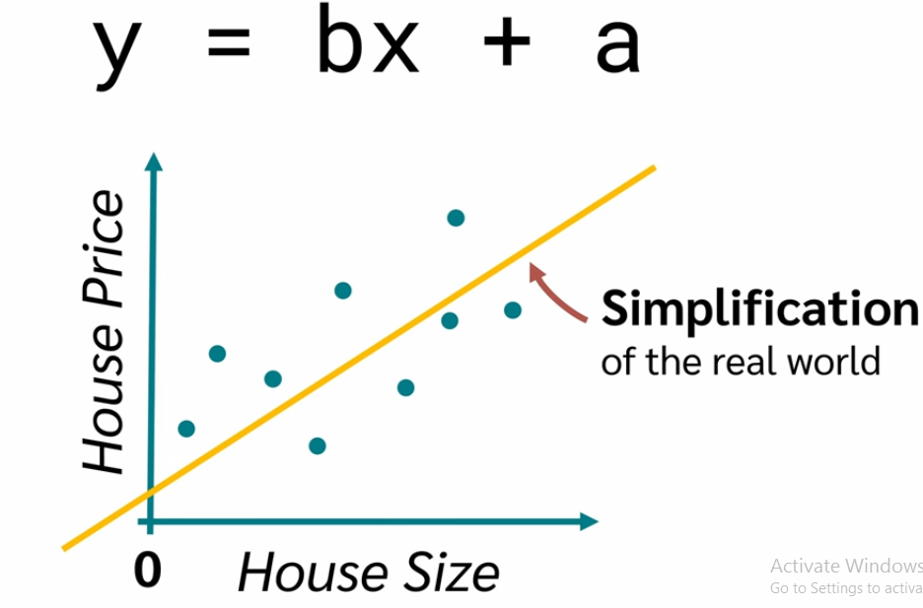
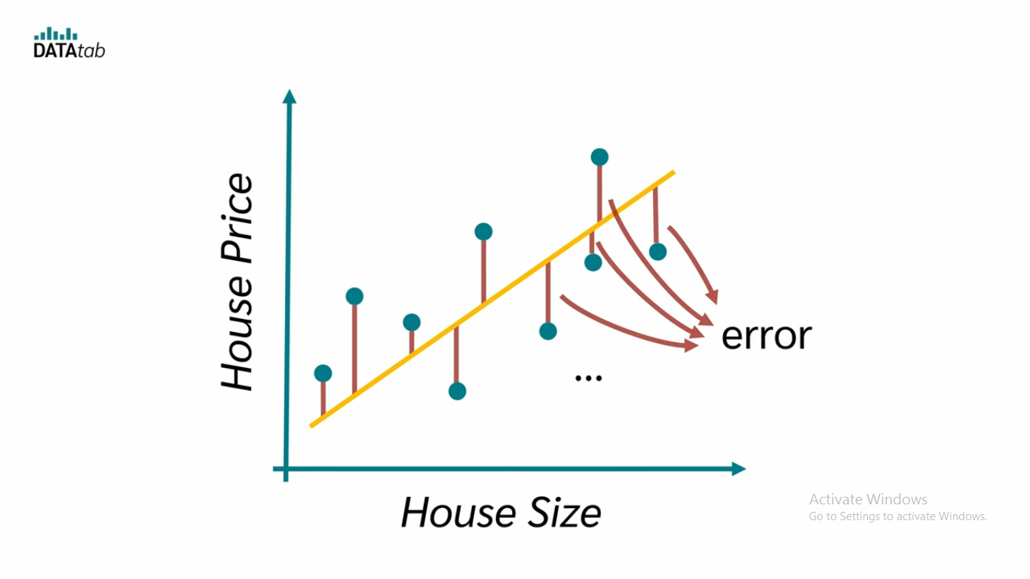
Reseduals

Slide 13
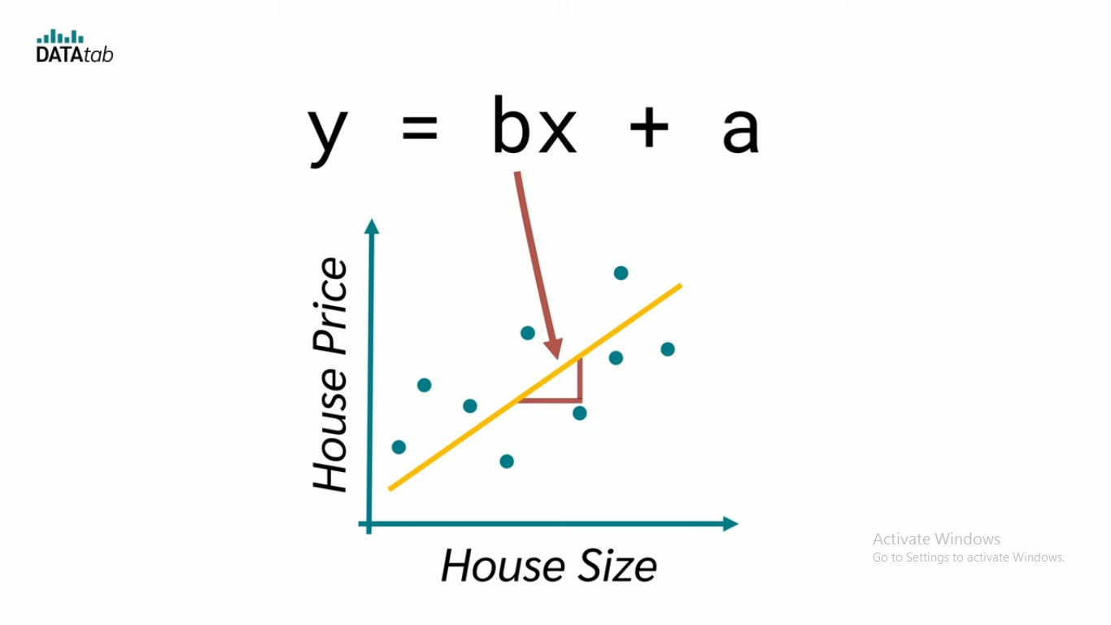
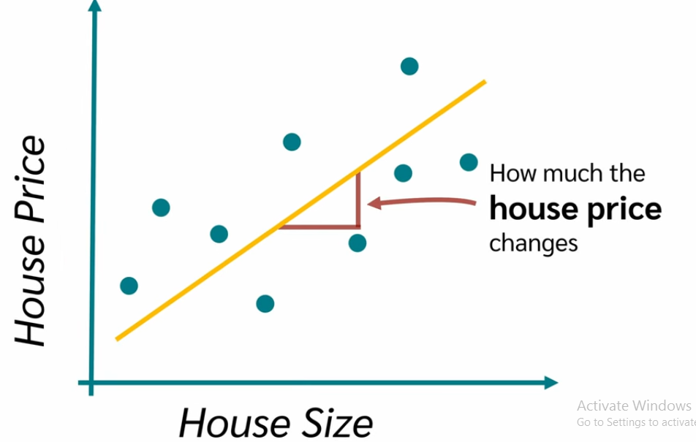
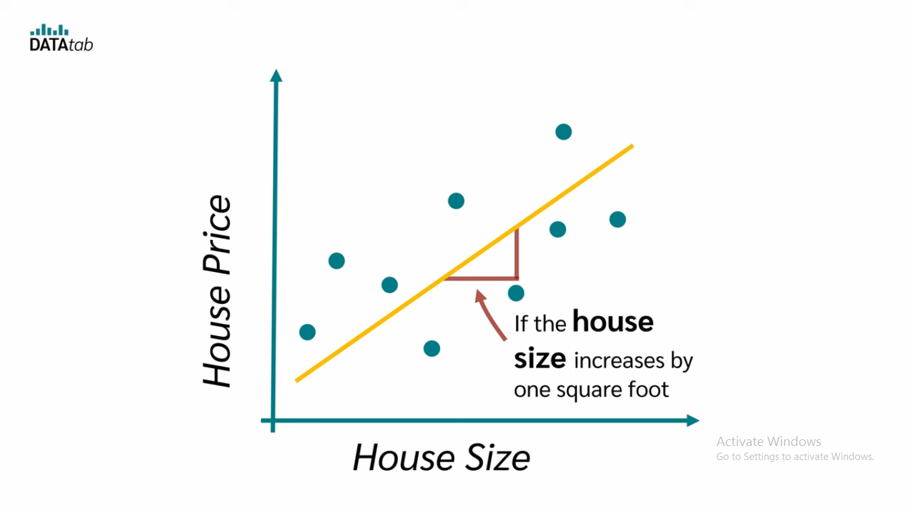

Slide 14
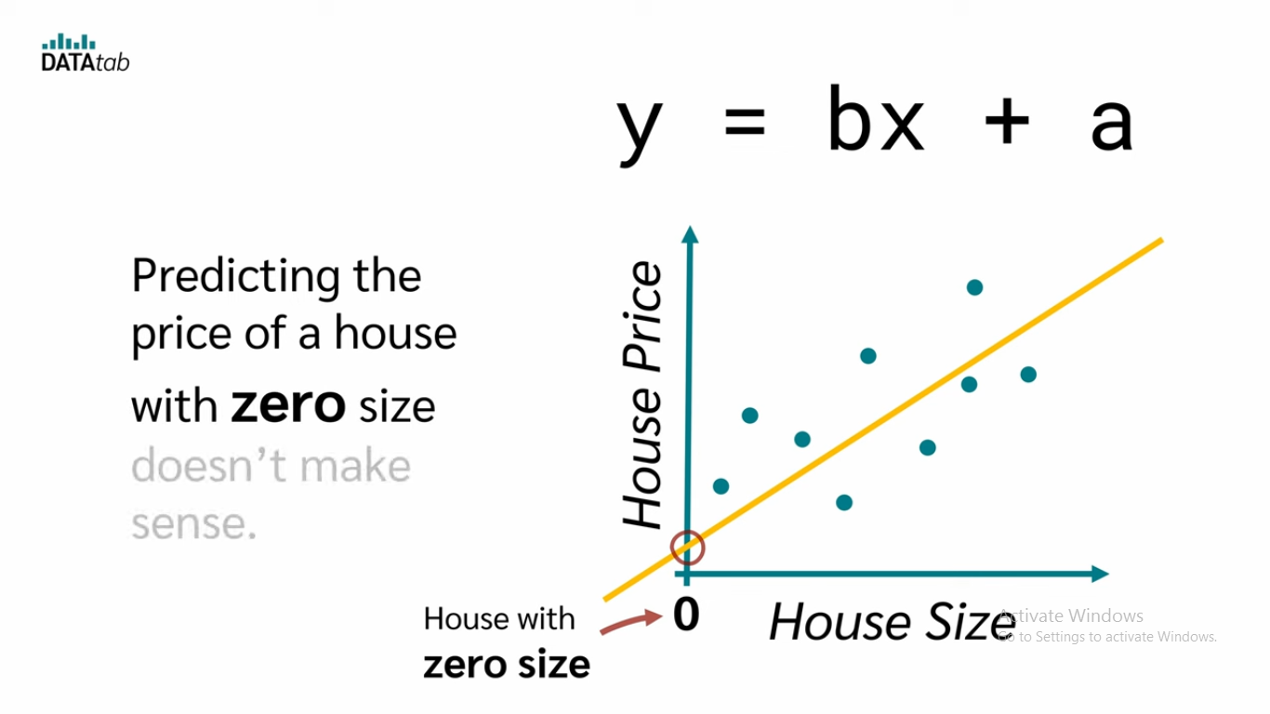
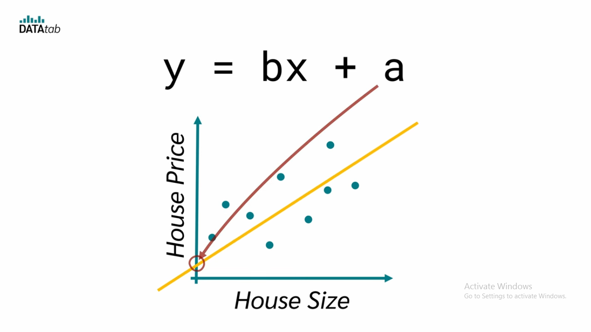

Slide 15
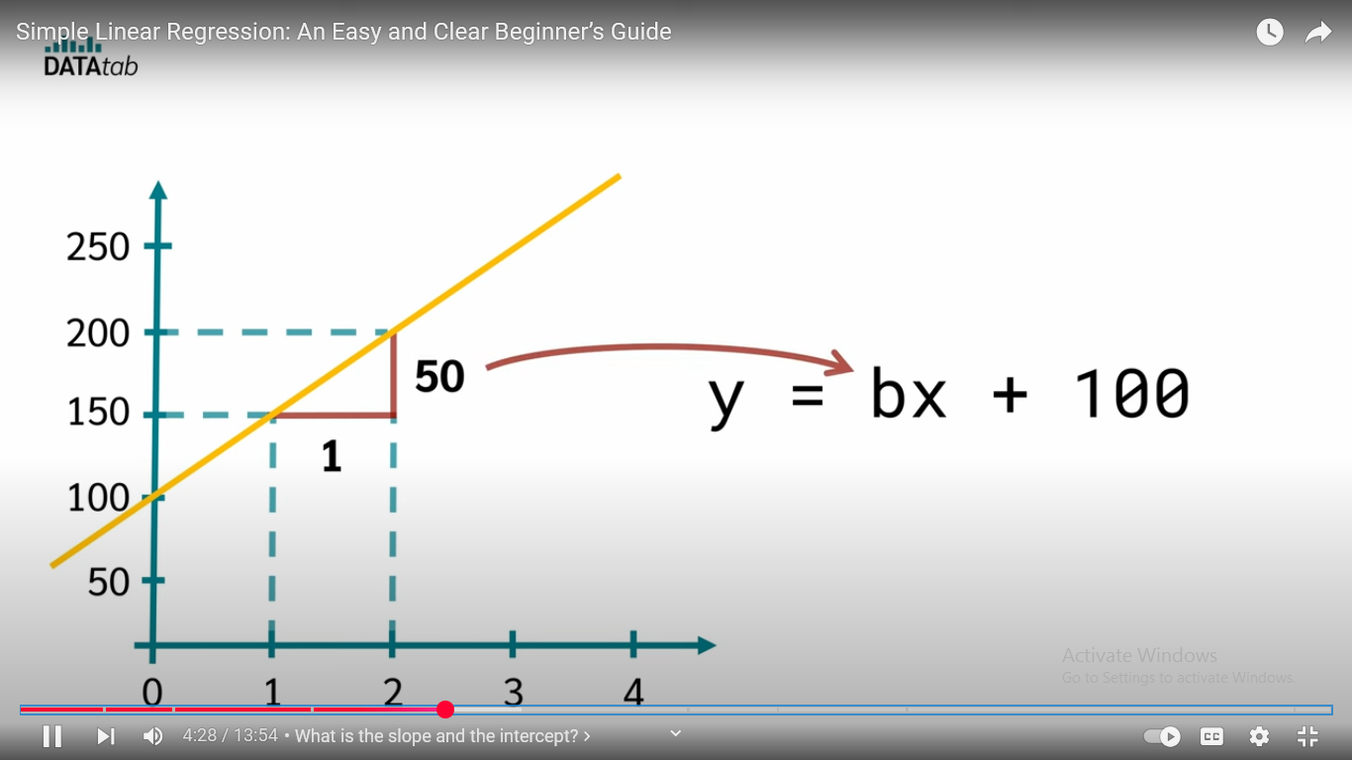

Slide 16
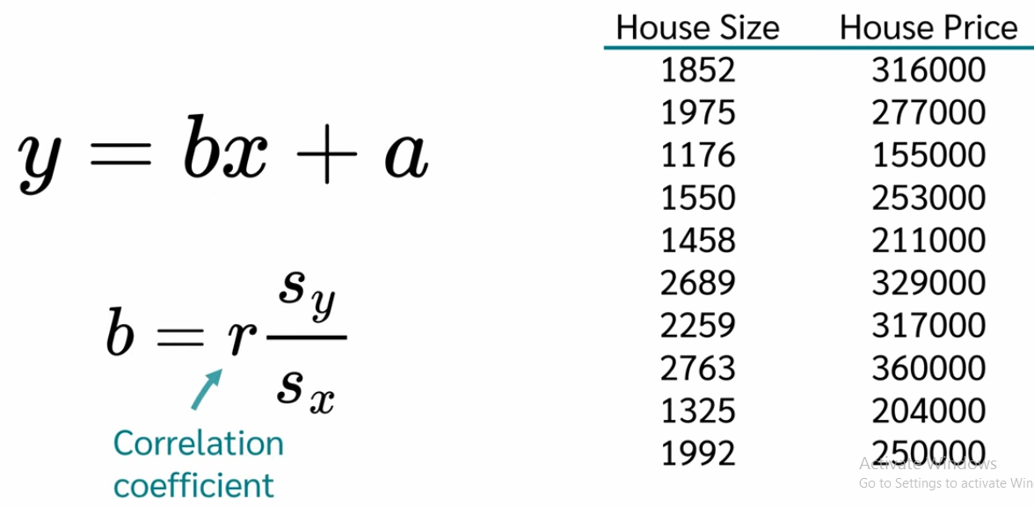

Slide 17
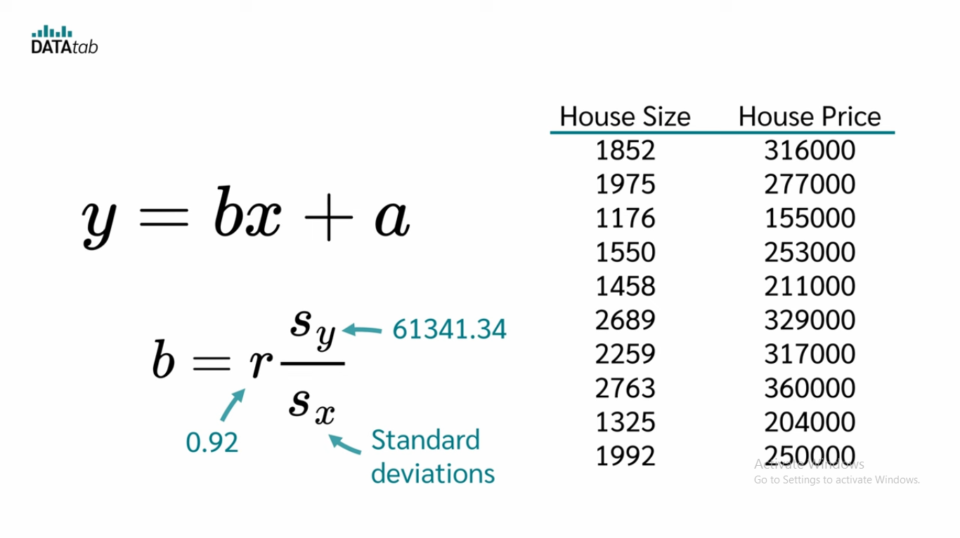
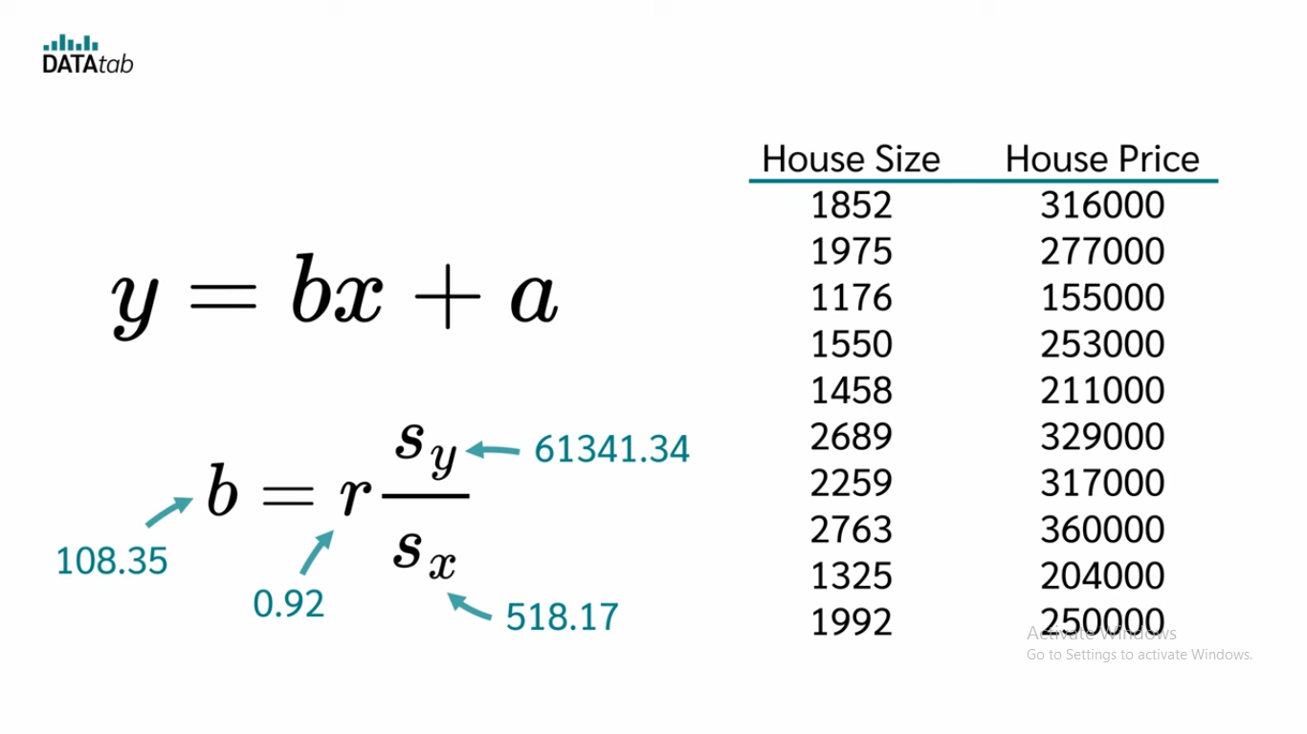

Slide 18
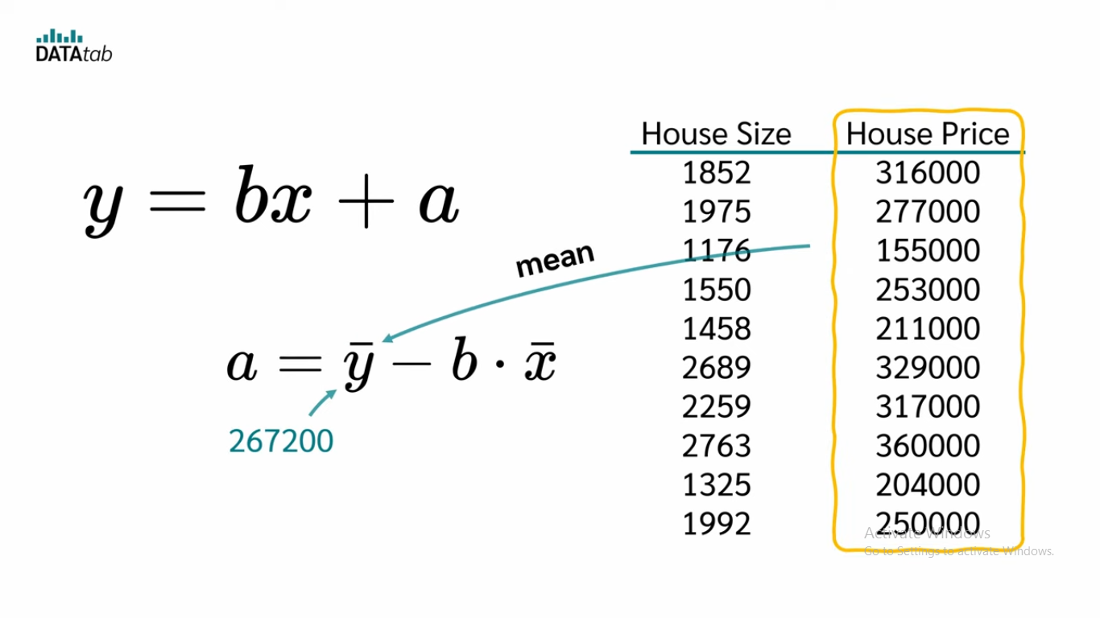
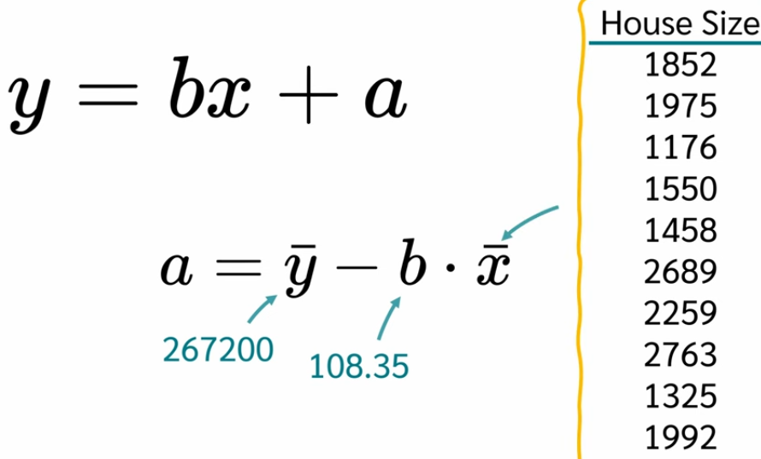
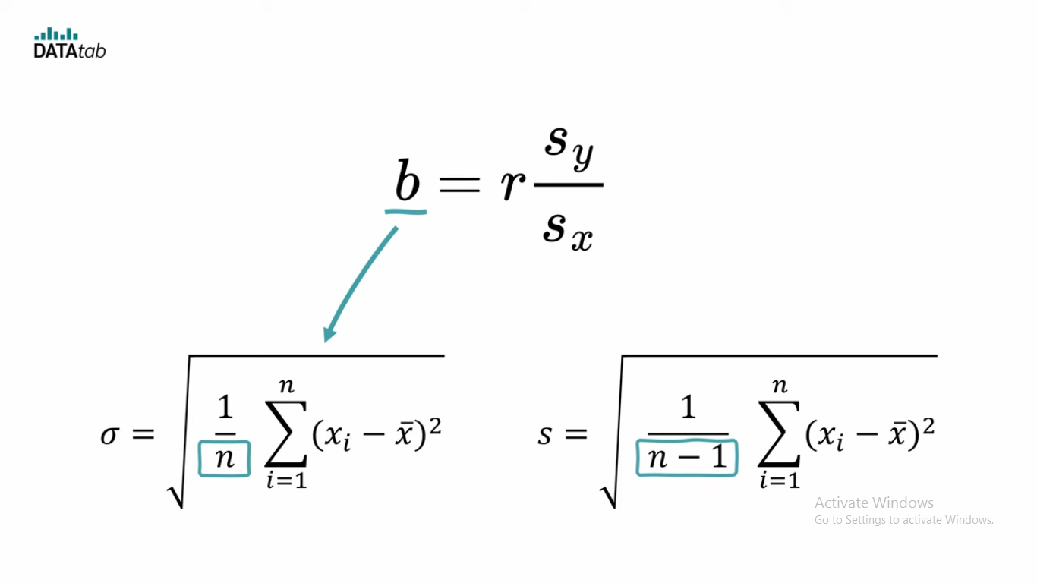
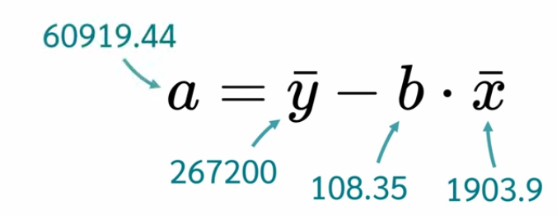

Slide 19
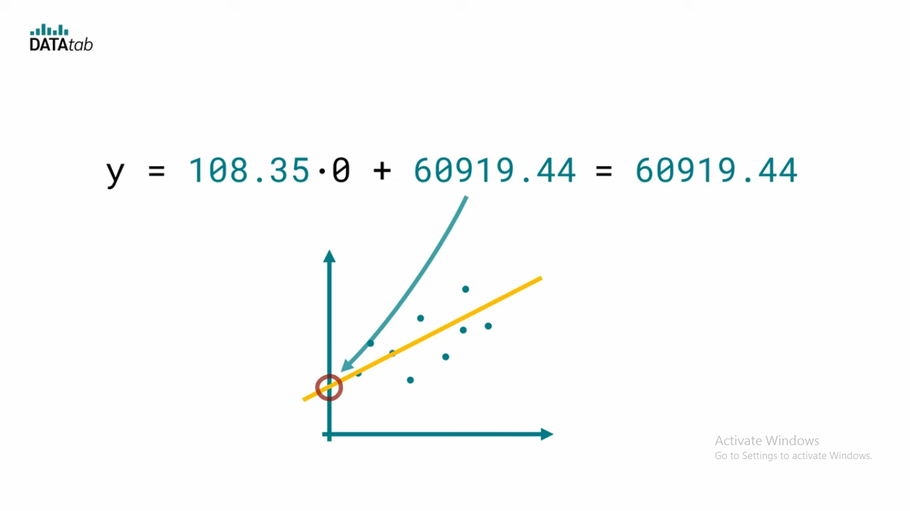
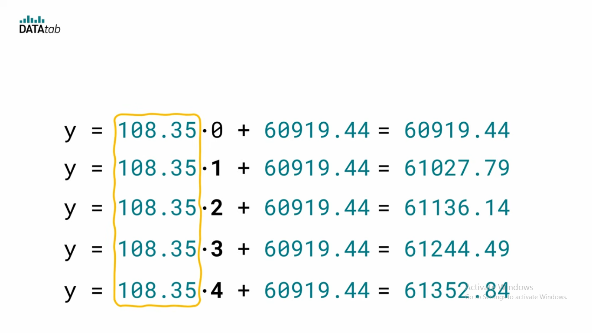

Slide 20

How to Find Linear Regression Slope:
Find the following data from the information given: Σx, Σy, Σxy, Σx², Σy². If you don’t remember how to get those variables from data, see this Pearson’s correlation coefficient.
In the linear regression formula, the slope is the a in the equation y’ = b + ax.

Slide 21
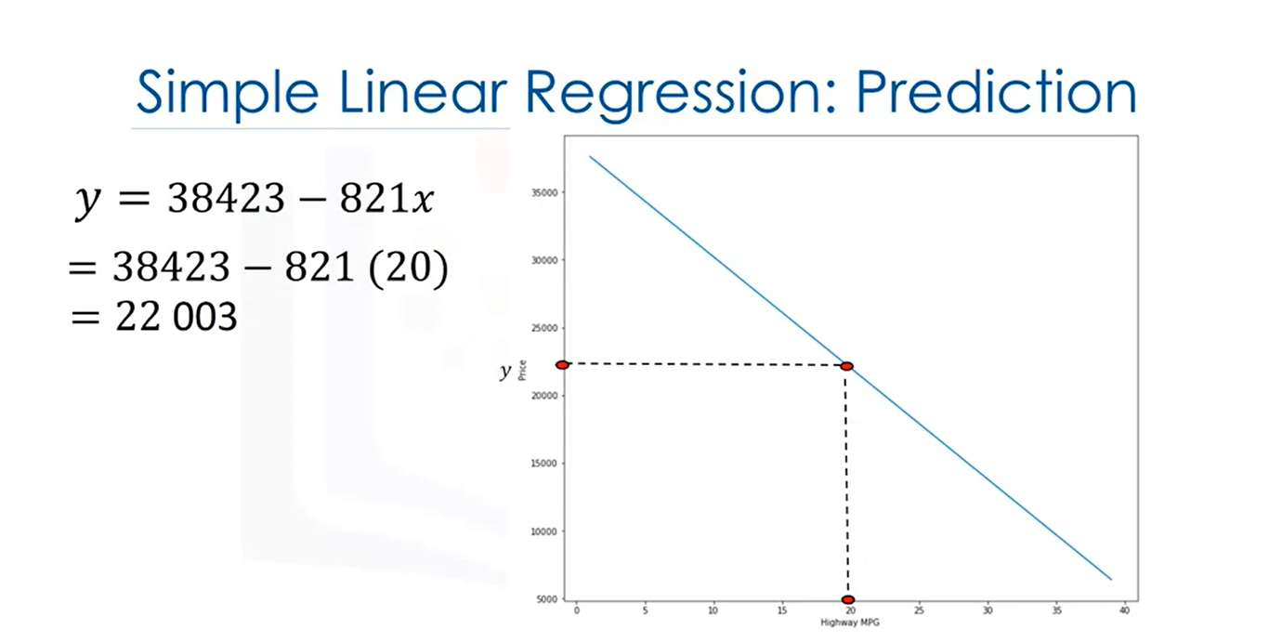
Notes:
If the highway miles per gallon is 20, we can input this value into the model to obtain a prediction of $22,000.
In order to determine the line, we take data points from our data set marked in red here. We then use these training points to fit our model.

Slide 22
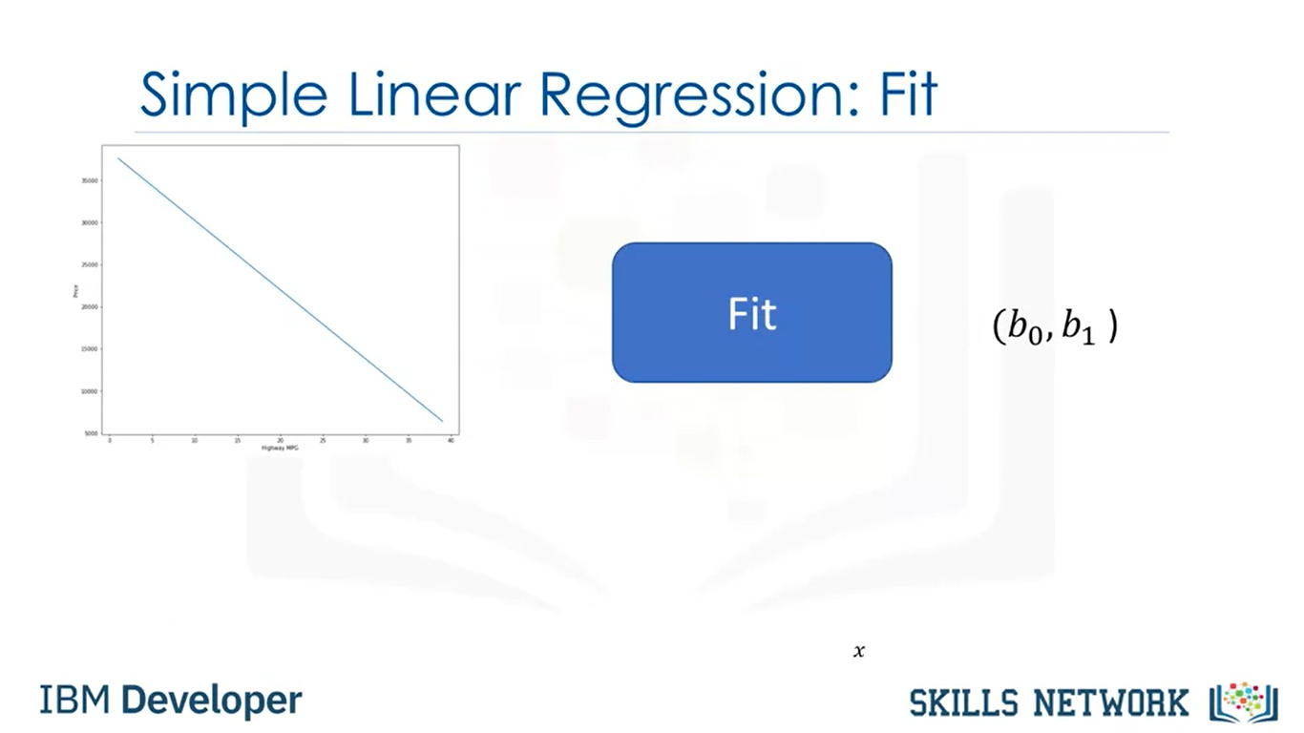

Slide 23
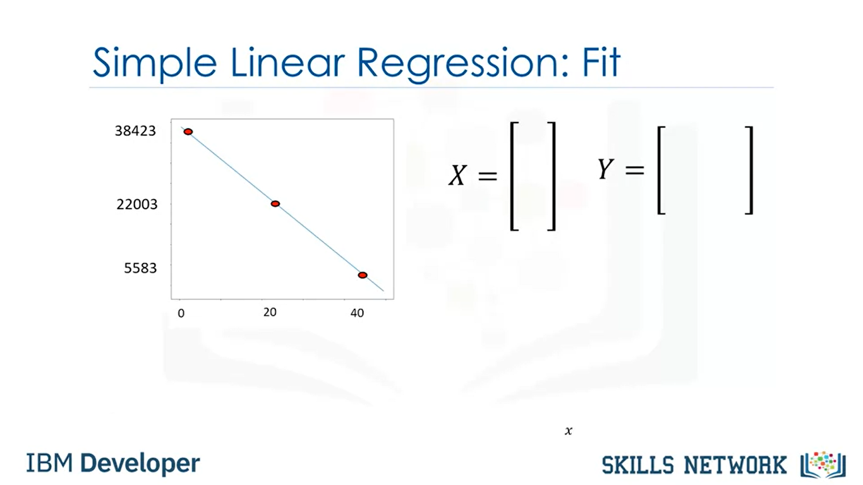

Slide 24
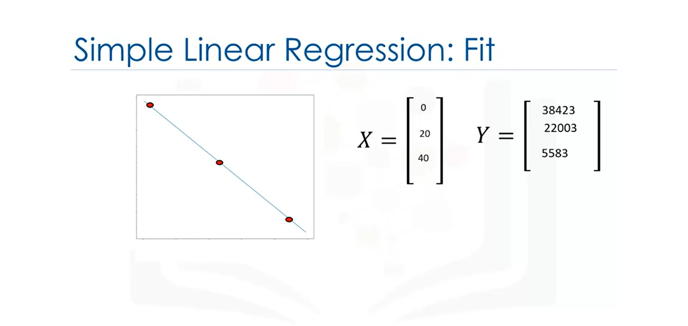

Slide 25
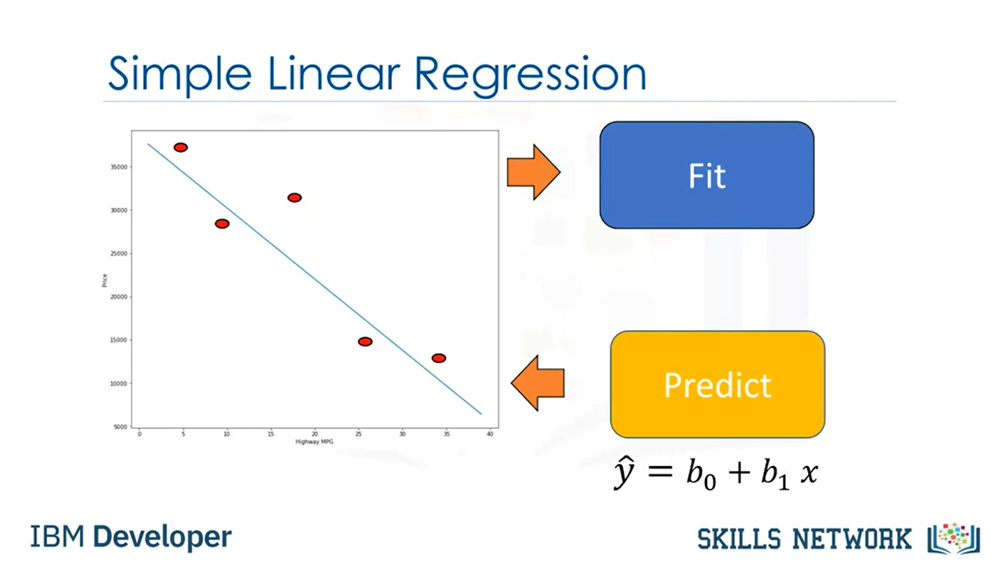

Slide 26
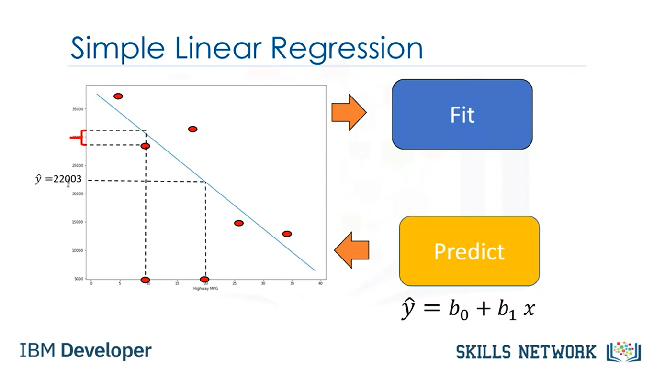
Notes:
For example, make or how old the car is.
In this model, this uncertainty is taken into account by assuming a small random value is added to the point on the line.
This is called noise.
The figure on the left shows the distribution of the noise.
The vertical axis shows the value added and the horizontal axis illustrates the probability that the value will be added.
Usually a small positive value is added or a small negative value.
Sometimes, large values are added. But for the most part, the values added are near zero.
We can summarize the process like this. We have a set of training points.
We use these training points to fit or train the model and get parameters.
We then use these parameters in the model. We now have a model.
We use the hat on the y to denote the model is an estimate. We can use this model to predict values that we haven't seen.
For example, we have no car with 20 highway miles per gallon. We can use our model to make a prediction for the price of this car.
But don't forget our model is not always correct. We can see this by comparing the predicted value to the actual value.
We have a sample for 10 highway miles per gallon but the predictive value does not match the actual value.
If the linear assumption is correct, this error is due to the noise. But there can be other reasons

Slide 27
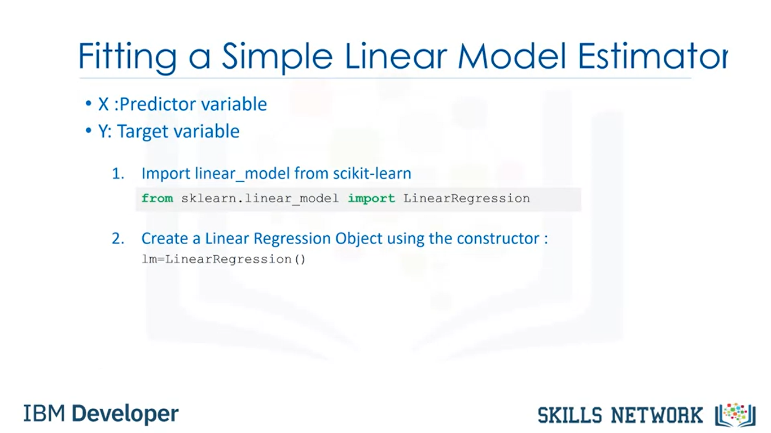

Slide 28
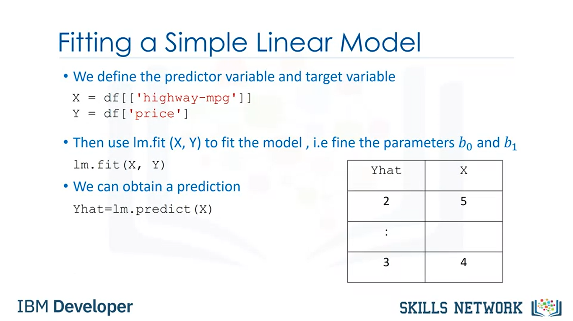

Slide 29
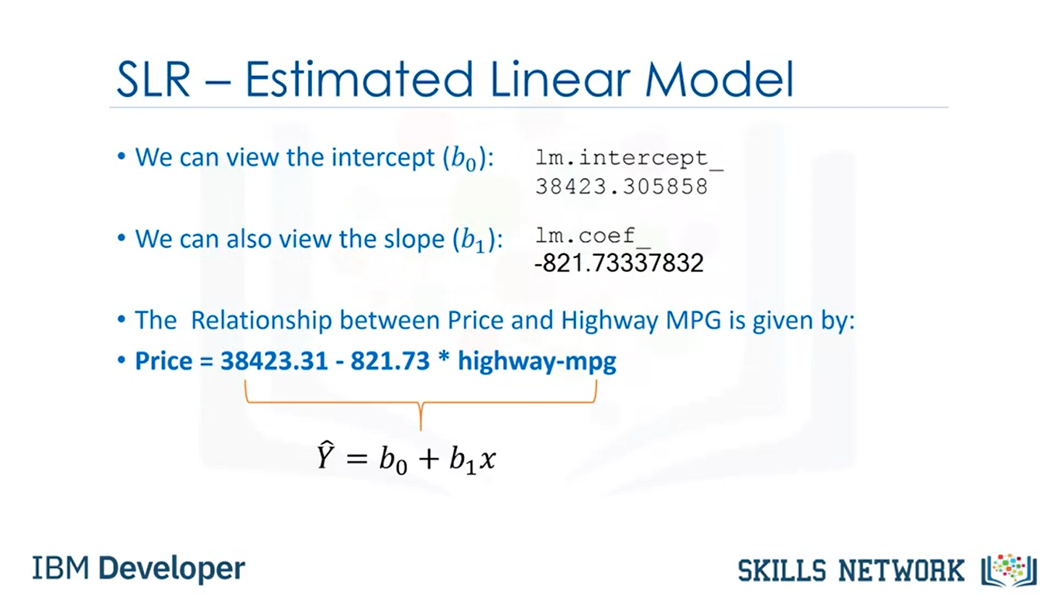

Slide 30
Cont…
To find out the best fit line, we have something called residual sum of squares (RSS). In RSS, we take the square of residuals and sum them up.
The line with the lowest value of RSS is the best fit line.
In simple linear regression, if the coefficient of x is positive, then we can conclude that the relationship between the independent and the dependent variables is positive.
Here, if the value of x increases, the value of y also increases

Slide 31
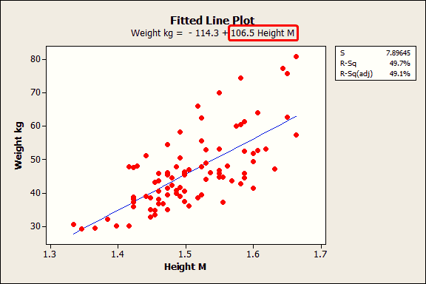
example
The height coefficient in the regression equation is 106.5. This coefficient represents the mean increase of weight in kilograms for every additional one meter in height. If your height increases by 1 meter, the average weight increases by 106.5 kilograms.
Notes:
The regression line on the graph visually displays the same information. If you move to the right along the x-axis by one meter, the line increases by 106.5 kilograms.

Slide 32
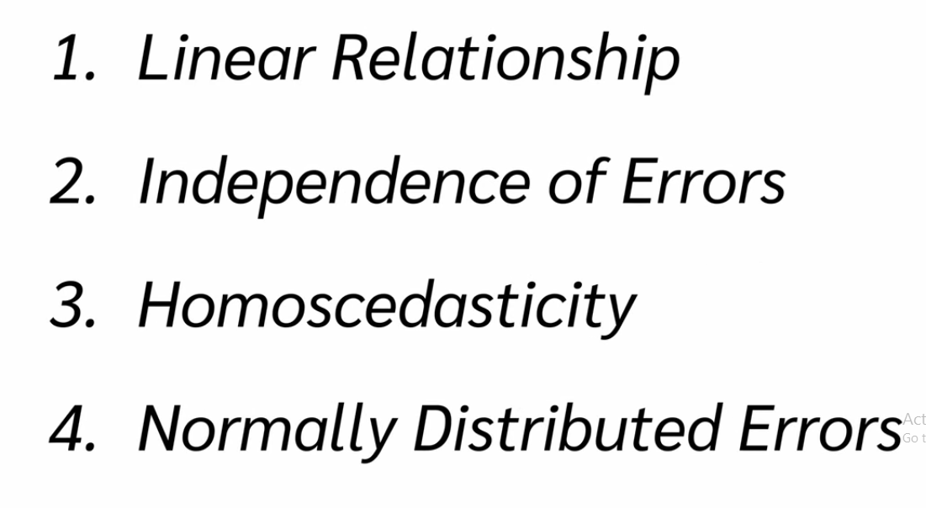

Slide 33
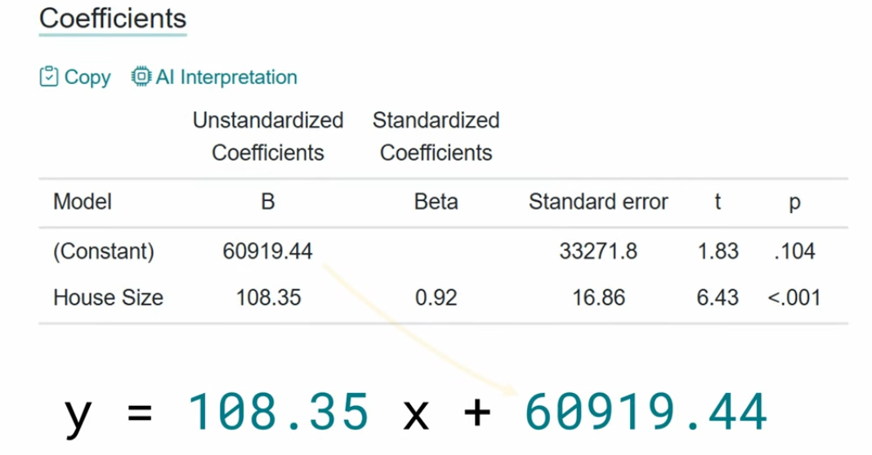

Slide 34
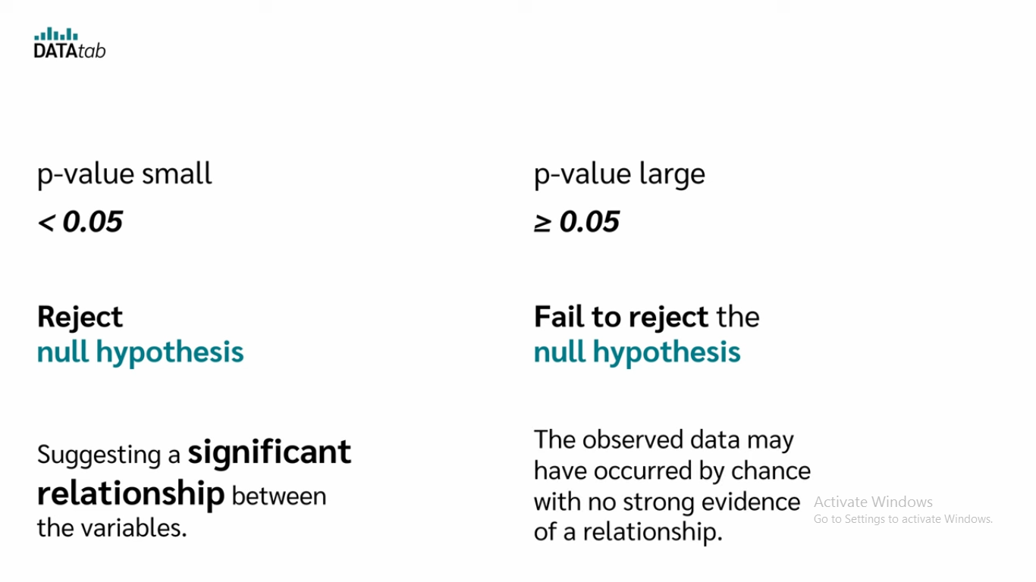
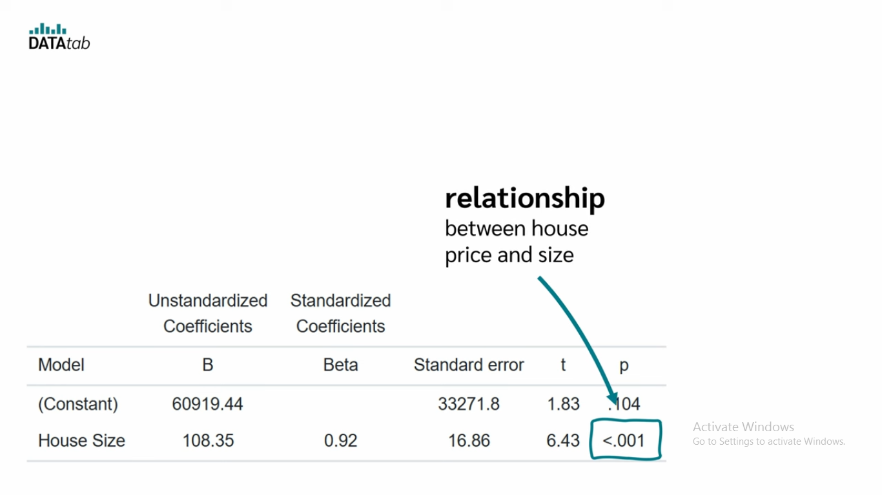

Slide 35
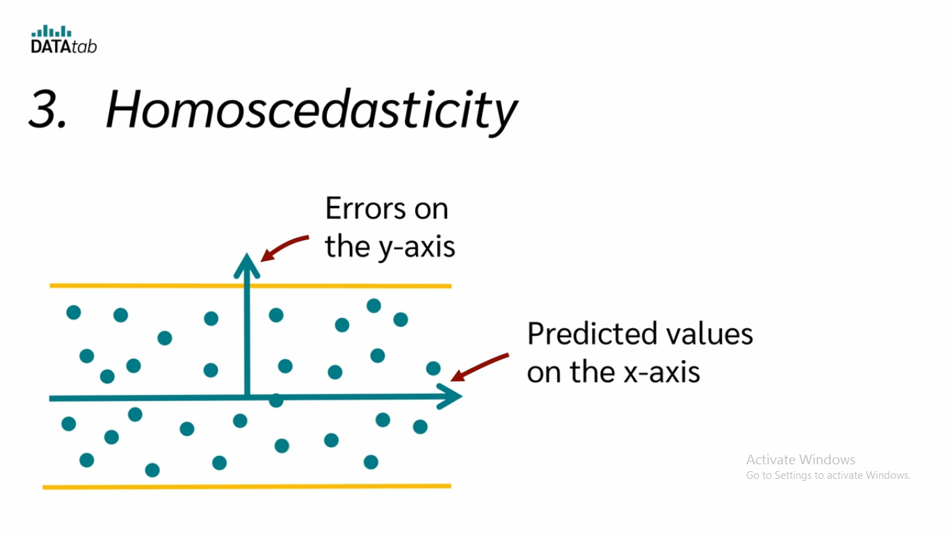
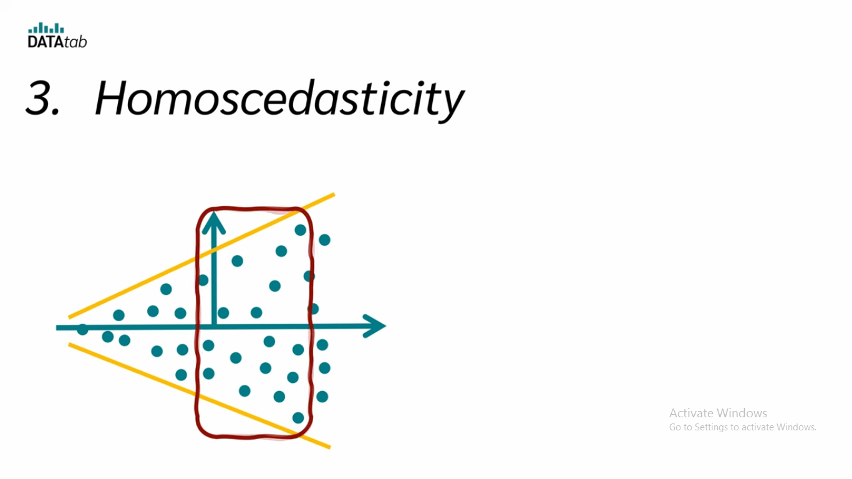
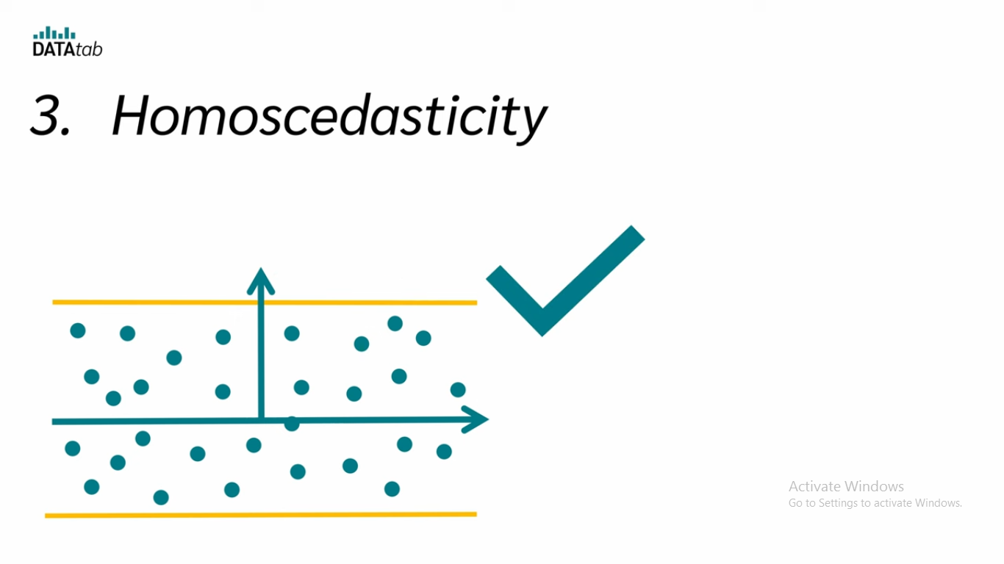

Slide 36
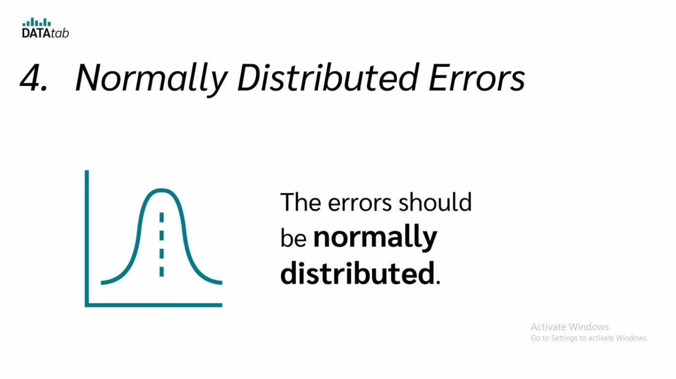
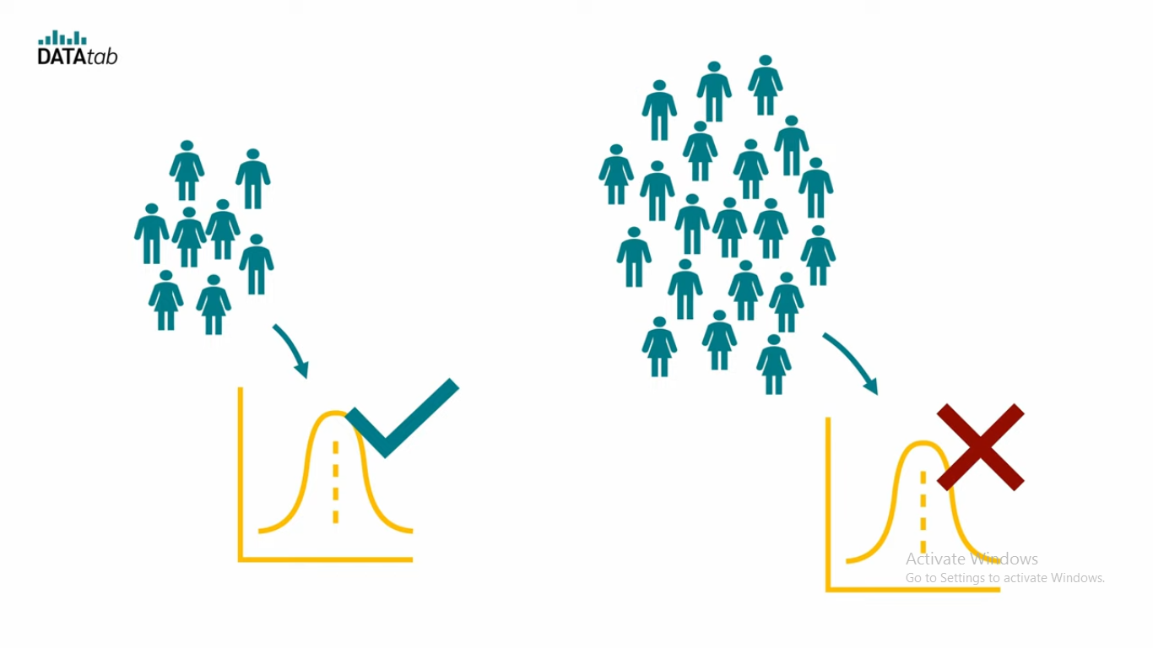

Slide 37
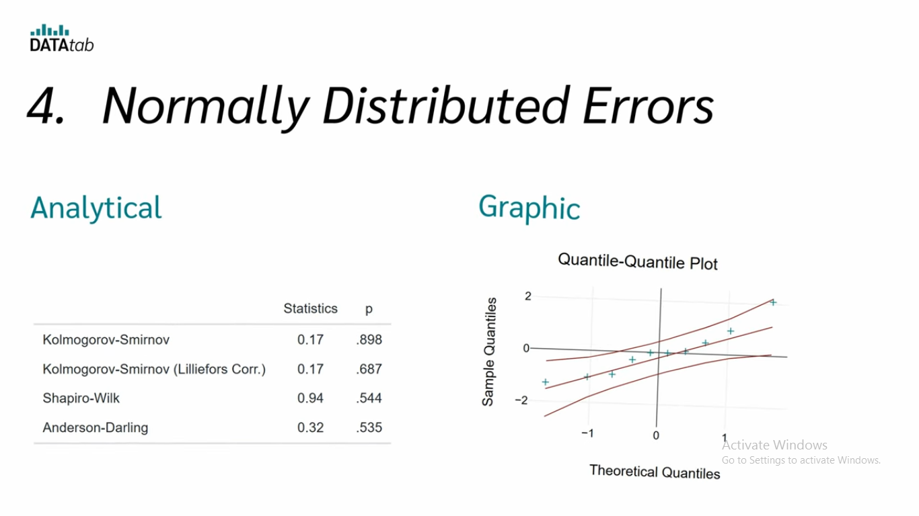
Normally Distributed Errors

Slide 38
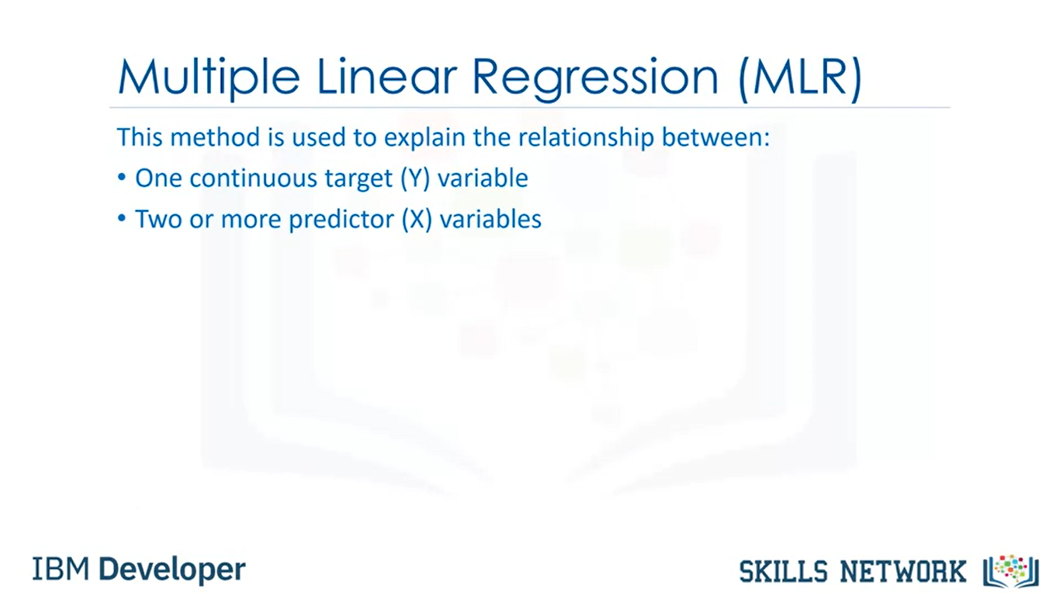
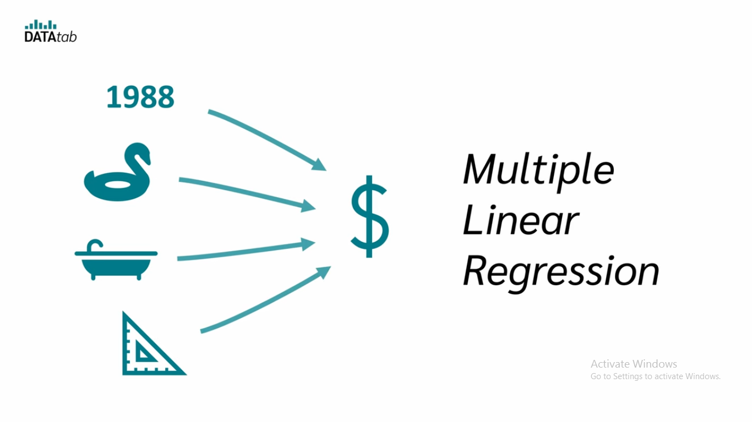
Predicting House Price using multiple features

Slide 39
What is multiple Linear regression and why is it used?
Multiple linear regression is a statistical technique that can be used to analyze the relationship between a single dependent variable and several independent variables.
The objective of multiple regression analysis is to use the independent variables whose values are known to predict the value of the single dependent value.
Multiple linear regression is a regression model that estimates the relationship between a quantitative dependent variable and two or more independent variables using a straight line.

Slide 40
You can use multiple linear regression :
How strong the relationship is between two or more independent variables and one dependent variable (e.g. how rainfall, temperature, and amount of fertilizer added affect crop growth).
The value of the dependent variable at a certain value of the independent variables (e.g. the expected yield of a crop at certain levels of rainfall, temperature, and fertilizer addition).

Slide 41
Cont…
The goal of MLR is to model the linear relationship between the explanatory (independent) variables and response (dependent) variables. In essence, multiple regression is the extension of ordinary least-squares (OLS) regression because it involves more than one explanatory variable.
yi​=β0​+β1​xi1​+β2​xi2​+...+βp​xip​+ϵ
where, for i=n observations
yi​=dependent variable
xi​=explanatory variables
β0​=y-intercept (constant term)
βp​=slope coefficients for each explanatory Variable
ϵ=the model’s error term (also known as the residuals)​

Slide 42
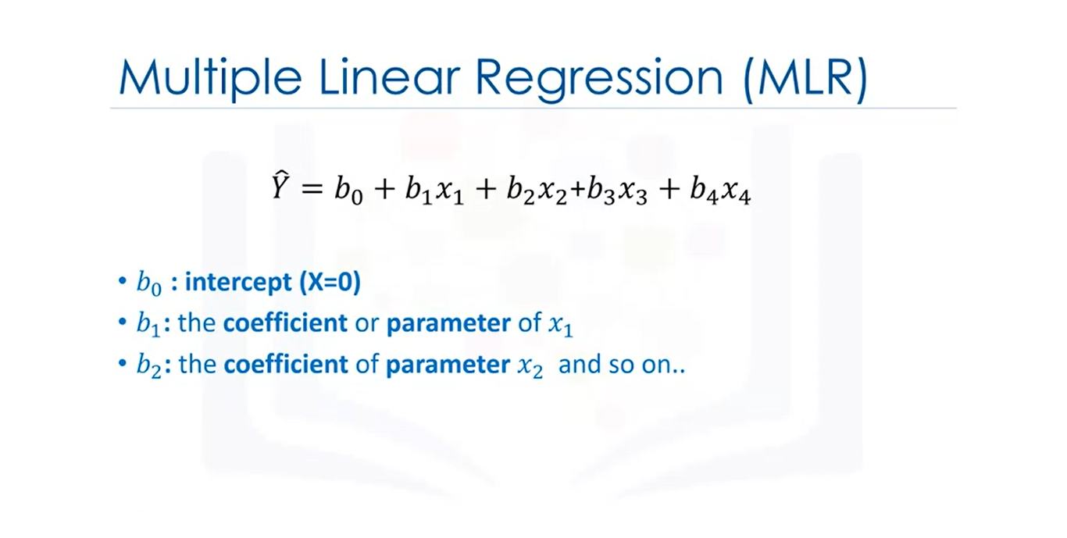

Slide 43


Slide 44


Slide 45


Slide 46
Follow these steps to perform the calculation:
Identify the explanatory variables you plan to use for the regression analysis.
Collect data on these variables along with the response variable.
Use statistical software to input the data and perform the regression analysis.
Analyze the output to understand the relationships between variables.
Interpret the coefficients to assess the impact of each explanatory variable on the response variable.

Slide 47


Slide 48


Slide 49
The MLR model is based on the following assumptions:
There is a linear relationship between the dependent variables and the independent variables
The independent variables are not too highly correlated with each other
y_{i} observations are selected independently and randomly from the population
Residuals should be normally distributed with a mean of 0 and variance σ
Important
MLR assumes there is a linear relationship between the dependent and independent variables, that the independent variables are not highly correlated, and that the variance of the residuals is constant.

Slide 50
What Does It Mean for a Multiple Regression to Be Linear?
In multiple linear regression, the model calculates the line of best fit that minimizes the variances of each of the variables included as it relates to the dependent variable. Because it fits a line, it is a linear model. There are also non-linear regression models involving multiple variables, such as logistic regression, quadratic regression, and probit models.
The coefficient of determination (R-squared) is a statistical metric that is used to measure how much of the variation in outcome can be explained by the variation in the independent variables. R² always increases as more predictors are added to the MLR model, even though the predictors may not be related to the outcome variable.

Slide 51

R Squared Formula
Thus, R² by itself can't be used to identify which predictors should be included in a model and which should be excluded.
R² can only be between 0 and 1, where 0 indicates that the outcome cannot be predicted by any of the independent variables, and 1 indicates that the outcome can be predicted without error from the independent variables.
R² = 1 – (RSS/TSS)
Where,
R² represents the requrired R Squared value,
RSS represents the residual sum of squares, and
TSS represents the total sum of squares.

Slide 52

Cont..
The coefficient of determination can also be calculated using another formula which is given by:
R2 = r2
Where r represents the correlation coefficient and is calculated using the following formula:

