Slide 1
Polynomial Regression
Data Analysis

Slide 2
Why Polynomial Regression?
In simple linear regression algorithm only works when the relationship between the data is linear But suppose if we have non-linear data then Linear regression will not capable to draw a best-fit line and It fails in such conditions.
consider the below diagram which has a non-linear relationship and you can see the Linear regression results on it,
which does not perform well means which do not comes close to reality.
Hence, we introduce polynomial regression to overcome this problem, which helps identify the curvilinear relationship between independent and dependent variables.

Slide 3
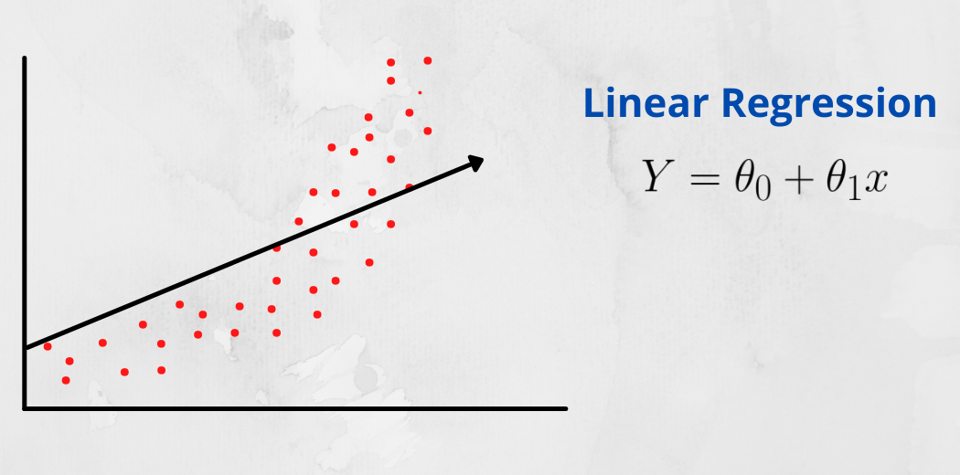

Slide 4
How Polynomial Regression Overcomes the problem of Non-Linear data?
Polynomial regression is a form of Linear regression where only due to the Non-linear relationship between dependent and independent variables we add some polynomial terms to linear regression to convert it into Polynomial regression.
Suppose we have X as Independent data and Y as dependent data. Before feeding data to a model in preprocessing stage we convert the input variables into polynomial terms using some degree.

Slide 5
example
Consider an example my input value is 35 and the degree of a polynomial is 2 so I will find 35 power 0, 35 power 1, and 35 power 2 And this helps to interpret the non-linear relationship in data. The equation of polynomial becomes something like this.
y = a₀ + a₁x₁ + a₂x₁² + … + a_{n}x₁^{n}
The degree of order which to use is a Hyperparameter, and we need to choose it wisely. But using a high degree of polynomial tries to overfit the data and for smaller values of degree, the model tries to underfit so we need to find the optimum value of a degree.

Slide 6
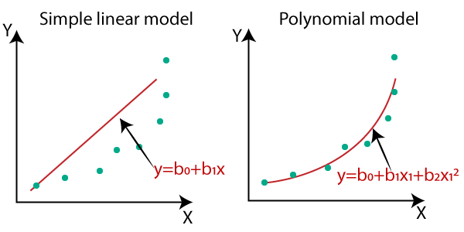
comparison diagram of the linear dataset and non-linear
So for such cases, where data points are arranged in a non-linear fashion, we need the Polynomial Regression model. We can understand it in a better way using the below comparison diagram of the linear dataset and non-linear dataset.
Notes:
if the datasets are arranged in a non-linear fashion, then we should use the Polynomial Regression model instead of Simple Linear Regression.

Slide 7
Why Polynomial Regression is called Polynomial Linear Regression?
If you see the equation of polynomial regression carefully, then we can see that we are trying to estimate the relationship between coefficients and y.
And the values of x and y are already given to us, only we need to determine coefficients and the degree of coefficient here is 1 only, and degree one represents simple linear regression Hence, Polynomial regression is also known as polynomial Linear regression.

Slide 8
Equation of the Polynomial Regression Model:
Simple Linear Regression equation: y = b₀+b₁x .........(a)
Multiple Linear Regression equation: y= b₀+b₁x+ b₂x₂+ b₃x₃+....+ b_{n}x_{n} .........(b)
Polynomial Regression equation: y= b₀+b₁x + b₂x²+ b₃x³+....+ b_{n}x^{n} ..........(c)
When we compare the above three equations, we can clearly see that all three equations are Polynomial equations but differ by the degree of variables.
The Simple and Multiple Linear equations are also Polynomial equations with a single degree, and the Polynomial regression equation is Linear equation with the nth degree. So if we add a degree to our linear equations, then it will be converted into Polynomial Linear equations.

Slide 9
Steps for Polynomial Regression:
The main steps involved in Polynomial Regression are given below:
Data Pre-processing
Build a Linear Regression model and fit it to the dataset
Build a Polynomial Regression model and fit it to the dataset
Visualize the result for Linear Regression and Polynomial Regression model.
Predicting the output.

Slide 10
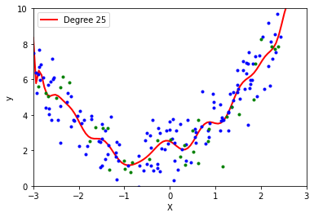
problem with a High degree of polynomial
when we run the function while passing high degrees like 10, 15, 20 then the model tries to overfit the data means slowly the prediction line will leave its original essence and try to rely on training data points and as there is some change in the training path the line tries to catch the point.

Slide 11
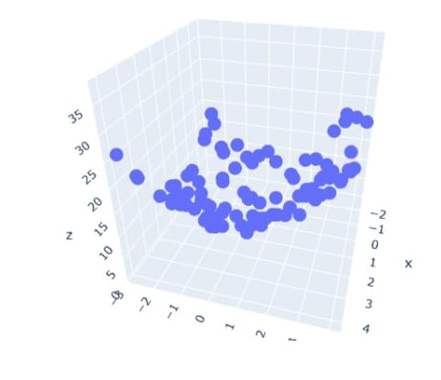
Polynomial Regression with Multiple columns
most of the time there will be many columns in input data so how to apply polynomial regression and visualize the result in 3-dimensional space.

Slide 12
Strengths and Limitations of Polynomial Regression
While polynomial regression is useful, it should be used with caution. it’s possible to add lots of polynomial components to a model to improve its fit, this increases the risk of overfitting. To avoid overfitting,
it’s important to test that each polynomial component in a regression model makes a meaningful difference to the model fit. By doing this, your model will include only the essential components needed to predict the outcome of interest.
polynomial regression is a useful method for modelling non-linear relationships between predictor and outcome variables. As demonstrated, polynomial regression models give more accurate predictions about test data than linear regression in these cases. When used carefully, it is a powerful and versatile tool that belongs in any data scientist’s skill set.

Slide 13
How to find the right degree of the equation?
In order to find the right degree for the model to prevent over-fitting or under-fitting, we can use:
Forward Selection: This method increases the degree until it is significant enough to define the best possible model.
Backward Selection: This method decreases the degree until it is significant enough to define the best possible model.

Slide 14
Cont..
One possible approach is to successively fit the models in increasing order and test the significance of regression coefficients at each step of model fitting. Keep the order increasing until t -test for the highest order term is nonsignificant. This is called a forward selection procedure.
Another approach is to fit the appropriate highest order model and then delete terms one at a time starting with the highest order. This is continued until the highest order remaining term has a significant t -
statistic. This is called a backward elimination procedure.

Slide 15
Cost Function of Polynomial Regression
Cost Function is a function that measures the performance of a Machine Learning model for given data. Cost Function is basically the calculation of the error between predicted values and expected values and presents it in the form of a single real number.

