Slide 1
CRISP-DM
ANALYSIS ON FutureLearn data

Slide 2
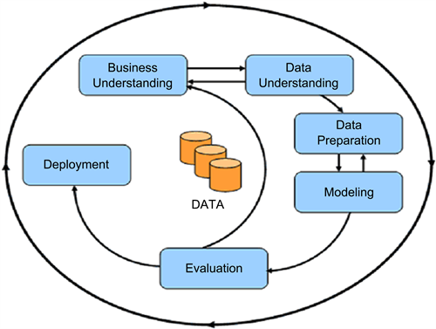
INTRODUCTION
The aim is to analyse the data related to massive open online course (MOOC) at Newcastle University using the crisp-dm model.
The CRISP-DM model contains six main steps as shown
in the figure.
The data set chosen for the analysis is
cyber_security_enrolments data.

Slide 3
CRISP-DM CYCLE 1
Business understanding- The objective of the analysis is to find the age group which is more.
enrolled in this online learning platform
Data Understanding - The field names, column descriptions, primary keys, row count and
data types are discussed.
Data Preparation - Appending data, duplicate check, removing trailing and leading spaces
renaming and data type changes are done.
Model - Graph showing the age group and corresponding probability is plotted

Slide 4
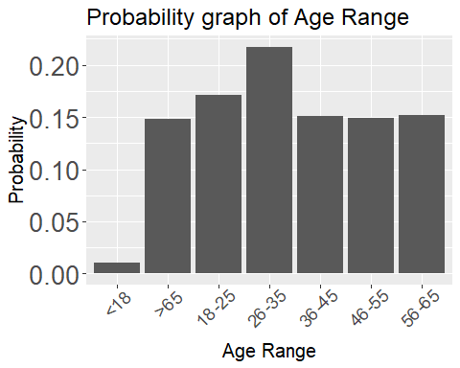
EVALUATION
The model shows that the majority of candidates
are from the age group 26-35.
For the remaining age group above 35, the total
number of candidates is approximately the same
in each group.
Only few candidates under 18 are enrolled

Slide 5
CRISP-DM CYCLE 2
Business understanding- The employment status of the majority of candidates aged under 26-35 is
required.
Data preparations - It is the same as that of cycle 1
Model -The graph showing the Employment status and corresponding probability
is plotted.

Slide 6
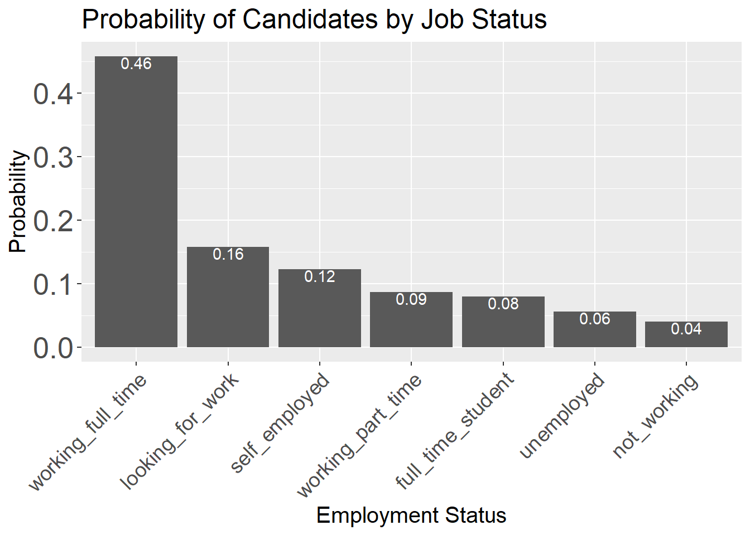
EVALUATION-2
The majority of candidates are working as full-time employees
under the given age group. (46%)
The number of candidates who are not working under
this group is relatively very low (4%)

Slide 7
CRISP-DM CYCLE 3
Business understanding- Year-wise analysis of the candidates aged under 25-36 working full-time is
the requirement.
Data preparations - The year of the enrollment is extracted from enrollment_dttm column.
Model -The graph showing the year and corresponding percentage of enrolled
candidate is plotted.

Slide 8
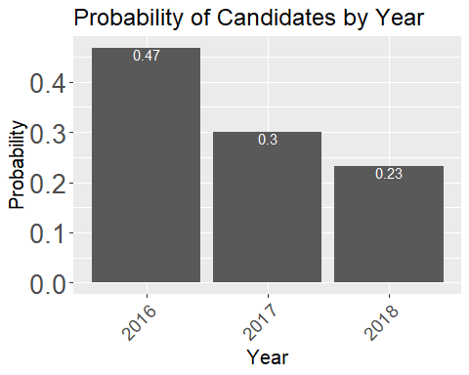
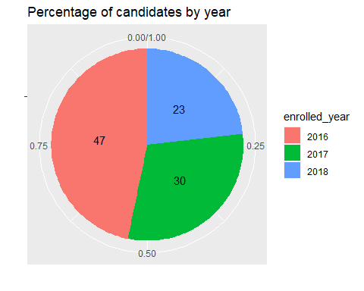
EVALUATION-3
The Number of enrolled candidates under the age 26-35 and working as a full-time employee is
decreasing from 2016 to 2018

Slide 9
DEPLOYMENT/CONCLUSION
The first cycle shows that majority of enrolled candidates are under the age group 26-35.
The second cycle gives that Full-time working is the majority status of the enrolled learners who are
under the age group 26-35 which is the output of the first cycle
The third iteration reveals the number of enrolled learners is decreasing from 2016 to 2018
Data
26-35
Year wise analysis
Full-time
Cycle 1
Cycle 2
Cycle 3
Data preparation

