Slide 1
Capstone Project I - Mutual Fund Analytics
Project Progress Presentation
Day 1 - Day 6
Prepared By : Ankur Kumar

Slide 2
Problem Statement & Objective
Mutual fund data is spread across multiple datasets, making it difficult to analyse fund performance, risk, investor behaviour and market trends in one place.
Objectives:
Load and analyse mutual fund datasets
Clean and validate data
Build SQLite analytical database
Perform EDA
Calculate fund performance and risk metrics
Build an interactive Power BI dashboard

Slide 3
Data Sources 10 CSV Datasets
Fund Master
NAV History
AUM by Fund House
Monthly SIP Inflows
Category Inflows
Industry Folio Count
Scheme Performance
Investor Transactions
Portfolio Holdings
Benchmark Indices

Slide 4
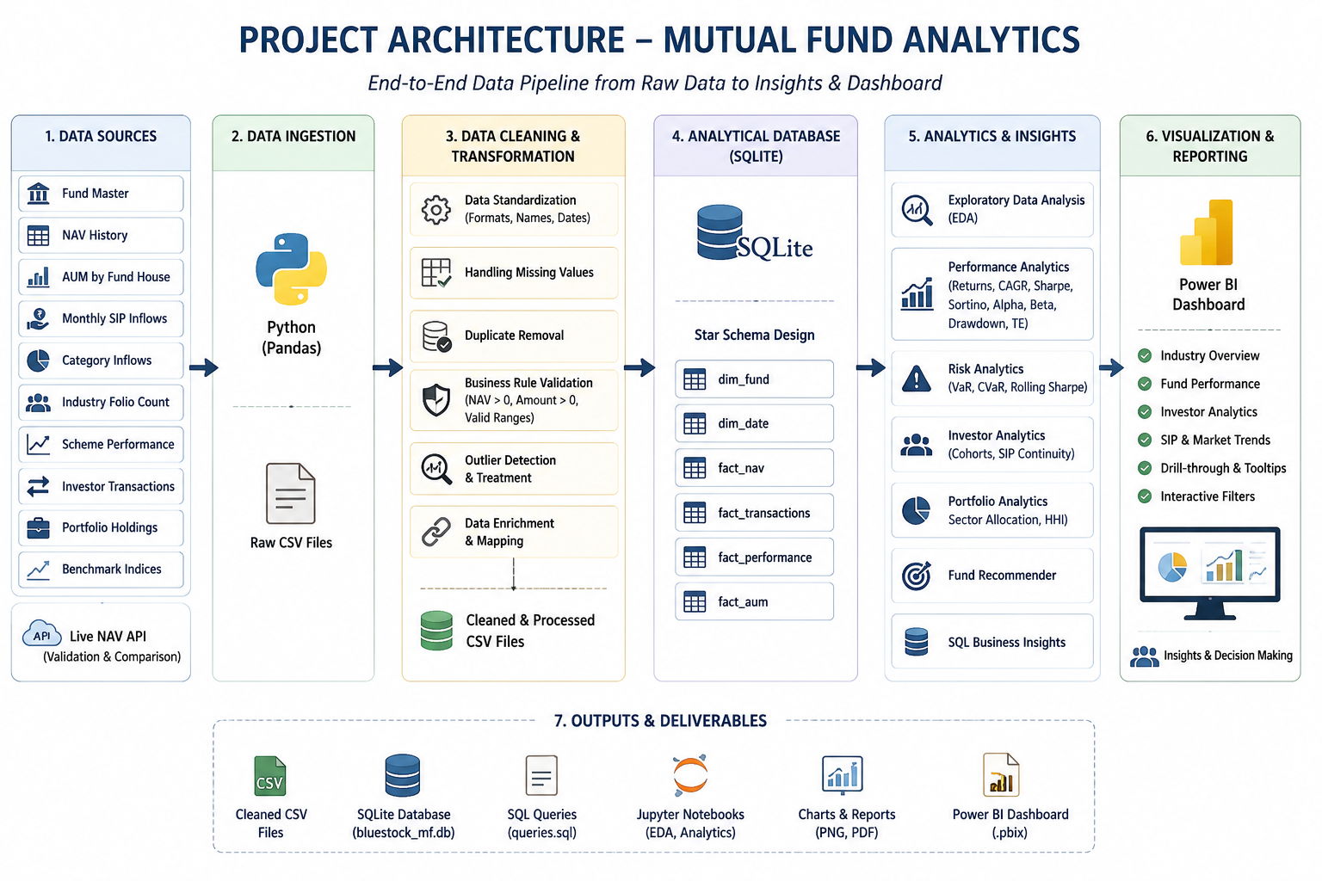
Project Architecture

Slide 5
EDA Highlights — Industry & Market Trends
Key highlight:
SIP inflows vary over time.
AUM is concentrated among leading fund houses.
Investor participation increased significantly.

Slide 6
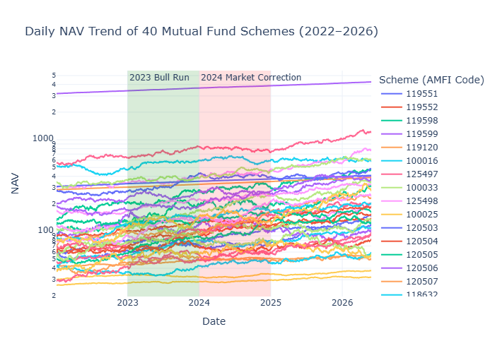
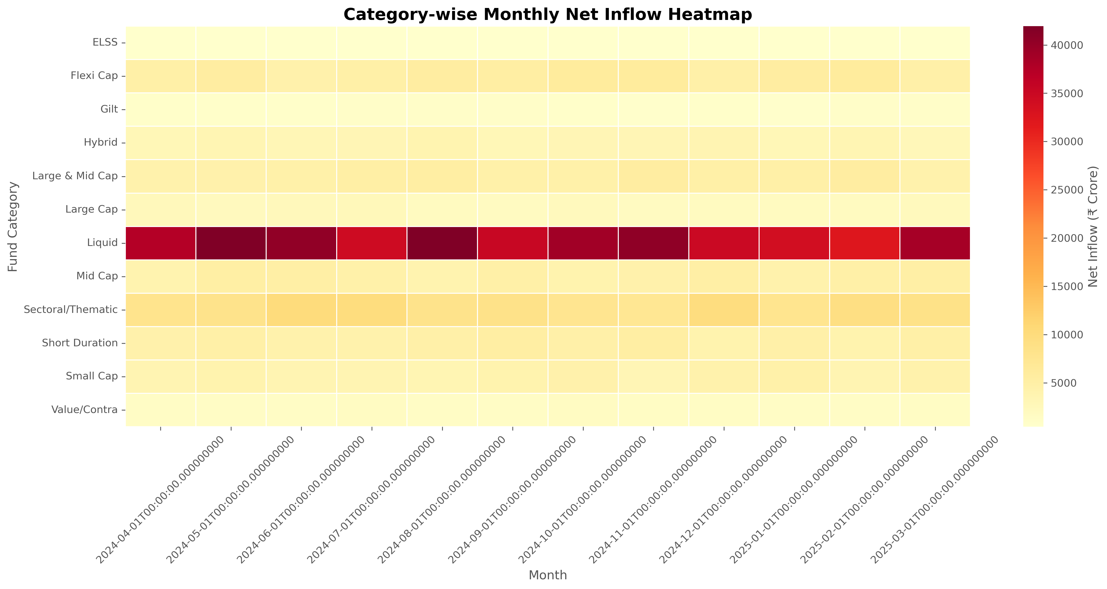
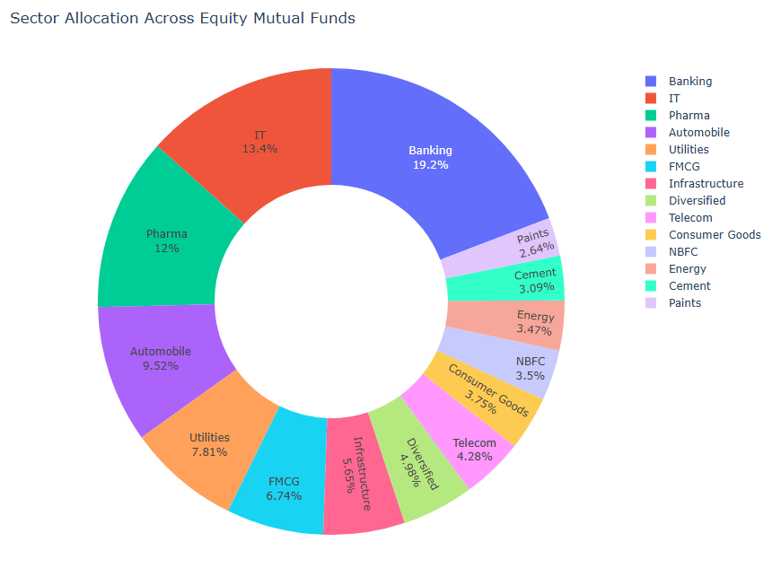
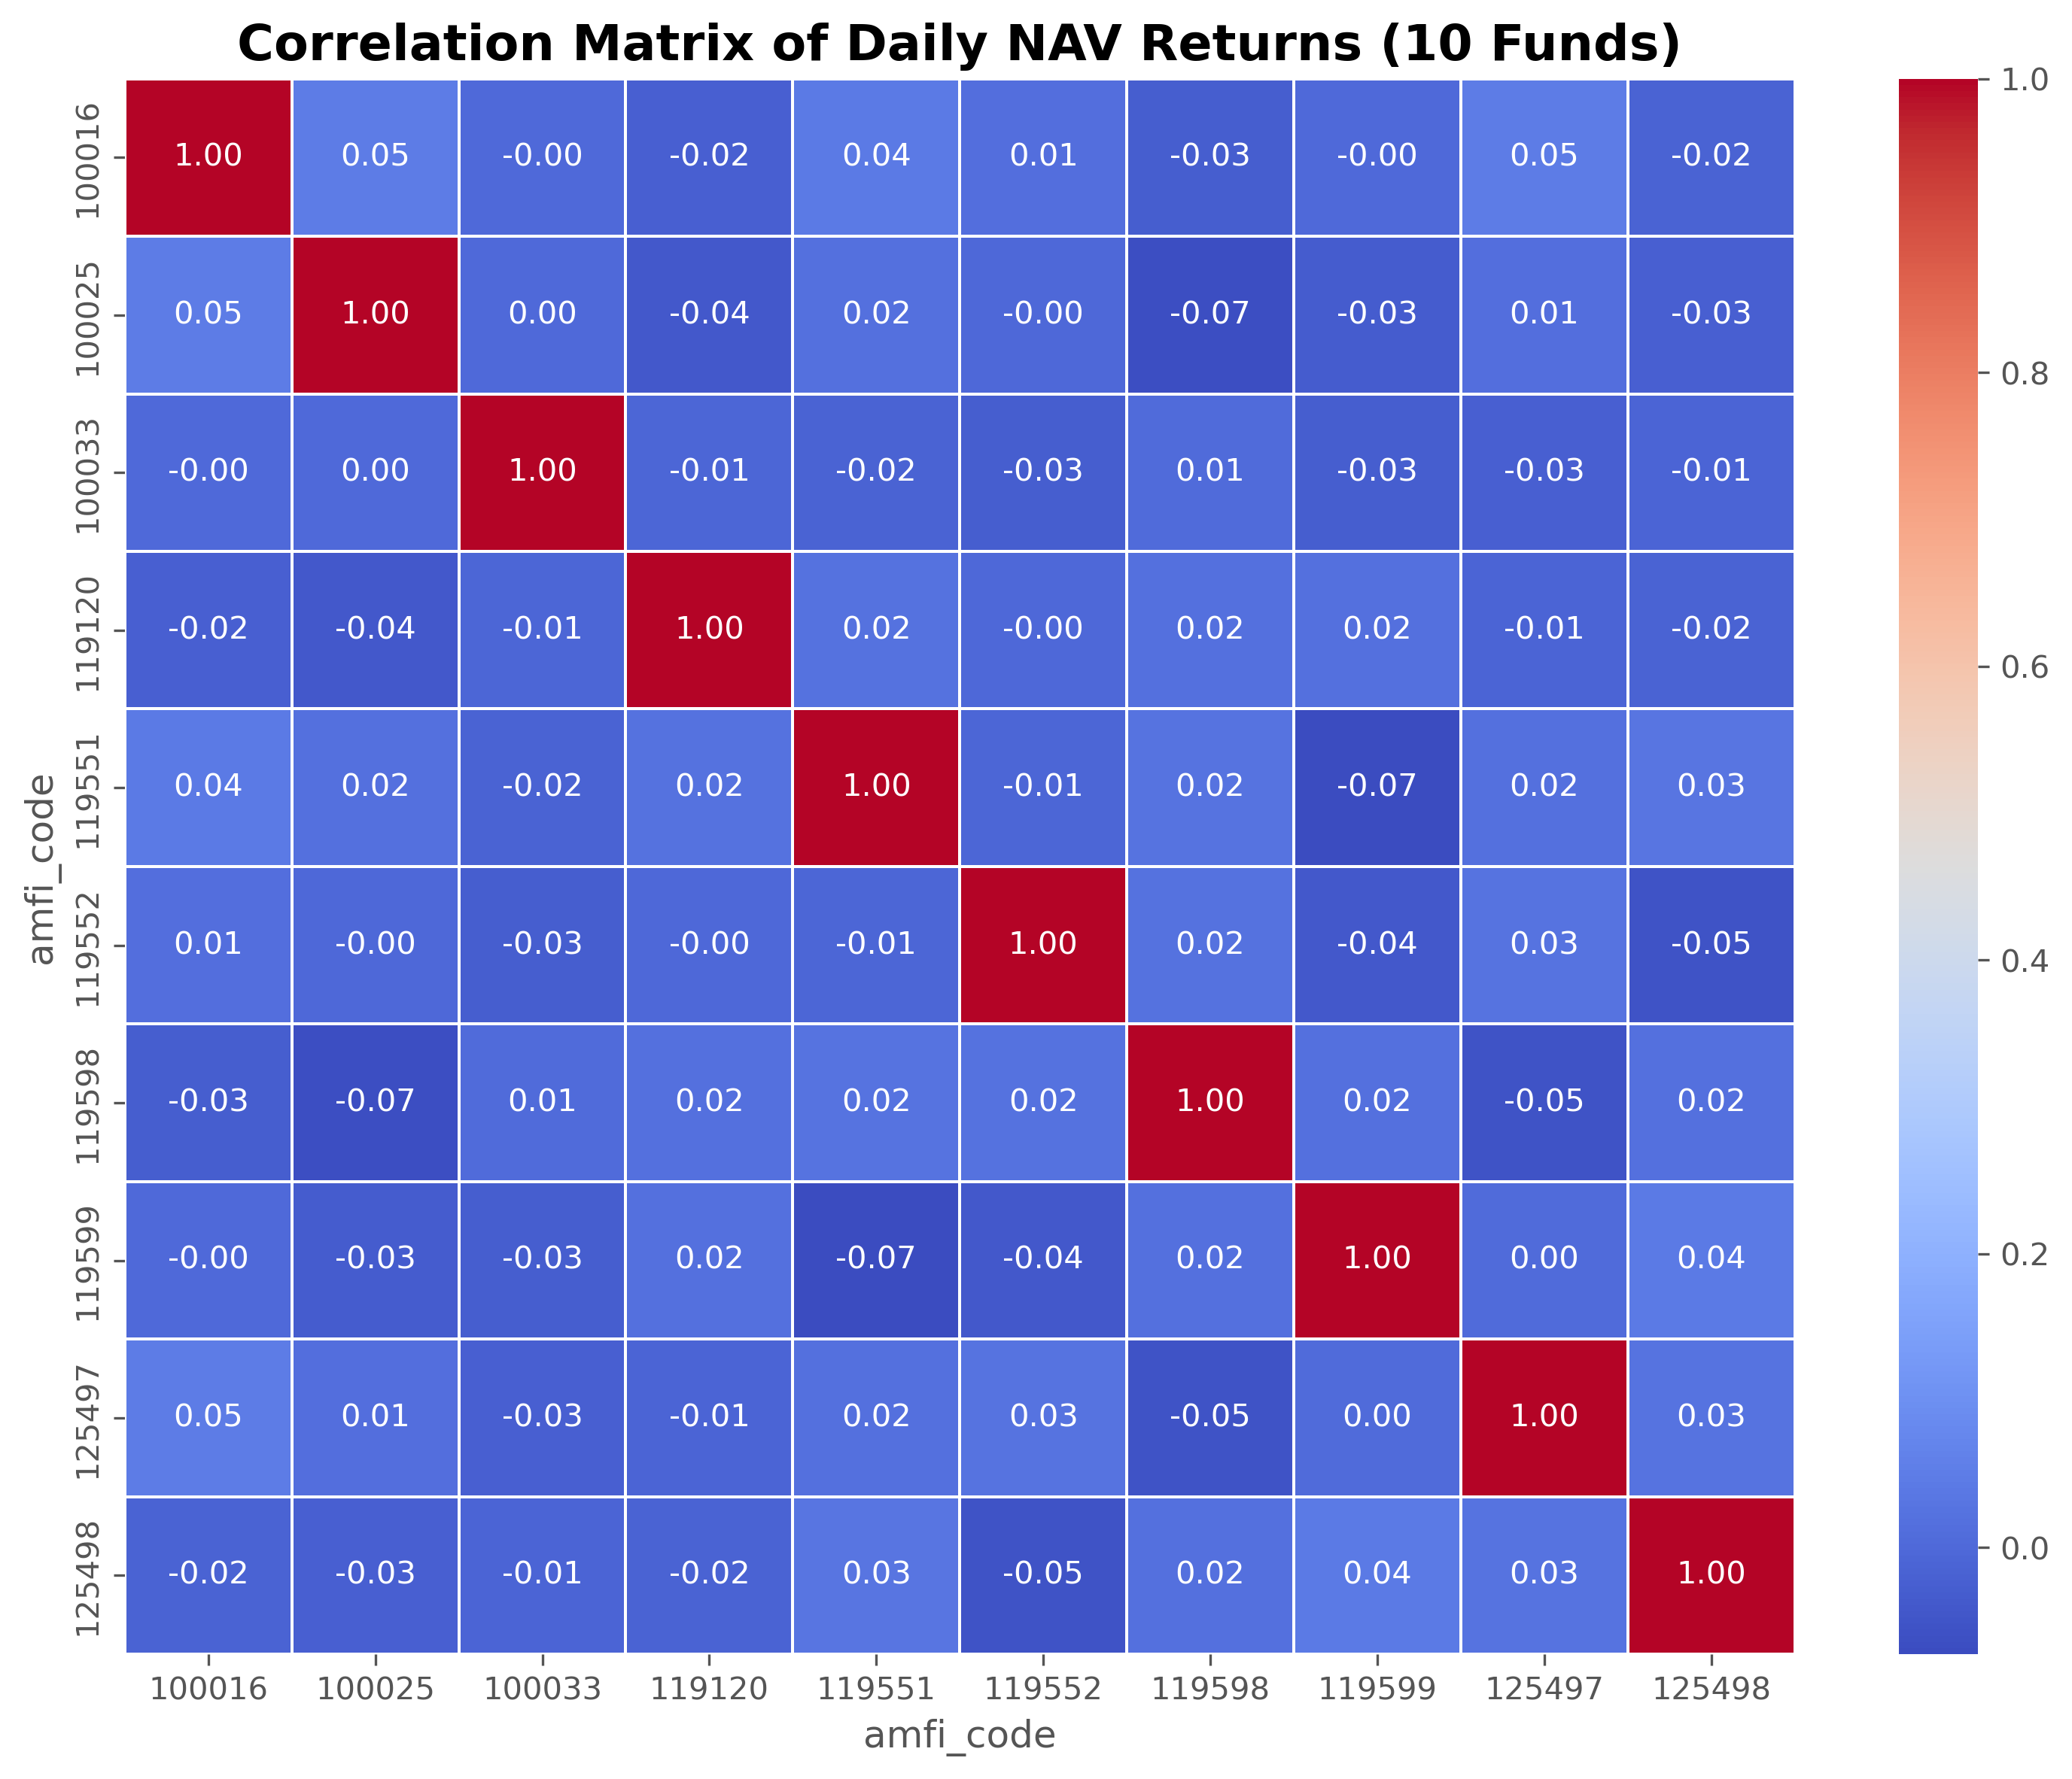
EDA Highlights — Fund & Portfolio Analysis
NAV Trend Category Inflow Heatmap
Sector Allocation / Donut Chart Correlation Matrix

Slide 7
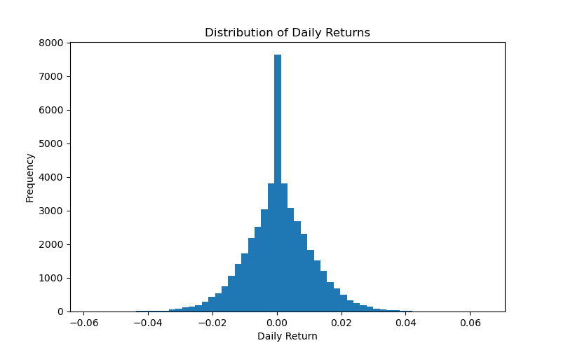
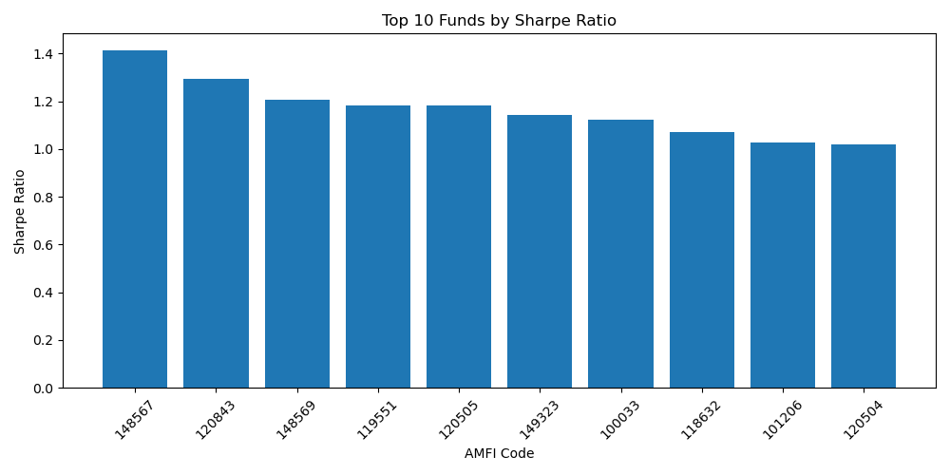
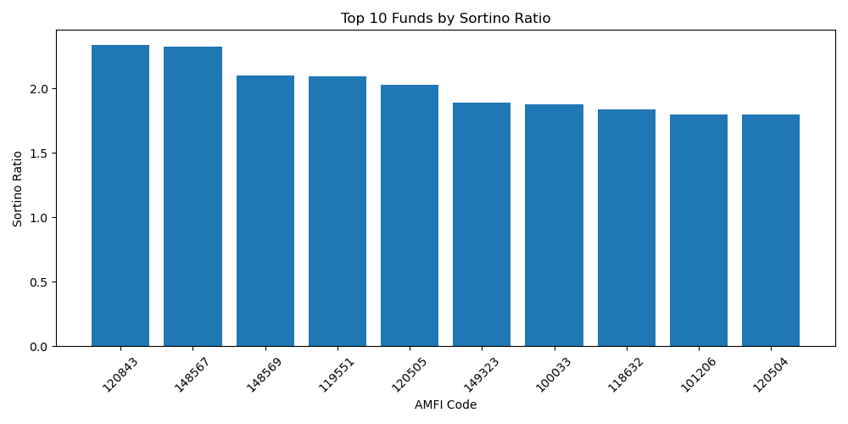
Fund Performance Analysis
Daily Return Distribution Top 10 Sharpe Ratio
Top 10 Sortino Ratio

Slide 8
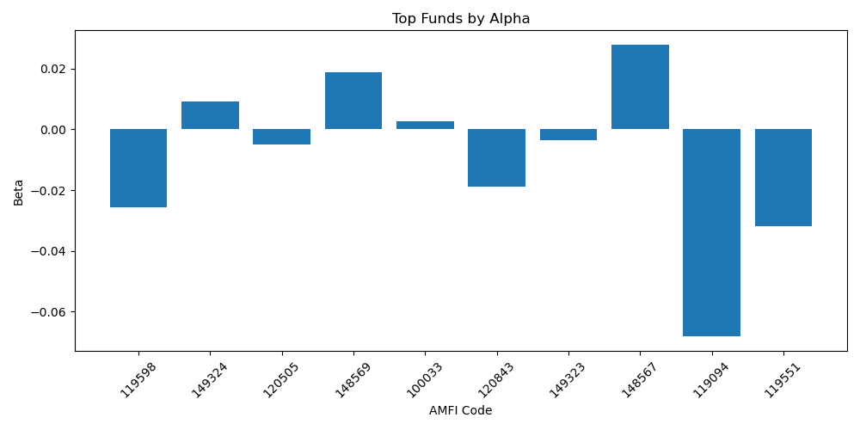
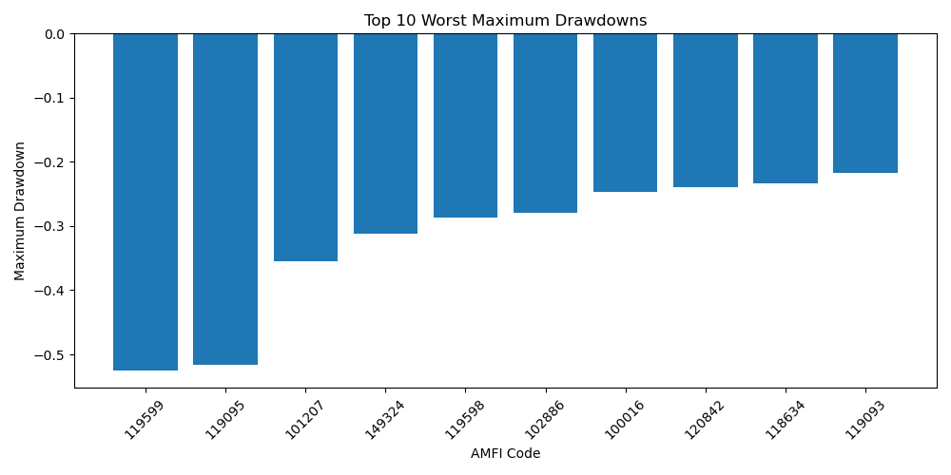
Advanced Performance & Risk Analysis
Include:
Alpha & Beta vs Nifty 100
Maximum Drawdown
Fund Scorecard (0–100)
Benchmark Comparison
Tracking Error

Slide 9
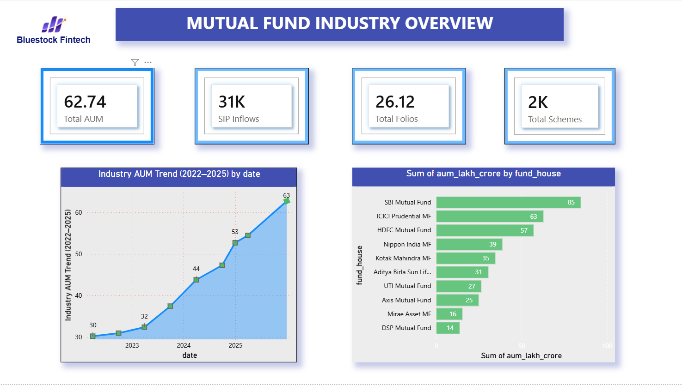
Power BI Dashboard — Industry
Industry Overview
KPIs
AUM Trend
AUM by AMC

Slide 10
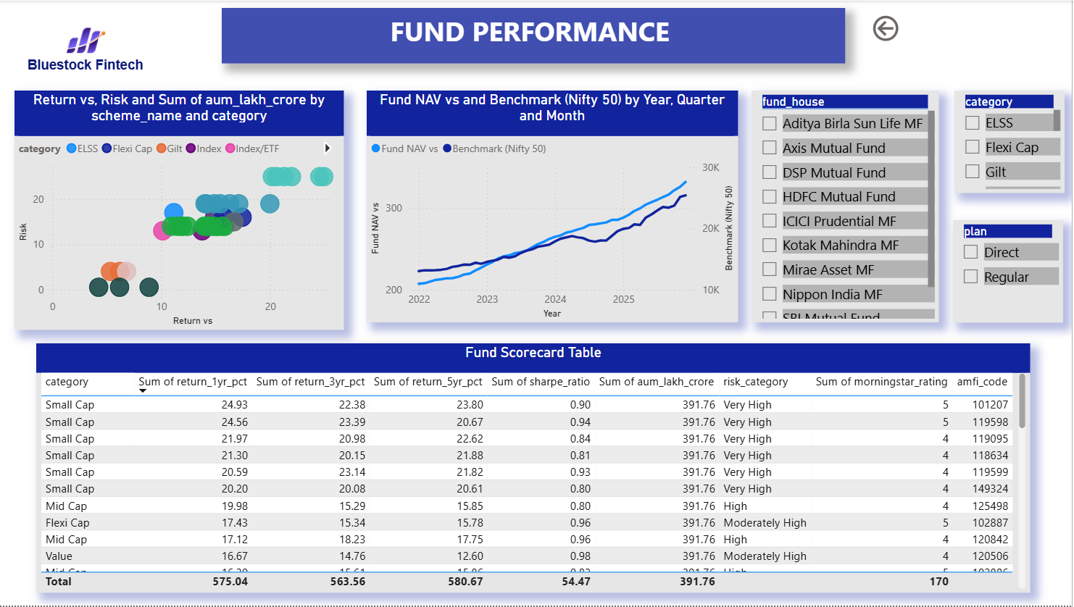
Power BI Dashboard — Fund Performance
Fund Performance
Scatter Plot
Fund Scorecard
NAV vs Benchmark

Slide 11
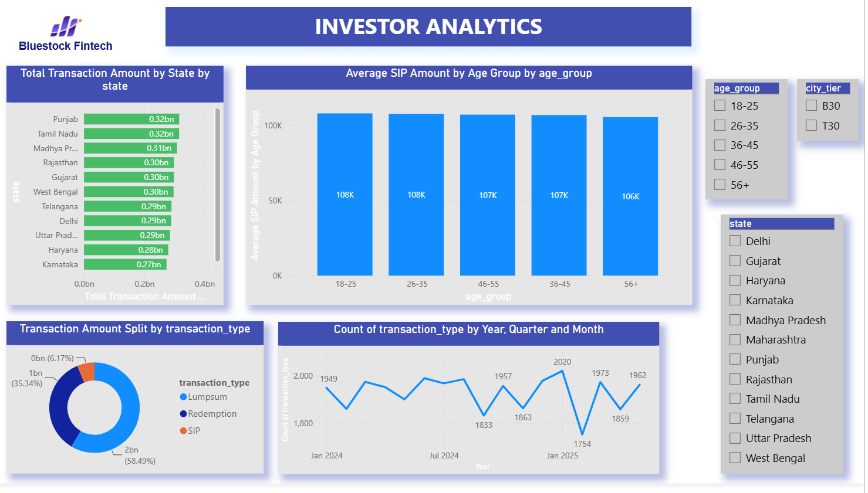
Power BI Dashboard — Investor
Investor Analytics
Transaction by State
Transaction Type
SIP Analysis

Slide 12
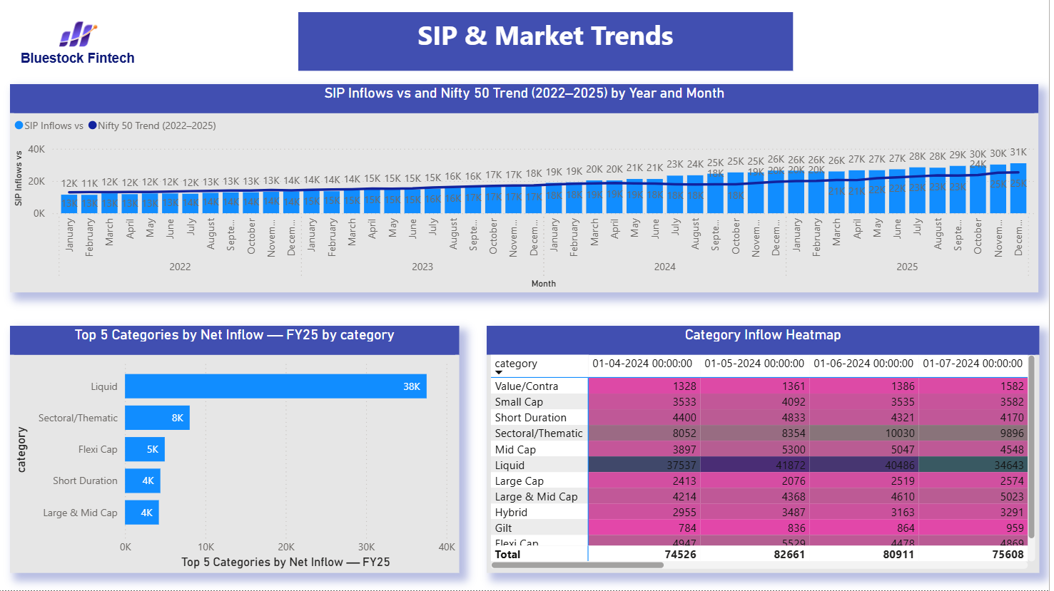
Power BI Dashboard —SIP Analytics
SIP & Market Trends
SIP vs Nifty 50
Category Heatmap
Top 5 Categories
Interactivity: Drill-through | Tooltips | Slicers | Bluestock Theme

Slide 13
Key Findings
Mutual fund performance differs significantly across schemes.
Risk-adjusted metrics are important along with returns.
SIP inflows and investor participation show strong industry growth.
AUM is concentrated among major fund houses.
Expense ratio alone does not guarantee higher returns.
Portfolio sector allocation varies, creating different concentration risks.
Advanced Analytics Completed: VaR & CVaR | Rolling Sharpe | Investor Cohort | SIP Continuity | Sector HHI | Fund Recommender

Slide 14
Thank You

