Slide 1


A Personal CRM Tailored for You

Slide 2
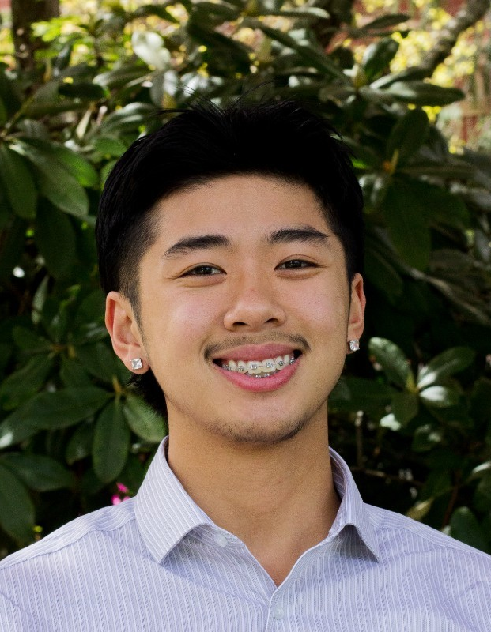
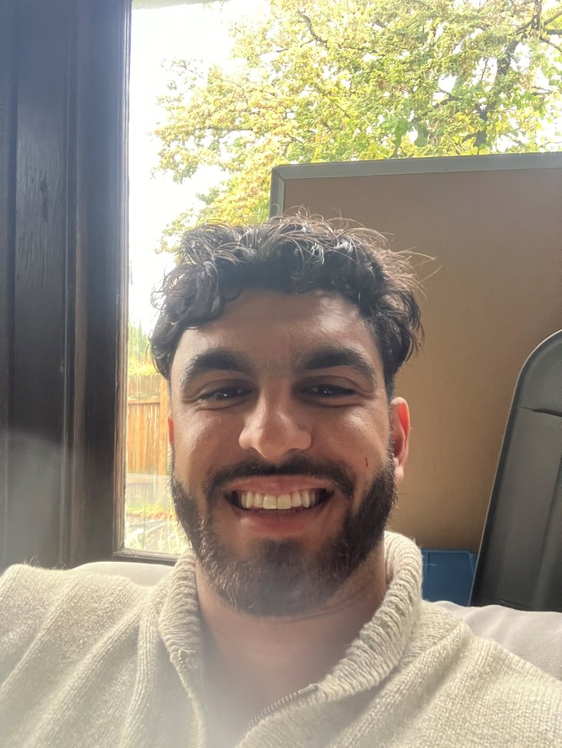
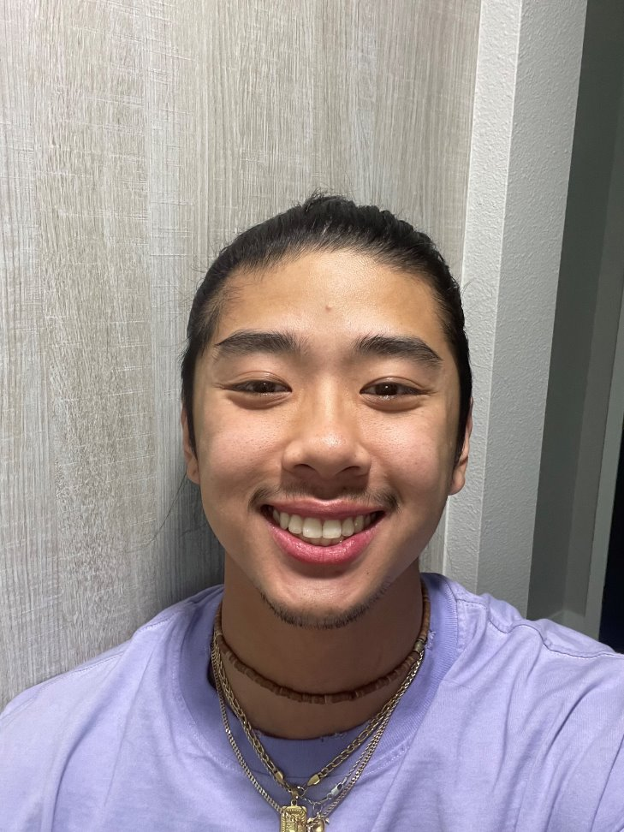
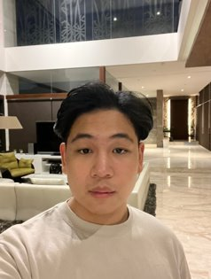
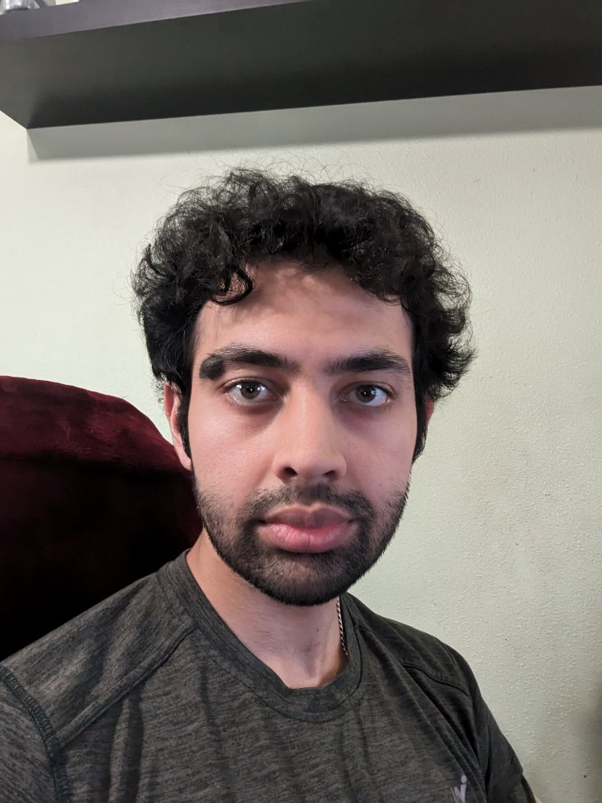
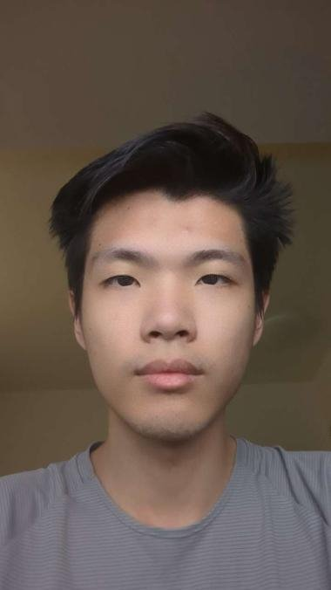
Our Team Members
Ari Salehpour
Houston Tu
Mikhael Bradley Soebroto
Raj Dhillon
Zhi Min Yan
Developer​
ScrumMaster
Developer​​
Developer​​​
Build Meister
Developer​​
Scribe/Recorder
Developer​​​
Notes:
New picture for Hustion

Slide 3

AGENDA
Motivation
MVP/Project Status
Achievements
Demo
What's Next
Learnings
Questions
Notes:
Our Motivation
MVP definition
Project Status
Accomplishments
Demo
Team's Development
And Questions at the end.

Slide 4
Motivation
Manage Our Relationships
Have Personalized, Crafted Messages with the Help of AI
Maximize Opportunities and Relationships
Build Stronger Connections
Effortlessly Stay Connected

Slide 5







MVP DEFINITION
Contact
Management
Interaction Tracking
Reminders
Voice-to-Text Transcriber
Data Storage + User Registration
AI Context Generation
Mobile Integration
Notes:
Contact Management – Syncing contacts, searching contacts and tags
Interaction Tracking – Metric tracking how often you've kept in touch with your contact
Reminders – Notifications to get in touch with your contacts
Transcriptions – Easily dictate the notes that you wish to store for a contact
Context Generation – Extracting useful data from the user's notes to then generate personalized and usable conversation questions
Mobile Integration – Android/iOS, Android is priority, but iOS is nice to have
Data – Securely logging in with Clerk, and storing user data in our personal database

Slide 6








Project Status
Current Status: GREEN (90%)
LEGENDS
0%-40%
41%-91%
91%-100%
Contact Management
Interaction Tracking
Voice-to-Text Transcriber
AI Context Generation
Beautification
Reminders
Data Storage + User Registration
Mobile Integration
Notes:
Contact Management – 80% done: adding ability to search contacts via name or tag, ability to remove contacts
Interaction Tracking – keep track of how many times you've connect with your contacts
Transcription – Works well, fully complete
Context Generation – Can generate usable questions, exploring notes meta data and open source models
Beautification – Big improvement, make ux more seamless and clean up overall layout, new logo
Reminders – Can display upcoming reminders along with connect modal, working on notifications and editing reminders
Data – Fully complete
Mobile Integration – Android working, looking into deploying on play store; iOS has an unresolved bug

Slide 7
Features and Why
Text-to-Speech – A natural way for the user to provide their notes to the app.
Contact Management - Select the people you wish to stay connected with from your phone's contact list.
AI-Generated Questions – Helps spark new conversations by using the notes on what you last spoke about with that person.
Reminders and Tracking – Help keep you connected with a person, so that it doesn't seem like a passing interaction.
Notes:
Features and Why
Instead of typing being the only way for users to input their notes, we’ve implemented text-to-speech as a natural and effortless way for users to verbally add their notes into the app.
With whisperAI’s models, users can actually speak from a range of common languages and the functionalities would remain the same.
On top of any privacy concerns, We recognized that giving the app full access to the user’s contacts may overwhelm the user’s interface. So, users would be able to select the specific people that they wish to stay connected with
The purpose of our app is to remove as much friction as we can for people to stay connected. And with the help of AI generated questions (and summaries), shooting a text to your loved ones is only a few clicks away with little brain power.
& Reminder notifications on mobile phones are created to keep the connections going,

Slide 8
Major Accomplishments
User Authentication, Login/Registration System
Database Implementation
Sync Contacts
Voice-to-Text Transcription and Question Generation
Notes:
Major Accomplishments
Now, some of first major accomplishments include 1 2 3 4
User authentication was created to just separate user’s and their information, standard stuff
Database Implementation was a little tough but we finally found a stable database to commit to
Contacts Syncing provided a great foundation for us to create all sorts of new modal screens for users to interact with them.
Similarly, the AI functionalities provided user’s with an endpoint within the app

Slide 9
Recent Accomplishments
Test App Deployment
~Tagging System
~Notification
Database Migration
Notes:
Recent Accomplishments
Recently though, we’ve been able to provide app distributors with our recent builds in order to test them mobiley
Users can now also store contacts into specific groups they can name themselves such as… “School, Family, Roommate”
andd finally our Notificiations are able to send some scheduled reminders per the user’s preferences on frequency, but we’re still in the works of properly storing them within the database

Slide 10
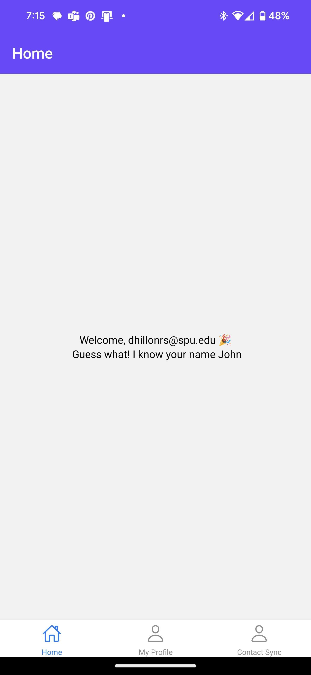
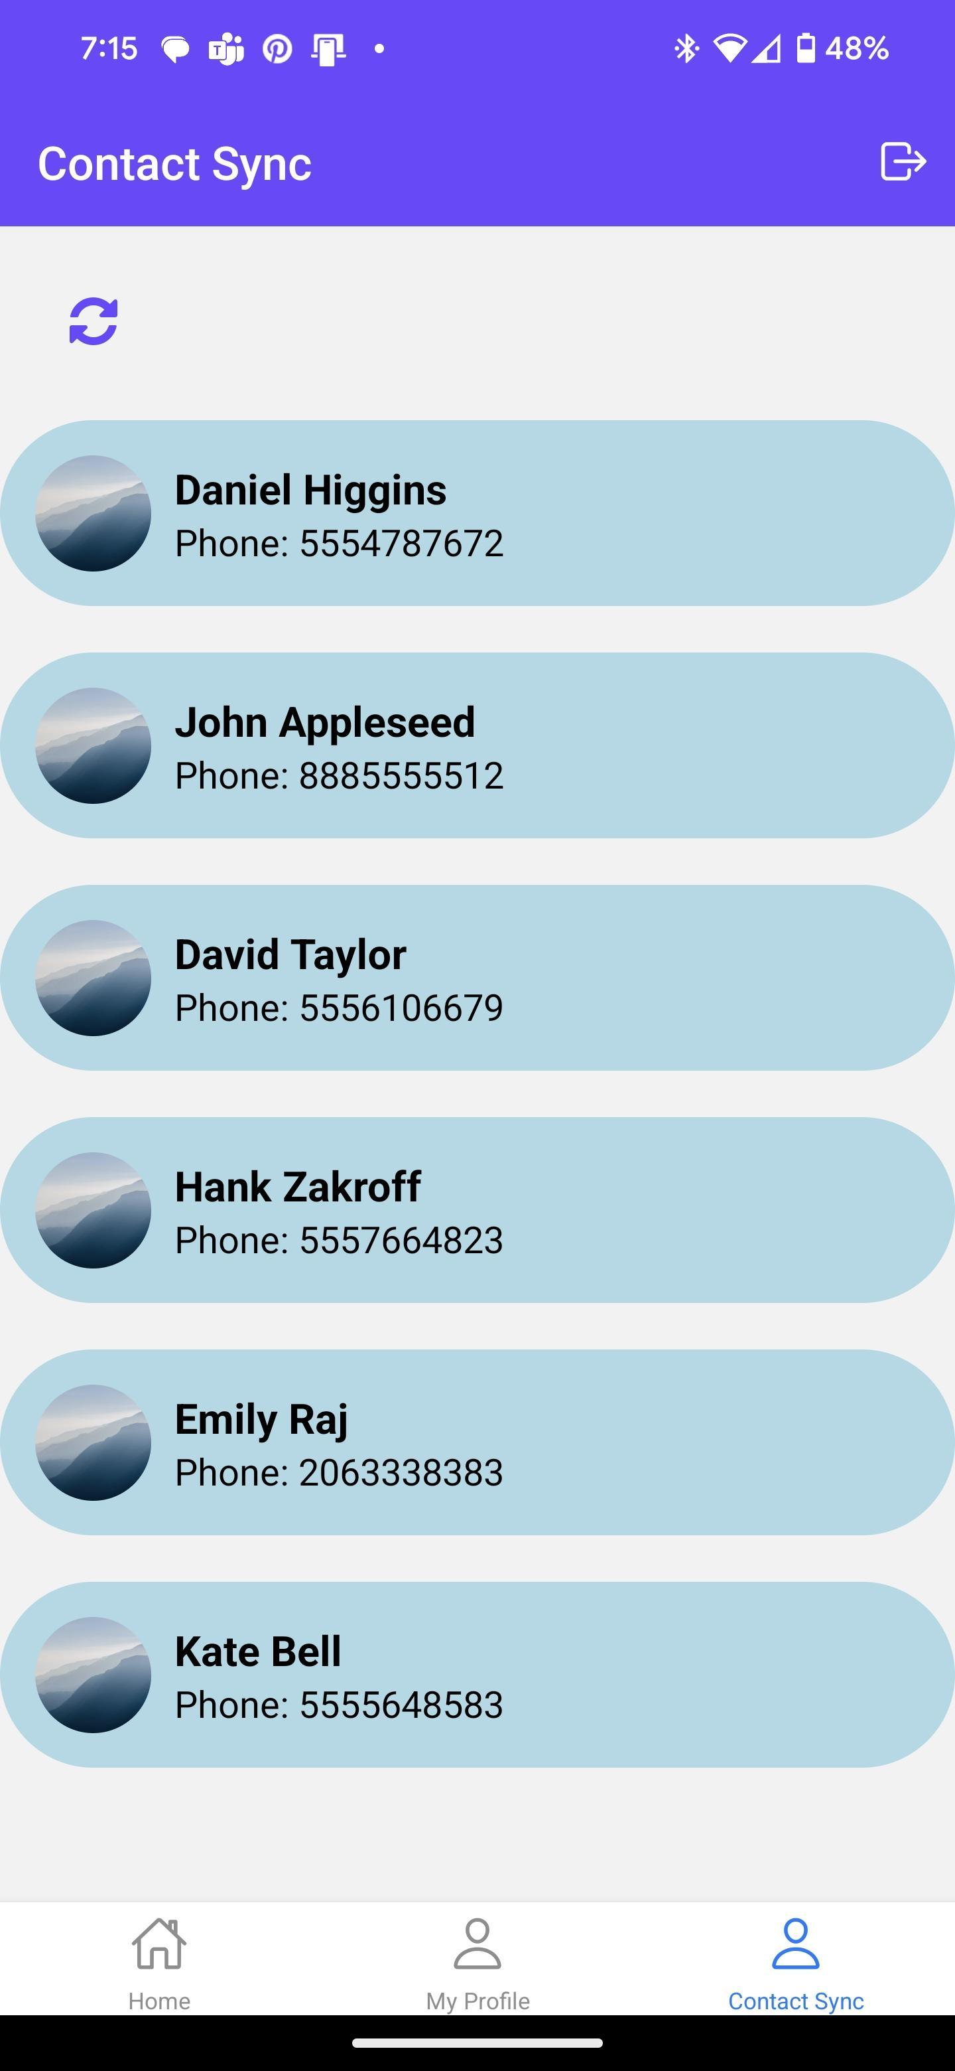
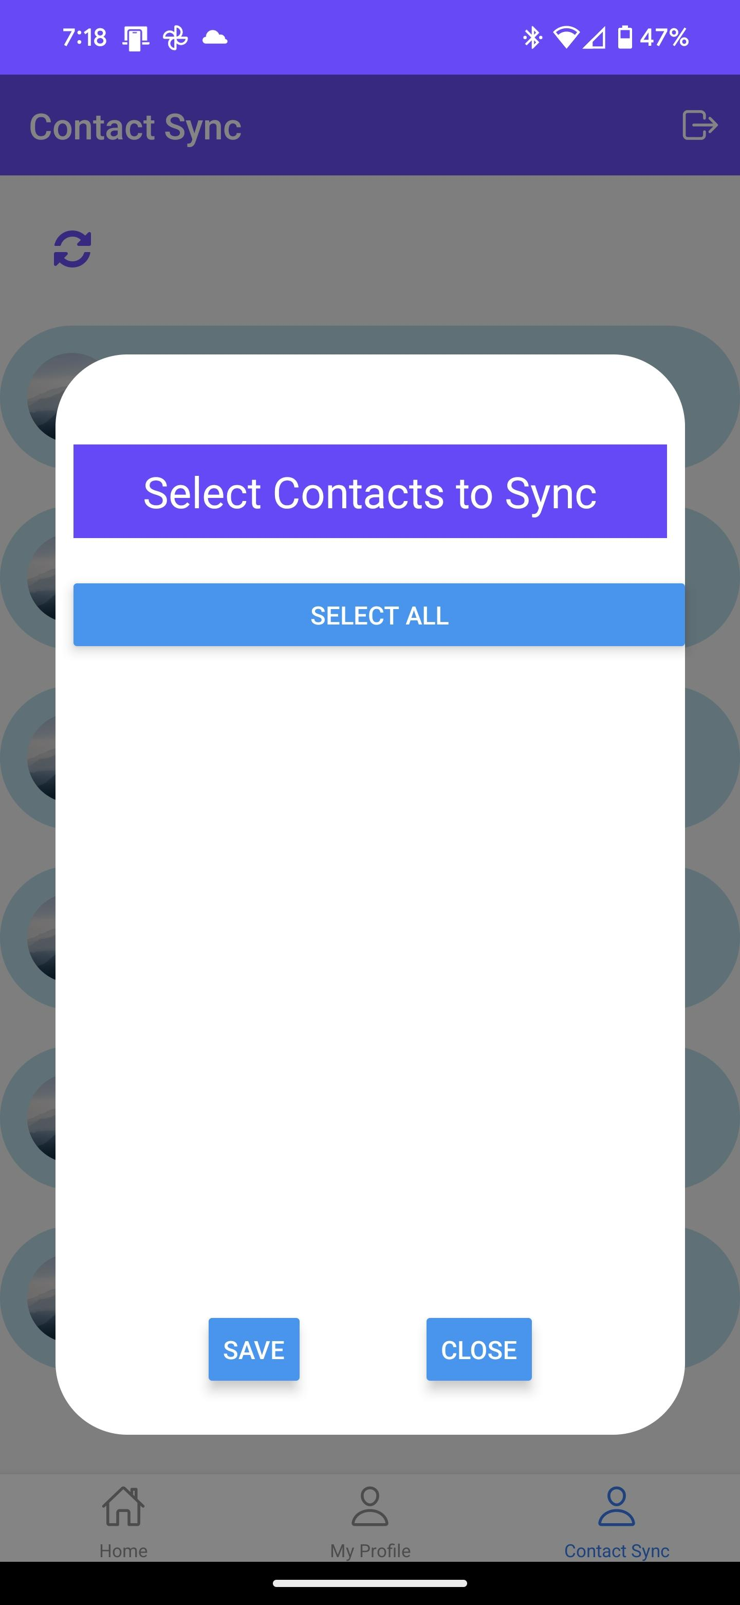
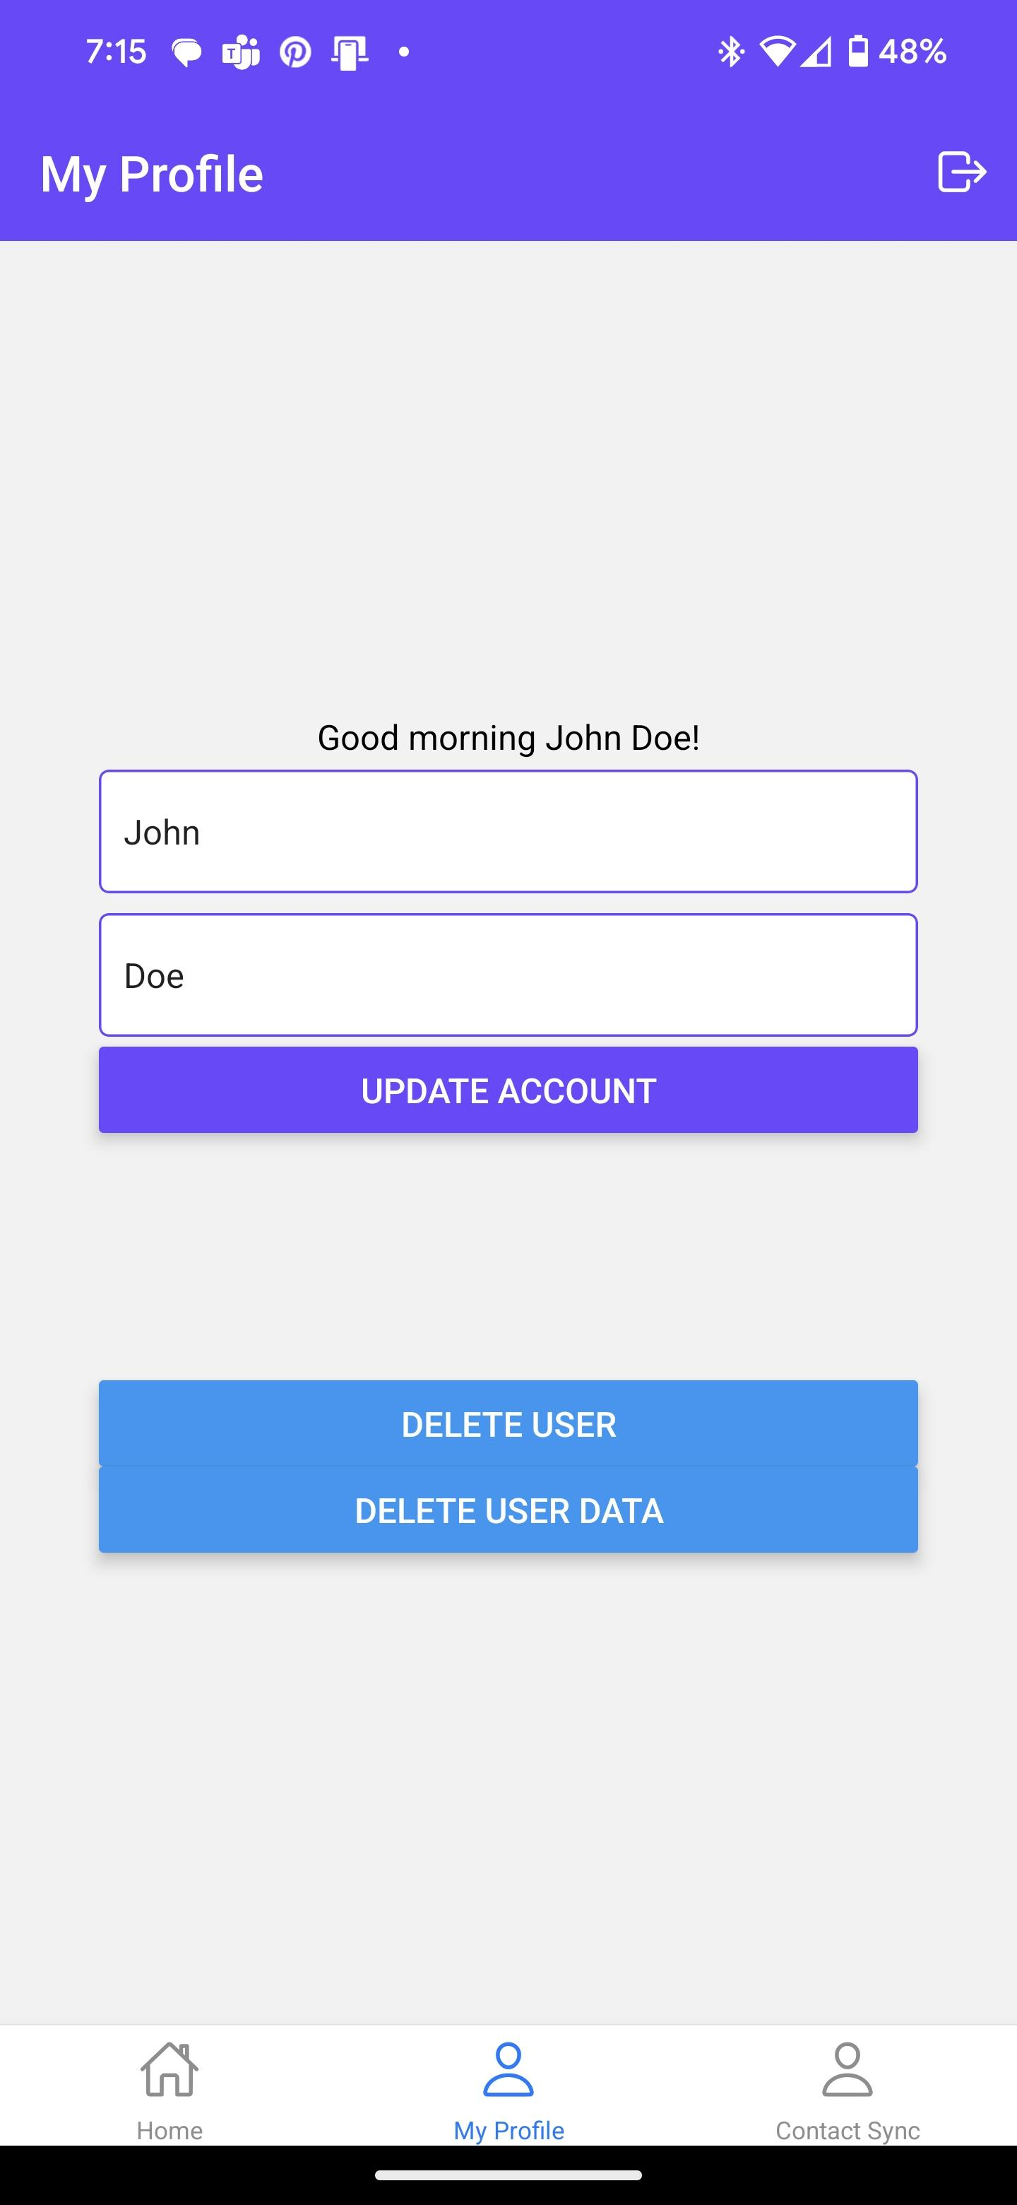
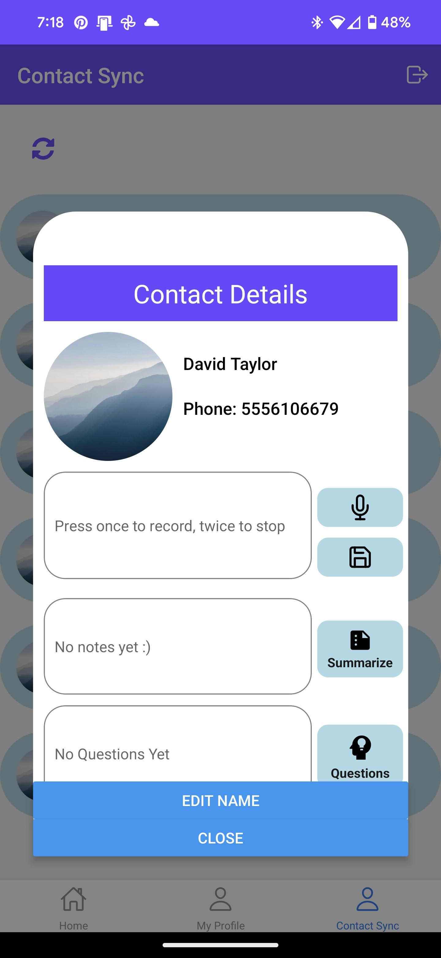
Old Snippets

Slide 11
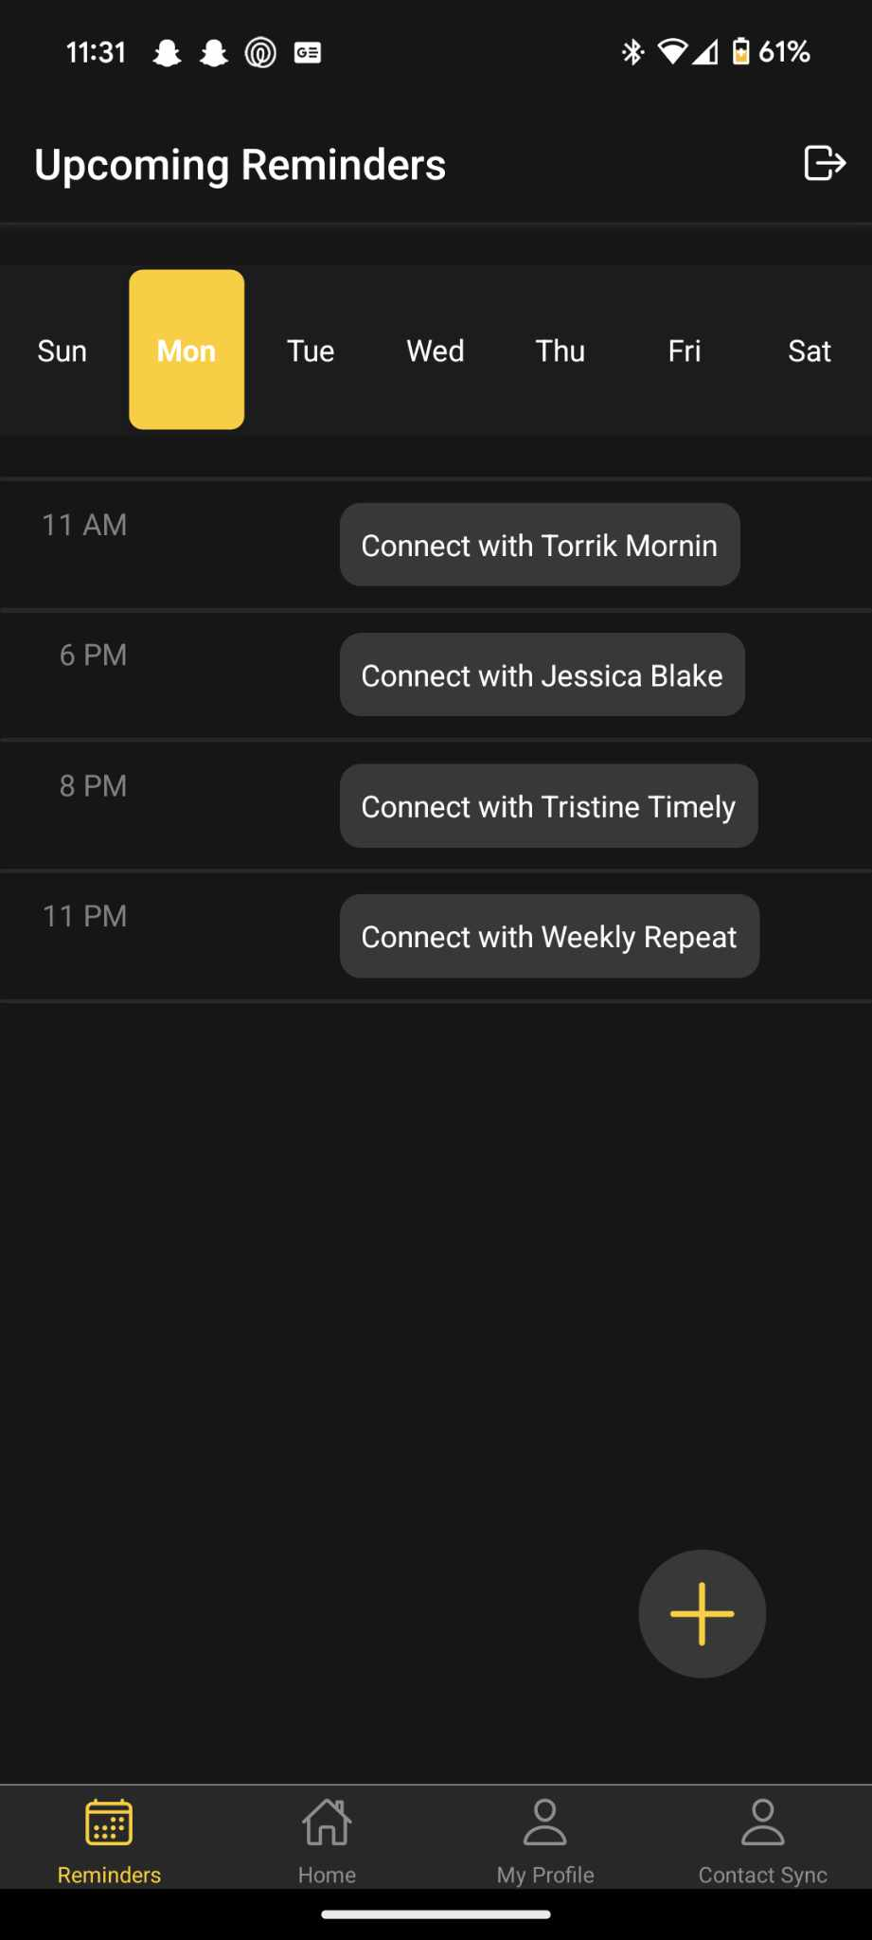
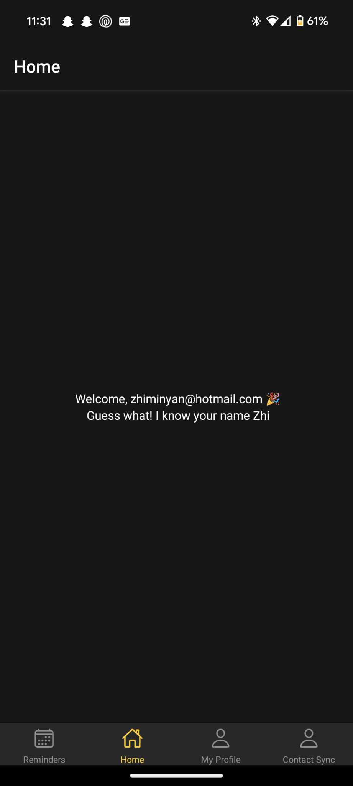
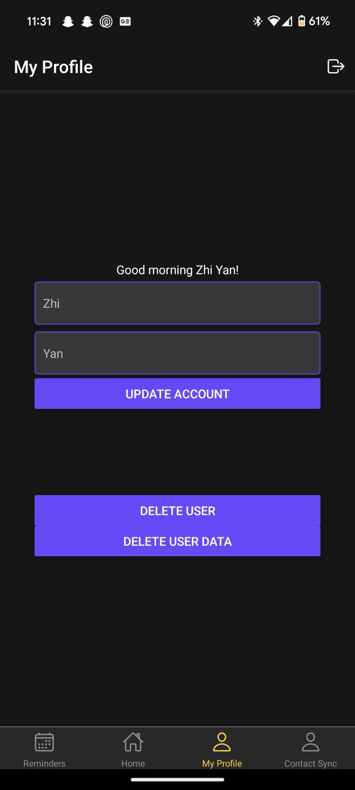
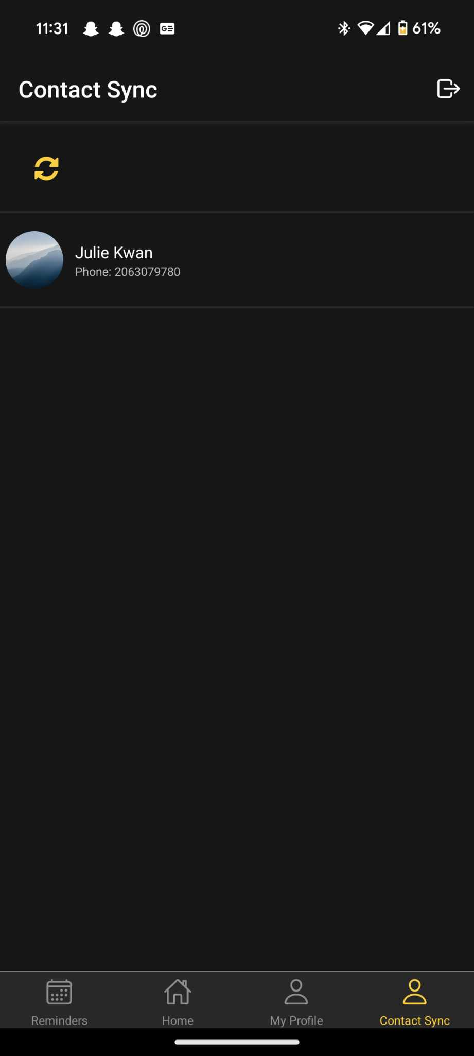
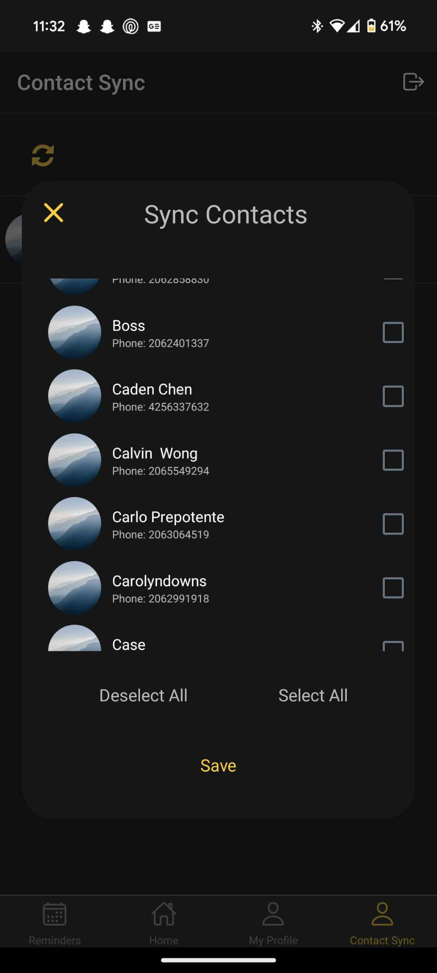
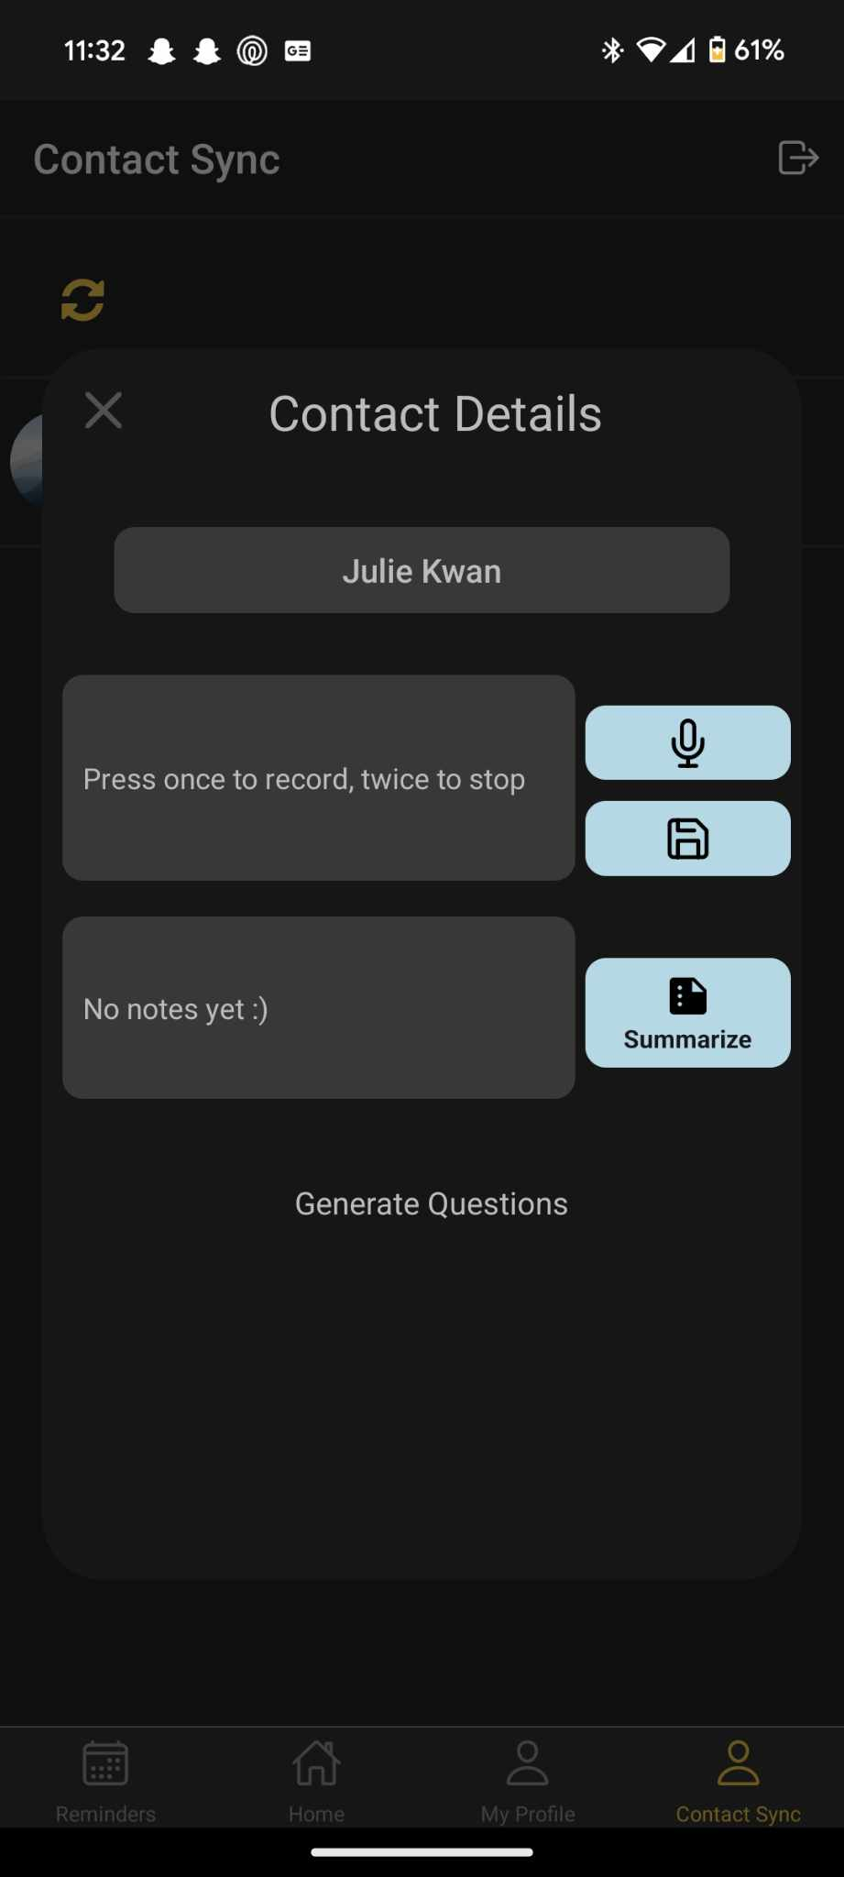
Snippets of Our App
Notes:
A link for the live/keep for now: Intentions App – Uizard
Images needs to get replace

Slide 12

DEMO

Slide 13

Next Steps
Exploring open-source models
Latency, cost, usage, quality, privacy
Improving user-facing summary
Leveraging notes meta-data
Notes:
Exploring open source models
Extracting more meta data from notes to use for question generation
- thought about allowing user's to set tone of questions, now trying to extract tone from their notes

Slide 14
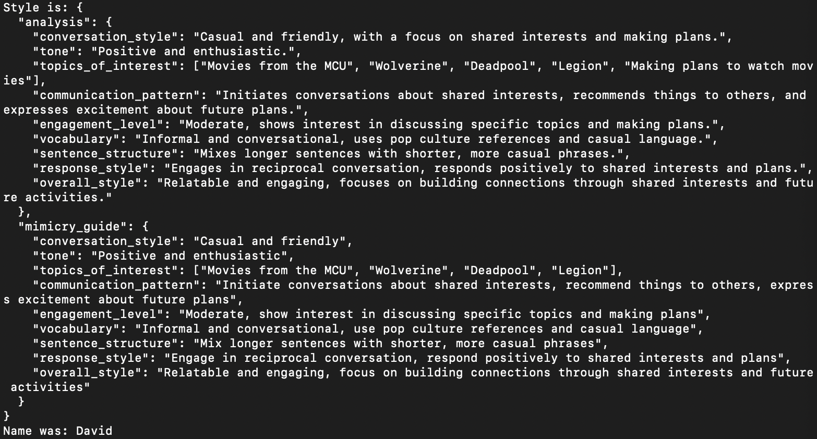
Notes:
Analyze the data, and then provide a guide to best replicate the way the user would ask questions
[topics, vocabulary, sentence structure]
Analyze conversation style and find out the words you like to use, topics you like, and use that to make questions
Exciting because we can get the specific meta data that we find to be useful, but also have the LLM dynamically pull new meta data that it finds to be useful- and then use all of that to create new conversation questions
Go from one model with gpt, to two specialized models, one extracting meta data, and other generating the questions

Slide 15

Our Team's Development Journey Navigating Challenges and Achieving Growth
Rough Start
Task Ownership
Results and Learning
Research

Slide 16
Team Dynamics Building Communication, Collaboration, and Task Management
Communication Enhancement
Collaboration and Support
Task Management Strategies
Continuous Improvement

Slide 17

Thank You For Your Time

