Slide 1
OPTIMAL AUTOMATIC GENERATION CONTROL WITH HYDRO, THERMAL, GAS, AND WIND POWER PLANTS IN 2-AREA INTERCONNECTED POWER SYSTEM
Navapallav Borthakur, Vedansh Pandey
under Dr. Avirup Maulik,
Department of Electrical Engineering,
Indian Institute of Technology(BHU), Varanasi

Slide 2
OUR REPORT EXPLORES AUTOMATIC GENERATION CONTROL (AGC) OF A MORE REALISTIC 2-AREA MULTI-SOURCE POWER SYSTEM COMPRISING HYDRO, THERMAL, GAS, AND WIND ENERGY SOURCES-BASED
POWER PLANTS IN EACH CONTROL AREA. THE WIND POWER PLANTS (WPPS) HAVE BEEN GROWING CONTINUOUSLY WORLDWIDE DUE TO THEIR INHERENT FEATURE OF PROVIDING ECO-FRIENDLY SUSTAINABLE ENERGY. BUT, OPERATIONS OF WPPS ARE ASSOCIATED WITH SYSTEM STABILITY PROBLEMS DUE TO THE VARYING WIND SPEED. TO MINIMIZE THESE DISTURBANCES AND PROVIDE FOR A STABLE SYSTEM LQR AND LQI CONTROLLERS HAVE BEEN USED AND THE RESPONSES CORRESPONDING TO THEM HAVE BEEN VERIFIED BY THE SIMULATION RESULTS.
IT IS OBSERVED THAT THE SYSTEM DYNAMIC GRAPHS OF DEVIATION IN AREA FREQUENCY ARE SIGNIFICANTLY IMPROVED WITH THE IMPLEMENTATION OF OPTIMAL AGC CONTROLLERS.
WHAT DOES OUR REPORT SHOW =>

Slide 3
WHY ARE OPTIMAL CONTROLLERS ARE REQD ???
THE SUCCESSFUL OPERATION OF A POWER SYSTEM REQUIRES PROPER MATCHING OF AREA LOAD DEMAND AND SCHEDULED TIE-LINE FLOWS TO THE AREA GENERATION.
THESE BALANCES ARE ACHIEVED BY REGULATING THE POWER GENERATION WITH LOAD DEMAND.
ALSO,CONDITIONS OF THE SYSTEM ARE ALWAYS DYNAMIC DUE TO STOCHASTIC NATURE OF THE LOAD.
DUE TO THIS, PRECISE MANUAL CONTROL TO ACHIEVE THESE BALANCES IS INADEQUATE. THEREFORE, AGC CONTROLLERS BASED ON MODERN CONTROL CONCEPTS ARE REQUIRED AT CONTROL CENTER FOR REGULATING THE SYSTEM FREQUENCY

Slide 4
MOREOVER,
OPTIMAL AGC CONTROLLERS ARE SIMPLE TO DESIGN, OFFER LOW COST AND ROBUST PERFORMANCE; THEREFORE, IN THIS REPORT LQR AND LQI ( INTEGRAL FEEDBACK ) IS ADAPTED FOR DESIGNING AND IMPLEMENTATION OF AGC SCHEMES IN POWER SYSTEM MODEL UNDER CONSIDERATION.
SOME OTHER APPLICATIONS OF OPTIMAL AGC CONTROLLERS IN POWER SYSTEMS ARE SINGLE/MULTI-ENERGY SOURCE SINGLE/MULTI-AREA POWER SYSTEMS AND 2- AREA RESTRUCTURED SINGLE/MULTI-ENERGY SOURCE POWER SYSTEMS

Slide 5
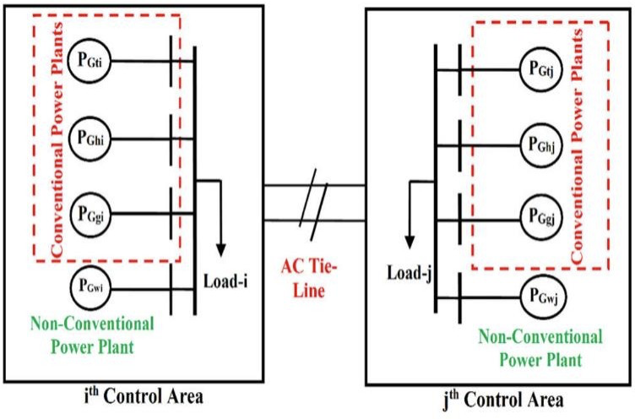
FIGURE. Block diagram model of power systems is having hydro, thermal and gas power plants along with WPPs.

Slide 6
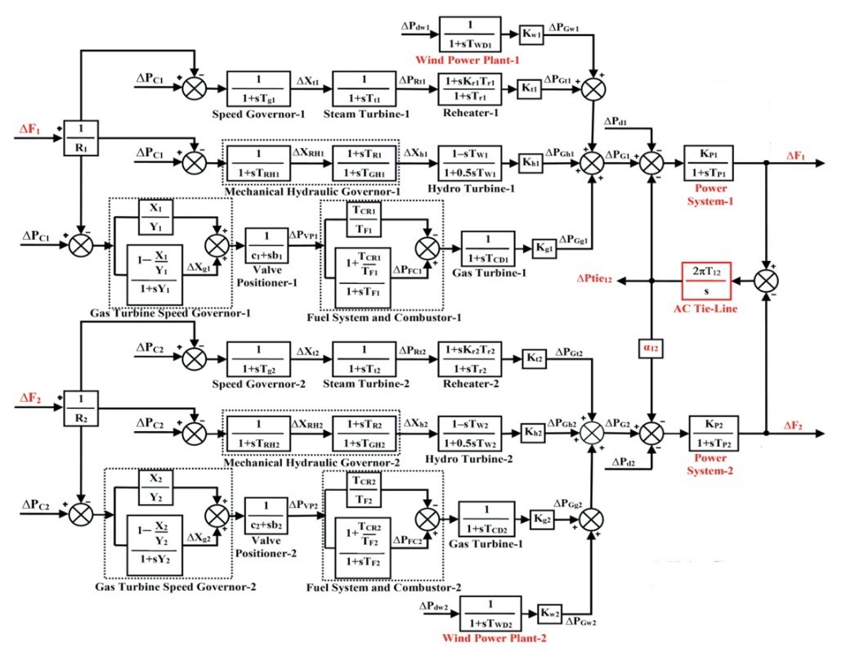
FIGURE . Transfer function model of power system under investigation.

Slide 7
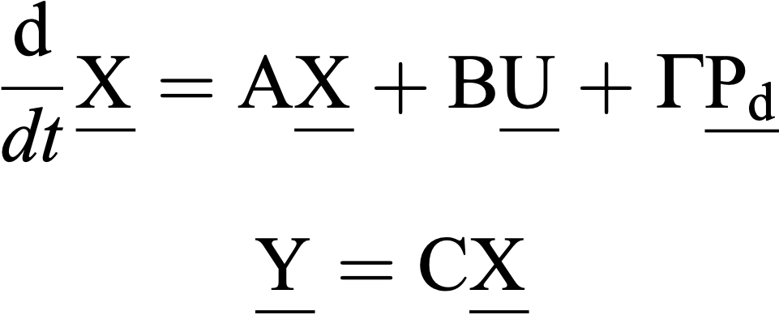
The power system model under examination is a linear continuous time-invariant dynamic system which may be represented by equations=>
X, U, Pd , and Y are state, control, disturbance, and output vectors respectively as well as A, B, U, and C are system, control, disturbance, and output matrices of compatible dimensions, respectively
(Here,for a feedback control system the matrix ‘D’ is assumed zero)

Slide 8
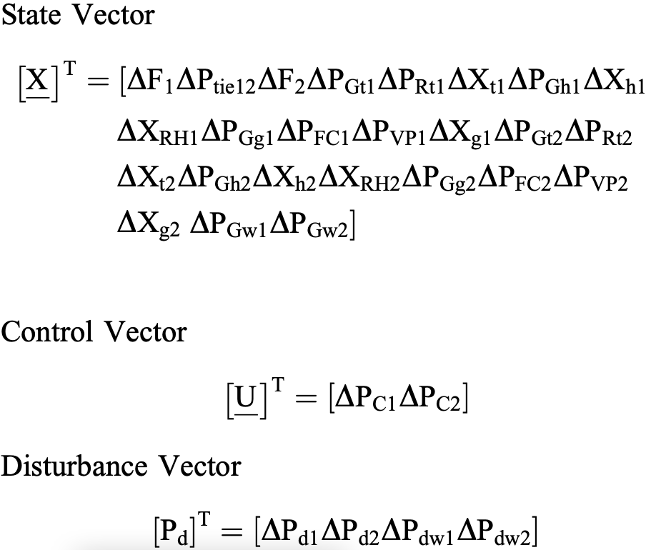
THE STATE, CONTROL, AND DISTURBANCE VECTORS FOR POWER SYSTEM MODEL UNDER INVESTIGATION ARE GIVEN BY=>

Slide 9
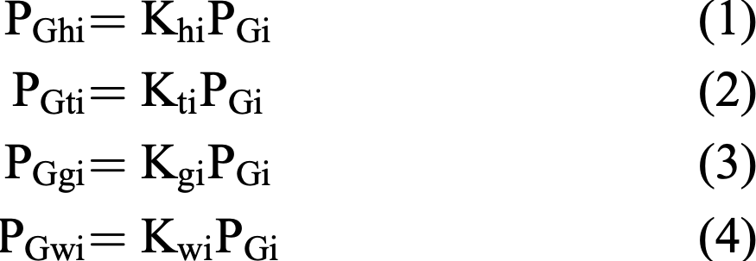
MATHEMATICAL MODEL OF POWER SYSTEM UNDER EXAMINATION
Let Khi, Kti and Kgi along with Kwi be the power sharing factors of hydro, thermal and gas power plants along with WPPs, respectively for total power generation in ith control area.
The PGhi, PGti and PGgi along with PGwi are power generations in MW by hydro, thermal and gas power plants along with WPPs in the ith control area, respectively. the power generations from hydro, thermal and gas along with WPPs to meet out the total load demand are given by
The total power generated; PGi of ith area for nominal generation loading, is mathematically given by: PGi=PGhi+PGti+PGgi+PGwi
Putting the value of PGhi, PGti, PGgi, and PGwi from eqn (1)-(4),the value of PGi is given by=>
PGi=Khi*PGi+Kti*PGi+Kgi*PGi+Kwi*PGi
Kti+Khi+Kgi+Kwi=1

Slide 10
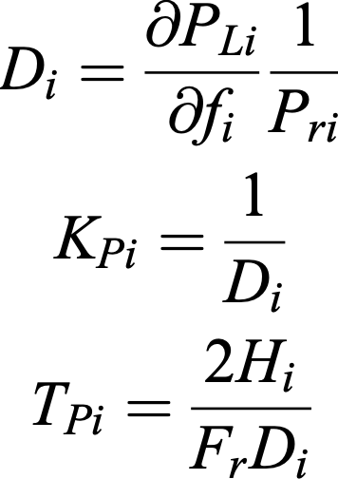

For small load perturbation in ith control area, the deviation in power generation; ∆PGi can be formulated as: ∆PGi=∆PGhi+∆PGti+∆PGgi+∆PGwi
Similarly, for jth control area, ∆PGj is given by:∆PGj=∆PGhj+∆PGtj+∆PGgj+∆PGwj
The load frequency characteristic (Di), power system gains constant (KPi), power system time constant (TPi), and bias constant (βi) are defined as

Slide 11
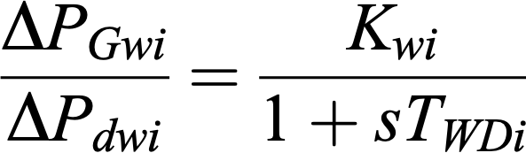
SAMPLE TRANSFER FUNCTION DERIVATION
THE TRANSFER FUNCTION MODEL OF WPPS FOR iTH CONTROL AREA IN TERMS OF WIND DISTURBANCE (∆PDWi), DEVIATION OF POWER GENERATED BY WPPS (∆PGWi) AND TIME CONSTANT OF WPPS (TWDi) IS GIVEN BY
SIMILARLY, THE ABOVE EQUATIONS FOR JTH CONTROL AREA CAN BE DETERMINED
FROM THE TRANSFER FUNCTION MODEL SHOWN IN FIGURE 2, THE VARIOUS DIFFERENTIAL EQUATIONS MAY BE DERIVED TO DEVELOP THE STATE SPACE MODEL OF THE SYSTEM TOTAL 25 DIFFERENTIAL EQUATIONS MAY BE DERIVED FOR POWER SYSTEM MODEL BUT THE SAME ARE NOT GIVEN HERE DUE TO THE SPACE LIMITATIONS.

Slide 12
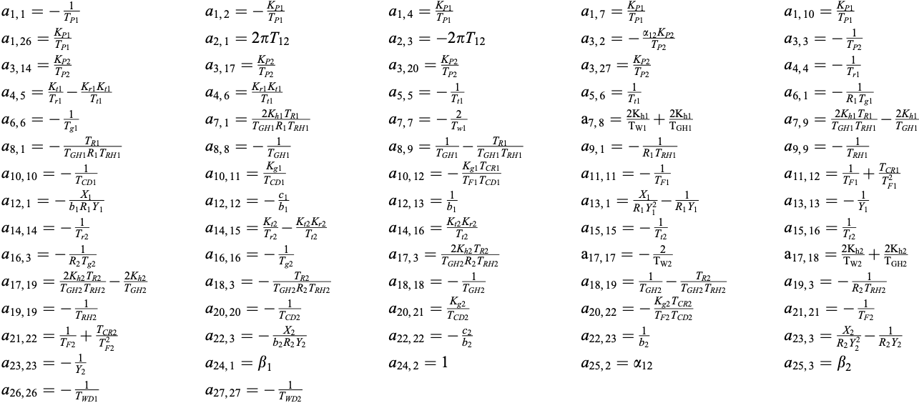
SYSTEM MATRICES
MATRIX A

Slide 13
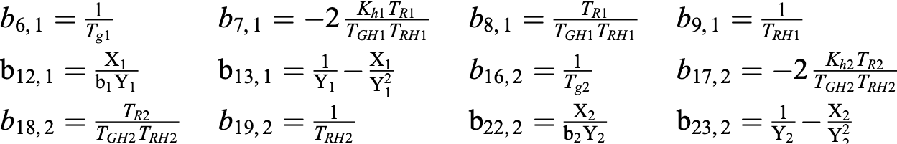
MATRIX B
MATRIX Tau

Slide 14
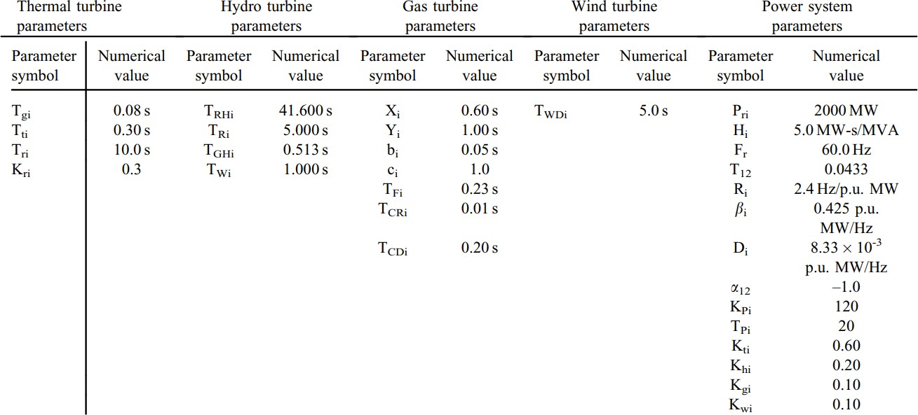
DATA OF THE SYSTEM PARAMETERS

Slide 15
ALL THE STATE SPACE EQUATIONS HAVE BEEN VERIFIED BY SOLVING ON PEN-PAPER
ALL SYS,CTRL,DISTURBANCE & OUTPUT MATRICES HAVE BEEN CHECKED BY SOLVING ON PEN-PAPER

Slide 16
MATLAB CODE-MATRIX A
a(8,1)=-TR1/(TGH1*R1*TRH1);
a(8,8)=-1/TGH1;
a(8,9)=(1/TGH1)-(TR1/(TGH1*TRH1));
a(9,1)=-1/(R1*TRH1);
a(9,9)=-1/TRH1;
a(10,10)=-1/TCD1;
a(10,11)=Kg1/TCD1;
a(10,12)=-(Kg1*TCR1)/(TF1*TCD1);
a(11,11)=-1/TF1;
a(11,12)=1/TF1+(TCR1/(TF1*TF1));
a(12,1)=-X1/(b1*R1*Y1);
a(12,12)=-c1/b1;
a(12,13)=1/b1;
a(13,1)=(X1/(R1*Y1*Y1))-(1/(R1*Y1));
a(13,13)=-1/Y1;
a(14,14)=-1/Tr1;
a(14,15)=(Kt1/Tr1)-(Kr1*Kt1/Tt1);
a(14,16)=Kr1*Kt1/Tt1;
a(15,15)=-1/Tt1;
a(15,16)=1/Tt1;
a(16,3)=-1/(R1*Tg1);
a(16,16)=-1/Tg1;
a(17,3)=(2*Kh1*TR1)/(TGH1*R1*TRH1);
a(17,17)=-2/TW1;
a(17,18)=(2*Kh1/TW1)+(2*Kh1/TGH1);
a(17,19)=((2*Kh1*TR1)/(TGH1*TRH1))-(2*Kh1/TGH1);
a(18,3)=-TR1/(TGH1*R1*TRH1);
a(18,18)=-1/TGH1;
a(18,19)=(1/TGH1)-(TR1/(TGH1*TRH1));
a(19,3)=-1/(R1*TRH1);
a(19,19)=-1/TRH1;
a(20,20)=-1/TCD1;
a(20,21)=Kg1/TCD1;
a(20,22)=-(Kg1*TCR1)/(TF1*TCD1);
a(21,21)=-1/TF1;
a(21,22)=1/TF1+(TCR1/(TF1*TF1));
a(22,3)=-X1/(b1*R1*Y1);
a(22,22)=-c1/b1;
a(22,23)=1/b1;
a(23,3)=(X1/(R1*Y1*Y1))-(1/(R1*Y1));
a(23,23)=-1/Y1;
a(24,24)=-1/TWD1;
a(25,25)=-1/TWD1;
a=zeros(25,25);
a(1,1)=-1/TP1;
a(1,2)=-KP1/TP1;
a(1,4)=KP1/TP1;
a(1,7)=KP1/TP1;
a(1,10)=KP1/TP1;
a(1,24)=KP1/TP1;
a(2,1)=2*pi*T12;
a(2,3)=-2*pi*T12;
a(3,2)=-(al1*KP1)/TP1;
a(3,3)=-1/TP1;
a(3,14)=KP1/TP1;
a(3,17)=KP1/TP1;
a(3,20)=KP1/TP1;
a(3,25)=KP1/TP1;
a(4,4)=-1/Tr1;
a(4,5)=(Kt1/Tr1)-(Kr1*Kt1/Tt1);
a(4,6)=Kr1*Kt1/Tt1;
a(5,5)=-1/Tt1;
a(5,6)=1/Tt1;
a(6,1)=-1/(R1*Tg1);
a(6,6)=-1/Tg1;
a(7,1)=(2*Kh1*TR1)/(TGH1*R1*TRH1);
a(7,7)=-2/TW1;
a(7,8)=(2*Kh1/TW1)+(2*Kh1/TGH1);
a(7,9)=((2*Kh1*TR1)/(TGH1*TRH1))-(2*Kh1/TGH1);

Slide 17
MATLAB CODE-MATRIX B
MATLAB CODE-MATRIX Tau
b=zeros(25,2);
b(6,1)=1/Tg1;
b(7,1)=(-2*Kh1*TR1)/(TGH1*TRH1);
b(8,1)=TR1/(TGH1*TRH1);
b(9,1)=1/TRH1;
b(12,1)=X1/(b1*Y1);
b(13,1)=(1/Y1)-(X1/(Y1*Y1));
b(16,2)=1/Tg1;
b(17,2)=(-2*Kh1*TR1)/(TGH1*TRH1);
b(18,2)=TR1/(TGH1*TRH1);
b(19,2)=1/TRH1;
b(22,2)=X1/(b1*Y1);
b(23,2)=(1/Y1)-(X1/(Y1*Y1));
tau=zeros(25,4);
tau(1,1)=-KP1/TP1;
tau(3,2)=-KP1/TP1;
tau(24,3)=1/TWD1;
tau(25,4)=1/TWD1;

Slide 18
EIGENVALUES for Matrix A =>
-19.9837 + 0.0000i
-19.9838 + 0.0000i
-12.6556 + 0.0000i
-12.6587 + 0.0000i
-5.5266 + 0.0000i
-5.4955 + 0.0000i
-3.9487 + 0.0000i
-0.1659 + 2.0497i
-0.1659 - 2.0497i
-3.9213 + 0.0000i
-1.5463 + 0.0000i
-2.6244 + 0.4760i
-2.6244 - 0.4760i
-2.6369 + 0.2758i
-2.6369 - 0.2758i
-0.6812 + 0.6928i
-0.6812 - 0.6928i
-1.2899 + 0.0000i
-0.9485 + 0.0000i
-0.2842 + 0.0000i
-0.0967 + 0.0000i
-0.0289 + 0.0000i
-0.0240 + 0.0000i
-0.2000 + 0.0000i
-0.2000 + 0.0000i
THE EIGENVALUES OBTAINED HAVE NO ZEROES( POLES) AND REAL PART IS NEGATIVE=>
HENCE, THE SYSTEM IS STABLE

Slide 19
SIMULATIONS
Using MATLAB AND SIMULINK

Slide 20
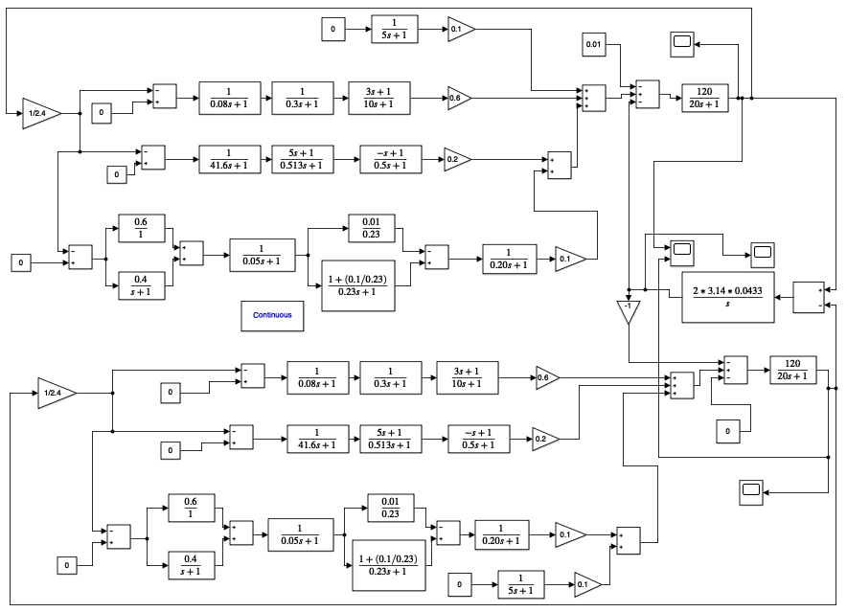
COMBINED

Slide 21
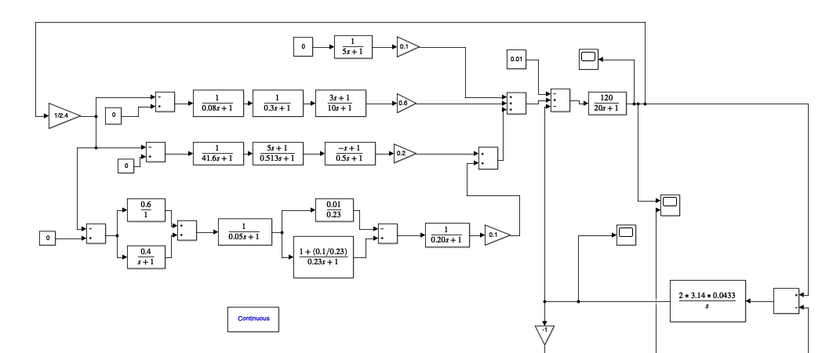
Control Area-1

Slide 22
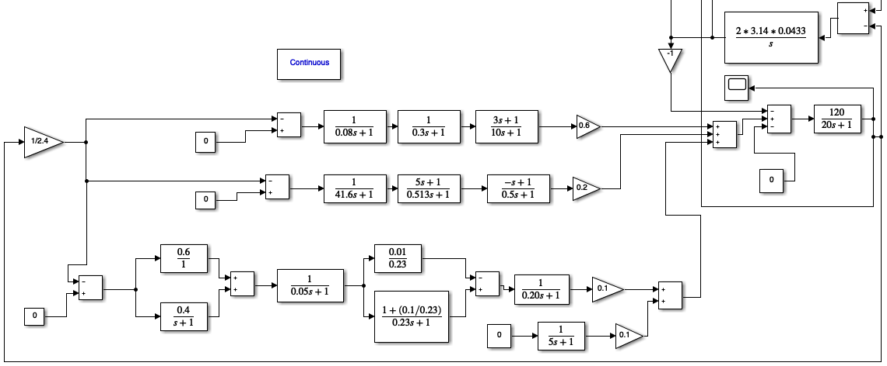
Control Area-2

Slide 23
SIMULINK MODEL OUTPUTS( THROUGH SCOPE BLOCK )
Without using any “Optimal”Controller design

Slide 24
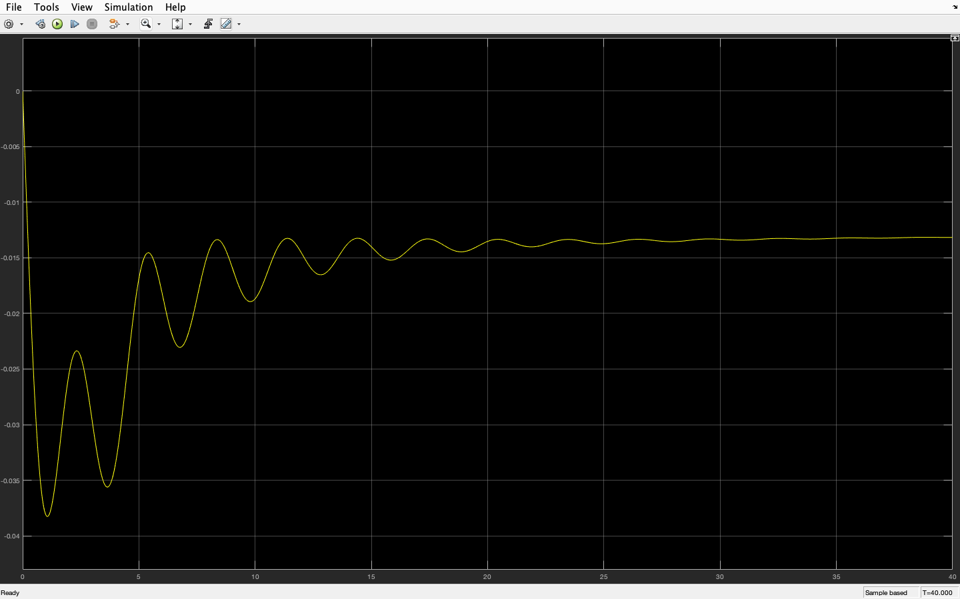
FOR STATE X1 ( ∆F1 )

Slide 25
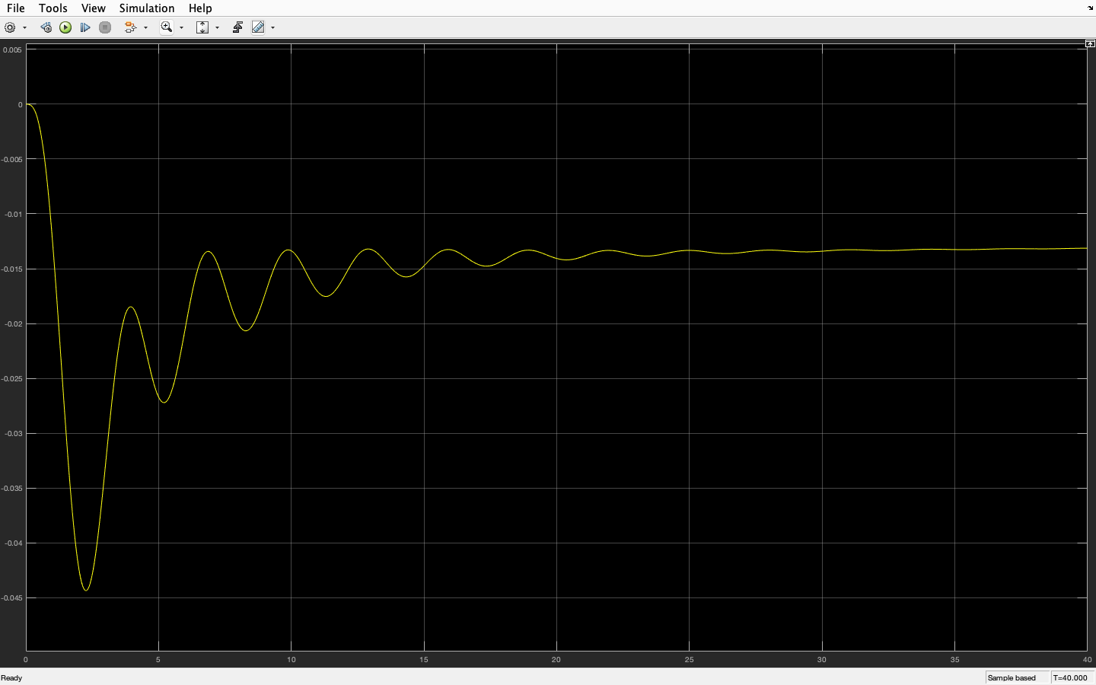
FOR STATE X3 ( ∆F2 )

Slide 26
DESIGNING THE CONTROLLERS=>
WITHOUT DESIGNING ANY “OPTIMAL” CONTROLLER METHOD
APPLYING LQR METHOD
APPLYING LQI METHOD-INCORPORATING AN INTEGRAL ACTION IN LQR BY AUGMENTING SYSTEM MATRIX WITH ERROR IN THE STATE VARIABLE

Slide 27
In our MATLAB codes, the following is our naming convention=>
a=>matrix A
b=>matrix B
u=> matrix U
tau=>matrix T
delp=> matrix Pd
c=> matrix C
bt1=>βi
al1=> a12
ad=> discretized matrix A
bd=> discretized matrix B
cd=>discretized matrix C (here, same as C)
taud=>discretized matrix T
delt=>time interval for each iteration
xa=>initial matrix X
x=>stores matrix dX/dt in each iteration
time(it)=> time matrix for each iteration
y(it)=> Y matrix for each iteration
gain=> matrix K in [K,S,e] = LQR(A,B,Q,R,N)
We have applied only one disturbance (i.e.∆Pd1=0.01 ) for all the 3 controller types

Slide 28
WITHOUT DESIGNING ANY “OPTIMAL” CONTROLLER METHOD

Slide 29
DISCRETIZATION USING C2D COMMAND
delt=10^-3;
[ad,bd]=c2d(a,b,delt);
[ad1,taud]=c2d(a,tau,delt);
IT WILL BE NEEDED IN DESIGNING THE CONTROLLERS

Slide 30
For Output ∆F1 ( state X1)=>
delt=10^-3
% discretization of
% matrices
[ad,bd]=c2d(a,b,delt);
[ad1,taud]=c2d(a,tau,delt);
xa=zeros(25,1);
u=[0
0];
delp=[0.01
0
0
0];
c=zeros(1,25);
% for ∆F1(X1)
c(1,1)=1;
t=0;
it=1;
y(1)=0;
time(it)=t;
cd=c;
while t<30
it=it+1;
x=ad*xa+bd*u+taud*delp;
y(it)=cd*x;
xa=x;
t=t+delt;time(it)=t;
end
plot(time,y);

Slide 31
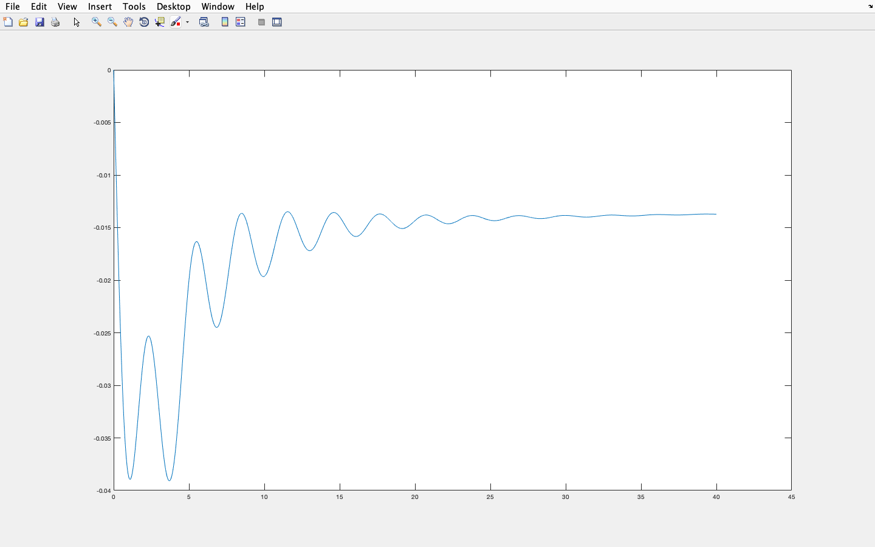
FOR STATE X1 ( ∆F1 )

Slide 32
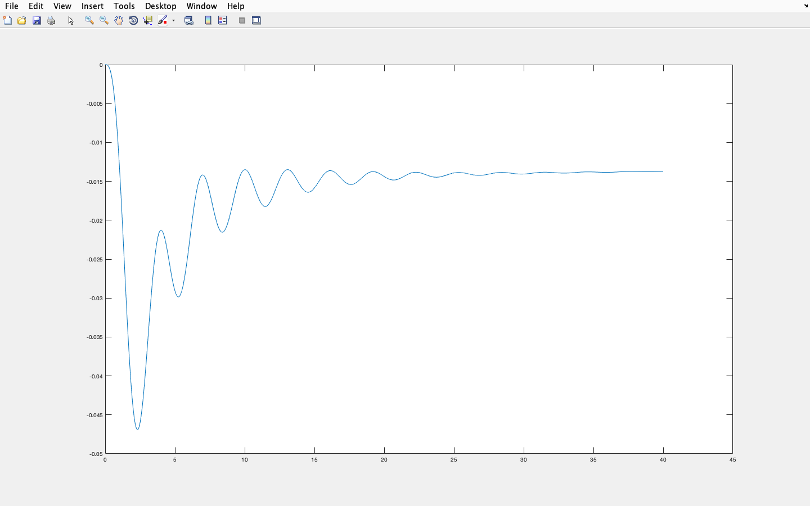
FOR STATE X3 ( ∆F2 )

Slide 33
WE CAN SEE THAT THE GRAPHS OBTAINED HERE ARE SIMILAR TO THE MATLAB-SIMULINK MODEL - WITHOUT ANY “ OPTIMAL ” CONTROLLER DESIGN
WE CAN FIND A LOT OF STEADY - STATE ERRORS.
MOREOVER, THE STEADY-STATE IS REACHED VERY LATE

Slide 34
2. APPLYING LQR METHOD

Slide 35


Syntax:
[K,S,E] = LQR(SYS,Q,R,N)
[K,S,E] = LQR(A,B,Q,R,N)
Description:
[K,S,e] = LQR(SYS,Q,R,N) CALCULATES THE OPTIMAL GAIN MATRIX K.
([Q] AND [R] ARE WEIGHTING MATRICES FOR THE SYSTEM STATE AND THE INPUT VARIABLES)
FOR A CONTINUOUS TIME SYSTEM, THE STATE-FEEDBACK LAW U = –KX MINIMIZES THE QUADRATIC COST FUNCTION
SUBJECTED TO SYSTEM DYNAMICS
FOR A DISCRETE-TIME STATE-SPACE MODEL, U[N] = –KX[N] MINIMIZES
SUBJECT TO X[N + 1] = AX[N] + BU[N].

Slide 36
MATLAB CODE FOR LQR METHOD
% defining the Q,R,N Matrices
Q=100*eye(25);
v2=[50 50];
R=diag(v2);
N=zeros(25,2);
c=zeros(1,25);
% for ∆F1(x1)
c(1,1)=1;
t=0;
it=1;
y(1)=0;
time(it)=t;
cd=c;
% applying lqr
[gain,sy,er]=lqr(a,b,Q,R,N);
while t<40
it=it+1;
x=ad*xa+bd*u+taud*delp;
y(it)=cd*x;
xa=x;
t=t+delt;
time(it)=t;
u=-gain*xa;
end
plot(time,y);

Slide 37
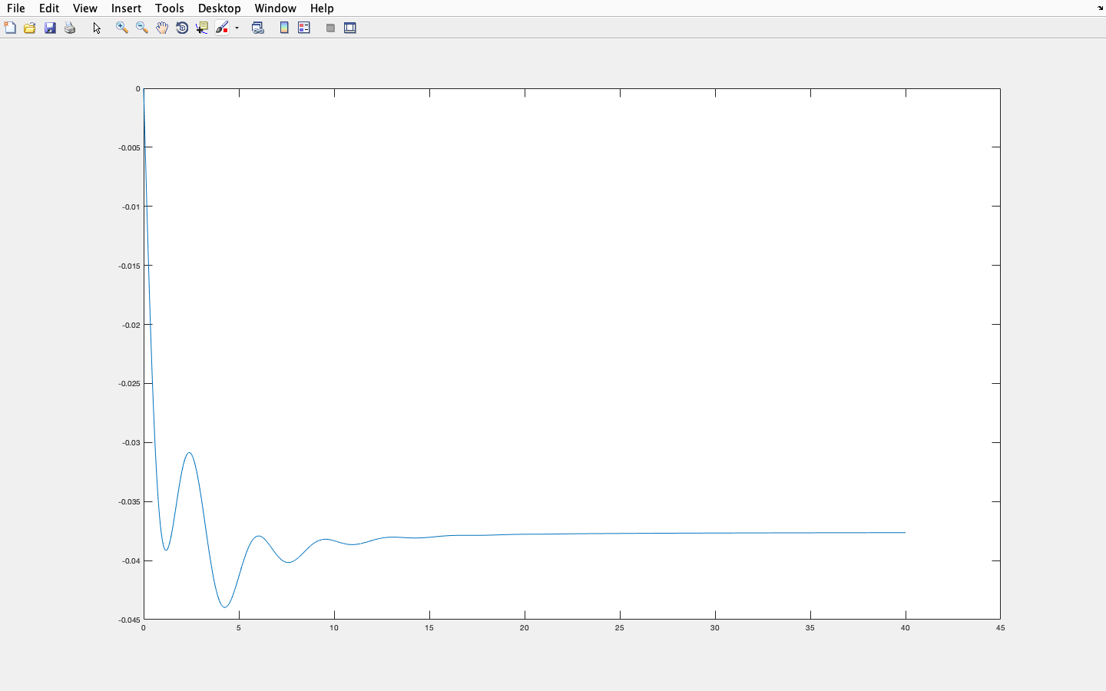
FOR STATE X1 ( ∆F1 )

Slide 38
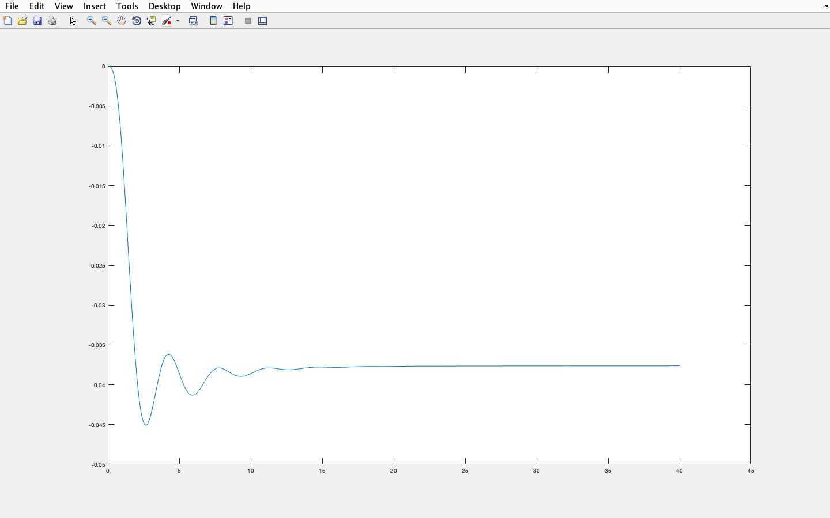
FOR STATE X3 ( ∆F2 )

Slide 39
IN THE ABOVE GRAPHS, WE CAN SEE THAT THE STEADY STATE IS REACHED EARLIER, BUT THERE ARE STILL STEADY STATE ERRORS.
TO REDUCE THESE DISTURBANCES AND TO REDUCE THE TIME REQD TO REACH STEADY STATE, WE DESIGN A MORE ACCURATE CONTROLLER KNOWN AS THE LQI CONTROLLER.
INSTEAD OF USING TRADITIONAL LQI CONTROLLER , WE INCORPORATE AN INTEGRAL ACTION ITSELF IN LQR BY AUGMENTING SYSTEM MATRIX WITH ERROR IN THE STATE VARIABLE

Slide 40
3. INCORPORATING AN INTEGRAL ACTION IN LQR BY AUGMENTING SYSTEM MATRIX WITH ERROR IN THE STATE VARIABLE INSTEAD OF TRADITIONAL LQI METHOD

Slide 41

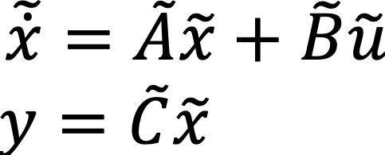
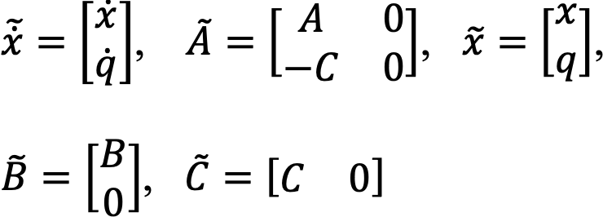
Our Original system=>
We define integral state q as follows: q̇ = -y = - Cx
Therefore the system (1) and (2) after augmenting with integral state, q becomes,
Where,

Slide 42
The other convention add-ons are⇒
% redefining the Q,R,N Matrices
Q=100*eye(25);
Q(26,:)=0;
Q(:,26)=0;
Q(26,26)=100;
v2=[50 50];
R=diag(v2);
N=zeros(26,2);
ak=>augmented matrix A̅
bk=>augmented matrix B̅
ck=>augmented matrix C̅
q=>integral state
xak=>augmented matrix X̅a
tauk=>augmented matrix T̅
ad, bd, taud=> discretized matrices A̅ , B̅ , T̅
cd=>discretized matrix C̅ ( here, same as C̅ )

Slide 43
MATLAB CODE FOR INCORPORATING AN INTEGRAL ACTION IN LQR BY AUGMENTING SYSTEM MATRIX WITH ERROR IN THE STATE VARIABLE
For Output ∆F1 ( state X1)=>
c=zeros(1,25);
% for ∆F1(x1)
c(1,1)=1;
t=0;
it=1;
y(1)=0;
time(it)=t;
% getting the value of q
fun=@(y) -y;
q=integral(fun,0,1);
xak=[xa;q];
% augmenting the matrices
ck=[c 0];
cd=ck;
bk=[b;0 0];
tauk=[tau;0 0 0 0];
ve1=zeros(25,1);
a=[a ve1];
c=[c 0];
ak=[a;-c];
% applying lqr
% after augmenting
[gain,sy,er]=lqr(ak,bk,Q,R,N);
[ad,bd]=c2d(ak,bk,delt);
[ad1,taud]=c2d(ak,tauk,delt);
while t<40
it=it+1;
x=ad*xak+bd*u+taud*delp;
y(it)=cd*x;
xak=x;
t=t+delt;
time(it)=t;
u=-gain*xak;
end
plot(time,y);

Slide 44
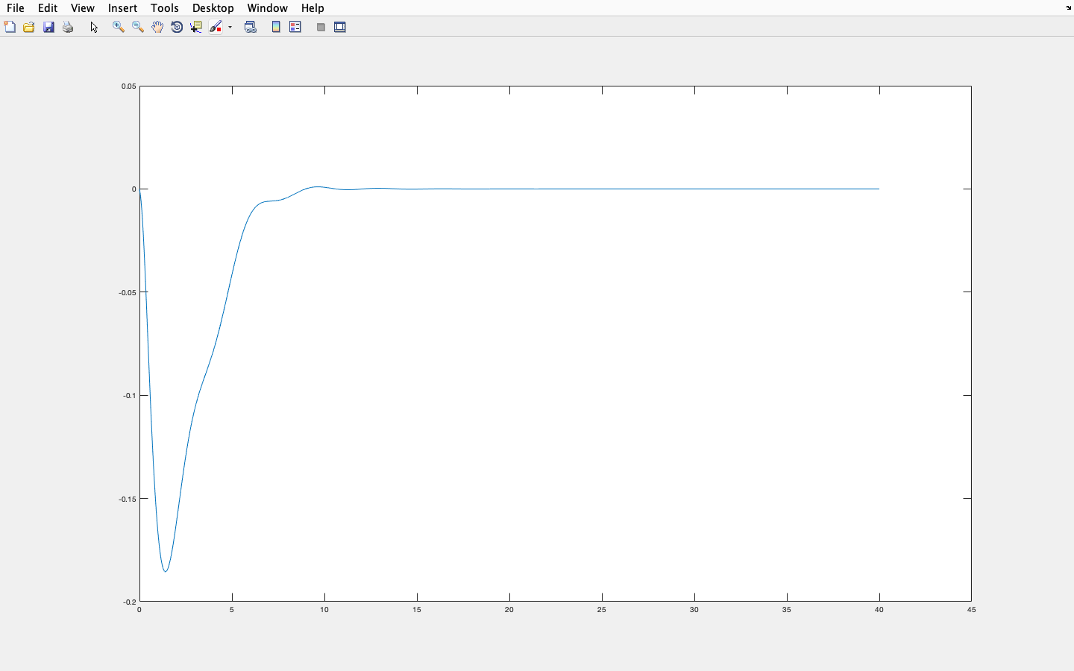
FOR STATE X1 ( ∆F1 )

Slide 45
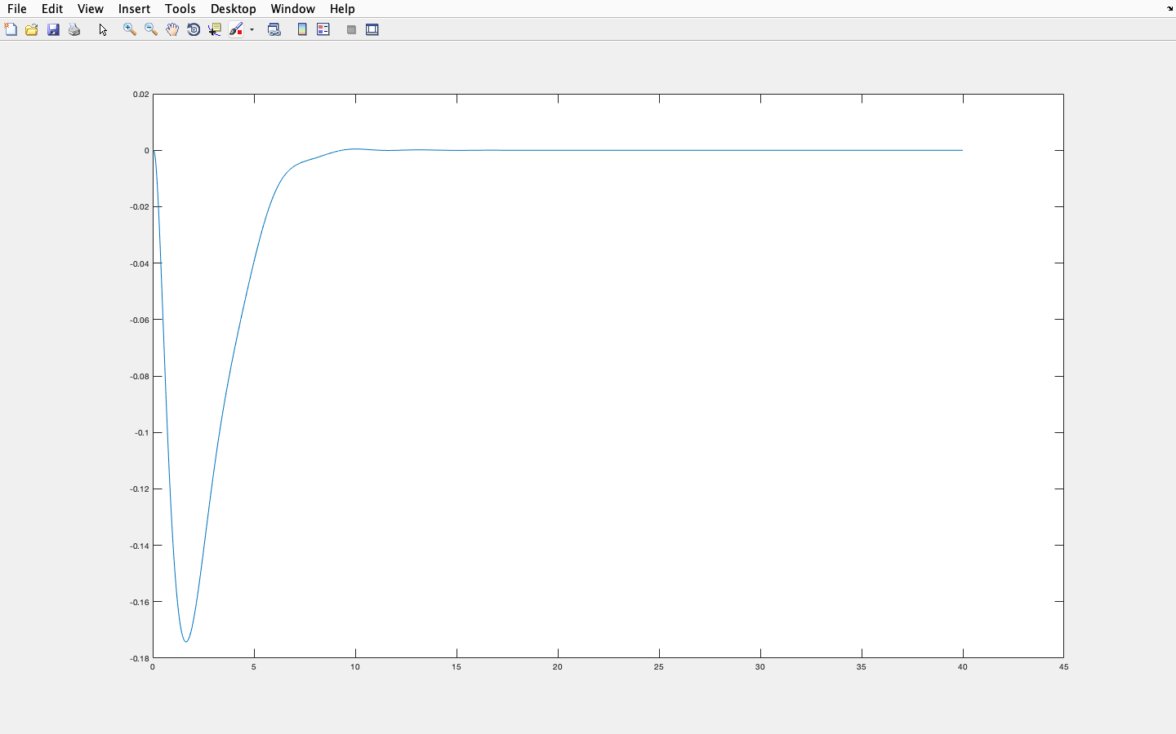
FOR STATE X3 ( ∆F2 )

Slide 46
IN THE ABOVE GRAPHS, WE SEE THAT THE STEADY STATE IS REACHED MUCH EARLIER AND THE STEADY STATE ERRORS ARE REDUCED.

Slide 47
REFERENCES=>
1. Nizamuddin Hakimuddin , Ibraheem Nasiruddin , Terlochan Singh Bhatti & Yogendra Arya (2020) :Optimal Automatic Generation Control with Hydro, Thermal, Gas, and Wind Power Plants in 2- Area Interconnected Power System - Electric Power Components and Systems, Vol. 0 (2020), No. 0; 1-6,10-11,13-14
2. I.J. Nagrath, M. Gopal (4th ed:2006): Control Systems Engineering - New Age International Publishers
3. Hanmant G. Malkapure, M. Chidambaram (2014):Comparison of Two Methods of Incorporating an Integral Action in Linear Quadratic Regulator - Third International Conference on Advances in Control and Optimization of Dynamical Systems, Kanpur, India; 56,60
4. R. M. Murray (2006):Lecture 2 – LQR Control ( CDS 110b ) - California institute of technology ( Control and Dynamical Systems );1-5
5. Nilaykumar N. Shah, Anamika R. Pandit, Mansi T. Shah, Sherin Cherin, Sheetal G. Vsava(2016):
automatic load frequency control of two area system using l-q-r method - international journal of current engineering and scientific research (IJCESR), volume-3, issue-6;54-60
6. in.mathworks.com/help/control/ref/lqr.html
7. in.mathworks.com/help/control/ref/ss.lqi.html

