Slide 1
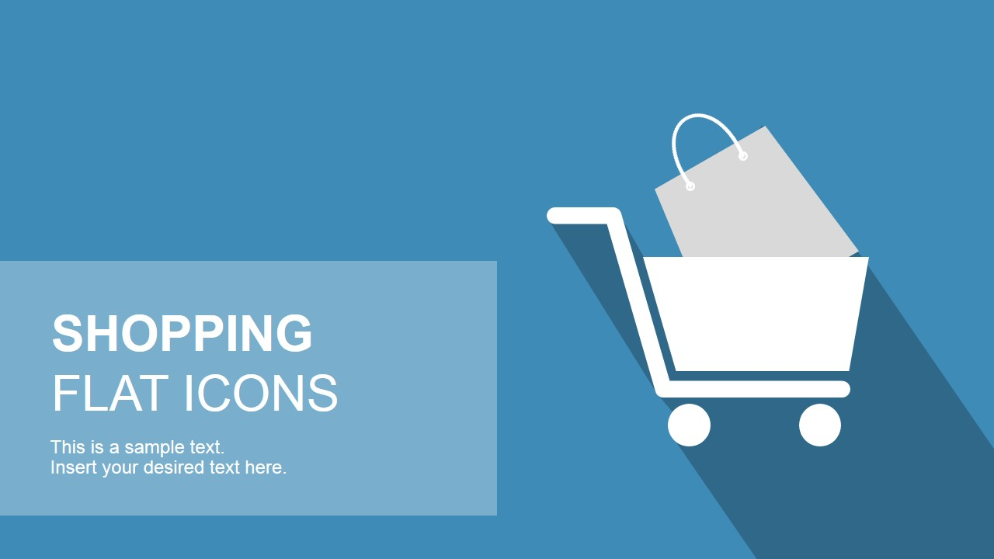
PRESENTATION
ON
“ E-Commerce (Online Shopping )”
Prepared by :
19BECE30508 - Darsh Savani
19BECE30519 - DhruvrajSinh Zala
19BECE30555 - Preet Patel
19BECE30560 - Raj Jetani
Internal Guide
Prof. Nimesh Patel

Slide 2
Introduction
What is E-Commerce ?
  Commonly known as Electronic Marketing.
  It consists of buying and selling goods and services over an electronic systems such as the internet and other computer networks.
  Our System is an e-commerce website from where people can buy products online.
  Admin can monitors the activity of the users and checks the transactions.

Slide 3
Tools And Technologies
LANGUAGES
HTML
CSS
JAVASCRIPT
ReactJS
NodeJS
DATABASE
MongoDB
TOOLS
Visual Studio Code
MongoDB Compass

Slide 4
Why do People shop Online ?
Huge Selection and variety of products
Convenience of not Going to Stores
Better Prices with Coupons/ Discounts
No Sales Pressure in Online Shopping
Discrete Shipping
Quick and Easy Product Replacement and Return
Easy Checkout process and Fast Delivery options
Clear information about Products and Vendors
Easy to find rare products Online

Slide 5
Different type of e-commerce ..
Business-to-Business (B2B)
Business-to-Consumer (B2C)
Business-to-Government (B2G)
Consumer-to-Consumer (C2C)
Government-to-Consumer (G2C)
Government-to-Business (G2B)

Slide 6
The Process of E-Commerce
A Consumer uses Web Browser to connect to the home page of a merchant’s website on the internet.
The consumer browses the catalog of products featured on the site and selects items to purchase. The selected items are placed in the electronic equivalent of a shopping cart.
When the customer is ready to complete the purchase of selected items, he/she provides a bill-to and ship-to address for purchase and delivery.

Slide 7
The Process of E-Commerce
When the payment is done and the order is completed at the commerce server site, the merchant’s site displays a receipt confirming the customer’s purchase.
The commerce server site then forwards the order to a processing Network for payment processing and fulfilment.

Slide 8
ADVANTAGES OF E-COMMERCE
Faster buying/selling procedure, as well as easy to find products.
Buying/selling 24/7
More reach to customers, there is no theoretical geographic limitations.
Low operational costs and better quality of services.
No need of physical company set-ups.
Easy to start and manage a business.
Customers can easily select products from different providers without moving around physically.

Slide 9
DISADVANTAGES OF E-COMMERCE
Unable to examine products personally.
Not everyone connected to internet.
There is the possibility of credit card number theft.
Mechanical failures can cause unpredictable effects on the total processes

