Slide 1
Intellectual Property Unit IV
Adv. Rakshya Giri

Slide 2
Meaning and Definition of Intellectual Property
Intellectual property, very broadly, means the legal rights which result from intellectual activity in the industrial, scientific, literary and artistic fields. Countries have laws to protect intellectual property for two main reasons.
One is to give statutory expression to the moral and economic rights of creators in their creations and the rights of the public in access to those creations.
The second is to promote, as a deliberate act of Government policy, creativity and the dissemination and application of its results and to encourage fair trading which would contribute to economic and social development.
Generally speaking, intellectual property law aims at safeguarding creators and other producers of intellectual goods and services by granting them certain time-limited rights to control the use made of those productions. Those rights do not apply to the physical object in which the creation may be embodied but instead to the intellectual creation as such.
Intellectual property is traditionally divided into two branches, “industrial property” and “copyright.”

Slide 3
Intellectual Property rights -Like any property rights-which allow the creator or owner of intellectual property (patent, trademark, copyright etc.) to benefit from his or her own work or investment.
Art. 27(2) of UDHR sets forth the right to benefit from the protection of moral and material interests resulting from authorship of any scientific, literary or artistic production.
Intellectual Property Right can be simplified as rights granted to the creator of his/her creation. It is a legal right established with the sole motive of protecting the creation of the intellect. Any sort of inventions, such as: literature, designs, music, logos, images etc. can be copied, hence to protect and restrict misusing of the creations, Intellectual Property Rights can be very advantageous.
Intellectual Property Rights assures the creator that their work will be safeguarded and they will completely posses the right for usage of their creation. There are four main types of intellectual property rights such as trademarks, copyrights, patents and trade secrets.
Intellectual Property Rights provides a support to the creators to continue producing their things and be assured that their creations will not be misused at any cost. For e.g. music producer will be discouraged if his/her piece of work is copied by some third party without his knowledge.
Intellectual property rights are an asset to your business and many aspects of your business can be fortified under Intellectual Property Rights such as your company name, logo, designs, inventions etc. It keeps your business apart from competitors and is an essential part for your marketing and branding purpose.

Slide 4
Intellectual Property establishes property rights which allow creators to benefit from his/her creations.
In modern industrial and commercial society property is not an exclusive relation of dominance exercise by one person natural or corporate, over the thing, or even a number of “quasi-things” but that is rather a collective description for complex of powers, functions, expectation, liabilities, which may be apportioned between different parties to a legal transaction.
The concept of IP was originally designed to cover ownership of copyright on literary, artistic works and industrial property relating to patents for invention, trademarks.
A. Industrial Property covers the following:
Patents
Industrial Designs
Trademarks
Geographical indication
Integrated Circuits
Trade Secrets
Copyright and related rights
Protection against acts of unfair competition
Utility Model

Slide 5
As economies are getting increasingly knowledge and technology oriented, intellectual capital and its protection have gained significant importance. In line with the global development, Nepal too has recognized the value of Intellectual Property (IP) and there is a growing trend both on the part of the legislators and the judiciary to afford protection to IP and enforce Intellectual Property Rights (IPR).
In Nepal, the protection and enforcement of IPR are primarily governed by Copyright Act, 2059 (2002) and the Patent, Design and Trademark Act, 2022 (1965).
In addition, Nepal is also a signatory to various intellectual property treaties such as the Paris Convention for the Protection of Industrial Property, 1883, the Agreement on Trade-Related Aspects of Intellectual Property Rights, 1995 and the Berne Convention for the Protection of Literary and Artistic Works, 1886 pursuant to which Nepal is under an obligation to safeguard IPR.
Nepal is also a member country of World Intellectual Property Organization.

Slide 6
Patents
A patent right governs inventions and prohibits any other third party from making, selling or using the invention for a certain period of time. The creator has the right to commercialize his/her inventions to a third party on mutual agreement by selling his/her patent rights.
According to Section 2 of the Patent, Design and Trademark Act of Nepal, a “patent” means any useful invention relating to a new method of process or manufacture, operation or transmission of any or a combination of, or that made on the basis of a new theory or formula.
Patent is a government-granted monopoly to build, sell, and use your invention (and prevent others from doing so). If we issue a patent, it’s usually good for 20 years; however, there are some patents that are only good for 14 years. After 20 years, our patent expires and anyone can copy, build, and sell your invention. In exchange for the “monopoly,” we must disclose the details of your invention to the public so that someone “practiced in the arts” could recreate it.

Slide 7
To receive a patent your idea must meet four requirements:
1. The subject matter must be “patentable” (as defined by Congress and the courts).
2. Your idea must be “new.”
3. The idea must be “useful.”
4. Your idea must be “non-obvious.”
There are three types of patents you can file for:
1. Utility patent
Utility patents may be granted to anyone who invents or discovers any new and useful process, machine, article of manufacture, composition of matter, or any new and useful improvement thereof (good for 20 years).
2. Design patent
Design patents may be granted to anyone who invents a new, original, and ornamental design (good for 14 years).
Plant patent
Plant patents may be granted to anyone who invents or discovers and asexually reproduces any distinct and new variety of plant (good for 20 years).

Slide 8
A patent sought to be registered may not be patentable in the following circumstances:
1. If it has already been registered in the name of another.
2. If the patent asked to be registered is not invented by the applicant` himself and he has not acquired the right from the inventor.
3. If the patent asked to be registered is found to cause adverse effects in health, conduct or morale, or people in general or in the national interest.
4. If it violates any prevailing laws of Nepal.
Section 23 of the Act deals with renewal. Accordingly, A patent holder shall renew the registration within a period of 35 days from the date of expiration of the term for which he is entitled to use the same. The prescribed form is Schedule 2(D) and the fee for the first time is NPR 5000 & the second time is NPR 7500.
When the time limit of renewal expires, it may be done within 6 months from the date of expiry of the time limit for the same along with a fee of NPR 1000. A patent can only be renewed twice for a period of 7 years at a time.

Slide 9
Copyrights
A copyright is usually implemented for original work of art, music, videos, literature etc. It does not necessarily protect the ideas but protects the tangible forms of creations of a creator. The owner has the exclusive right to distribution, reproduce or to perform their work publically.
Copyrights protect original works of authorship, such as paintings, photographs, musical compositions, sound recordings, computer programs, books, blog posts, movies, architectural works, and plays.
There are some things that are not “creative,” like titles, names, short phrases, and slogans; familiar symbols or designs; lettering or coloring; and mere listings of ingredients or contents.
Copyrights protect expression and never ideas, procedures, methods, systems, processes, concepts, principles, or discoveries.
Companies can be copyright owners as the law allows ownership through “works made for hire”
The works created by an employee within the scope of employment or certain independent contractors owned by the employer.

Slide 10
Copyright law provides copyright owners with the following exclusive rights (among others):
1. Reproduce the work
2. Prepare derivative works
3. Distribute copies by sale, transfer of ownership, or license
4. Perform or display the work publicly
Copyrights exist automatically but you can enhance the protection by registering the work. Copyright registration is not mandatory but allows copyright owners to seek certain types of monetary damages and attorney fees.
Notable exceptions to the exclusive rights are “copyright fair use” or the use of copyrighted works that have fallen into the “public domain.” As to the latter, in-house counsel must ensure any company copyrights are kept current until they otherwise expire.

Slide 11
Utility patent
Utility patents may be granted to anyone who invents or discovers any new and useful process, machine, article of manufacture, composition of matter, or any new and useful improvement thereof (good for 20 years).
Design patent
Design Patents may be granted to anyone who invents a new, original, and ornamental design (good for 14 years).
Plant patent
Plant patents may be granted to anyone who invents or discovers and asexually reproduces any distinct and new variety of plant (good for 20 years).
Patents can be expensive to obtain and maintain, as there are yearly or regular fees required to main them. And, like trademarks, patents are only good in the country where the patent was granted. So, in-house counsel must consider which countries and markets require patent protection.

Slide 12
Trade secret
While businesses have a lot of confidential information, not everything is a trade secret. A trade secret is typically something not generally known to the public, where reasonable efforts are made to keep it confidential, and confers some type of economic value to the holder by the information not being known by another party.
A good shorthand for what constitutes a trade secret is: any information you would not want your competitors to have. Some examples of likely trade secrets include new business models; customer and supplier information, especially around price; marketing strategy; processes and formulae; and other confidential business information.
Even if you have plans, processes, or formulae that you don’t want your competitors to have, if the company doesn’t take appropriate steps to keep that information confidential it can lose the ability to claim such items are trade secrets. For example, if the company has handed out copies of its future marketing plans to customers without any type of non-disclosure agreement in place or failed to label the plans as “confidential,” the plans may not be treated as a trade secret.

Slide 13
Trademarks
A trademark can be any word, phrase, symbol, design, or combination of these things that identifies your goods or services — it’s how customers recognize your company in the marketplace. We tend to use the term “trademark” generically as referring to both trademarks and service marks. A trademark is used for goods; a “service mark” is used for services.
A trademark has many benefits, including:
a. Identifying the source of your goods or services
b. Providing legal protection for your brand
c. Guarding against counterfeiting and fraud
A trademark does not mean you own a particular word or phrase. Rather, you own the rights to how that word or phrase is used with respect to specific goods or services. Key to obtaining trademark protection is the need to identify the specific categories of goods and services the mark will cover. And, the company must actually use or provide such goods and services in the chosen categories — or have a good faith and demonstrative intent to do so.

Slide 14
Unique words or phrases are far easier to protect and more likely to qualify for trademark protection. For example, “Nike” is a stronger, more unique mark than “Quality Tennis Shoes Company.”
We own a trademark as soon as we start using it along with our goods or services. This is known as common law trademarks and it applies only to the geographic area where the company provides its goods or services.
Every time we use our trademark, we can use a symbol with it: “™” for goods, “℠” for services, or “®” for registered trademark. The symbol lets consumers and competitors know we are claiming the mark as ours. We can use “™” for goods or “℠” for services even if you haven’t sought to register our trademark.

Slide 15
Industrial Design
Design means any design, form or shape of materials made through the preparation by any method.
Industrial design is the legal right granted for the protection of the original ornament and non-functional of an industrial article or product result from design activity. It mainly focuses on the protecting the visual features of an article, namely its design, shape, pattern or ornament.
In simple sense, industrial design is a type of intellectual property right that tends to protect the visual design of the object. It also refers to ornamental aspect of an article.
An industrial design includes creation of shape, configuration or composition of pattern or color on three dimensional containing an aesthetic value.
Intangible goods that are not visible to eyes are not protected by industrial design. Industrial design are protected until it is registered in the concerned authority. Registration is the legal way to protect the product.
An industrial design does not get legal protection until the industrial design is registered in competent authority of Nepal. Person desiring to register the design should submit the Registration application pursuant to section 13 of PDTA

Slide 16
.
The grounds for the refusal are as follows;
1) If such design hurts the prestige of any individual or institution,
2) If such design adversely affect the public conduct or morality,
3) If the design affects the national interest,
4) In case the design has been already registered in the name of the other person.

Slide 17
Right on Design
Any body may have a right on a design of any goods under the act, which is made or caused to be made by him, and has been registered in Department.
Owner ship of a design can be transfer.
No body shall make any goods by using other’s design or in a way to manipulate the people in general and copying such design without written consent of the person in whose name design is registered.
Application For Registration Of Design
Person willing to get registered a design of any goods made or caused to be made by him shall apply to the department along with a description, drawings and sketch of design and four copies of its model.
Applicant shall submit prescribed application fee.

Slide 18
Registration of Design
The Department after examination of any application shall register the in name of applicant
The applicant shall pay prescribe registration fee to the Department to obtain the certificate of registration.
Un-registrable Design
Sec 14(3) PDTA, 2022 has stated that if the Department sees any circumstances mentioned in the sub-section (1), it may refuse the registration
If, it is deemed to make adverse affect in the dignity of any individual or institution or,
It makes bad affect in the well being and morale of the people in general or in the national interest, or
If such design has already been registered to the name of other person
Department also looks whether the design to be registered is new and original.
Department may cancel the registration of any design in case if it deems that there is a situation of above.

Slide 19
Terms And Renewal Of Design
The design holder shall have his right on the design for a period of five years from the date of its registration.
The design holder shall renew the registration of design within 35 days from the date of expiry.
Penalty to the Violator
If any body violates the rights of registered design holder may be punished with a fine by the order of the Department and all the goods related with such offence shall be confiscated.

Slide 20
Geographical Indication
Geographical Indication (GI) is a sign used on products that have a specific geographical origin and possess a reputation or quality that is due to that origin.
The qualities, characteristics or reputation of the product should be essentially due to the place of origin.
Since the qualities depend on the geographical place of production, there is a clear link between the product and its original place of production.
In the context of Nepal, there are no specific laws regarding GI registration.
However, there is the Patent, Design and Trademark Act, 1965 (PDTA) to protect industrial property, and it also protects collective trademarks, which can be used for GI protection.
In addition, although the PDTA, 1965 does not have specific provisions for GI and its protection, this does not stop Nepal from providing such protection as Nepal is a member of WTO/TRIPS, which has clearly mentioned about GI protection.
And as per section 9 of the Nepal Treaty Act, 1990, the provisions of a treaty in which Nepal is a party will be implemented in the same way as the law of Nepal. Therefore, even though Nepal lacks a specific provision regarding GI protection, Nepal has a duty to recognize GI and confer the protection to the one seeking it.

Slide 21
Intellectual Property issues
Intellectual property infringement is the violation of an intellectual property right. For example, creating a listing using a third party’s image, trademark, logo, design, etc., without the appropriate permission from the intellectual property rights owner, can constitute intellectual property infringement.

Slide 22
Plagiarism
Plagiarism is the act of taking or copying ideas or words without clearly acknowledging the source of information. A specific example of plagiarism is using a program found in a textbook as your solution to a programming assignment, i.e., without mention of the original author and source of the program.
Plagiarism is presenting someone else’s work or ideas as your own, with or without their consent, by incorporating it into your work without full acknowledgement. All published and unpublished material, whether in manuscript, printed or electronic form, is covered under this definition.
Plagiarism may be intentional or reckless, or unintentional. Under the regulations for examinations, intentional or reckless plagiarism is a disciplinary offence.
Plagiarism is a breach of academic integrity. It is a principle of intellectual honesty that all members of the academic community should acknowledge their debt to the originators of the ideas, words, and data which form the basis for their own work.

Slide 23
Passing off another’s work as your own is not only poor scholarship, but also means that you have failed to complete the learning process.
Plagiarism is unethical and can have serious consequences for your future career; it also undermines the standards of your institution and of the degrees it issues.
Thus, plagiarism is an act of literary theft, an act of fraud which involves stealing and passing off the ideas or words of another as one's own, or using another's work without crediting the source.
This scientific misconduct and academic dishonesty have become a global phenomenon. This is increasingly threatening the trust in science and integrity of the scientific community.
The development of computer technology and the internet has made plagiarism effortlessly easy via copy which are plenty and easily available.

Slide 24
Following acts are considered as Plagiarism
turning in someone else’s work as your own
copying words or ideas from someone else without giving credit
failing to put a quotation in quotation marks
giving incorrect information about the source of a quotation changing words but copying the sentence structure of a source without giving credit
copying so many words or ideas from a source that it makes up the majority of your work, whether you give credit or not (see our section on “fair use” rules)

Slide 25
Types of Plagiarism
1. Direct plagiarism or ctrl-c or templating or complete plagiarism or cloning
Extremes of intellectual theft of copy and publish others work as own
2. Self-plagiarism or duplication or recycling plagiarism
Reuse or repetition of own previous work without citation
3. Error-404 or invalid source plagiarism
Use of false citation or non-existent or inaccurate sources
4. Remix plagiarism, mash, mosaic, patchwork plagiarism
Rephrasing, combining, and mixing sentences from one or more sources
5. Replication or duplication or shot gunning plagiarism
Dual or multiple submission of a manuscript to multiple journals
6. Colluding, cartelling, or unethical collaborative plagiarism
A group of researchers cites each other’s works to promote themselves
7. Secondary sources plagiarism
Data from a secondary source (meta or systematic review) is used without citing it, giving a false impression of the review by cherry-picking references

Slide 26
Paraphrasing Plagiarism
Change words or phrases here and there as your idea without citing
9. Verbatim plagiarism
Use of quotation marks to copy other's ideas without citation
10. Aggregator or stitching sources plagiarism
The paper contains no original work and is copy-pasted with a citation from sources
11. Salami slicing plagiarism
Publishing several papers from the same data-set instead of one study
Picture and/or figure manipulation
copying image or manipulating it to present as original work

Slide 27
Reverse-Engineering
Reverse-engineering is the act of dismantling an object to see how it works.
It is done primarily to analyze and gain knowledge about the way something works but often is used to duplicate or enhance the object.
Many things can be reverse-engineered, including software, physical machines, military technology and even biological functions related to how genes work.
The practice of reverse-engineering as applied to computer hardware and software is taken from older industries.
Depending on the technology, the knowledge gained during reverse-engineering can be used to repurpose obsolete objects, do a security analysis, gain a competitive advantage or simply to teach someone about how something works. No matter how the knowledge is used or what it relates to, reverse-engineering is the process of gaining that knowledge from a finished object.
It is a process to achieve system specification by thoroughly analyzing, understanding the existing system. It is an existing system is a previously implemented design, about which we know nothing. Designers then do reverse engineering by looking at the code and try to get the design.

Slide 28
Reverse engineering, in computer programming, is a technique used to analyze software in order to identify and understand the parts it is composed of. The usual reasons for reverse engineering a piece of software are to recreate the program, to build something similar to it, to exploit its weaknesses, or strengthen its defenses.
It is a process of extracting knowledge or design information from anything man-made and reproducing it based on the extracted information. It is also called back Engineering.
Reverse Engineering is the process of recovering the design and the requirements specification of a product from an analysis of its code.
Reverse Engineering is becoming important, since several existing software products, lack proper documentation, are highly unstructured, or their structure has degraded through a series of maintenance efforts.

Slide 29
Purpose of Reverse- Engineering
To find out how an object or system works.
Reverse-engineering can be used to learn how something works and to recreate the object or to create a similar object with added enhancements.
To find a way to create a similar product more inexpensively or because the original product is no longer available.
To use to address compatibility issues and make the hardware or software work with other hardware, software or operating systems that it wasn't originally compatible with.

Slide 30
Importance of Reverse-Engineering
Providing proper system documentation
Recovery of lost information
Assisting with maintenance
The facility of software reuse
Discovering unexpected flaws or faith

Slide 31
Open Source Code
Open source is a term that originally referred to open source software (OSS).
The term open source refers to something people can modify and share because its design is publicly accessible.
The term open source refers to any program whose source code is made available for use or modification as users or other developers see fit.
Open source software is code that is designed to be publicly accessible; anyone can see, modify, and distribute the code as they see fit.
Open source software is developed in a decentralized and collaborative way, relying on peer review and community production.
Open source software is often cheaper, more flexible, and has more longevity than its proprietary peers because it is developed by communities rather than a single author or company.
Open source has become a movement and a way of working that reaches beyond software production. The open source movement uses the values and decentralized production model of open source software to find new ways to solve problems in their communities and industries.
Many open source projects are hosted on GitHub, where we can access repositories or get involved in community projects. Linux, Ansible, and Kubernetes are examples of popular open source projects.

Slide 32
Benefits of using open source software
Open source licensing doesn’t involve copyright restrictions. A relative freedom of use brings advantages to such products, which lures many users. The main benefits of software with a publicly available source code are:
Flexibility
Stability
Security and reliability
Easier evaluation
Better support
Possible savings

Slide 33
Values of open source
Peer review:
Because the source code is freely accessible and the open source community is very active, open source code is actively checked and improved upon by peer programmers.
Transparency:
Need to know exactly what kinds of data are moving where, or what kinds of changes have happened in the code. Open source allows us to check and track that for ourself, without having to rely on vendor promises.
Reliability:
Proprietary code relies on the single author or company controlling that code to keep it updated, patched, and working. Open source code outlives its original authors because it is constantly updated through active open source communities. Open standards and peer review ensure that open source code is tested appropriately and often.
Flexibility:
Because of its emphasis on modification, we can use open source code to address problems that are unique to our business or community.

Slide 34
Lower cost:
With open source the code itself is free, what we pay for when we use a company like Red Hat is support, security hardening, and help managing interoperability.
No vendor lock-in:
Freedom for the user means that we can take our open source code anywhere, and use it for anything, at anytime.
Open collaboration:
The existence of active open source communities means that we can find help, resources, and perspectives that reach beyond one interest group or one company.

Slide 35
Competitive Intelligence
Competitive intelligence (CI) or competitor intelligence is the process in which a company gathers and analyzes information about its industry, business environment, competitors, and products with the goal of directing their future strategy.
Competitive Intelligence is largely believed to be a critical component of building a successful competitive strategy and ultimately lead to creating a clear competitive advantage in business. With many businesses facing an increasingly competitive environment, quality research and market intelligence can often be the difference between a thriving business and one that struggles to keep up with their competition.
Competitive intelligence programs are used by both businesses large and small, to help give them an edge.
Organizations with a clear read on the competitive landscape of their industry put themselves at a significant advantage compared to those who are not keeping up with market intelligence.
The information-gathering and analysis process can help a company develop its strategy or identify competitive gaps as well as develop a complete competitive analysis picture.

Slide 36
Competitive intelligence refers to the ability to gather and use information on factors that affect a company's competitive advantage.
Competitive intelligence practices involve ethical and legitimate research and information-gathering such as studying a company’s social media posts for specifics that might reveal the timing of a product launch.
Competitive intelligence covers the entire process of understanding your competition and market conditions to help give businesses a competitive edge. This covers everything from doing SEO(Search Engine Optimization) research on your competitors, to user-research, and more.
Competitive intelligence is important because it helps businesses understand their competitive environment and the opportunities and challenges it presents.
Organizations analyze collected data and information to develop effective and efficient business practices.
Competitive intelligence can be classified as myopic-oriented, tactical intelligence, or long-term focused strategic intelligence.

Slide 37
Importance of Competitive Intelligence
identify and analyze industry trends to decide on future moves;
obtain knowledge and insights into expectations, trends, and technologies;
analyze strengths and weaknesses;
allocate resources more efficiently;
improve ROI(Return of Investment);
boost the process of product launching;
predict the steps of competitors;
make the right business decisions.

Slide 38
Types of Competitive Intelligence
Competitive intelligence activities can be grouped into two main types: tactical and strategic.
1. Tactical intelligence:
It is shorter-term and seeks to provide input into issues such as capturing market share or increasing revenues.
2. Strategic intelligence:
It focuses on longer-term issues, such as key risks and opportunities facing the enterprise.

Slide 39
Sources of Competitive Intelligence
Social media platforms
Sites of competitors
Syndicated research reports
Marketing tests
Product reviews
Pricing and packaging updates
Changes in positioning and messaging

Slide 40
Examples of Competitive Intelligence
Each business needs to know its external environment to operate successfully. That’s why companies in different industries consider competitive intelligence in their strategies. Further, we’ll review examples where entrepreneurs use their knowledge of CI.
1. Startups
Since large companies have big budgets, resources, and necessary technology, startups need to adapt to competitive intelligence insights. This way, they can understand their customers and offer better solutions. Let’s take Airbnb, for example. This company managed to satisfy the needs of clients by using technology and consumer insights.
Airline tickets.
A great example of using competitive intelligence is the way airlines do it. They change the prices of their tickets every day based on the information they obtain. For instance, if competitors increase the prices on a certain route, this company will do the same to receive good revenue. Besides, airline companies track the actions of potential customers to make price adjustments. For example, they spot users who search for the same flight details several times and increase prices.

Slide 41
Top competitive intelligence tools
G2
Ahrefs
SemRush
Wappalyzer
Prisync
Answer The Public
Owler

Slide 42
Trademark Infringement
Trademark infringement is defined as the unauthorized use of a trademark or service mark.
This use can be in connection with goods or services and may lead to confusion, deception, or a misunderstanding about the actual company a product or service came from.
Trademark owners can take legal action if they believe their marks are being infringed. If infringement of a trademark is proven, a court order can prevent a defendant from using the mark, and the owner may be awarded monetary relief.
No one has the exclusive right to use trademark without authorization of trademark owner.
Section 16 of PDTA has made restriction to copy or use or cause to use, registered trademark without transferring the ownership or licensing from the trademark owner.

Slide 43
The unauthorized use of a trademark or service mark is referred to as trademark infringement. This usage may be in connection with goods or services and may cause confusion, deception, or misunderstanding about the actual company from which a product or service was obtained.
If trademark owners believe their marks are being infringed on, they can file a lawsuit. If trademark infringement is proven, a court order can prevent a defendant from using the mark, and the owner may receive monetary compensation.
When a typical consumer looks at a trademark, he or she is likely to be confused about the origin of the goods or services. In Nepal, two types of trademarks are legally protected.
The need for trademarks can be viewed as a three-pronged approach to representing goods or services by: – assisting consumers in recognizing the source – assisting consumers in determining the quality – assisting consumers in making a purchasing decision once a trademark has acquired such value, it is critical to protect it from misuse and infringement by others.

Slide 44
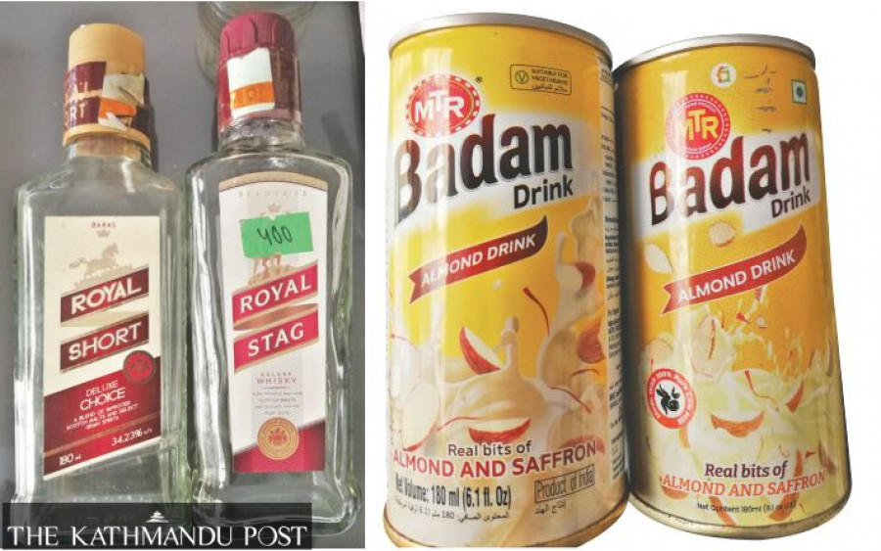
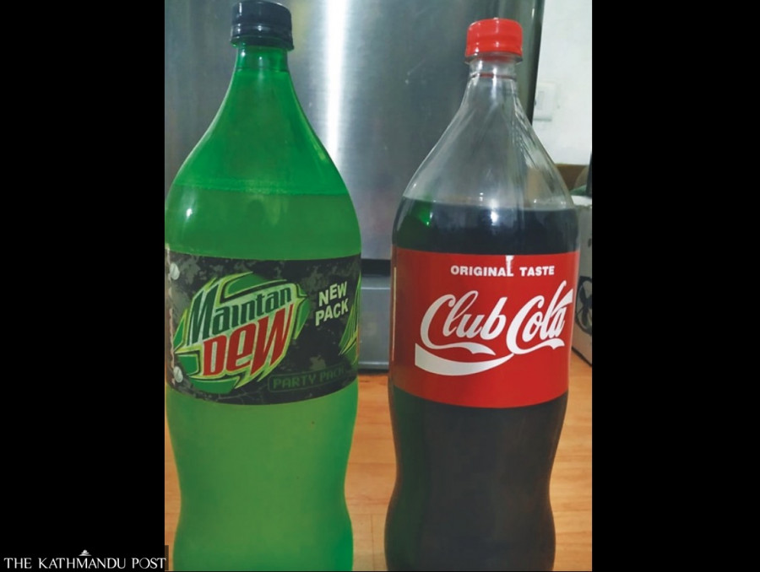

Slide 45
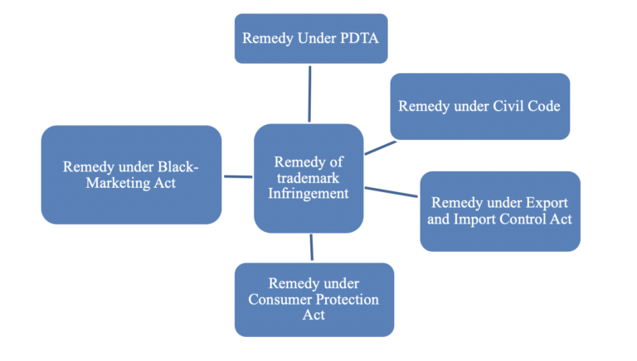
Remedies for Trademark Infringement
Various Acts provide various form of remedy against the infringement of Trademark. It is the option of the party to choose the best remedy depending upon the conditions.

Slide 46
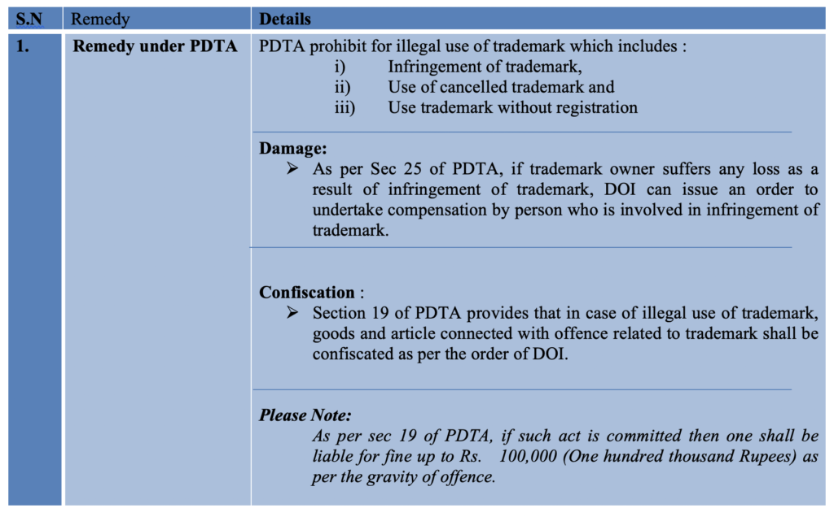

Slide 47
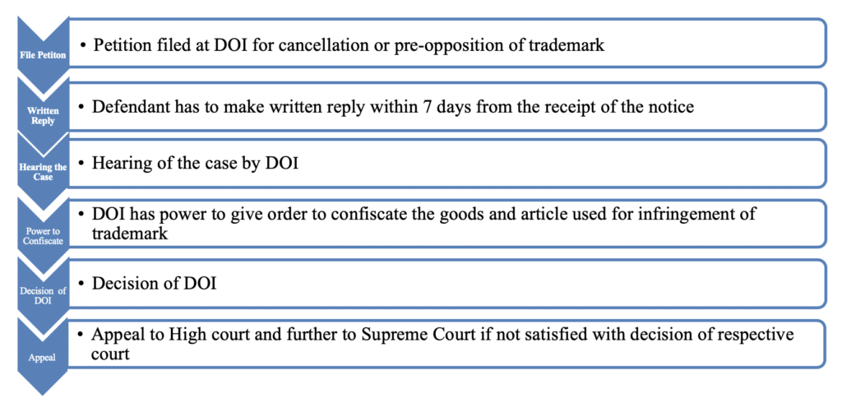

Slide 48
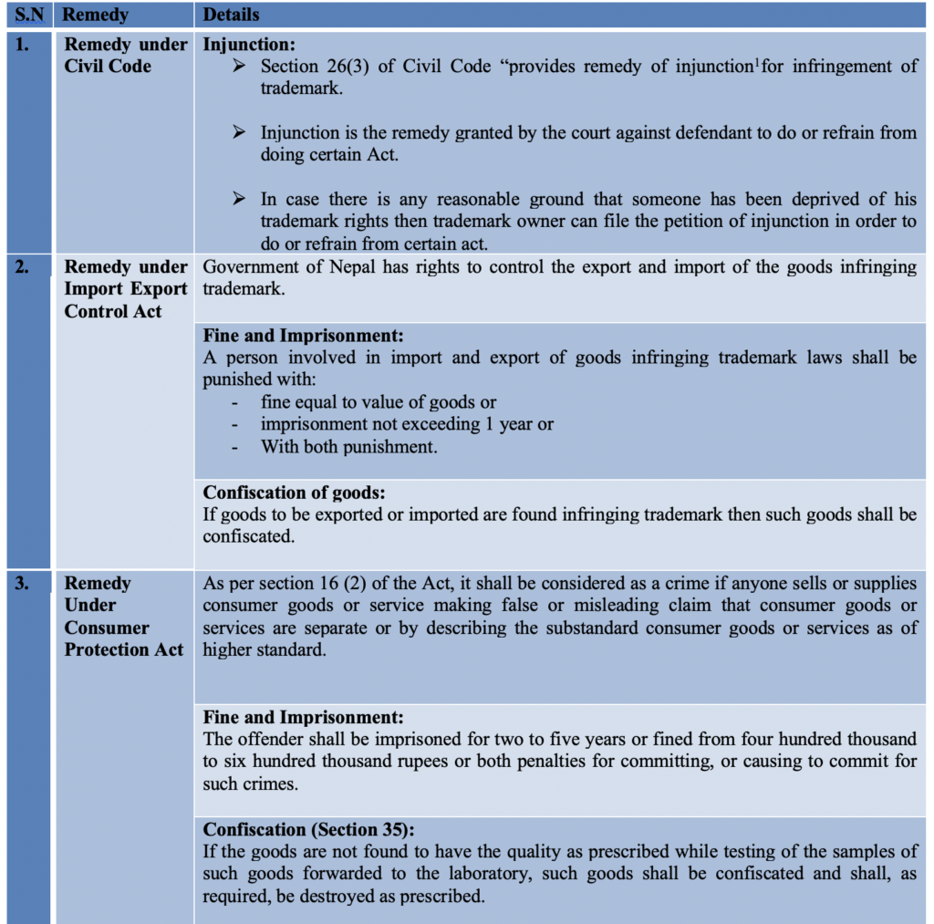

Slide 49
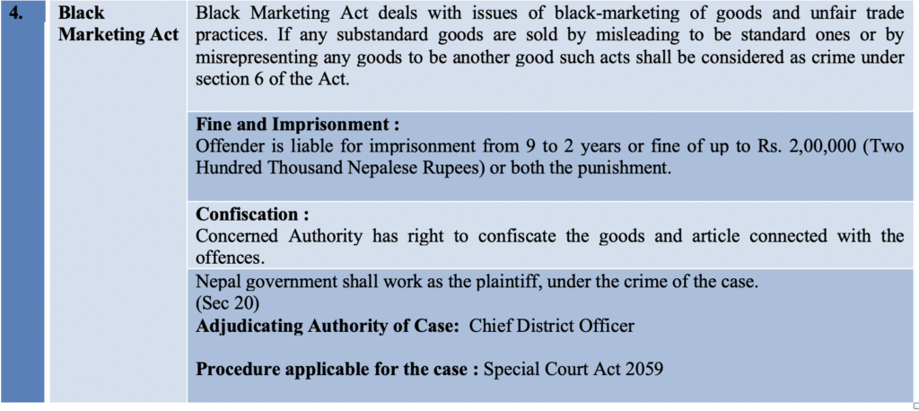

Slide 50
Cybersquatting
The term cybersquatting refers to the unauthorized registration and use of Internet domain names that are identical or similar to trademarks, service marks, company names, or personal names.
Cybersquatting registrants obtain and use the domain name with the bad faith intent to profit from the goodwill of the actual trademark owner.
Cybersquatting is registering, selling or using a domain name with the intent of profiting from the goodwill of someone else's trademark.
It generally refers to the practice of buying up domain names that use the names of existing businesses with the intent to sell the names for a profit to those businesses.
In a cybersquatting practice, the perpetrator registers and uses internet domain names that are identical or similar to company names (i.e., Go0gle.com instead of Google.com), personal names, trademarks, product names, service marks, and so on, with malicious intent to profit from the actual brand/trademark owner in one way or another.
Cyber Squatting is a word that has come to be linked with the registration of domain names without the objective of using them, in the names of popular brands or personalities exclusively for the purpose of making money.
The crux is that “name” belongs more appropriately to another entity. Secondly, the registrant is targeting to trade the name.

Slide 51
Types of cybersquatting
1. Typo-squatting
As the name suggests, typo-squatting relies on “typos,” typing mistakes made by internet users when typing a web address or URL into the web browser. Typo-squatting is one of the most common types of cybersquatting where the perpetrator intentionally registers misspelled domain names of established brands, for example:
Gogle.com
Gooogle.com
Googlee.com
There are also other variations of typo-squatting, for example, using other top-level domains (Google.net instead of Google.com), involving different phrasing of the domain name (i.e., Goggle.com), and so on.
Homograph attack, which leverages the visual similarity of symbols to confuse users (i.e., “w” and “vv”) is also a type of cybersquatting.
Typo-squatting attacks are also often accompanied by the perpetrator creating a fake website that resembles the legitimate website (i.e., similar layout, colors, content, logo placement, etc.) to further confuse the potential visitors.
The perpetrator can then launch further attacks, like spreading malware or forcing the legitimate trademark owner to buy the fake domain name to monetize their cybersquatting attempt.

Slide 52
2. Name-jacking
Name jacking is a type of cybersquatting attempt in which the perpetrator registers a domain name that can be associated with the name of an individual (typically famous people like celebrities, political figures, or influencers.)
The main objective of a name-jacking attack is to intercept the web traffic associated with this targeted individual.
As mentioned above, not all individual names can be trademarked. Individual names can be trademarked only when they have already acquired distinctiveness through long use or advertising (meaning, you must be famous first) and have established a secondary meaning by being well-known. For instance, the rights associated with using the name, “Michael Jordan”, are owned and trademarks by the man himself, giving him full control of its use, and the right to take legal action against anyone that misuses it.
So, there can be cases in which name jacking may fall outside the scope of ACPA and other legal regulations when the individual names cannot be registered as trademarks.

Slide 53
3. Identity theft
In an identity theft attack, the cyber-squatter purchases a legitimate domain that was not renewed (typically intentionally) by the trademark owner, allowing the cyber-squatter to assume the identity of the brand.
There are many techniques and technologies the perpetrators can use to launch an identity theft attack, but typically it involves using a special software solution that can perform real-time monitoring of the target domain’s expiry date.
The perpetrator can then link the purchased domain name with a fake website containing the duplicated content of the legitimate website (that now is abandoned by the owner or has a new address). This practice may effectively mislead visitors that think they are visiting the legitimate website of the previous domain owner.

Slide 54
4. Reverse-cybersquatting
Last but not least, reverse-cybersquatting is a specific type of cybersquatting in which a rightful trademark owner attempts to obtain a registered domain name currently owned by another company or person.
While this “should” be legal, in practice, reverse-cybersquatting may involve pressure, intimidation, and even abuse, forcing the current legitimate owner to transfer ownership of the domain name.
Depending on whether it’s performed ethically or not, reverse-cybersquatting may be considered illegal. It’s best for the legitimate trademark owner to follow the standard name dispute resolution procedures instead.

Slide 55
Ways to prevent cybersquatting
Register your trademark (or trademarks) as soon as possible
Know your legal protection
Buy more top-level domains (TLDs)
Pay attention to the domain expiry date
Invest in an anti-cybersquatting solution
Contact the website owner

