Slide 1
Unit 2 Cyber Attacks, Cybersecurity and Cyber Law
Adv. Rakshya Giri
BALLB, LLM,MA

Slide 2
Threat Landscape-Computer Incidents
During the last years, more and more digital products became part of our daily life. We talk to friends over social network sites, discuss with people from all over the world in internet forums and e-mail has widely replaced other communication methods.
More and more companies and governments offer digital products and services and most of our data is stored somewhere on a server. But the more we become dependent on digital products, the more we become vulnerable to attacks from cyber space. Cyber attacks can not only cause financial damage or loss of personal data, it is feared that cyber attacks which target hospitals and power plants or other elementary infrastructure of a nation can also cause fatal damages.
The threat landscape means the entire scope of potential and recognized cybersecurity threats affecting user groups, organizations, specific industries, or a particular time.
The threat landscape consists of the factors that pose a risk to each entity in their respective contexts.

Slide 3
The threat landscape changes both over time and as a result of events with a significant impact on the organization, group of people, or sector for which the threat landscape is defined. For example, as a result of 2020’s large-scale shift to work from home, attacks targeting remote-access tools have surfaced on many companies’ threat landscapes. The following factors, among others, influence the threat landscape:
The emergence and discovery of vulnerabilities that provide cybercriminals with new attack opportunities;
The release of new software versions with additional functionality;
The development of new hardware platforms, as well as the emergence of new approaches to data processing, such as the use of cloud services or edge computing;
Global events such as the COVID-19 pandemic compelling organizations to make major changes to their infrastructure.

Slide 4
The threat landscape is usually thought of as including the vulnerabilities, malware, and specific groups of attackers and their techniques that represent a danger in a given context.
Threat landscape analysis makes it possible to see potential information security problems facing a specific entity — a company, an individual, or a whole sector — and to take preventive measures by adopting a proactive approach to information security.
The threat landscape is the entirety of potential and identified cyberthreats affecting a particular sector, group of users, time period, and so forth.
The threat landscape consists of the factors that pose a risk to each entity in their respective contexts.

Slide 5
The main factors contributing to the dynamic threat landscape include:
The main factors contributing to the dynamic threat landscape include:
Increasingly sophisticated tools and attack methods;
Greater reliance on information technology products and services, such as SaaS offerings;
Networks that encourage and enable the distribution of cybercrime profits, such as the dark web;
Greater availability of skills, personnel, and finances to drive cyber attacks;
External factors, such as a global pandemic or financial crisis;
Faster software releases with added functionality;
New hardware development, such as Internet of Things (IoT) devices.

Slide 6
Current threat landscape and incidents in Nepal
Currently there are no proper organization or mechanism dealing with detection, tracking and mitigation of cyberattacks and cybercrime at national level.
Isolated cases are treated on an ad-hoc basis either by the Police, ISPs or computer related departments in the government.
There are no mechanism or an institution to track or monitor cybercrimes in the country.
The people of Nepal are not aware of who to report computer related crimes or breaches and most of them go to the Police.
Currently cybersecurity incidents are handle by the police and organizations which has some the capability.

Slide 7
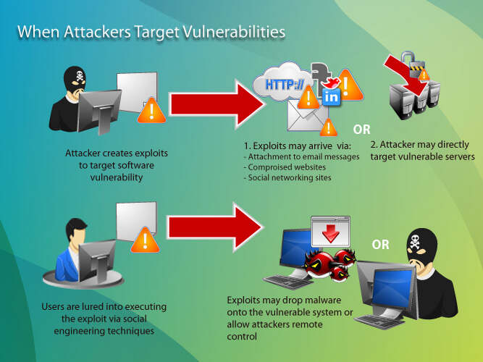
Introduction of Exploits

Slide 8
Introduction of Exploits
A computer exploit, or exploit, is an attack on a computer system, especially one that takes advantage of a particular vulnerability the system offers to intruders.
In simpler term, exploit refers to the act of successfully making such an attack. An exploit takes advantage of a weakness in an operating system, application or any other software code, including application plug-ins or software libraries. The owners of the code typically issue a fix, or patch, in response.
Users of the system or application are responsible for obtaining the patch, which can usually be downloaded from the software developer on the web, or it may be downloaded automatically by the operating system or application that needs it. Failure to install a patch for a given problem exposes the user to a computer exploit and the possibility of a security breach.

Slide 9

A computer exploit is a piece of code or software that identifies security flaws in applications, systems, and networks and takes advantage of them for the benefit of cybercriminals.
It is a specialized programs or snippets of code that take advantage of a software vulnerability or security flaw.
It is a tool that allows a hacker to leverage a security vulnerability for their own ends. If one can program it, and if it takes advantage of a software or hardware vulnerability, then it’s a security exploit.

Slide 10
Types of Exploits

Slide 11
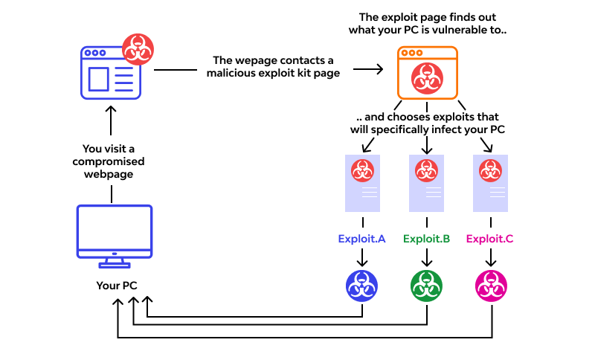

Slide 12
Types of Exploits
Normally bundled with other software and distributed as part of a kit, computer exploits are typically hosted on compromised websites. Hackers may send out phishing emails to trick potential victims into visiting these websites.
When you visit one such site, the exploit kit hosted on it will secretly scan your computer to determine which operating system you’re running, what software you’re using, and whether any of them have some security flaws or vulnerabilities that the attacker can use to access your computer.
As a rule, most exploits target commonly installed browser plug-ins like Microsoft Silverlight, Adobe Flash, and Java. Before it was discontinued by Microsoft in 2016, Internet Explorer was also a common exploit target.

Slide 13
General Types of Exploits
1. Known Exploits
As the name suggests, known exploits are computer exploits that have already been investigated and identified by cybersecurity experts. Since they are known and well-documented, developers can create patches to fight these exploits and fix the flaws that they are targeting. When the patches are released, the release info usually will typically include a full list of issues that have been fixed in the latest version.
Despite the fact that the targeted security flaws are easily rectified, some of these exploits manage to persist long after they have been discovered. The reason for this is quite simple: with dozens of pieces of software installed on their machines, computer owners may find it hard to keep up with all the security patches and fixes, so they opt to update the software at irregular intervals rather than daily or weekly.

Slide 14
2. Unknown Exploits
Unknown exploits are computer exploits that haven’t yet been identified, researched, and reported on by cybersecurity experts. This could either mean that cybercriminals are the only ones aware of the flaws targeted by these exploits or that software developers couldn’t create a fix for this issue as fast as hackers could build a corresponding exploit kit. Also known as zero-day vulnerabilities, these flaws can sometimes take months to rectify, which gives hackers plenty of opportunities to distribute malware.
Unlike known exploits, there is often nothing you can do to prevent unknown exploits from targeting your machine. Even if you’re using up-to-date software, hackers can still take advantage of its flaws to breach your security. This is why they are always on the lookout for user reports on the most recently detected security flaws before developers have had a chance to analyze them and create a patch.

Slide 15
Specific Types of Exploits
Hardware: This elaborates poor encryption, absence of board design, or firmware weakness.
Software: These dangers incorporate memory security infringement (support floods, over-peruses, hanging pointers), input approval blunders (code infusion, cross-site prearranging (XSS), index crossing, email infusion, design string assaults, HTTP header infusion, HTTP reaction parting, SQL infusion), advantage disarray bugs (clickjacking, cross-site demand falsification, FTP ricochet assault), race conditions (symlink races, season of-check-to-season of-utilization bugs), side-channel assaults, timing assaults and UI disappointments (accusing the person in question, race conditions, cautioning weariness).

Slide 16
‍Network: They incorporate decoded correspondence lines, man-in-the-center assaults, area capturing, typo squatting, helpless organization security, absence of verification or default passwords.
‍Personnel: They incorporate poor enrolling strategy and interaction, absence of safety mindfulness preparing, helpless adherence to data security strategy, helpless secret word the board or succumbing to normal social designing assaults like phishing, skewer phishing, pretexting, honey catching, smishing, water-holding, or whaling.
‍Physical site: They incorporate poor actual security, closely following, and absence of keycard access control.

Slide 17
Examples of Computer Exploit
Cybersecurity experts regularly track the activity of known computer exploits to assess how big of a threat they pose and determine how hackers are using them for their own personal or financial benefit. Some of the most active exploit kits in the last few months include the following:
1. Rig
First launched in 2017, Rig is by far one of the most successful exploit kits. Combining technologies like Flash and DoSWF to mask the attack, it is used by hackers to distribute ransomware and banking Trojans. Distributed as part of so-called “malvertising” campaigns (malware posing as advertising), Rig has experienced a gradual decline in activity since April 2017, but still remains widely used across the globe.

Slide 18
2. GreenFlash Sundown
GreenFlash Sundown is an updated version of Sundown, an exploit kit that was among the most active in the world before it went missing in April 2017. Discovered in October 2017, GreenFlash Sundown has an anti-analysis feature that prevents most anti-malware programs from detecting it. Distributed via a network of compromised OpenX ad servers, this threat is particularly active in South Korea and Taiwan.
3. Fallout
Active across Europe and Asia, Fallout scans a potential victim’s browser for vulnerabilities and uses multiple 302 redirects to take them to a fake advertising page that will initiate malware download. Discovered in August 2018, this is one of the newest exploit kits that utilize the same URI patterns as the now-neutralized Nuclear kit. The patterns change all the time, which makes Fallout very hard to detect.

Slide 19
4. Magnitude
Magnitude remains one of the few exploit kits to use a fileless payload, which means that it extracts malware into a legitimate-looking executable file (.exe) that usually cannot be detected by anti-malware programs. Like GreenFlash Sundown, Magnitude is particularly active in South Korea and Taiwan. This kit is also known for delivering Magniber, a strain of ransomware that focuses solely on South Korea.
5. GrandSoft
With Rig on the decline, GrandSoft could soon become the most active exploit kit. Characterized by a somewhat static backend infrastructure, GrandSoft is distributed via JavaScript-enhanced malvertising campaigns and doesn’t target any particular territory. Like most other currently active exploit kits, it is primarily used to deliver ransomware and other types of malicious software to unsuspecting victims.

Slide 20
Ways to protect computer from Exploits
Update all the software on your computer on a regular basis
Use the best antivirus software that automatically checks for and installs database and definition updates and allows to set up scheduled scans.
Practice safe browsing habits
Never click on links or attachments sent from unknown email addresses
Do not download software or any other files from unknown websites
Uninstall Flash and Java browser plug-ins, as well as any others that you’re not using.
Back up files

Slide 21
Some of the common types of cybercrimes are related to:
Finance
Viruses and worms
Scams
Frauds
Phishing
Nepal needs to have focal point for incident reporting and handling such as a National Computer Incident Response Team (CIRT).
While there is a definite need for a National Cybersecurity Awareness Program, there is a need for dedicated agency for incident handling and response as such formal institution will have able to provide proactive and reactive services with highly specialized knowledge and skillset.
As the National CIRT will also act as trusted party to the government, businesses and people at large as it is seen as critical service provider. They will also act as a channel for communicating awareness messages and provide advisory services for organizations, including sharing of best practices and guidelines.

Slide 22
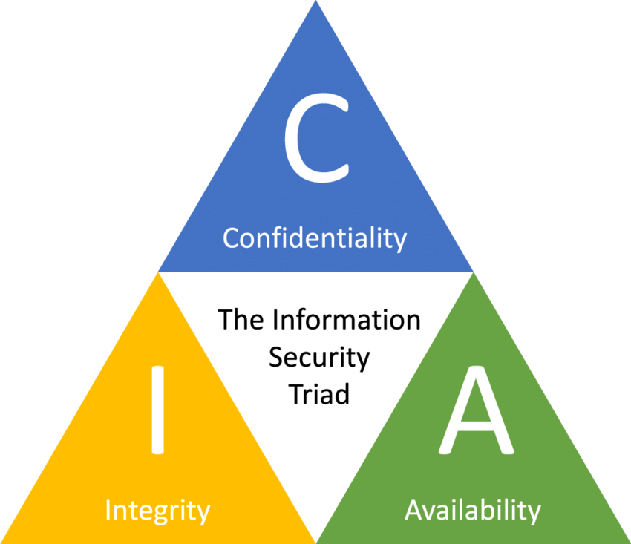
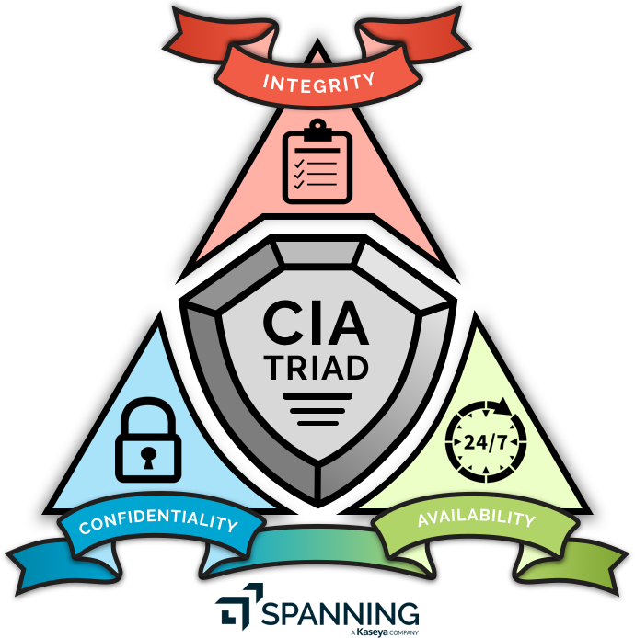
CIA Security Triad; Confidentiality, Integrity, and Availability

Slide 23
CIA Security Triad; Confidentiality, Integrity, and Availability
The three letters in "CIA triad" stand for Confidentiality, Integrity, and Availability. The CIA triad is a common model that forms the basis for the development of security systems. They are used for finding vulnerabilities and methods for creating solutions.
The confidentiality, integrity, and availability of information is crucial to the operation of a business, and the CIA triad segments these three ideas into separate focal points. This differentiation is helpful because it helps guide security teams as they pinpoint the different ways in which they can address each concern.
The CIA triad is widely accepted as a model in information security. It’s not a singular doctrine and there was no one author. Rather the model appears to have developed over time, with roots as old as modern computing, pulling concepts from various sources.

Slide 24
Confidentiality
Confidentiality or privacy refers to measures taken to guarantee that data — particularly sensitive data that is protected from unauthorized access.
Confidentiality is roughly equivalent to privacy. Confidentiality measures are designed to prevent sensitive information from unauthorized access attempts. It is common for data to be categorized according to the amount and type of damage that could be done if it fell into the wrong hands.
More or less stringent measures can then be implemented according to those categories.
Sometimes safeguarding data confidentiality involves special training for those privy to sensitive documents. Training can help familiarize authorized people with risk factors and how to guard against them.
Further aspects of training may include strong passwords and password-related best practices and information about social engineering methods to prevent users from bending data-handling rules with good intentions and potentially disastrous results.

Slide 25
A good example of methods used to ensure confidentiality is requiring an account number or routing number when banking online. Data encryption is another common method of ensuring confidentiality.
User IDs and passwords constitute a standard procedure; two-factor authentication (2FA) is becoming the norm.
Other options include Biometric verification and security tokens, key fobs or soft tokens.
In addition, users can take precautions to minimize the number of places where information appears and the number of times it is actually transmitted to complete a required transaction.
Extra measures might be taken in the case of extremely sensitive documents, such as storing only on air-gapped computers, disconnected storage devices or, for highly sensitive information, in hard-copy form only.

Slide 26
Integrity
Integrity pertains to safeguarding the accuracy of data as it moves through your workflows.
It not only includes protecting data from unauthorized deletion or modification, but also should contain measures to quickly reverse the damage if a breach were to occur.
Integrity involves maintaining the consistency, accuracy and trustworthiness of data over its entire lifecycle.
Data must not be changed in transit, and steps must be taken to ensure data cannot be altered by unauthorized people (for example, in a breach of confidentiality)
These measures include file permissions and user access controls. Version control may be used to prevent erroneous changes or accidental deletion by authorized users from becoming a problem.
In addition, organizations must put in some means to detect any changes in data that might occur as a result of non-human-caused events such as an electromagnetic pulse (EMP) or server crash.

Slide 27
Integrity focuses on the accuracy, consistency, and trustworthiness of data over its entire lifecycle.
It ensures that information remains unaltered and reliable.
Techniques like data validation, checksums, digital signatures, and access controls help maintain data integrity, preventing unauthorized modifications or corruption.
Data might include checksums, even cryptographic checksums, for verification of integrity. Backups or redundancies must be available to restore the affected data to its correct state.
Furthermore, digital signatures can be used to provide effective nonrepudiation measures, meaning evidence of logins, messages sent, electronic document viewing and sending cannot be denied.

Slide 28
Availability
Availability means information should be consistently and readily accessible for authorized parties. This involves properly maintaining hardware and technical infrastructure and systems that hold and display the information.
This is best ensured by rigorously maintaining all hardware, performing hardware repairs immediately when needed and maintaining a properly functioning operating system (OS) environment that is free of software conflicts.
Availability ensures that authorized users have timely and uninterrupted access to information and resources when needed.
It involves protecting systems from disruptions, ensuring proper functionality, and implementing redundancy or backup systems to mitigate the impact of potential failures or attacks.

Slide 29
It's also important to keep current with all necessary system upgrades. Providing adequate communication bandwidth and preventing the occurrence of bottlenecks are equally important tactics.
Fast and adaptive disaster recovery is essential for the worst-case scenarios; that capacity relies on the existence of a comprehensive DR plan.
Use preventive measures such as redundancy, failover and RAID. Ensure systems and applications stay updated.
Use network or server monitoring systems.
Ensure a data recovery and business continuity (BC) plan is in place in case of data loss.
Safeguards against data loss or interruptions in connections must include unpredictable events such as natural disasters and fire.
To prevent data loss from such occurrences, a backup copy may be stored in a geographically isolated location, perhaps even in a fireproof, waterproof safe. Extra security equipment or software such as firewalls and proxy servers can guard against downtime and unreachable data blocked by malicious denial of service(DoS) attacks and network intrusions.

Slide 30
Implementation of CIA at Organization, Network, Application and High End Users
In implementing the CIA triad, an organization should follow a general set of best practices. Some best practices, divided by each of the three subjects, include:
Confidentiality
Data should be handled based on the organization's required privacy.
Data should be encrypted using 2FA.
Keep access control lists and other file permissions up to date.
Integrity
Ensure employees are knowledgeable about compliance and regulatory requirements to minimize human error.
Use backup and recovery software.
To ensure integrity, use version control, access control, security control, data logs and checksums.
The CIA Triad, in a way, helps make sense of the diverse security techniques, software, and services available. Rather than a shot in the dark, it helps to clearly draw a picture of what is exactly required that will address the security concerns.
The CIA Triad is a well-known, venerable model for the development of security policies used in identifying problem areas, along with necessary solutions in the arena of information security.

Slide 31
Pros of the CIA triad
Simplicity: This model is straightforward and gives a clear, easy-to-understand principles, reducing the risk of human error.
Balanced: This model’s focus on availability helps security leaders make decisions that satisfy business and security needs.
Open-ended: There’s no permanent goal or status that we’re aiming for with this model, which is helpful as an organization grows and brings in new devices or upgrades data infrastructures.
Cons of CIA triad
Limited: The CIA triad model is best used when considering data, and so it might not be the right tool to protect against social engineering or phishing attacks targeting employees.
Lack of specificity: The model’s simplicity may also be a struggle for organizations with less security knowledge or starting from scratch
Not holistic: It should be used alongside other models and frameworks to help to establish robust processes and make effective decisions.

Slide 32
History of the CIA triad
The concept of the CIA triad formed over time and does not have a single creator. Confidentiality may have first been proposed as early as 1976 in a study by the U.S. Air Force. Likewise, the concept of integrity was explored in a 1987 paper titled "A Comparison of Commercial and Military Computer Security Policies" written by David Clark and David Wilson. The paper recognized that commercial computing had a need for accounting records and data correctness. Even though it is not as easy to find an initial source, the concept of availability became more widespread one year later in 1988.
By 1998, people saw the three concepts together as the CIA triad.

Slide 33
CIA at Organization
In implementing the CIA triad, an organization should follow a general set of best practices. Some best practices, divided by each of the three subjects, include:
Confidentiality
Data should be handled based on the organization's required privacy.
Data should be encrypted using 2FA.
Keep access control lists and other file permissions up to date.

Slide 34
Integrity
Ensure employees are knowledgeable about compliance and regulatory requirements to minimize human error.
Use backup and recovery software.
To ensure integrity, use version control, access control, security control, data logs and checksums.

Slide 35
Availability
Use preventive measures such as redundancy, failover and RAID. Ensure systems and applications stay updated.
Use network or server monitoring systems.
Ensure a data recovery and business continuity (BC) plan is in place in case of data loss.

Slide 36
CIA at Network
The CIA triad encompasses a wide range of network threats.
Network security is part of the enterprise’s risk management responsibilities within the overall business policy mechanisms. Every company has to determine the acceptable levels of risk and vulnerabilities that are actually based on the value of the corporate assets. Enterprises should also define the risk probability and the reasonable expectation of quantifiable loss in case of a security compromise.
Network designers and engineers play a key role in developing these security policies; however, this does not extend to the security implementation phase.
When a network engineer is in the process of attack recognition and identifying countermeasures for those specific attacks, he should consider and plan for the worst situations because modern networks are large, and they can be susceptible to many security threats. The applications and systems in these organizations are often very complex, and this makes them difficult to analyze, especially when the company uses Web applications and services.

Slide 37
A network engineer must understand the real threats to the network infrastructure (e.g., risk assessment or business impact analysis) before he can offer security consultancy services. We will analyze different categories of threats to confidentiality, integrity, and availability, including:
Denial of Service (DoS) and Distributed Denial of Service (DDoS) attacks
Spoofing (masquerading)
Telnet attacks
Password cracking programs
Viruses
Trojans and worms
These threats must be analyzed in the context of the network areas they affect and considering the exact system component they target.

Slide 38
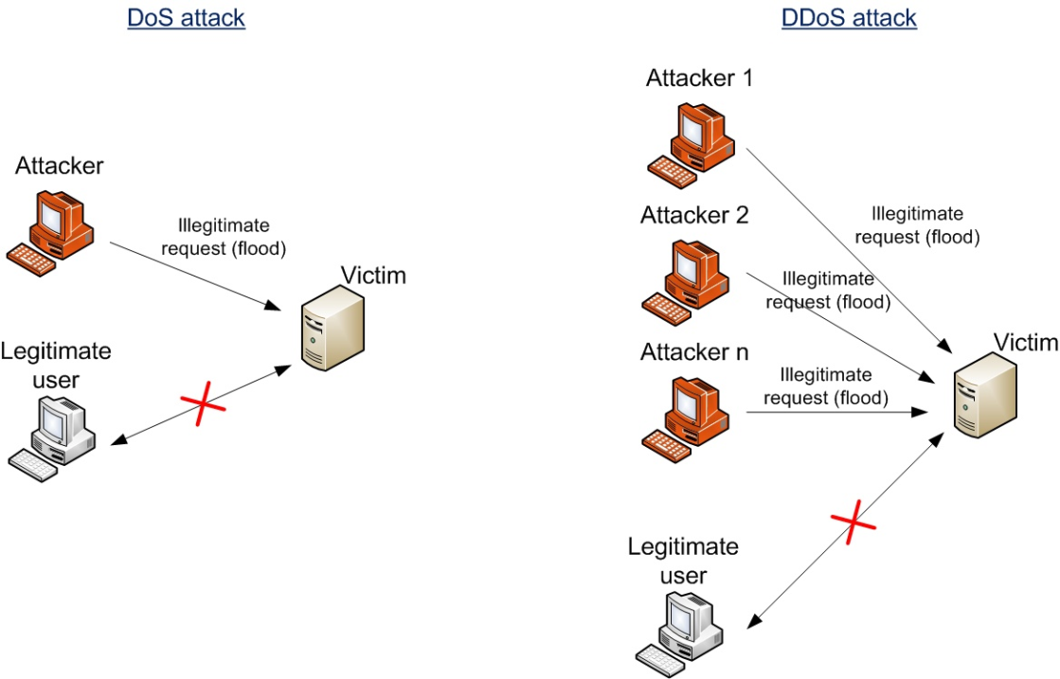
Denial of Service(DoS) Attack

Slide 39
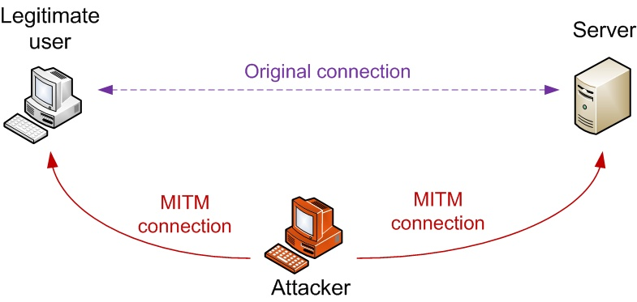
Spoofing (masquerading)

Slide 40
CIA at Application
Authentication Methods
Two-Factor Authentication requires the user to provide two types of credential before being able to access an account : the two credentials can be any of the followings:
PIN or Password
Some form of Security card or token
Such as a biometric (For Example, a fingerprint or retinal scan)
User Roles or Accounts
Data Encryption
Enterprise resource planning(ERP),Customer Relationship Management(CRM)Product Lifecycle Management(PLM).

Slide 41
CIA at End-User Level
Security Education
Guarding the password s to protect against unauthorized access to the accounts.
Prohibiting others from using their-password.
Appling Strict Access controls(File and Directory permissions) to protect data from disclosure or destruction.
Reporting all unusual activities to the organization’s IT Security group.
Taking care to ensure that portable computing and data storage devices are protected(thousands of Laptops are stolen every year)
Authentication Methods
Anti-virus Software
Data Encryption

Slide 42
Response to cyber attacks
Over the past years, the size and magnitude of cyber security breaches have increased. More often we tend to underestimate the possibility of falling prey to a cyber attack. Small businesses feel like they’re too small to be attacked and larger companies like to believe that they have all the right protective measures in place to stay safe from cyber attacks.
In the case of a larger company, a security breach could just mean a negative reputation and financial losses that can be eventually covered. But for a smaller company, it can mean the end of their business if it’s not addressed in the correct way.
In reality, the amount of security in place or the scale of a business does not decrease the chances of falling prey to a cyber attack.
Companies should have a clear understanding of how to respond and recover from a cyber-attack. The default should be to turn to your cyber security incident response plan to take action immediately and better contain or reduce the impact of a cyber-attack.

Slide 43
Protection of Evidences and Activity Log
Organizations should document all details of a security incident as it works to resolve the incident
Documentation captures valuable evidence for a future prosecution
And provides data to help during the incident eradication and follow-up phases
Organizations should establish a set of document-handling procedures using the legal department as a resource
Protection of Evidence and Activity Logs
Organizations should document all details of a security incident as it works to resolve the incident
Documentation captures valuable evidence for a future prosecution
And provides data to help during the incident eradication and follow-up phases
Organizations should establish a set of document-handling procedures using the legal department as a resource

Slide 44
Incident Containment
The incident response plan should clearly define the process for deciding if an attack is dangerous enough to warrant shutting down or disconnecting critical systems from the network
Elements of an effective response plan:
How decisions for shutting down systems is made
How fast those decisions are made
Who makes them
Incident Containment

Slide 45
Eradication
Before eradication, the IT security group must:
Collect and log all possible criminal evidence from the system
Verify that all necessary backups are current, complete, and free of any malware
Create a forensic disk image of each compromised system
After eradication, a new backup must be created
A log should be kept of all actions taken
All backups should be created with enough frequency to enable a full and quick restoration of data
If an attack destroys the original

Slide 46
Incident Follow-upUsing an MSSP(Managed Security Service Provider)
Determining how the organization’s security was compromised
A review to determine exactly what happened and to evaluate how the organization responded
A detailed chronology of all events
An estimate of the monetary damage
A decision on how much effort should be put into capturing the perpetrator

Slide 47
A company that monitors, manages, and maintains computer and network security for other organizations
Includes companies such as AT&T, Computer Sciences Corporation, Dell SecureWorks, IBM, Symantec, and Verizon
Some MSSPs provide vulnerability scanning and Web blocking and filtering capabilities using a Managed Security Service Provider (MSSP)
A decision on whether it has an ethical or a legal duty to inform customers or clients of a cyber attack

Slide 48
Identify the threat
It’s important to understand the extent of an attack, its source and take further measures to limit its severity. There are a number of questions that IT team should be finding answers to.
Who had access to it internally?
How was the attack initiated?
Are any online resources unavailable or having performance issues?
Are any files inaccessible?
What information was accessed?
Who may have been affected?
Which network connections were active when the breach occurred?
Have access credentials been changed?
Is any system functioning abnormally?
Are further business functions being affected with time?

Slide 49
Computer Forensics
Forensics is the process of using scientific knowledge for collecting, analyzing, and presenting evidence to the courts.
Forensics deals primarily with the recovery and analysis of latent evidence.
computer forensics is a new discipline, there is little standardization and consistency across the courts and industry.
Computer forensics is a relatively new discipline to the courts and many of the existing laws used to prosecute computer-related crimes, legal precedents, and practices related to
computer forensics are in a state of flux.
A discipline that combines elements of law and computer science to identify, collect, examine, and preserve data from computer systems, networks, and storage devices in a manner that preserves the integrity of the data gathered
Computer forensics investigators work as a team to investigate an incident and conduct the forensic analysis
Proper handling of computer forensics investigation is the key to fighting computer crime successfully in a court of law

Slide 50
Numerous certifications exist:
CCE (Certified Computer Examiner), CISSP (Certified Information Systems Security Professional), CSFA (Cyber Security Forensic Analyst), and GCFA (Global Information Assurance Certification Certified Forensic Analyst)
Computer Forensics A discipline that combines elements of law and computer science to identify, collect, examine, and preserve data from computer systems, networks, and storage devices in a manner that preserves the integrity of the data gathered.
The application of investigation and analysis techniques to gather and preserve evidence from a particular computing device in a way that is suitable for presentation in a court of law.
Referred to as computer forensic science essentially is data recovery with legal compliance guidelines to make the information admissible in legal proceedings .

Slide 51
The goal of computer forensics is to perform a structured investigation and maintain a documented chain of evidence to find out exactly what happened on a computing device and who was responsible for it.
A field of technology that uses investigative techniques to identify and store evidence from a computer device. Often, computer forensics is used to uncover evidence that could be used in a court of law.
Computer forensics is primarily used for two separate purposes, investigation and data recovery. Computer forensics, a branch of digital forensic science, handles crime evidence legally found on computer hard drives and all digital storage files and software.

Slide 52
Importance of Computer Forensics
In the civil and criminal justice system, computer forensics helps ensure the integrity of digital evidence presented in court cases.
As computers and other data-collecting devices are used more frequently in every aspect of life, digital evidence and the forensic process are used to collect, preserve and investigate in solving crimes and other legal issues.
Digital evidence isn't just useful in solving digital-world crimes, such as data theft, network breaches and illicit online transactions.
It's also used to solve physical-world crimes, such as burglary, assault, hit-and-run accidents and murder.
Identify, collect, preserve, and analyze data in a way that preserves the integrity of the evidence collected so it can be used effectively in a legal case.

Slide 53
Businesses often use a multilayered data management, data governance and network security strategy to keep proprietary information secure. Having data that's well managed and safe can help streamline the forensic process should that data ever come under investigation.
Businesses also use computer forensics to track information related to a system or network compromise, which can be used to identify and prosecute cyber attackers.
Businesses can also use digital forensic experts and processes to help them with data recovery in the event of a system or network failure caused by a natural or other disaster.
Examine these digital files and content, to uncover and analyze the data for the reporting of facts and educated opinions about the information retrieved.

Slide 54
Types of computer forensics
Database forensics: The examination of information contained in databases, both data and related metadata.
Email forensics: The recovery and analysis of emails and other information contained in email platforms, such as schedules and contacts.
Malware forensics: Sifting through code to identify possible malicious programs and analyzing their payload. Such programs may include Trojan horses, ransomware or various viruses.
Memory forensics: Collecting information stored in a computer's random access memory (RAM) and cache.
Mobile forensics: The examination of mobile devices to retrieve and analyze the information they contain, including contacts, incoming and outgoing text messages, pictures and video files.
Network forensics: Looking for evidence by monitoring network traffic, using tools such as a firewall or intrusion detection system.

Slide 55
Conclusion
Computer crime is a serious and rapidly growing area of concern requiring management attention
Organizations must take strong measures to ensure secure, private, and reliable computing experiences for their employees, customers, and business partners.

Slide 56
Cyber Law
Cyber Law is the area that deals with the internet and technological and electronic elements, such as computers, software, hardware & information systems. It is also called internet law.
Cyber law refers to the relationship between the Internet and technical and electronic elements such as computers, software, hardware, and information systems.
Cyber law, also known as cybersecurity law or information technology law, encompasses legal regulations, policies, and practices concerning the internet, digital technology, data protection, and cybersecurity.
It's a broad field that addresses various legal issues related to the use of technology, online activities, digital transactions, and the protection of digital assets.
Cyber laws are fundamental. They provide security to not only the intellectual property of IT companies but also helps to maintain the privacy of internet users. They check the programs of corporates to make the internet a neutral platform, help to create standard models of use which helps to create tailored facilities to the citizens to boost the economy, and so on.

Slide 57
Cyber law refers to the relationship between the Internet and technical and electronic elements such as computers, software, hardware, and information systems.
Cyber Law also called IT Law is the law regarding Information-technology including computers and the internet. It is related to legal informatics and supervises the digital circulation of information, software, information security, and e-commerce.
It is a criminal activity using computers and the internet .
Any criminal activity that involves computer or network resources , equipment or targets or crime sites.
Crimes involving the use of information or the use of electronic means to increase crime fall within the scope of cyber crime.
Cyber crimes can be committed individually, appropriately and against the government.
Cyberlaw is the law that includes a variety of issues related to the internet and other communication technology, including intellectual property, privacy, freedom of expression, and jurisdiction.
Cyberlaw governs the legal issues of cyberspace. Cyberspace is the electronic medium of computer networks, in which online communication takes place.

Slide 58
Importance of Cyber Law
It covers all transactions over the internet.
It keeps eye on all activities over the internet.
It touches every action and every reaction in cyberspace.
It allows employees to work safely
It protects the personal information of the user
It protects productivity

Slide 59
Area of Cyber Law
Cyber laws contain different types of purposes. Some laws create rules for how individuals and companies may use computers and the internet while some laws protect people from becoming the victims of crime through unscrupulous activities on the internet. The major areas of cyber law include:
1. Fraud:
Consumers depend on cyber laws to protect them from online fraud. Laws are made to prevent identity theft, credit card theft, and other financial crimes that happen online. A person who commits identity theft may face confederate or state criminal charges. They might also encounter a civil action brought by a victim. Cyber lawyers work to both defend and prosecute against allegations of fraud using the internet.

Slide 60
2. Copyright:
The internet has made copyright violations easier. In the early days of online communication, copyright violations were too easy. Both companies and individuals need lawyers to bring an action to impose copyright protections. Copyright violation is an area of cyber law that protects the rights of individuals and companies to profit from their creative works.
3. Defamation:
Several personnel uses the internet to speak their mind. When people use the internet to say things that are not true, it can cross the line into defamation. Defamation laws are civil laws that save individuals from fake public statements that can harm a business or someone’s reputation. When people use the internet to make statements that violate civil laws, that is called Defamation law.
4. Harassment and Stalking:
Sometimes online statements can violate criminal laws that forbid harassment and stalking. When a person makes threatening statements again and again about someone else online, there is a violation of both civil and criminal laws. Cyber lawyers both prosecute and defend people when stalking occurs using the internet and other forms of electronic communication.

Slide 61
5. Freedom of Speech
Freedom of speech is an important area of cyber law. Even though cyber laws forbid certain behaviors online, freedom of speech laws also allows people to speak their minds. Cyber lawyers must advise their clients on the limits of free speech including laws that prohibit obscenity. Cyber lawyers may also defend their clients when there is a debate about whether their actions consist of permissible free speech.
6. Trade Secrets:
Companies doing business online often depend on cyber laws to protect their trade secrets. For example, Google and other online search engines spend lots of time developing the algorithms that produce search results. They also spend a great deal of time developing other features like maps, intelligent assistance, and flight search services to name a few. Cyber laws help these companies to take legal action as necessary to protect their trade secrets.
7. Contracts and Employment Law:
Every time you click a button that says you agree to the terms and conditions of using a website, you have used cyber law. There are terms and conditions for every website that are somehow related to privacy concerns.

Slide 62
Advantages of Cyber Law
Organizations are now able to carry out e-commerce using the legal infrastructure provided by the Act.
Digital signatures have been given legal validity and sanction in the Act.
It has opened the doors for the entry of corporate companies for issuing Digital Signatures Certificates in the business of being Certifying Authorities.
It allows Government to issue notifications on the web thus heralding e-governance.
It gives authority to the companies or organizations to file any form, application, or any other document with any office, authority, body, or agency owned or controlled by the suitable Government in e-form using such e-form as may be prescribed by the suitable Government.
The IT Act also addresses the important issues of security, which are so critical to the success of electronic transactions.
Cyber Law provides both hardware and software security.

Slide 63
Electronic Transaction Act of Nepal
This was the first cyber law in Nepal, introduced on September 2, 2063 to combat the cyber crimes caused due to sudden growth of internet and computer use in Nepali households at that time.
Before enactment of this law, all cyber crimes in Nepal were dealt under the country’s criminal code.
It deals with unauthorized use and adulteration of electronic records among other things.
According to this law, “Stealing, pirating or destroying someone else’s computer system or accessing it without proper authorization will result in 3 years of imprisonment or 2 thousand rupees fine or both.
Also, publication of illegal material in electronic form can land you in prison for 5 years or a fine of 1 hundred thousand rupees or both.”

Slide 64
The first cyber law was the Computer Fraud and Abuse Act (CFAA), which was enacted in 1986.
On the 30th Bhadra, 2061 B.S., a cyber law was developed to tackle computer crime and violence.
In 2004, Nepal passed the much-awaited Electronic Transaction and Digital Signature Act Ordinance known as Cyber Law of Nepal.
The Government Nepal issued electronic transaction ordinance 2061 in September 2004 as ordinance.
The government also passed the Electronic Transactions Act (ETA), 2063 (2008), and Electronic Transaction Regulations (ETR) in 2064 (2007).
The act deals with issues related to digital signature, intellectual property, cybercrime, etc.
The Act is dived into 12 sections and 80 clauses. This law keeps an eyeball on issues which are related to computer networks and cybercrime. It brings cyber criminals under the justice of law and penalizes them just like other crimes.
As per the Act, if anyone is found violating cybercrime, he/she will be punished for a minimum of 6 months to a maximum of 3 years in jail and has to pay minimum 50 thousand to maximum three lakhs as a penalty.

Slide 65
Electronic Transaction Act 2063 has 12 chapters:
Preliminary Statement
The provisions related to electronic records and digital signatures
Provisions relating to Dispatch, Receipt, and Acknowledgement of Electronic Records.
Provisions relating to controller and Certifying Authority
Provisions relating to Digital Signature and Certificates
Functions, Duties and Rights of Subscriber
Electronic record and government use of digital signature
Provisions relating to network service
Offence relating to computer
Provisions relating to Information Technology Tribunal
Provisions relating to Information technology Appellate Tribunal
Miscellaneous

Slide 66
The Electronic Transactions Act of Nepal broadly addresses the following key areas:
1. Legal Recognition of Electronic Records: It grants legal recognition to electronic records and documents, treating them similarly to physical documents.
2. Digital Signatures: The Act acknowledges the legal validity of digital signatures and outlines the requirements and standards for their use in electronic transactions.
3. E-Commerce: It provides a legal framework for electronic commerce (e- commerce) and electronic contracts, ensuring their enforceability and validity.
4. Liabilities and Offenses: The Act specifies liabilities and penalties for offenses related to unauthorized access, data tampering, and other cybercrimes.
5. Government Use of Electronic Records: It outlines the procedures for the use of electronic records and digital signatures in government transactions and communications.

