Slide 1
ASP.NET
It is a web framework designed and developed by Microsoft.
It is used to develop websites, web applications
It provides fantastic integration of HTML, CSS and JavaScript.
It was first released in January 2002.
ASP.NET is a web application framework developed and marketed by Microsoft to allow programmers to build dynamic web sites.
It allows you to use a full featured programming language such as C# or VB.NET to build web applications easily.
It is built on the Common Language Runtime (CLR) and allows programmers to write code using any supported .NET language.

Slide 2
ASP.NET Web Forms Server Controls
ASP.NET provides web forms controls that are used to create HTML components.
The following table contains the server controls for the web forms.
Control Name | Description
Label | It is used to display text on the HTML page.
TextBox | It is used to create a text input in the form.
Button | It is used to create a button.
LinkButton | It is used to create a button that looks similar to the hyperlink.
ImageButton | It is used to create an imagesButton. Here, an image works as a Button.
Hyperlink | It is used to create a hyperlink control that responds to a click event.
DropDownList | It is used to create a dropdown list control.
CheckBox | It is used to create checkbox.
RadioButton | It is used to create radio button.

Slide 3
ASP.NET Web Forms Label
This control is used to display textual information on the web forms.
It is mainly used to create caption for the other controls like: textbox.
To create label either we can write code or use the drag and drop facility of visual studio
This is server side control, asp provides own tag to create label.
The example is given below.
< asp:Label ID="Label1" runat="server" Text="Label" >
</asp:Label>

Slide 4
ASP.NET Web Forms TextBox
This is an input control which is used to take user input.
To create TextBox either we can write code or use the drag and drop facility of visual studio IDE.
This is server side control, asp provides own tag to create it. The example is given below.
< asp:TextBox ID="TextBox1" runat="server" ></asp:TextBox>
Server renders it as the HTML control
and produces the following code to the browser.
<input name="TextBox1" id="TextBox1" type="text">
Property | Description
BackColor | It is used to set background color of the control.
BorderColor | It is used to set border color of the control.
BorderWidth | It is used to set width of border of the control.
Font | It is used to set font for the control text.
ForeColor | It is used to set color of the control text.
Text | It is used to set text to be shown for the control.
Visible | To set visibility of control on the form.
Height | It is used to set height of the control.
Width | It is used to set width of the control.
MaxLength | It is used to set maximum number of characters that can be entered.
Readonly | It is used to make control readonly.

Slide 5
ASP.NET Web Forms Button
This control is used to perform events.
It is also used to submit client request to the server.
To create Button either we can write code or use the drag and drop facility of visual studio IDE.
This is a server side control and asp provides own tag to create it.
The example is given below.
< asp:Button ID="Button1" runat="server" Text="Submit" />
Server renders it as the HTML control and
produces the following code to the browser.
<input value="Submit" id="Button1" type="submit">
Property | Description
BackColor | It is used to set background color of the control.
BorderColor | It is used to set border color of the control.
BorderWidth | It is used to set width of border of the control.
Font | It is used to set font for the control text.
ForeColor | It is used to set color of the control text.
Text | It is used to set text to be shown for the control.
ToolTip | It displays the text when mouse is over the control.
Visible | To set visibility of control on the form.
Height | It is used to set height of the control.
Width | It is used to set width of the control.

Slide 6
ASP.NET Web Forms HyperLink
It is a control that is used to create a hyperlink.
We can use it to refer any web page on the server.
To create HyperLink either we can write code or use the drag and drop facility of visual studio IDE.
This control is listed in the toolbox.
This is a server side control and ASP.NET provides own tag to create it.
The example is given below.
< asp:HyperLink ID="HyperLink1" runat="server" Text="JavaTpoint" NavigateUrl="www.javatpoint.com" ></asp:HyperLink>
Server renders it as the HTML control and produces the following code to the browser.
<a id="HyperLink1" href="www.javatpoint.com">JavaTpoint</a>

Slide 7
ASP.NET Web Forms RadioButton
It is an input control which is used to takes input from the user.
It allows user to select a choice from the group of choices.
To create RadioButton we can drag it from the toolbox of visual studio.
This is a server side control and ASP.NET provides own tag to create it.
The example is given below.
< asp:RadioButton ID="RadioButton1" runat="server" Text="Male" GroupName="gender"/>
< /asp:RadioButton >

Slide 8
ASP.NET validation controls
ASP.NET validation controls validate the user input data to ensure that useless, unauthenticated, or contradictory data don't get stored.
ASP.NET provides the following validation controls:
RequiredFieldValidator
RangeValidator
CompareValidator
RegularExpressionValidator
CustomValidator

Slide 9
RequiredFieldValidator Control
The RequiredFieldValidator control ensures that the required field is not empty. It is generally tied to a text box to force input into the text box.
The syntax of the control is as given:
<asp:RequiredFieldValidator ID="rfvcandidate"
runat="server" ControlToValidate ="ddlcandidate"
ErrorMessage="Please choose a candidate" >
</asp:RequiredFieldValidator>

Slide 10
RangeValidator Control
The RangeValidator control verifies that the input value falls within a predetermined range.It has three specific properties:
Properties | Description
Type | It defines the type of the data. The available values are Double, Integer, and String etc.
MinimumValue | It specifies the minimum value of the range.
MaximumValue | It specifies the maximum value of the range.
<asp:RangeValidator ID="rvclass" runat="server" ControlToValidate="txtclass"
ErrorMessage="Enter your class (6 - 12)" MaximumValue="12"
MinimumValue="6" Type="Integer">
</asp:RangeValidator>

Slide 11
CompareValidator Control
The CompareValidator control compares a value in one control with a fixed value or a value in another control.
The basic syntax of the control is as follows:
<asp:CompareValidator ID="CompareValidator1" runat="server"
ErrorMessage="CompareValidator">
</asp:CompareValidator>

Slide 12
RegularExpressionValidator
The RegularExpressionValidator allows validating the input text by matching against a pattern of a regular expression. The regular expression is set in the ValidationExpression property.
<asp:RegularExpressionValidator ID="RegularExpressionValidator1" runat="server" ControlToValidate="txtEmail" Display="Dynamic" ErrorMessage="Not valid email" ForeColor="Red" SetFocusOnError="True" ValidationExpression="\w+([-+.']\w+)*@\w+([-.]\w+)*\.\w+([-.]\w+)*"></asp:RegularExpressionValidator>

Slide 13
Introduction to C#
C# is pronounced as "C-Sharp".
It is an object-oriented programming language provided by Microsoft that runs on .Net Framework.
C# was developed by Anders Hejlsberg and his team during the development of .Net Framework
Case sensitive,.cs is extension of c sharp file
By the help of C# programming language, we can develop different types of secured and robust applications:
WINDOWS APPLICATION: using console application or winform application.
MOBILE APPLICATIONS: for phones such as Nokia Lumia (built-in support) but we can use a third party tool or library called “XAMARIN” to create mobile applications for ANDROID and IOS as well.
WEB APPLICATON: using ASP.NET web forms or ASP.NET MVC.
GAMING APPLICATION
DATABASE APPLICATIONS

Slide 14
Features of C#
1) Simple
C# is a simple language in the sense that it provides rich set of library functions, data types etc.
2) Modern Programming Language
C# programming is based upon the current trend and it is very powerful and simple for building scalable, interoperable and robust applications.
3) Object Oriented
C# is object oriented programming language. OOPs makes development and maintenance easier where as in Procedure-oriented programming language it is not easy to manage if code grows as project size grow.(inheritance, encapsulation, etc)
4) Type Safe
C# type safe code can only access the memory location that it has permission to execute. Therefore it improves a security of the program. Eg. int a=“hello”;//error

Slide 15
.
5) Rich Library
C# provides a lot of inbuilt functions that makes the development fast.
6) Fast Speed
The compilation and execution time of C# language is fast.
7) Structured Programming Language
C# is a structured programming language in the sense that we can break the program into parts using functions. So, it is easy to understand and modify.
8)supports delegate, linq.

Slide 16
.NET FRAMEWORK
.NET is a programming framework created by Microsoft that developers can use to create applications more easily.
The .NET Framework is a software development platform that was introduced On 13 February 2002,
Microsoft launched the first version of the .NET Framework, referred to as the .NET Framework 1.0.
It provides a common platform to run an application that was built using the different language such as C#, Visual Basic, etc.
A programmer can develop applications using one of the languages supported by .NET.

Slide 17
It is basically a collection of libraries.
It has a number of pre-coded solutions that manage the execution of programs written specifically for the framework.
It is also used to create a console-based, mobile and web-based application that are available in Microsoft environment.
A framework is just a bunch of code that the programmer can call without having to write it explicitly.
It provides a controlled programming environment where software can be developed, installed and executed on Windows-based operating systems.
its application runs only to the windows platform.(ie.platform dependent)
The main objective of this framework is to develop an application that can run on the windows platform.

Slide 18
.NET framework features
.NET stands for ‘Network Enabled Technology’.
Easy development of different types of applications.
Rapid application development.
Multi-language support
Object oriented programming support.
easy and rich debugging support.
Memory management (automatic garbage collection).

Slide 19
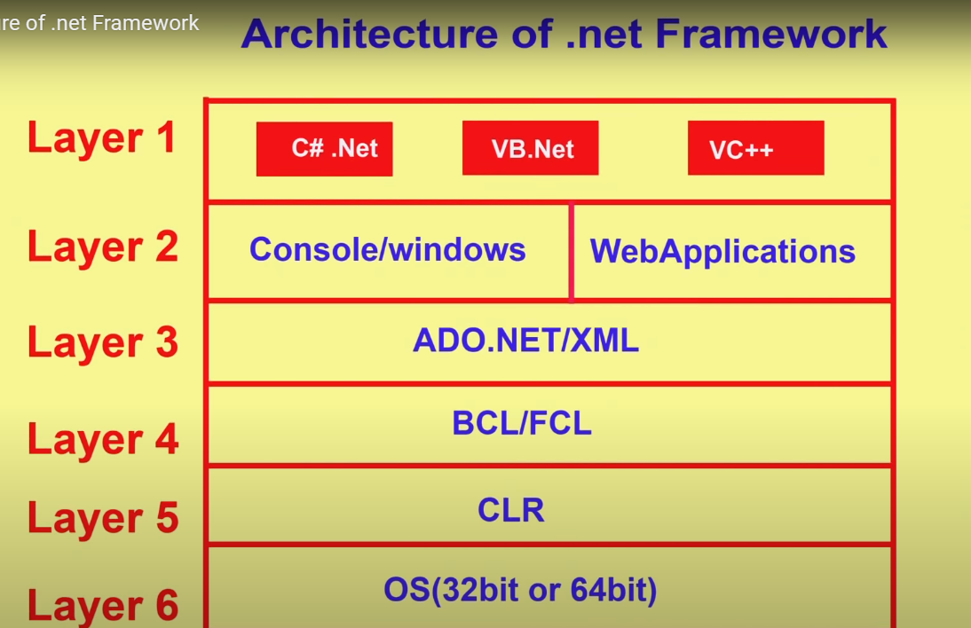
.NET Framework

Slide 20
Common Language Runtime(CLR)
CLR is a run-time environment that manages and executes the code written in any .NET programming language.
It converts code into native code which further can be executed by the CPU
When we write an application for the .NET framework with a language such as C# or visual basic .NET, our source code is never compiled directly into machine code.
Instead, the C# or visual basic compiler converts your code into a special language named MSIL(Microsoft Intermediate Language)
CLR handles the compiling the IL code to native code
CLR invoke the JIT compiler to convert IL code into native code.
The CLR converts the CIL code to the machine language code through Just-In-Time(JIT) compiler.

Slide 21
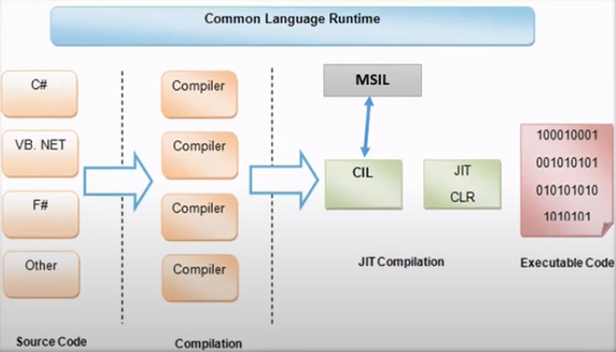

Slide 22
Functions of CLR
It converts the program into native code.
Handles Exceptions
Provides type-safety
Memory Management and garbage collection: this component performs automatic memory management. When any object is considered no longer to be in use, and then memory occupied by object will be released by garbage collection and give this space to operating system.
Improved performance
Language Independent
Provides language features such as inheritance, interfaces, and overloading for object oriented programming.
Debugging engine
Provides JIT compiler

Slide 23
Framework Class Library(FCL)
The .NET framework has a large collection of reusable classes for common and usual tasks that is called FCL.
FCL contains thousands of classes to provide access to common functions like string manipulation, input/output, common data structure, window programming, web programming etc.
It has large collection of built in functions
FCL work with any language under common language runtime(CLR) environment.

Slide 24
The framework class library was designed to make it easier to perform the most common programming tasks.
All classes of FCL are stored in different namespaces.
A namespace is simply a category, For example all classes for working a Microsoft SQL server database are located in the System.Data.SqlClient namespace.

Slide 25
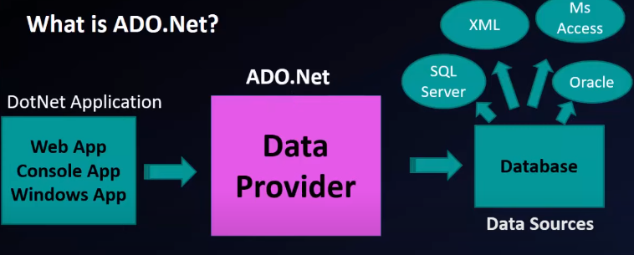
ADO.NET
ADO.NET is a module of .Net Framework which is used to establish connection between application and data sources.
Data sources can be such as SQL Server, MS-Access, Oracle and XML.
ADO.NET consists of classes that can be used to connect, retrieve,
insert and delete data.
ADO.NET SqlConnection Class
It is used to establish an open connection to the SQL Server database
ADO.NET SqlCommand Class
This class is used to store and execute SQL statement for SQL Server database.
ADO.NET SqlDataReader Class
This class is used to read data from SQL Server database.
ADO.NET DataSet
It is a collection of data tables that contain the data. It is used to fetch data

Slide 26
Object-oriented Programming Language | Object-based Programming Language
All the characteristics and features of object-oriented programming are supported. | All characteristics and features of object-oriented programming, such as inheritance and polymorphism are not supported.
These types of programming languages don't have a built-in object. | These types of programming languages have built-in objects. Example: JavaScript has a window object. Date object
C sharp,Java is an example of object-oriented programing language which supports creating and inheriting (which is reusing of code) one class from another. | VB is an example of object-based language as you can create and use classes and objects, but inheriting classes is not supported.

Slide 27
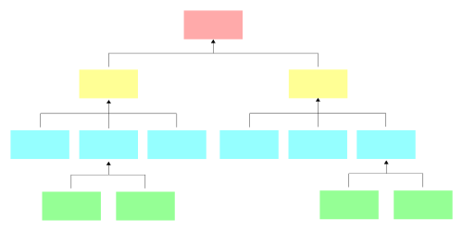
Procedural Oriented Programming | Object-Oriented Programming
In procedural programming, the program is divided into small parts called functions. | In object-oriented programming, the program is divided into small parts called objects.
Procedural programming follows a top-down approach The basic task of a top-down approach is to divide the problem into tasks and then divide tasks into smaller sub-tasks | Object-oriented programming follows a bottom-up approach. In this approach, bottom level modules developed first . Then the next module developed, tested and debugged. This process is continued until all modules have been completed.
There is no access specifier in procedural programming. | Object-oriented programming has access specifiers like private, public, protected, etc.
It focuses on functions. | It focuses on the data and classes.
It is not easy to maintain. | It is easy to maintain
In procedural programming, overloading is not possible. | Overloading is possible in object-oriented programming.
In procedural programming, there is no concept of data hiding and inheritance. | In object-oriented programming, the concept of data hiding and inheritance is used.

Slide 28
Procedural programming is used for designing medium-sized programs. | Object-oriented programming is used for designing large and complex programs.
Procedural programming uses the concept of procedure abstraction. | Object-oriented programming uses the concept of data abstraction.
Code reusability absent in procedural programming, | Code reusability present in object-oriented programming.
Examples: C, FORTRAN, Pascal, Basic, etc. | Examples: C++, Java, Python, C#, etc.

Slide 29
Scope of .net technology
A .NET Developer is a computer science expert who is well-versed in computer programming languages.
He uses Dot NET platform technologies to build, design, and implement software applications.
However, many such developers use C# as their preferred programming language for creating apps.
Also, they may develop apps for mobile, desktop, online, IoT, gaming, and machine learning platforms.
Besides creating the applications, they have multiple responsibilities like developing functioning code and detecting defects.

Slide 30
There is a great demand for .NET developers across the country. Many millennials want to be developers, but are unsure whether the language will benefit them in the long run.
NET technology has a promising future and is a language option to land a job in the Information technology domain. Though multiple technologies have come up to the market, current improvements and developments in this technology by Microsoft make it evergreen.

Slide 31
Responsibilities of Dot Net Developer
Dot Net Developer has to perform the responsibilities, which include the following:
Writing and modifying programming code
They have to build clean and accessible code using the .NET programming language.
In addition, the .NET developer must timely upgrade the existing software.
They should ensure that the applications and systems are evaluated, tested, and deployed in time. review, update, re-engineer and debug the codes
Apart from that, they should.
And create documentation across the life cycle of a system (SDLC).
At last, they should involve themselves in giving technological assistance.

Slide 32
.NET Core
.NET Core is a general-purpose framework that may be used to build software applications for Windows, Linux, and MacOS.
Unlike other software frameworks, .NET Core is the most versatile framework and can be used to build all kinds of software including Web applications, Mobile apps, Desktop applications, Games, and IoT applications.

Slide 33
Characteristics of .NET Core
Key characteristics of .NET Core include open source, cross-platform, modern, flexible, lightweight, fast, friendly, shareable, and built for future software development.
.NET Core is Free and Open Source.
The .NET Core platform is free and open source. Any developer can get involved in .NET Core development. There are thousands of active developers participating in .NET Core development who are improving features, adding new features, and fixing bugs and issues.
.NET Core is Cross-platform.
.NET Core supports and runs on Windows, macOS, and Linux operating systems

Slide 34
.
.NET Core is Modern.
Unlike some older frameworks, .NET Core is designed to solve today’s modern needs, including being mobile friendly, build once run it everywhere, scalable, and high performance. .NET Core is designed to build applications that target all kind of devices, including IoTs and gaming consoles.
NET Core is Fast.
.NET Core 3.0 is fast. Compared to the .NET Framework and .NET Core 2.2 and previous versions

Slide 35
 | .NET Framework | .NET Core
History | The .NET Framework was introduced in 2002 by Microsoft. | In 2014,Microsoft introduced .NET Core .
Open Source | .NET Framework is not fully open source. | .NET Core is open-source.
Cross-Platform | It works only on the Windows platform. This does not support cross-platform deployment. | It runs cross-platform like Windows, Linux, and macOS.
Performance | .NET Framework is less effective in comparison to .NET Core in terms of performance of applications. | .NET Core offers high performance compared to .NET Framework.
Compatibility | .NET Core is compatible with various operating systems — Windows, Linux, and Mac OS. | .NET Framework is compatible only with the Windows operating system.

Slide 36
Xamarin
Xamarin is a software company which is originated in 2011. Xamarin was recently acquired by Microsoft in 2016
It is a framework to develop a cross-platform mobile application using the C#.
It is used for building mobile applications for iOS, Android ,and windows .
It also open source platform.
Xamarin provides a wide range of tools to the developer that can be used for the development of the cross-platform mobile application.

Slide 37
.NET Standard
Let 's consider we have created an application using .NET Framework and used some shared libraries (which are developed by .NET Framework).
After some time, we have decided to create an application in .NET Core and try to re-use the above same shared library. Is it compatible and can we use it?
The Answer is NO.
We cannot use .NET Framework Base Class Library in .NET Core applications, because of compatibility issues.
Basically, the libraries which target to .NET Framework can only run in .NET Framework-based applications and the libraries which target to .NET Core can only run in .NET Core compatible applications.

Slide 38
What is the solution?
The solution is .NET Standard.
.NET Standard is a specification of the set of base class library which is compatible with any .NET platforms (which is either .NET Framework or .NET Core).
If we create the Base Class Library using .NET Standard, then it will run with any .NET Runtimes.
So, if you want to create a shared library that is going to be re-use later then you choose .NET Standard because it is portable with .NET Framework, .NET Core, and Xamarin as well.

Slide 39
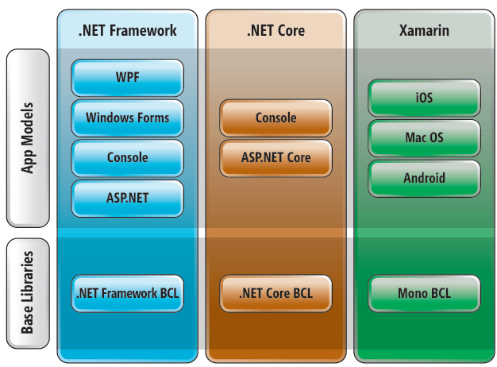

Slide 40
