Slide 1
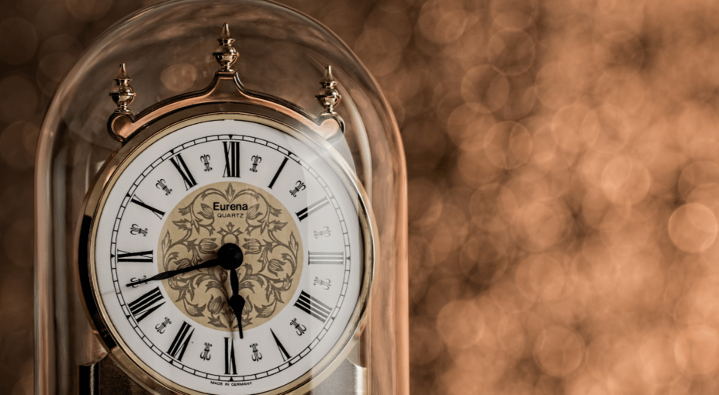
Time Managament System
-Raj Kumar karki

Slide 2
Introduction
Time management refers to managing time effectively
right can be done on right time

Slide 3
Why do we need time management ?
To save time
To Systematic
To acheive goal

Slide 4
Background of time
history of time (starting phase)
sundials, candle light
time (divide into two phase)

Slide 5
Problems of
time management
ancient time (no devices)
12 hours days only

Slide 6
Evolutions of time
Time devices like smart watch
Divided 24 into 12 hours (day & night)

Slide 7
Today’s world
Computers , mobile (time tracking)
Time scheduling (online system)

Slide 8
Thank you
For
Listening

