Slide 1


Early Prediction of Sepsis from Clinical Data
Prepared By: Guided By:
Raj Maharajwala (201703100810108) Ms. Palak V. Desai
Paawan Bhatt (201703100810118) Assistant Professor Amish Sharma (201703100810084) Dept. of Information B.Tech . IT (7th Semester) Technology, CGPIT. CGPIT.

Slide 2
Outline
Introduction
Motivation
Objective
Scope
Analysis for development
Modules
Diagrams
Technologies/Platform to be used for development
Implementation
Future work
References
Early Prediction of Sepsis from Clinical Data
2
Notes:
2

Slide 3
Introduction
Sepsis is a life-threatening illness caused by our body’s response to an infection.
The goal of this project is the prediction of sepsis six hours before the clinical prediction of sepsis using physiological data.
Early Prediction of Sepsis from Clinical Data
3

Slide 4
Motivation
Sepsis is a life threatening response to infection that can lead to death.
In the USA, more than 270,000 people die from sepsis. Internationally, 6 Million people die each year; each hour of delay in treatment can roughly increase mortality by 4-8 %. US hospitals spend 24 Billion each year on sepsis (13 % of Health Budget).
Early Prediction of Sepsis from Clinical Data
4

Slide 5
Objective
The goal of this project is to predict sepsis six hours before its onset using clinical data.
The final expected outcome is to accurately classify ‘SepsisLabel’ (‘1’ – meaning patient is suffering from sepsis & ‘0’ – meaning patient is not suffering from sepsis).
Early Prediction of Sepsis from Clinical Data
5

Slide 6
Scope
In this work, we address the problem of sepsis prediction using Long Short-Term Memory (LSTM), a recurrent neural network with specialized deep architecture.
We have followed the temporal approach that will take into consideration the time component of the data.
Early Prediction of Sepsis from Clinical Data
6

Slide 7









Analysis for development
Workflow:
Combine all Data
time dependent approach
Feature engineering
Handling data imbalance
Handling Missing values
Model Training
Classification
Model Evaluation
Figure 1 : Workflow of the project
Early Prediction of Sepsis from Clinical Data
7

Slide 8
Modules
Collection of reliable dataset
Feature selection
Data imbalance handling
Imputation using Predictive Mean Matching (PMM)
Data preparation
LSTM modeling
Model evaluation
Model deployment
Early Prediction of Sepsis from Clinical Data
8
*

Slide 9
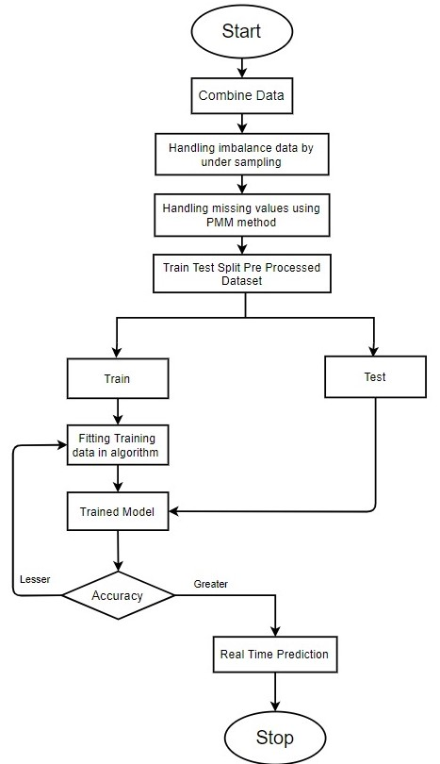
Diagram
Early Prediction of Sepsis from Clinical Data
Figure 2 : Data Flow Diagram
9

Slide 10
Technologies/Platform to be used for development
Hardware Requirement
- RAM: Minimum 8 GB
- Processor : Minimum 2GHz
- Hard Drive : Minimum 32 GB
- Storage : Minimum 1 GB Recommended Google Cloud
Early Prediction of Sepsis from Clinical Data
10

Slide 11
Technologies/Platform to be used for development (cont..)
Software Requirement
- R (RStudio) for preprocessing and data analysis.
- Python (Jupyter) for applying LSTM, data analysis and data visualization
- Django / Flask to deploy the model
Early Prediction of Sepsis from Clinical Data
11

Slide 12
Dataset
The data is sourced from ICU patients in two separate hospital systems and is obtained from ‘Physionet’ [1].
The data for each patient is contained within a single pipe delimited text file. Each row in a psv file represent a single hour’s worth of data. In total, there are 40,000 patients.
Early Prediction of Sepsis from Clinical Data
12

Slide 13
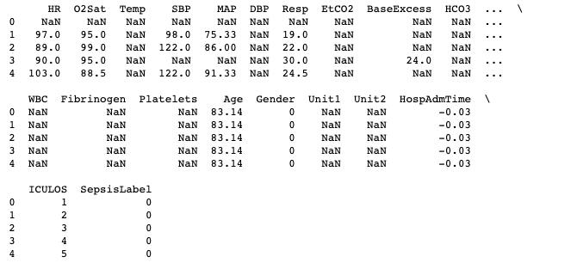
Dataset (cont..)
Figure 3: Raw data
Early Prediction of Sepsis from Clinical Data
13

Slide 14
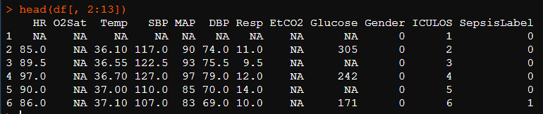
Implementation
Feature Engineering
Two Approaches employed for Feature Selection:
Checked correlation of features contributing to the presence of Sepsis
Review of the research papers [2][3][4].
Figure 4: Extracted features
Early Prediction of Sepsis from Clinical Data
14

Slide 15
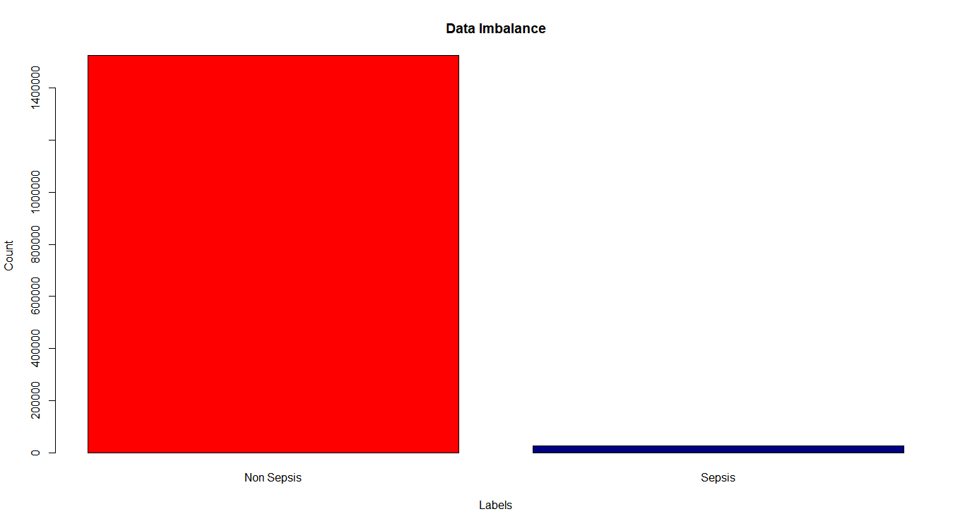
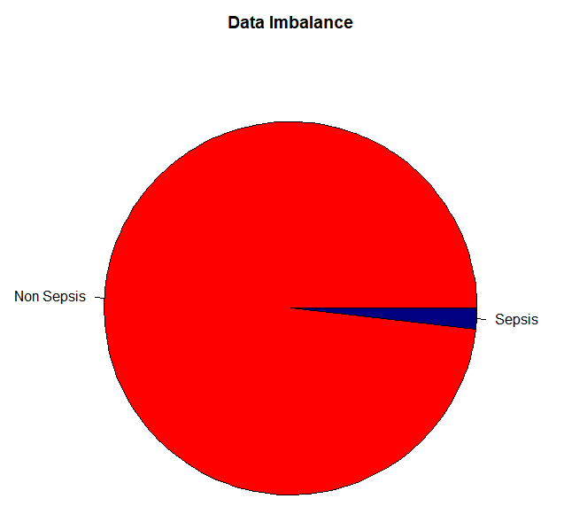
Implementation (cont..)
Data Imbalance:
98% of patients does not have sepsis and 2% have sepsis.
Under sampling: Way to deal with Imbalance
Figure 5(a) : Data Imbalance – Histogram
Figure 5(b) : Data Imbalance –
Pie chart
Early Prediction of Sepsis from Clinical Data
15

Slide 16
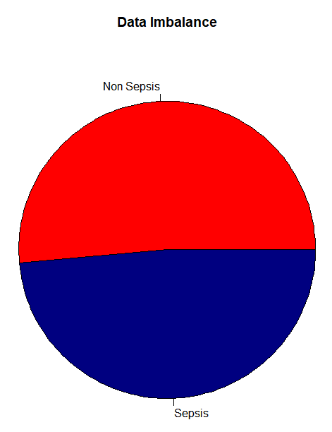
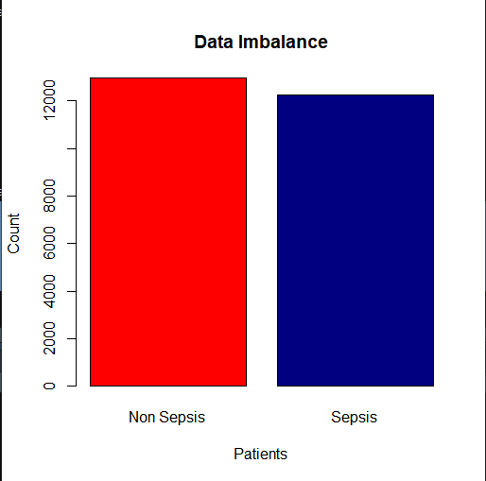
Implementation (cont..)
After Under sampling:
Figure 6(a) : Handling data imbalance – Histogram
Figure 6(b) : Handling data imbalance – Pie chart
Early Prediction of Sepsis from Clinical Data
16

Slide 17
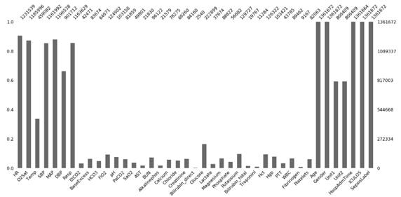
Implementation (cont..)
Missing values (before down-sampling):
- Most of Laboratory Data are having missing values (see fig 7)
- There is more than 90% of missing values.
Figure 7 : Missing values in the raw data
Early Prediction of Sepsis from Clinical Data
17
*

Slide 18
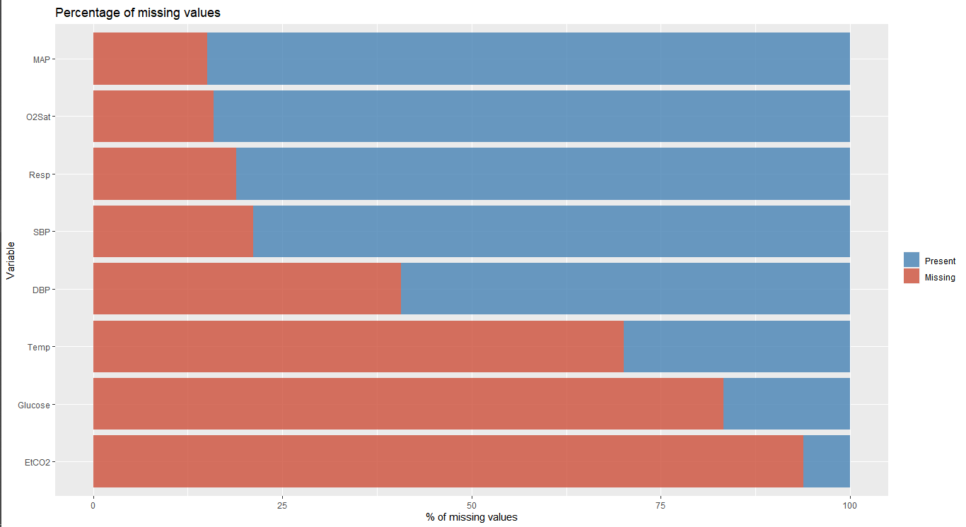
Implementation (cont..)
Missing values (After down-sampling)
PMM method from Multivariate Imputation by Chained Equations (MICE) package is used for imputation.
Figure 8 : Missing values in down sampled data.
Early Prediction of Sepsis from Clinical Data
18
*

Slide 19
Dataset
Selected features: HR, O2Sat, Temp, SBP, MAP, DBP, Resp, EtCo2, Glucose, Gender, ICULOS, SepsisLabel.
Total tuples | Before pre-processing | After pre-processing
Total tuples | 1552210 | 56110
Total attributes | 41 | 12
Class labels | 2 (‘0’ / ‘1’) | 2 (‘0’ / ‘1’)
Missing values (in %) | 90 | 0
Data imbalance (in %) | Non-Septic: 98 Septic: 2 | Non-Septic: 52 Septic: 48
Table 1 : Dataset characteristics – before & after preprocessing
Early Prediction of Sepsis from Clinical Data
19

Slide 20
Cleaned dataset:
Table 2 : Cleaned dataset
Early Prediction of Sepsis from Clinical Data
20

Slide 21
Preprocessed data
Early Prediction of Sepsis from Clinical Data
21
Table 3 : Pre-processed dataset

Slide 22
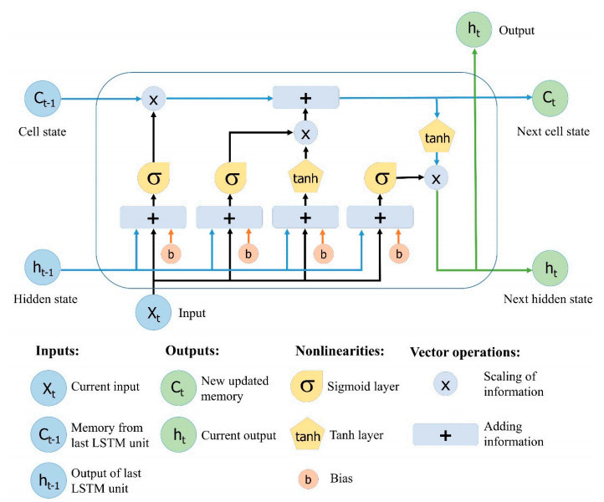
Long Short-Term Memory
Figure 9 : The structure of LSTM neural network [5]
Early Prediction of Sepsis from Clinical Data
22

Slide 23
Model parameters
No. of hidden layers: 4
Hidden neurons: (32, 16, 4)
Output neurons: 1
Epochs: 500
Activation: relu, sigmoid (o/p layer)
Dropout: 20%
Loss: binary cross-entropy
Optimizer: adam
Metrics: Accuracy
Input Shape: (31, 11)
Early Prediction of Sepsis from Clinical Data
23

Slide 24
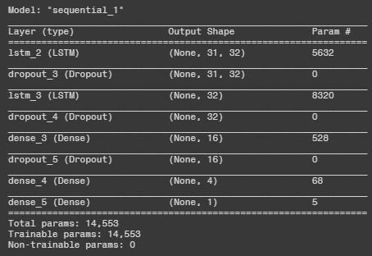
Model structure
Figure 10 : Model structure
Early Prediction of Sepsis from Clinical Data
24

Slide 25
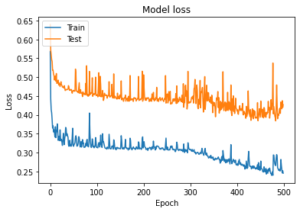
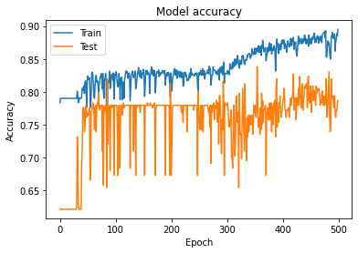
Loss and Accuracy
Figure 11(a) :
Loss v/s Epoch
Figure 11(b) : Accuracy v/s Epoch
Early Prediction of Sepsis from Clinical Data
25

Slide 26
Evaluation metrics
 | Predicted
Actual |  | Negative | Positive
 | Negative | 100 | 71
 | Positive | 26 | 255
Table 4(a) : Confusion / Misclassification matrix
 | Precision | Recall | F1-score
0 | 0.79 | 0.58 | 0.67
1 | 0.78 | 0.91 | 0.84
Accuracy |  |  | 0.79
Macro avg. | 0.79 | 0.75 | 0.76
Weighted avg. | 0.79 | 0.79 | 0.78
Table 4(b) : Classification report
26
Early Prediction of Sepsis from Clinical Data

Slide 27
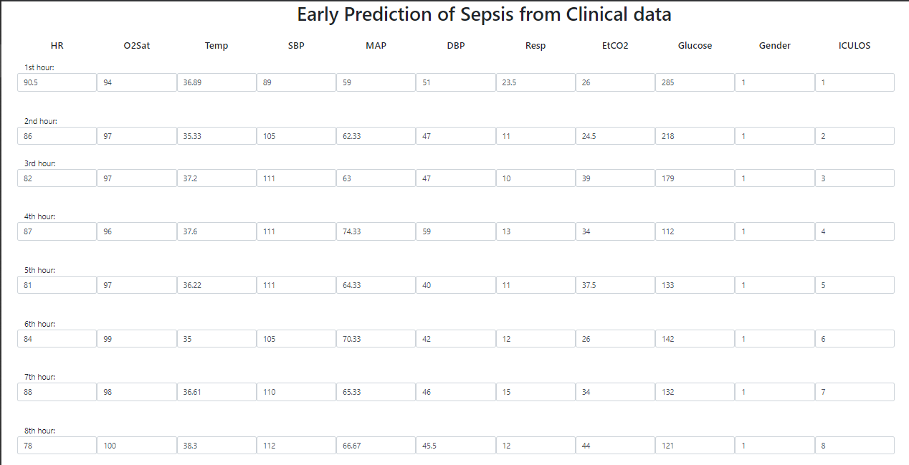
Deployment
Early Prediction of Sepsis from Clinical Data
27
*

Slide 28
References
[1] https://physionet.org/content/challenge-2019/1.0.0/
[2] Z. He et al., "Early Sepsis Prediction Using Ensemble Learning with Features Extracted from LSTM Recurrent Neural Network," 2019 Computing in Cardiology (CinC), Singapore, Singapore, 2019, pp. Page 1-Page 4.
[3] Y. Wang, B. Xiao, X. Bi, W. Li, J. Zhang and X. Ma, "Prediction of Sepsis from Clinical Data Using Long Short-Term Memory and eXtreme Gradient Boosting," 2019 Computing in Cardiology (CinC), Singapore, Singapore, 2019, pp. Page 1-Page 4.
Early Prediction of Sepsis from Clinical Data
28
*

Slide 29
References (cont..)
[3] Y. Wang, B. Xiao, X. Bi, W. Li, J. Zhang and X. Ma, "Prediction of Sepsis from Clinical Data Using Long Short-Term Memory and eXtreme Gradient Boosting," 2019 Computing in Cardiology (CinC), Singapore, Singapore, 2019, pp. Page 1-Page 4
[4] P. Nejedly, F. Plesinger, I. Viscor, J. Halamek and P. Jurak, "Prediction of Sepsis Using LSTM Neural Network With Hyperparameter Optimization With a Genetic Algorithm," 2019 Computing in Cardiology (CinC), Singapore, Singapore, 2019, pp. Page 1-Page 4
Early Prediction of Sepsis from Clinical Data

Slide 30
References (cont..)
[5] Le, Xuan Hien & Ho, Hung & Lee, Giha & Jung, Sungho. (2019). Application of Long Short-Term Memory (LSTM) Neural Network for Flood Forecasting. Water. 11. 1387. 10.3390/w11071387.
[6] Reyna, Matthew A. PhD1; Josef, Christopher S. MD1; Jeter, Russell PhD1; Shashikumar, Supreeth P. B.Tech2,3; Westover, M. Brandon MD, PhD4; Nemati, Shamim PhD1,3; Clifford, Gari D. DPhil1,2; Sharma, Ashish PhD1 Early Prediction of Sepsis From Clinical Data: The PhysioNet/Computing in Cardiology Challenge 2019, Critical Care Medicine: February 2020 - Volume 48 - Issue 2 - p 210-217
Early Prediction of Sepsis from Clinical Data

Slide 31
References (cont..)
[7] P. Hsu and C. Holtz, "A Comparison of Machine Learning Tools for Early Prediction of Sepsis from ICU Data," 2019 Computing in Cardiology (CinC), Singapore, Singapore, 2019, pp. Page 1-Page 4
Early Prediction of Sepsis from Clinical Data

Slide 32
Thank You
32

