Slide 1
01 • TITLE
TEAM Code and Chaos
CRIME FIR
FIR Intelligence & Crime Pattern Detector
From isolated FIR narratives → connected, explainable investigation intelligence.
PS10 • TRACK 4
IBM × NFSU
THE STORY OF THE SYSTEM
FIRs
INTELLIGENCE
CONNECTIONS
ACTION
Raw narratives
Entities + MO
Cross-case links
Leads + review
Core principle: AI accelerates analysis; investigators remain the decision-makers.

Slide 2
02 • PROBLEM
The Problem exists where…
WHAT THE INVESTIGATOR HAS
WHAT GETS LOST
PS10 DEMANDS
FIR TEXT
CASE CONTEXT
1
Classify crime type
Details are spread across names, places, dates, modus operandi and evidence identifiers.
One FIR is readable; the batch is harder to compare.
2
Extract entities + MO
REPEATED SIGNALS
The same infrastructure or MO may appear across cases.
3
Detect repeat-offender signatures
• Accused / aliases
• Location + station
CROSS-STATION LINKS
4
Summarize station-level trends
• MO + victim profile
Connections can span stations and districts.
• Phone / account / device / vehicle
So the design question becomes: How do we turn each FIR into evidence that can be compared, connected and explained?

Slide 3
03 • SOLUTION
CrimeFIR creates a chain from text → intelligence → connections → investigation leads.
1
2
3
4
5
READ
UNDERSTAND
CONNECT
EXPLAIN
REVIEW
Preserve the FIR
as the source
Extract entities,
MO and crime type
Link hard evidence
and similar patterns
Show why cases
are connected
Human confirms,
corrects or acts
ONE PIPELINE → FIVE USEFUL OUTPUTS
Case Intelligence
Investigation Graph
Repeat Groups
Station Intelligence
Bob / MCP
Structured FIR view
Evidence + pattern links
Cross-case signatures
Trends + activity
Natural-language access

Slide 4
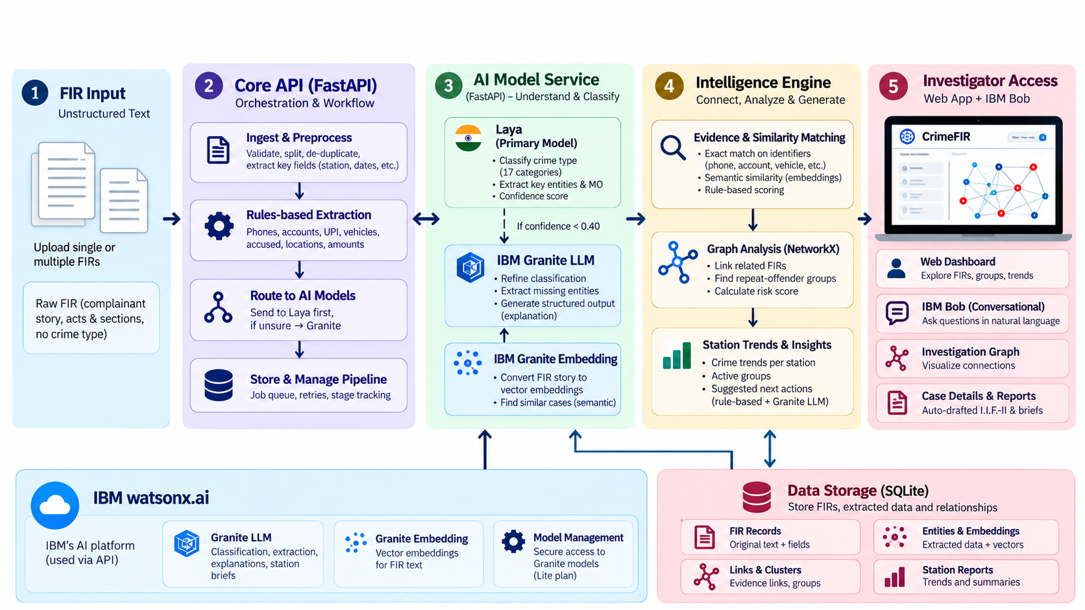
04 • ARCHITECTURE

Slide 5
05 • INTELLIGENCE
Every FIR is processed as…
EXTRACT
Phones • accounts • UPI • IMEI • vehicles • aliases • roles
TWO TYPES OF CONNECTIONS
EVIDENCE
Shared hard identifier or resolved accused.
→ Stronger, explainable connection
DECIDE
Laya classifies quickly; confidence < 0.40 escalates
PATTERN
Similar crime story / MO.
Granite adds structured MO / summary only when needed
→ Investigation lead, not proof
ENRICH
WHAT THE OFFICER SEES
• Why are these FIRs connected?
EMBED
Granite Embedding captures same-MO, different-words similarity
• Which evidence created the link?
• What should be checked next?
LINK + CLUSTER
Evidence links → NetworkX groups → visible reasons

Slide 6
05 • INTELLIGENCE
Tech Stack Used
- Frontend: NextJs, Tailwind CSS
- Backend: Python
- AI Tools: Laya, IBM Granite, IBM BOB

Slide 7
07 • IBM TECHNOLOGIES
IBM technologies are tied to specific jobs in the workflow.
We use IBM where it adds reasoning, semantic understanding or investigator interaction
IBM BOB
GRANITE LLM
GRANITE EMBEDDING
INVESTIGATOR INTERFACE
UNCERTAINTY + BRIEFS
SEMANTIC MATCHING
Natural-language questions
MCP tool access
FIR Analyst custom mode
Escalated FIR analysis
Structured enrichment
Grounded station briefs
Same MO, different words
Pattern similarity
Lead generation
watsonx.ai
Hosts the Granite LLM path used for escalated reasoning and grounded report generation.

Slide 8
08 • IMPACT & SUCCESS
Impact of CRIME FIR
Success means investigators can move from raw FIR batches to explainable cross-case intelligence with less manual comparison.
BEFORE CRIME FIR
WITH CRIME FIR
• FIRs remain case-by-case
• Every FIR becomes structured intelligence
• Cross-case comparison is manual
• Evidence links expose recurring infrastructure
• Patterns are harder to explain
• Graphs show why cases connect
• Station summaries take effort
• Station trends become repeatable outputs
SUCCESS LOOKS LIKE
93.4%
83.0%
100%
11 / 12
0 / 40
Major crime head
Exact crime type
Evidence precision
Planted gangs
Decoys
unseen test FIRs
unseen test FIRs
hard identifiers
exact clusters
flagged as gangs

Slide 9
Team & Roles
Member 1: Patel Raj - Team Lead & Architecture
Member 2: Karan yadav - backend & AI
Member 3: Dhaval Patil - Frontend
Member 4: Parth shete - Dataset, Testing & Docs

