Slide 1
DATA WAREHOUSING MODEL ON COLLEGE MANAGEMENT SYSTEM

Slide 2
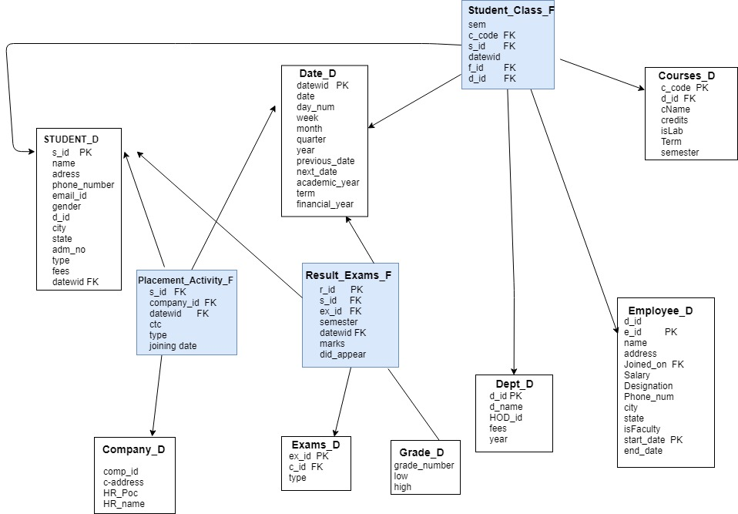

Slide 3
Reports generating from the model
Placement reports , department wise , student or package wise
Exam related analysis with semester wise course-wise , grade-wise or department-wise
Reports related to courses associated with faculty and students
Reports related to faculty and students

