Slide 1
TAKE-HOME SUBMISSION · STAFF PRODUCT MANAGER, AI ENABLEMENT
DecisionLens
An agent that interrogates a product decision instead of recommending one.
Raj Pasupathy 11 cases · claude-opus-5 make setup && make demo Runs offline, no API key

Slide 2
1 / THE PROBLEM I CHOSE
The hardest problem in PM enablement is trust, not capability
A PM can get an AI recommendation today. What they cannot get is the confidence to stake a roadmap on it in front of leadership. That gap explains the pattern everyone observes: heavy AI use for drafting, almost none for decisions.
The price of that gap is verification cost. If a PM cannot tell where a claim came from, which conclusions rest on assumption, or what the model left out, they have not saved work — they have moved it from analysis into audit.
So the agent should not produce a better memo. It should produce a brief a sceptic can check in ten minutes — and refuse to certify its own work when it cannot.
One framing I rejected was my own.
This began as “PMs have weak evidence.” That is a perennial PM-craft problem, not an AI-adoption one. Changing it was the most consequential decision in the project — recorded as D3/D4.
DecisionLens · Staff Product Manager, AI Enablement
2

Slide 3
2 / THE SITUATION, IN ONE PARAGRAPH
What the demo actually decides
You are a PM at a delivery company. First-attempt delivery success sits at 91% against a 93% goal, and delivery exceptions are the largest driver of support contacts. Nine documents sit in a folder.
Which intervention should the team prioritize to reduce delivery exceptions?
That question, the desired outcome and the as-of date all come from case_manifest.json — so the agent knows what it is being asked and can tell stale evidence from current.
Every file is synthetic and fictional. No real Walmart data is used and none is claimed.
DecisionLens · Staff Product Manager, AI Enablement
3

Slide 4
3 / THE INPUT
Nine files, deliberately made to disagree
About 11,500 characters — the kind of pile a PM actually faces. Each file is tagged with its type, owner and dates, because who wrote it and when is half of how you weigh it.
FILE
TYPE
OWNER
WHAT IT CONTRIBUTES
business_objectives.md
strategy document
leadership
The bar: 93% success, −20% contacts, cost flat
product_metrics.csv
quantitative metric
analytics
Exception rates by category and segment
support_ticket_summaries.csv
operational record
support-ops
What customers actually contacted us about
customer_feedback.csv
qualitative research
research
Verbatim comments — the rows the challenger later audits
prior_experiments.md
experiment result
—
A notification pilot whose own write-up disclaims an effect
prior_decisions.md
prior decision
—
An FY25 call whose cost rationale has since been superseded
stakeholder_notes.md
stakeholder input
—
Opinion, held apart from fact by design
technical_constraints.md
strategy document
engineering
What cannot ship this quarter
governance_requirements.md
governance policy
legal-privacy
Privacy limits on notifications and address data
A connector splits these into 56 individually addressable records — one per CSV row, one per paragraph. That is what makes a citation checkable: every claim points at a specific row, not at a file. The connector retrieves and never interprets.
DecisionLens · Staff Product Manager, AI Enablement
4

Slide 5
4 / WHAT RUNS
One orchestrator, seven stages, fixed order
Deliberately not a multi-agent system: a PM who cannot follow what the tool did cannot verify it (decision D8). The counts are what this case produced — so any answer traces back to the stage that made it.
#
STAGE
THE QUESTION IT ANSWERS
OUTPUT
1
Relevance
Which records bear on the question?
56 records
2
Classification
Fact, assumption, opinion or constraint?
37 claims
3
Contradictions
Where do sources disagree — and what would settle it?
9 found
4
Missing evidence
What is absent that would change the answer?
19 gaps
5
Alternatives
What are the options, scored on each criterion?
11 options
6
Recommendation
Which option, at what confidence?
data_quality · low
7
Challenger
Eight fixed attacks on the draft above.
1 error · 23 warnings
The challenger can only lower confidence
Never raise it. That asymmetry is enforced in code.
The guarantees are code, not prompting
Citation spans matched against source text. A non-AI option and a no-build option are required — the brief is rejected without them.
A failed stage degrades the brief
It never aborts the run, so a wrong answer is attributable to a stage rather than to “the system.”
DecisionLens · Staff Product Manager, AI Enablement
5

Slide 6
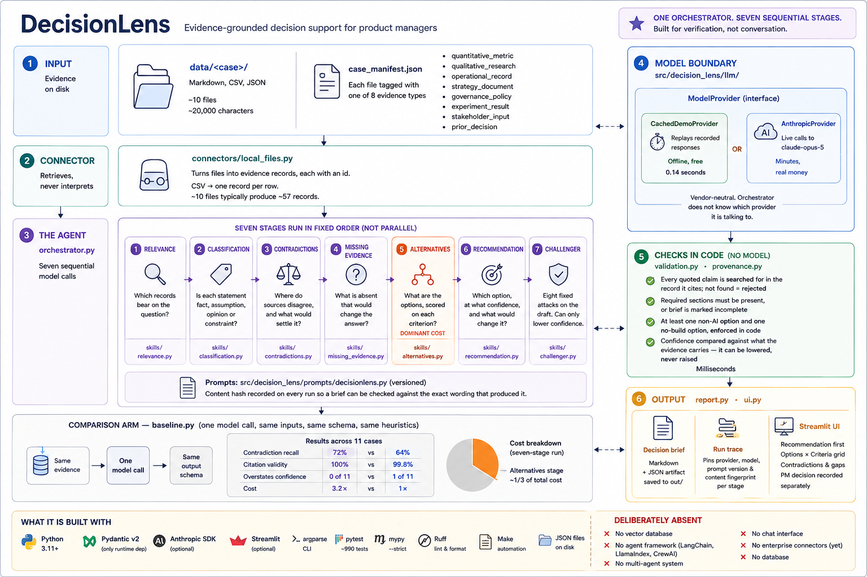
5 / ARCHITECTURE
Input · agent · model boundary · checks · output
The model sits behind a vendor-neutral ModelProvider with two interchangeable implementations — cached replay and a live Anthropic adapter — that the orchestrator cannot tell apart. That is why the demo runs offline and free, and why a live run is a two-line change in .env.
DecisionLens · Staff Product Manager, AI Enablement
6

Slide 7
6 / THE MOMENT IT WORKS · DEMO THIS LIVE
The tool blocks its own recommendation
THE THREE CITED ROWS
56 records · 37 claims · 9 contradictions ·
19 gaps · 11 alternatives
recommendation: data_quality (support: low)
checks: 1 error(s), 23 warning(s)
This brief should not be acted on as it stands:
! challenge_failed
EV-efad4673 supports
Mentions checkout entry
EV-b26a6ee3 does not
Only says the unit number was missing from the package
EV-6750be5d does not
Driver could not find unit 4B; label showed street number only
The recommendation claimed “multiple post-exception comments describe entering the unit number at checkout.” The challenger checked all three cited rows.
“Multiple” is n=1. It found two more errors on top of that.
I verified all three by hand. The challenger is right — and the error is left standing in the repository.
Removing it would mean weakening the check or re-running until the output flattered me, which is the habit this product argues against.
DecisionLens · Staff Product Manager, AI Enablement
7

Slide 8
7 / DOES IT WORK
Eleven cases, both arms, measured
The baseline is a strong single model call — same evidence, same schema, same shared heuristics — so the comparison is about workflow, not about who was told more.
METRIC
DECISIONLENS
BASELINE
The result I would defend
The baseline’s single overclaim happened on a case built so a thick corpus contains almost no load-bearing evidence. The defensible ceiling is low. The baseline read the volume and said moderate. DecisionLens said low.
That is the failure this product exists to prevent, reproduced under measurement.
Contradiction recall
36/50 · 72.0%
32/50 · 64.0%
— held out from prompt design
32/46 · 69.6%
28/46 · 60.9%
Citation validity
100%
99.8%
Options generated
134
79
Overstates its support
0 of 11
1 of 11
Understates its support
6 of 11
1 of 11
Cost
3.2×
1×
And what does not hold
Caution is not calibration — it under-claims on 6 of 11. Citation validity is not a differentiator. Eight points of recall is four items out of fifty, one run per case, no error bars. It costs 3.2× more, and the baseline won twice.
DecisionLens · Staff Product Manager, AI Enablement
8

Slide 9
8 / STATED UP FRONT
What this submission does not claim
Recorded here rather than left to be discovered.
Real PM research was not conducted. Three PMs contacted, one replied. n=1 is an anecdote — and it partly cut against me. They use AI daily on decisions that matter and verify as a habit, so verification cost has not stopped them. They named a barrier I had not anticipated: some work is inherently human.
All evidence is synthetic, authored by the same person who authored the answer keys.
One of eleven cases is in-sample. The other ten were written after the prompts were frozen at a recorded commit — checkable, but weaker than a genuine held-out set.
One run per case. No variance measurement, so no margin here has an error bar.
Enterprise connectors are documented, not implemented. No identity model, no permission delegation, no cost control, no red-teaming.
Lagging business outcomes cannot be demonstrated in a take-home and are not claimed.
DecisionLens · Staff Product Manager, AI Enablement
9

Slide 10
9 / LIKELY QUESTIONS
The four I expect
Is eight points of recall worth 3.2× the cost?
On recall alone, no — and I say so in the submission. The result I would defend is restraint: 0 of 11 overclaims, on a case built to induce exactly that failure. That is a mechanism, not an average.
Is this an agent, or just a workflow?
One orchestrator making stage-to-stage control decisions over tool-using stages, where a failed stage degrades rather than halts. Single-agent was traded deliberately for verifiability, which is the entire thesis.
Why a form rather than chat?
The brief has to be scanned by a sceptic — checks before the answer, a stable place for evidence, a visible record of what was left out. Chat is the wrong shape for verification and the right shape for framing, which is where it goes next over the same pipeline.
What would you do next with a team?
Multiple runs per case for error bars. A held-out case set authored by someone else. A real PM study measuring verification time and unsupported claims found. And a cheaper model tier on the alternatives stage, which is a third of total cost.
DecisionLens · Staff Product Manager, AI Enablement
10

Slide 11
ENGINEERING
Built to be checked, not just to run
1,010 tests · 100% line coverage
The coverage gate is what is enforced; the count is whatever it is on the day.
Python 3.11+ · Pydantic v2 · mypy --strict
No agent framework, no vector database, no multi-agent system — all deliberately absent.
Every run leaves a trace
Provider, model, prompt version and content fingerprint per stage, so a brief can be checked against the exact wording that produced it.
Nothing in the cache is hand-written
Every recorded response carries the model and the date it came from.
github.com/raj-principal-arch/decisionlens-ai make demo · make ui · make check · make eval All evidence synthetic and fictional
DecisionLens · Staff Product Manager, AI Enablement
11

