Slide 1
Big Data Training
Introduction

Slide 2
Who are we ???
IT Professional with 15+ years of experience
Cloudera Certified Professionals
Passion about technology, learning, career counseling etc
Hands on expert in providing end to end solutions

Slide 3
Agenda
Desired Audience
Course content
Pre-requisites
Support
What you will learn?
Schedule
Targeted jobs

Slide 4
Desired Audience
All IT professionals who want learn Spark/Hadoop Development and Certification.
Prerequisites: Basic knowledge of Linux, Java or SQL

Slide 5
Course Content
What is Big Data
Hadoop Architecture
Hortonworks/Cloudera Architecture
Install Prerequisites
Setting up Hadoop eco system (Spark, Hadoop, Hive, Sqoop etc)
Virtual Machines on your PC/Mac
Training process
- HDFS
- Hive
- Spark [RDD, Dataframe, Dataset, Real Time Streaming etc.,]
- Machine Learning
End to end POC which covers Spark, Hadoop, Hive, Sqoop etc.,
Various Big Data Certification Overview

Slide 6
Cloudera VM
Download any hypervisor application
VirtualBox
VMWare
KVMInstall any hypervisor application
Download the Cloudera CDH based on your
hypervisor
Follow the steps here to configure the vm -
https://community.cloudera.com/t5/Hadoop-101-Training-Quickstart/How-to-setup-Cloudera-Quickstart-Virtual-Machine/ta-p/35056

Slide 7






What is Big data
Huge volume of data, which cannot be stored and processed using the traditional approach at given time.
100 mb of file thru email
500 m tweets each day
100 tb data each day
48 hrs of fresh videos each min.
Airlines --> Air Traffic Controller

Slide 8
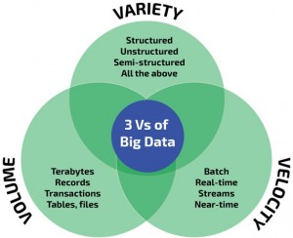
Big data challenges
1. How do we store and manage huge data
2. How to process and extract info

Slide 9
Certification Overview
Cloudera
HortonWorks
Databricks
MapR
AWS Big Data Speciality

Slide 10
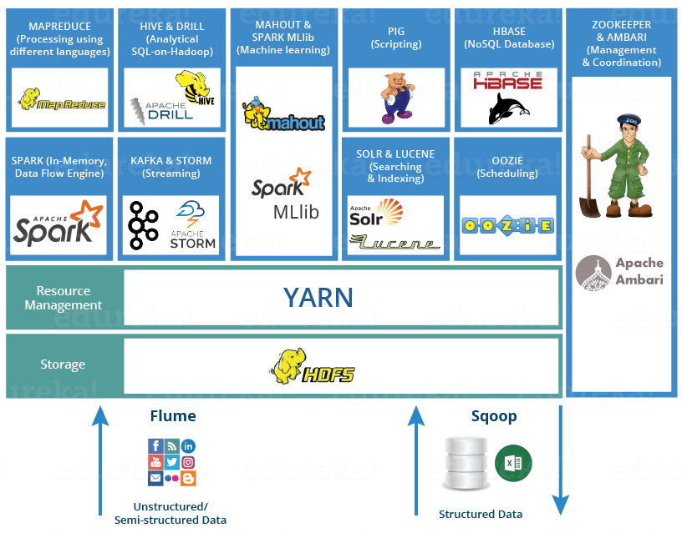
Big Data Ecosystem

