Slide 1
Apache Hive
Introduction

Slide 2
What is Hive ?
Hive is a datawarehouse tool to process structured data
Originally developed by Facebook and later Apache software took it up as open source
It store the data in HDFS and meta-data in RDBMS
It is designed for OLAP
It provided sql type structure called HQL
The queries will be converted as MapReduce jobs and executed in Hadoop

Slide 3
What is NOT Hive ?
Not a RDBMS
Not a No SQL
Not a OLTP
Not suit for transaction processing

Slide 4
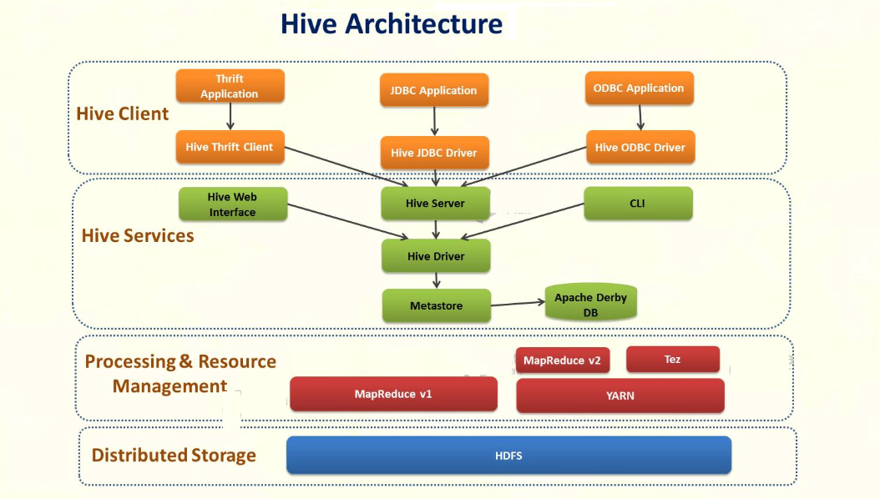
Architecture of Hive

Slide 5
Task
Create Database
Create managed table
Load the data set
Create external table
Where data & meta-store live
Partition
Clustering/Buckting

Slide 6
Internal Commands
How to set the column header
hive>set hive.cli.print.header=true
How to find the file store
hive> set fs.defaultFS
How to find the meta store
hive> set hive.metastore.warehouse.dir
How to find the execution engine
hive> set hive.execution.engine
How to query HDFS from hive shell
hive> dfs -ls

