Slide 1

Movie Recommendation System
This presentation explores a movie recommendation system that leverages both collaborative and content-based filtering techniques for personalized movie suggestions.
Raj Thumar(244161018)

Slide 2

Motivation
1
Overwhelming Choices
2
Personalized Suggestions
The sheer volume of movies available on streaming platforms makes it difficult for users to find something they'll enjoy.
Personalized movie recommendations enhance user satisfaction by providing suggestions tailored to their interests.
3
Widely Used
Recommendation systems are a key feature of popular streaming platforms like Netflix, Amazon, and YouTube.

Slide 3






Project Overview
Input
The system takes as input a dataset of movies, user ratings, and the user's input (their preferences or a movie they liked).
Data Preprocessing
The data is preprocessed by tokenizing movie genres and creating a user-item matrix of ratings.
Collaborative Filtering
Collaborative filtering calculates similarity between users based on their ratings and predicts ratings for unrated movies.
Content-Based Filtering
Content-based filtering calculates similarity between movies based on their genres and recommends movies similar to those the user likes.
Hybrid Approach
The scores from collaborative and content-based filtering are combined to produce a final score for each movie.
Output
The system outputs the top N recommended movies based on the combined scores, excluding movies already rated by the user.

Slide 4
Collaborative Filtering
What It Is
Workflow
Advantages
Collaborative filtering recommends movies based on the user's similarity to other users, leveraging the collective preferences of the community.
Create a user-item matrix representing user ratings for movies.
Personalized recommendations
Minimal metadata required
Calculate the cosine similarity between users based on their ratings.
Predict unrated movie ratings using weighted averages of ratings from similar users.
Exclude movies already rated by the user.
Recommend movies with the highest predicted ratings.

Slide 5
Content-Based Filtering
What It Is
Workflow
Advantages
Content-based filtering recommends movies based on the movie's content, such as genre, and suggests movies similar to those the user has already enjoyed.
Tokenize genres using CountVectorizer to create a matrix of genre tokens for each movie.
Works without user preferences, useful for new users ("cold start" problem).
Calculate the cosine similarity between the liked movie and all other movies based on their genre vectors.
Leverages movie metadata to find similar movies.
Rank movies based on the similarity scores.
Exclude the liked movie and recommend the top N similar movies.

Slide 6
Code Snapshots
Collaborative Filtering
Content-Based Filtering
Hybrid Approach
Calculate cosine similarity using scikit-learn.
Use CountVectorizer to tokenize genres and create a genre matrix.
Combine collaborative and content-based scores to create a final recommendation score.

Slide 7
Observations and Challenges
What Was Learned
Challenges Faced
Collaborative filtering relies on user similarity for recommendations, while content-based filtering leverages movie metadata.
Sparse data in the user-item matrix can pose a challenge for collaborative filtering, as it can be difficult to find users with enough overlapping ratings.
Combining both approaches improves recommendation accuracy by incorporating both user preferences and movie content.
Balancing the scores from collaborative and content-based filtering is crucial to ensure that the hybrid approach provides accurate and relevant recommendations.

Slide 8
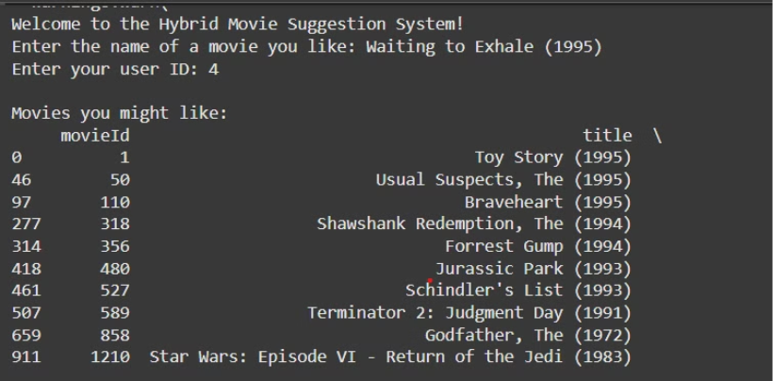
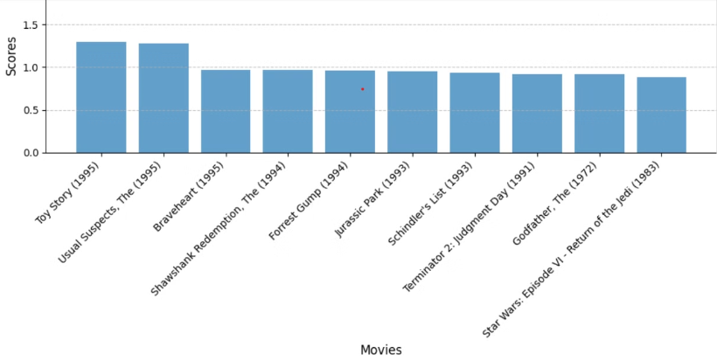
Working of System
Suggesting top 10 movies
Graph of suggested movies with their score

Slide 9
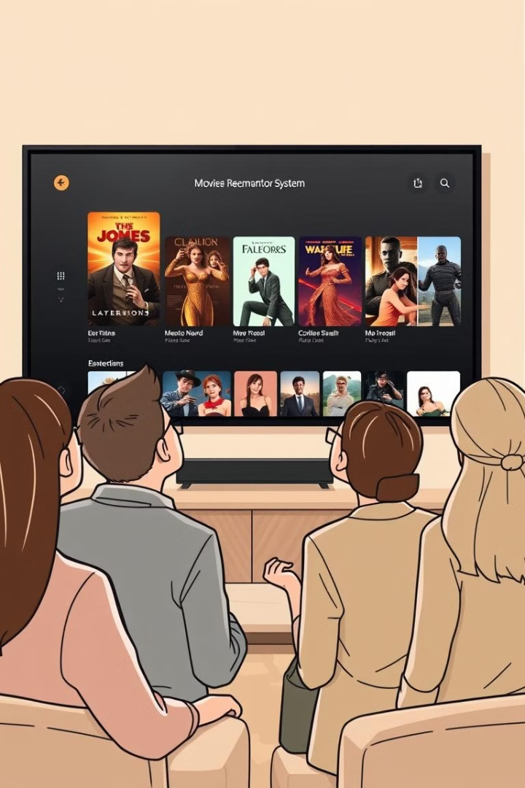
Conclusion
1
Summary
2
Future Enhancements
Collaborative filtering personalizes recommendations using user preferences, while content-based filtering suggests movies similar to what the user likes.
Adding more metadata, such as cast, director, and release year, can improve the accuracy of content-based filtering.
Using deep learning techniques can enable more advanced recommendation models, potentially leading to more accurate and diverse recommendations.
A hybrid approach combining both methods improves results by incorporating both user preferences and movie content.
Implementing real-time user feedback mechanisms can provide valuable data for refining the recommendation system and improving user experience.

