Slide 1


DATTA MEGHE COLLEGE OF ENGINEERING, AIROLI DEPARTMENT OF COMPUTER ENGINEERING
B.E. (Sem VII) MAJOR PROJECT
Group No – 16
Project Title – Blockchain Based NGO Donation Tracker
Group Members -
Sr. N o | Student ID | Roll Number | Name of Students
1 | 2023FHCO086 | 43 | Om Ananta Shingne
2 | 2023FHCO121 | 50 | Chinmay Vinay Tambe
3 | 2023FHCO019 | 54 | Raj Vijaykant Yadav
4 | 2024DSCO027 | 59 | Diksha Kailas Mirgal
Name of Supervisor – Prof. Pranita Chavan

Slide 2
C o n t e n t
Introduction
Literature Survey/Existing System
Limitation of Existing System or Research Gap
Problem Statement and Objective
Proposed Solution
5.1Analysis/Framework/Algorithm
5.2Design Details
5.3Methodology Proposed
6.Technology used
6.1Details of Database or details about input to systems
6.2Performance Evaluation Parameters (for Validation)
6.3Software and Hardware Requirement
7.Refrences

Slide 3
INTRODUCTION
When people donate money to an NGO, they often don't know how it was used. They cannot easily see what work was completed, who checked it, or how much money is still unused. This lack of visibility creates a trust problem in charitable giving.
This project is a working prototype (demo only) of a donation tracking system that tackles this by dividing a project into milestones, each with its own amount of funding. No real money, wallet or blockchain transaction is involved; contributions and releases are simulated.
The NGO submits proof of completed work, independent verifiers review it, and the demo records a milestone's funds as released only after two of three distinct verifiers approve. An activity ledger, stored in the browser, records every step, so donors can follow where their money goes.
DEPARTMENT OF COMPUTER ENGINEERING
2

Slide 4
Literature Survey/Existing System
Literature Survey | Existing System
Earlier research proposed blockchain platforms to track donations, mostly on Ethereum with smart contracts. | A donor gives money to an NGO on a general promise that the project will be completed.
Surveys found that blockchain gives immutable and verifiable donation records. | Donors have limited visibility into what work was done and how funds were used.
Studies found that lack of transparency in charity reduces people's willingness to donate. | No independent review is linked to the release of funds.
Recent work added smart contracts, escrow systems and WebAPIs to build secure, traceable donation tracking. | Donors cannot easily see how much money is released and how much is unused.
Most of these works focus mainly on tracking donations. | Trust depends on the NGO's word, not on checked evidence.
DEPARTMENT OF COMPUTER ENGINEERING
3

Slide 5
Limitation of Existing System or Research Gap
Limitations of the Existing System
In the traditional donation system, money is given on a general promise that a project will be completed. Donors have limited visibility into what work was actually done and how the funds were used. There is no clear proof of completed work linked to the money, and no independent person checks that work before funds are used. Donors also cannot easily see how much money has been released and how much is still unused. Because of this, trust depends only on the NGO's word.
Research Gap
Most of the earlier blockchain-based work I reviewed focuses on tracking donations: recording who gave money and keeping those records safe and unchangeable. But recording a donation does not show that the promised work was really completed. The gap is the missing link between the money and the work. There is a need for a system that divides a project into milestones, asks the NGO to submit evidence for each one, has independent verifiers review that evidence, and records funds as released only after enough of them approve. This project demonstrates that workflow as a blockchain-inspired prototype with simulated fund releases.
DEPARTMENT OF COMPUTER ENGINEERING
4

Slide 6
Problem Statement and Objective
Problem Statement
Every day, people donate to NGOs with good intentions, but once the money is given, it disappears from view. Donors cannot see what work was completed, who checked it, or how much money is still unused. Funds are given on a promise, not on proof, so trust depends only on the NGO's word. What is missing is a way to connect a project's funds to real, verified work.
Objective
The objective of this project is to turn a promise into proof. It divides a project into funded milestones, so that funds are tied to specific stages of work. For each milestone, the NGO submits evidence of the completed work, and independent verifiers review it. In this demo, a simulated release is recorded only when two of three distinct verifiers approve; if two verifiers reject the evidence, the milestone needs revision and the funds stay locked until the NGO submits improved proof. Every contribution, evidence submission, vote and release is added to a ledger, so donors can follow the journey of their money.
DEPARTMENT OF COMPUTER ENGINEERING
5

Slide 7
Proposed Solution
The proposed solution is a donation platform that connects a project's contributions to real, verified work. Instead of giving money for a general promise, a project is divided into funded milestones, and each milestone has its own planned amount and its own review step. The NGO submits a description of the completed work, its location and supporting files (only file names, types and sizes are saved in this demo), and independent verifiers inspect this evidence and either approve it or reject it with a reason.
The demo records a milestone's funds as released only after two of three distinct verifiers approve, no verifier can vote twice on the same milestone, and the system also checks that enough unspent contributions are available. A rejection needs a written reason; if two verifiers reject, the milestone needs revision, the money stays locked, and the NGO can submit improved evidence for a fresh review. Donors can see at any time how much was raised, how much has been released, and how much is still held, and a ledger, stored in the browser, records every contribution, evidence submission, verifier vote and release. In this way, trust moves from the NGO's word to checked evidence and a visible record.
DEPARTMENT OF COMPUTER ENGINEERING
6

Slide 8
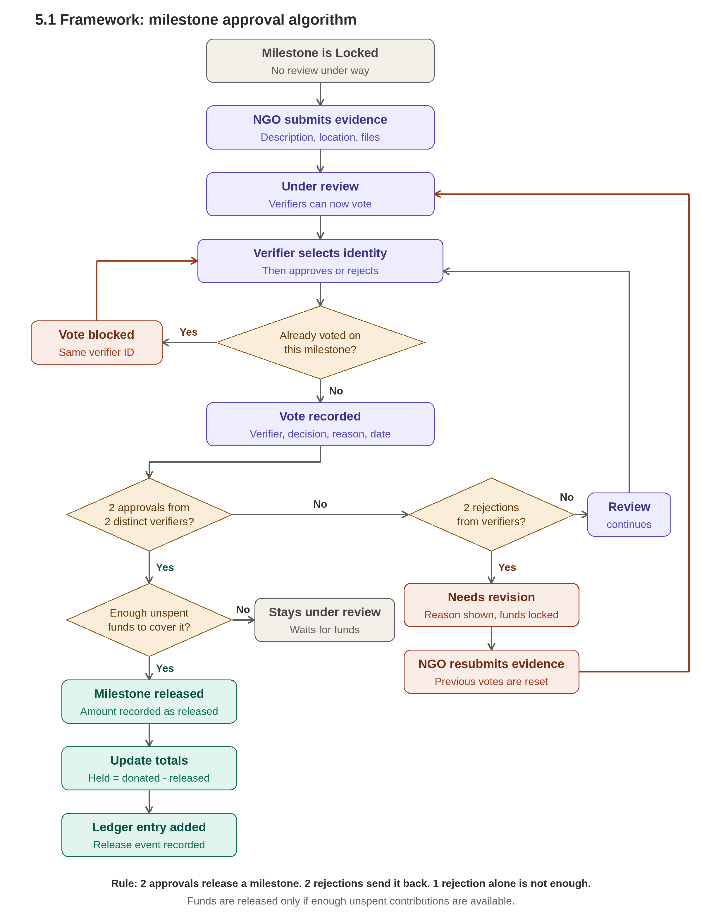
Analysis/Framework/Algorithm
DEPARTMENT OF COMPUTER ENGINEERING
7

Slide 9
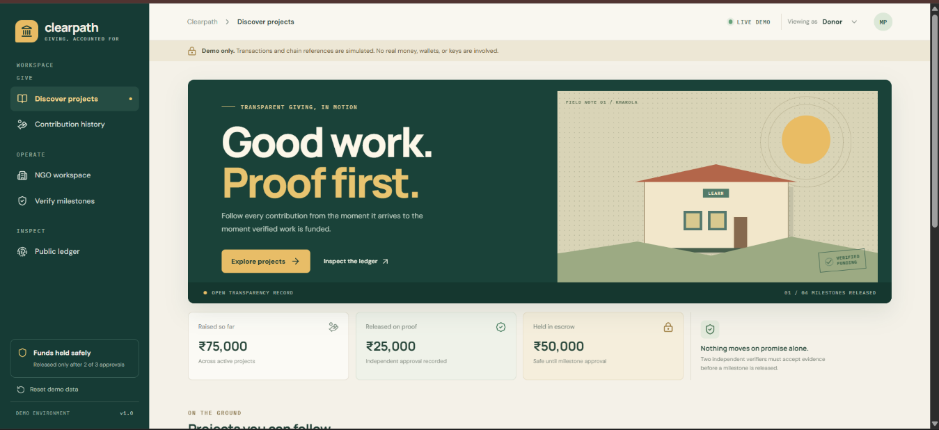
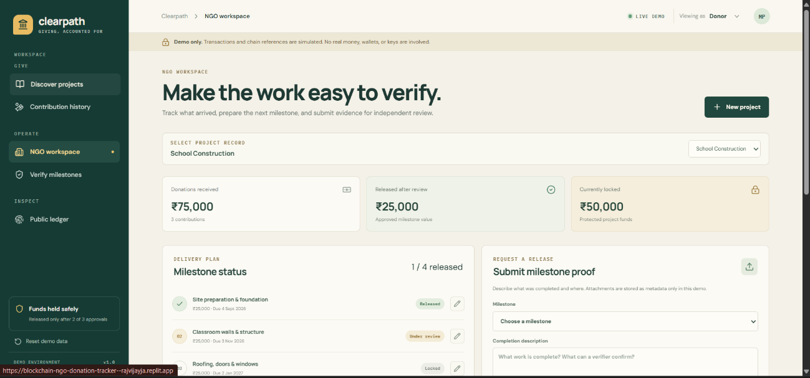
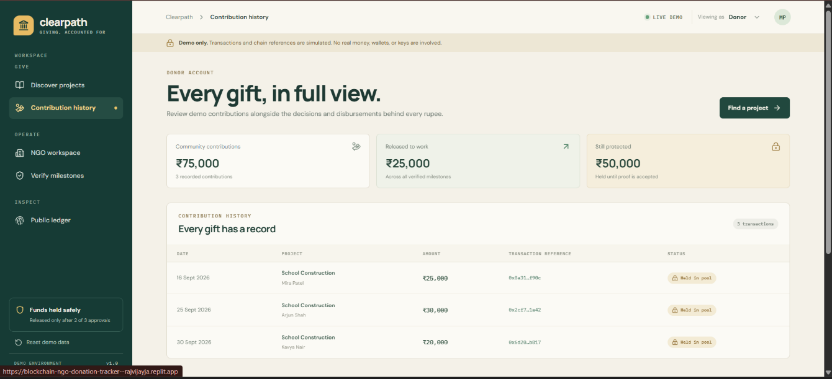
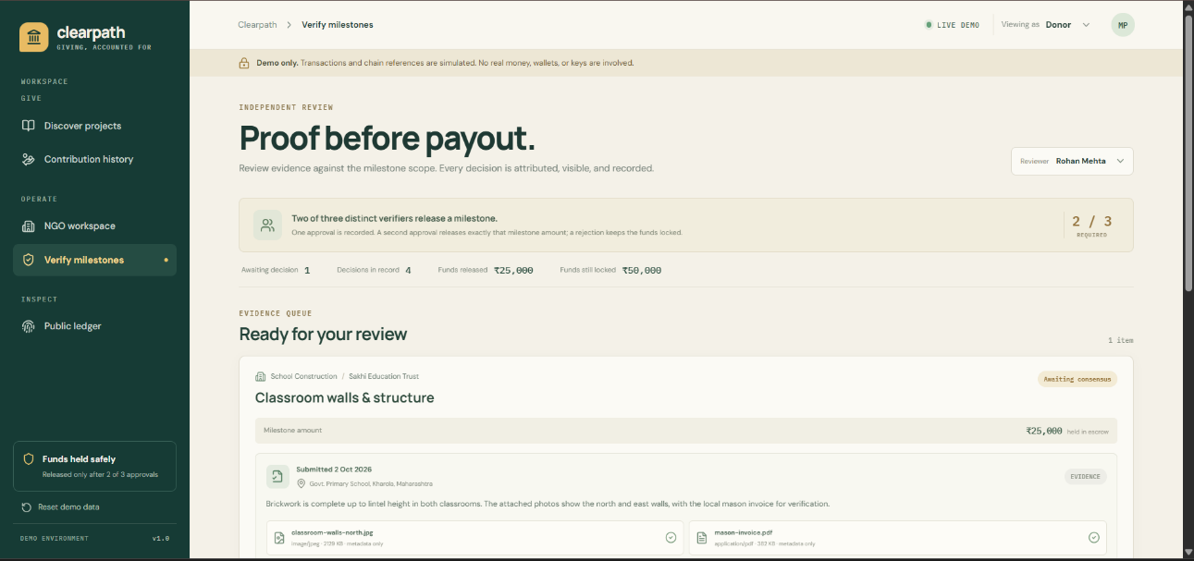
Design Details
Fig 1. Donor Home Page
Fig 3. NGO Workspace
Fig 2. Contribution History
Fig 4. Verify Workspace
DEPARTMENT OF COMPUTER ENGINEERING
8

Slide 10
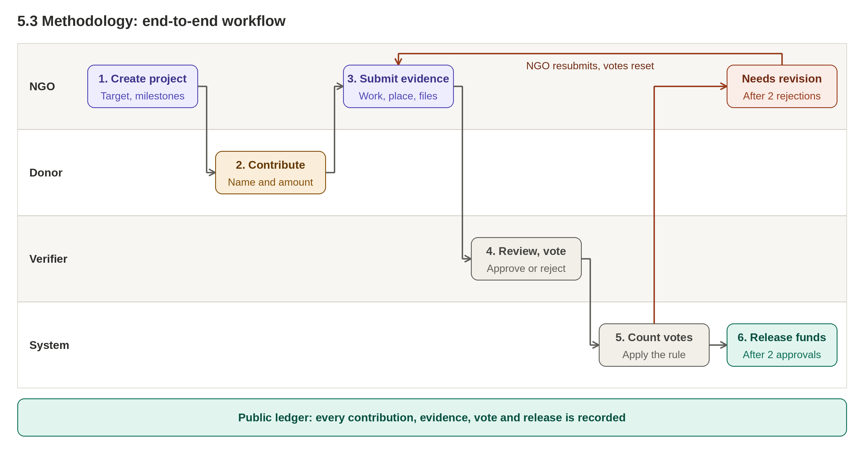
Methodology Proposed
Demo prototype: "Release funds" and the "ledger" are simulated records kept in the browser; no real money or blockchain is involved.
DEPARTMENT OF COMPUTER ENGINEERING
9

Slide 11
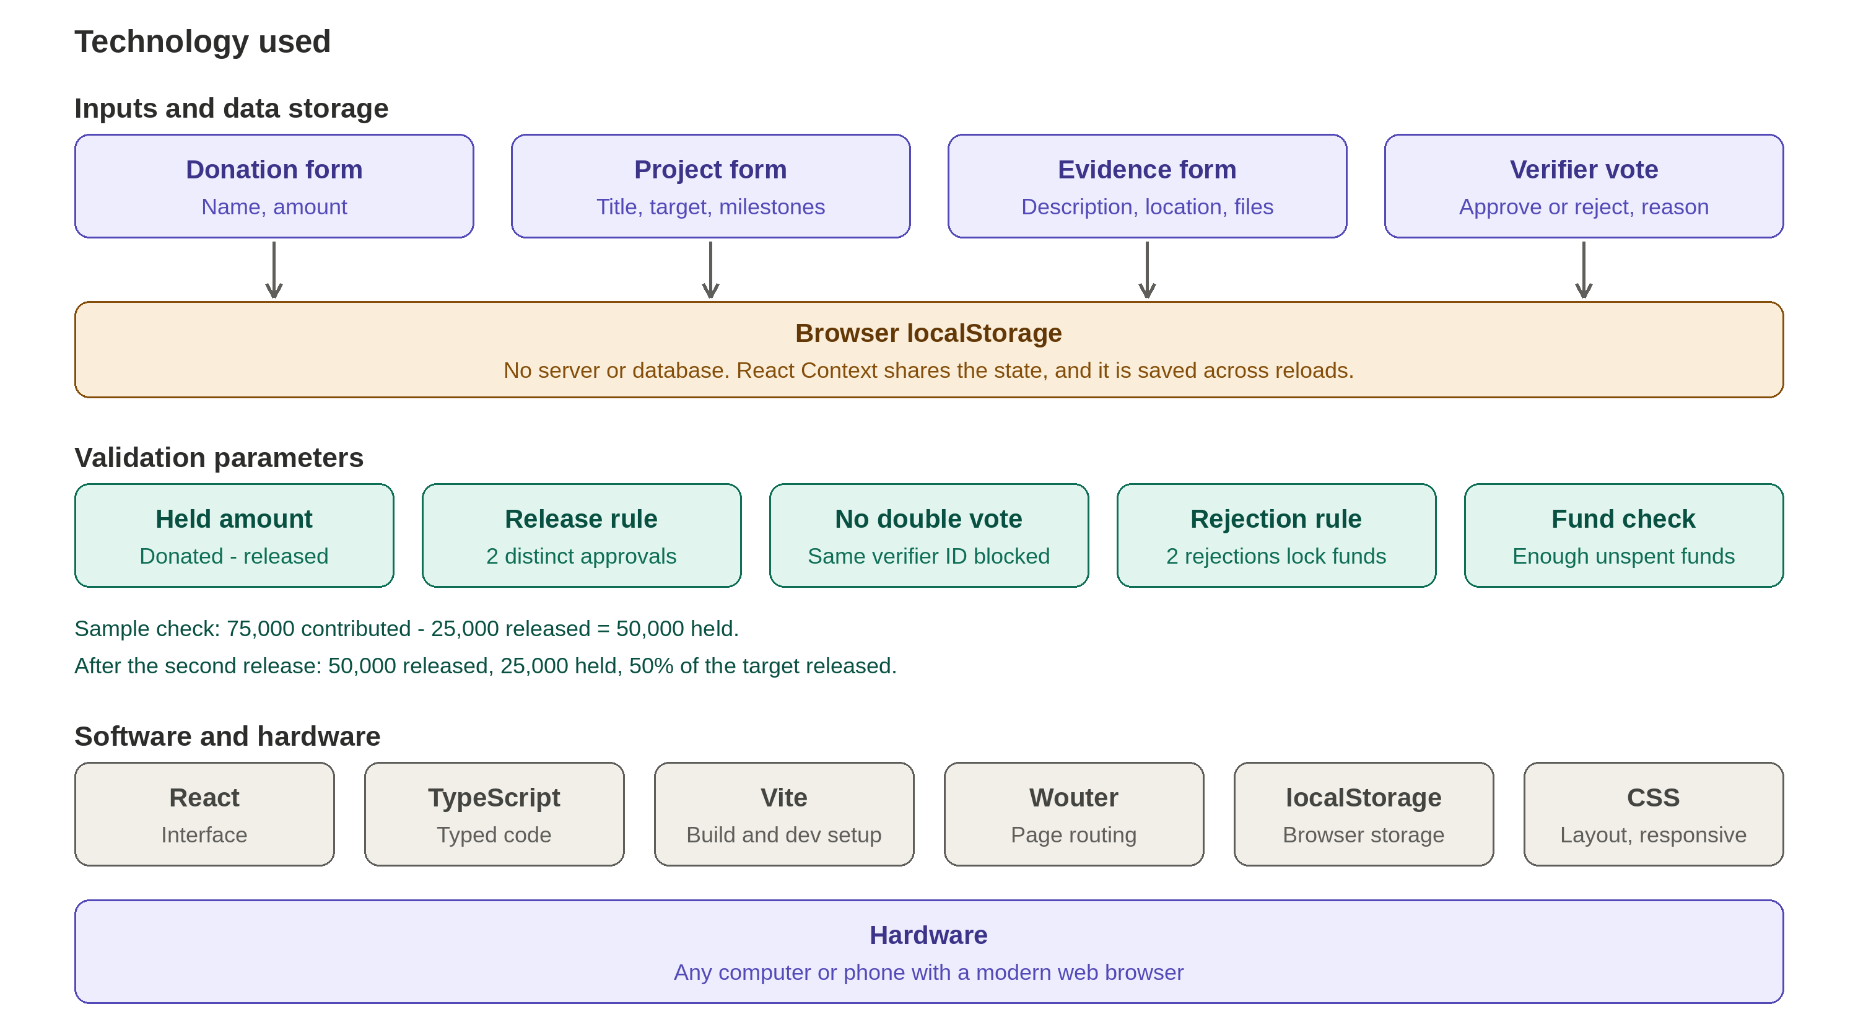
Technology used
DEPARTMENT OF COMPUTER ENGINEERING
10

Slide 12
Prototype Scope and Limitations
What the Current Website Is
The website is a demo-only prototype: no real money is collected, no wallet is connected and no blockchain transaction takes place. References and fund releases are simulated, and all data, including the ledger, is stored in the browser, so it is not immutable, distributed or independently verifiable. Contributions form one shared pool per project (not tracked rupee by rupee), and the contribution history is community-wide, not a private account. The role selector is not a login, and evidence files are saved as metadata only.
Limitations and Future Work
A production version would need secure role-based accounts, a shared backend, real payment handling and a smart contract (for example on Ethereum or Polygon) to enforce the two-of-three release rule. Evidence files would be stored off-chain (for example on IPFS) with a hash recorded on-chain to detect tampering, although a hash cannot prove that the original photograph or claim is true.
DEPARTMENT OF COMPUTER ENGINEERING
11

Slide 13
References
H. Saleh, S. Avdoshin, and A. Dzhonov, "Platform for tracking donations of charitable foundations based on blockchain technology," in Proc. 2019 Actual Problems of Systems and Software Engineering (APSSE), Moscow, Russia, Nov. 2019, doi: 10.1109/APSSE47353.2019.00031.
B. Hu and H. Li, "Research on charity system based on blockchain," IOP Conf. Ser.: Mater. Sci. Eng., vol. 768, no. 7, Art. no. 072020, 2020, doi: 10.1088/1757-899X/768/7/072020.
C. Nairi, M. Cicioğlu, and A. Çalhan, "Smart blockchain networks: Revolutionizing donation tracking in the Web 3.0," Computer Communications, vol. 228, Art. no. 107972, Dec. 2024.
A. Singh, R. Rajak, H. Mistry, and P. Raut, "Aid, charity and donation tracking system using blockchain," in Proc. 4th Int. Conf. Trends Electron. Informat. (ICOEI), 2020, doi: 10.1109/ICOEI48184.2020.9143001.
N. S. Sirisha, T. Agarwal, R. Monde, R. Yadav, and R. Hande, "Proposed solution for trackable donations using blockchain," in Proc. 2019 Int. Conf. Nascent Technol. Eng. (ICNTE), 2019, doi: 10.1109/ICNTE44896.2019.8946019.
J. Lee, A. Seo, Y. Kim, and J. Jeong, "Blockchain-based one-off address system to guarantee transparency and privacy for a sustainable donation environment," Sustainability, vol. 10, 2018, doi: 10.3390/su10124422.
DEPARTMENT OF COMPUTER ENGINEERING
12

