Slide 1
Vehicle Recall Prediction & Analysis System
Team Debuggers
A Data-Driven Approach to Recall Insights & Forecasting
Team Members:
Akash Raj Behera
Parthiv Sen
Madhav Dua
Dev Kumar
Aakash Kumar

Slide 2
Problem Statement 3
Referencing data from NHTSA database (https://www.nhtsa.gov/nhtsa-datasets-and-apis#recalls), predict the possibility of a new issue that would lead to recall for that OEM. Attach a chatbot which can answer questions related to these issues.

Slide 3
Introduction
- Importance of recall analysis
- Objective: Fetch, visualize, and analyze recall data
- Chatbot integration for insights

Slide 4
Technologies Used
- Backend: Flask, Python
- Frontend: HTML, CSS, JavaScript
- Data: Pandas, Matplotlib, Seaborn
- AI: Google Gemini API
- API: NHTSA Recall Data

Slide 5
System Architecture
- User inputs vehicle details
- Fetches recall data from NHTSA API
- Stores data in JSON
- Generates visual charts
- AI chatbot for recall queries

Slide 6
Features & Functionalities
- Fetch recall data from API
- Store and process data
- Generate interactive charts
- AI chatbot for insights
- Forecast future recalls

Slide 7
Flow Diagram
1. User enters vehicle details
2. Data is fetched and stored
3. Charts are generated
4. User interacts with chatbot
5. Insights and predictions

Slide 8
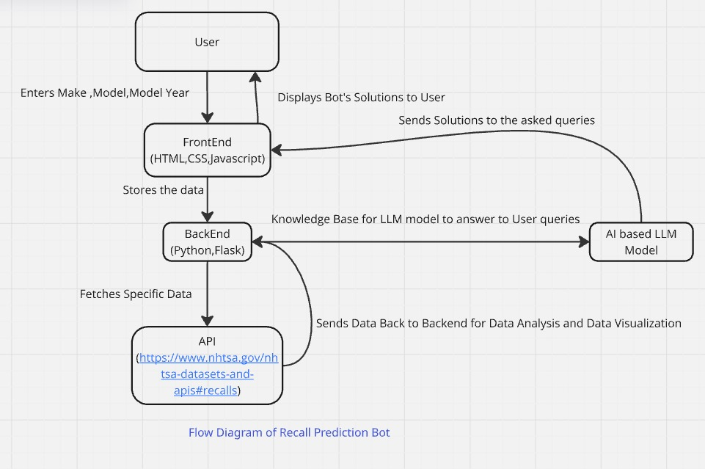

Slide 9
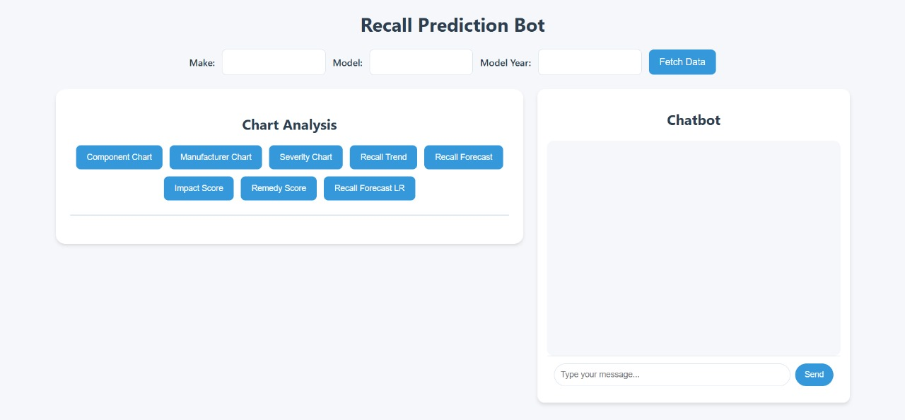

Slide 10


Slide 11
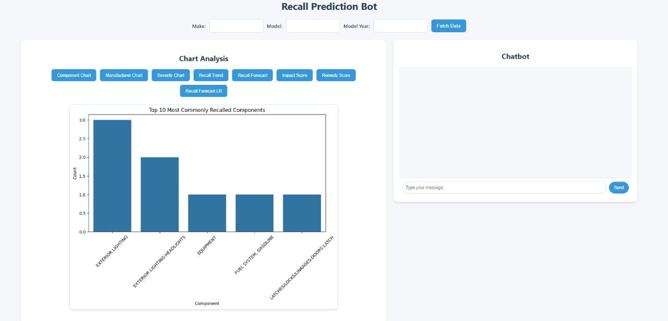

Slide 12
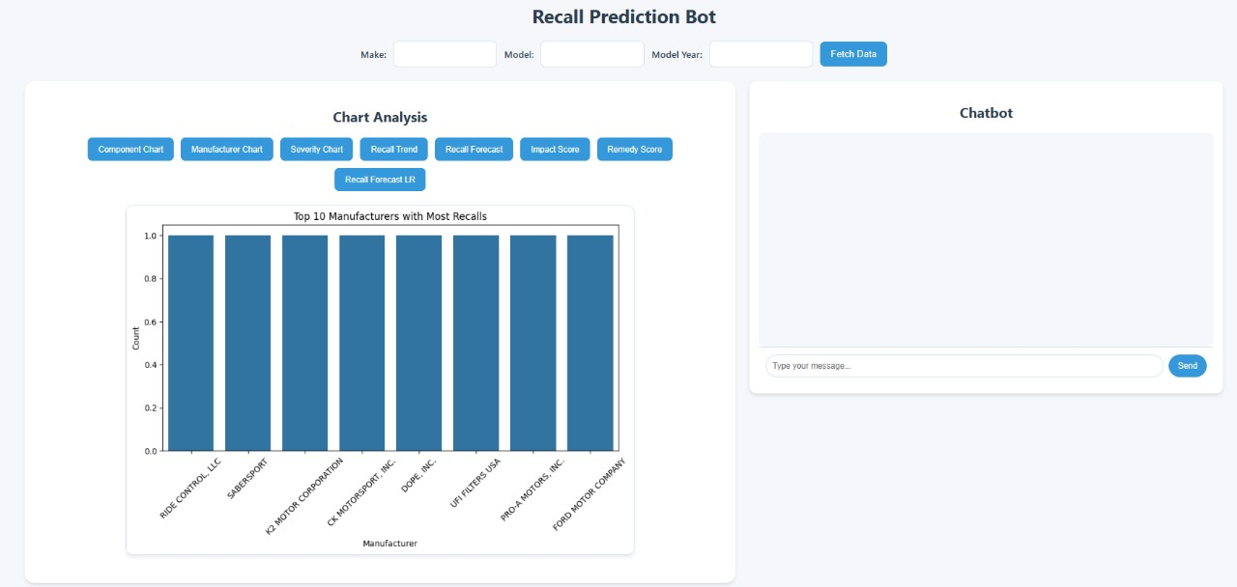

Slide 13
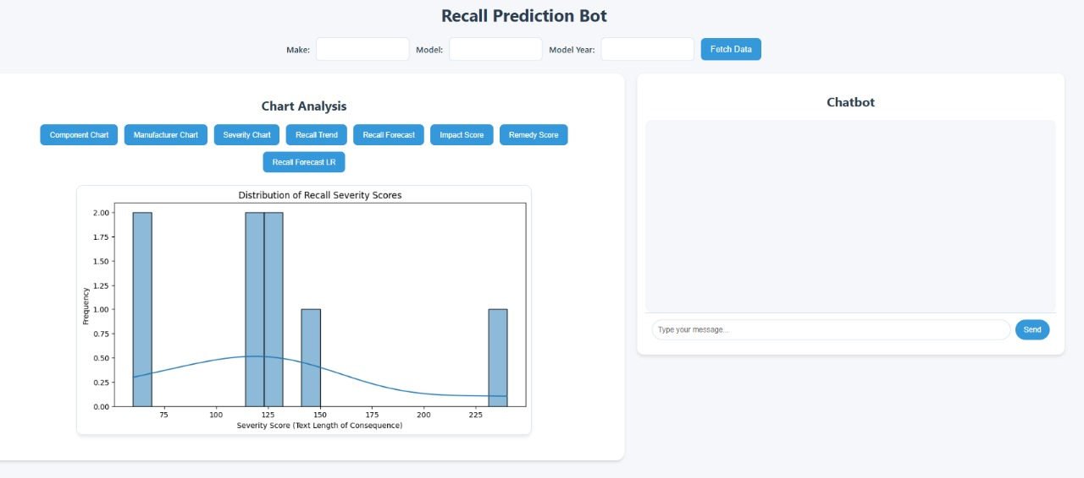

Slide 14
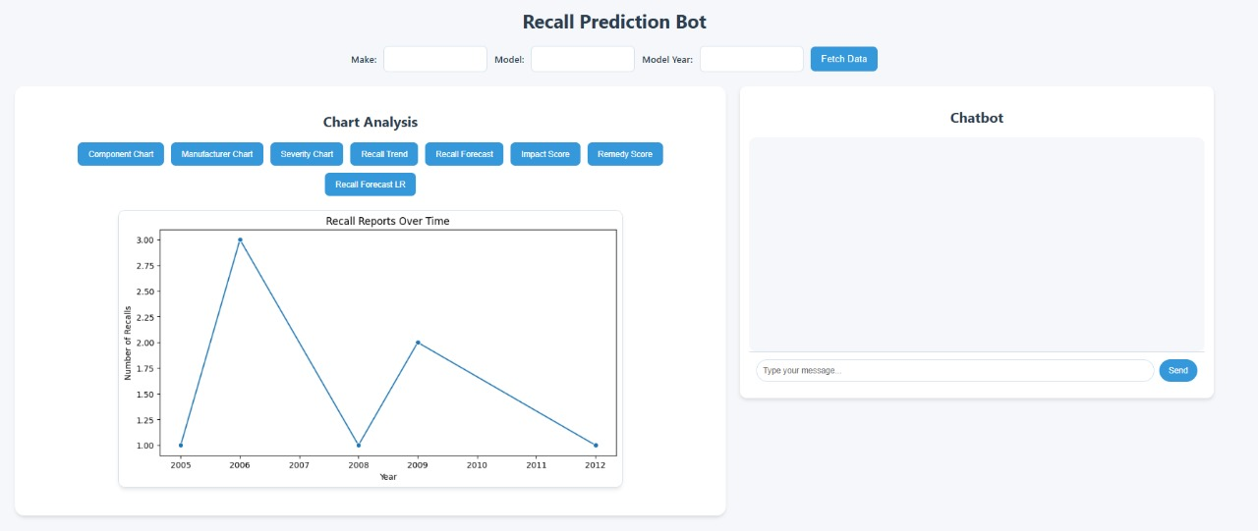

Slide 15
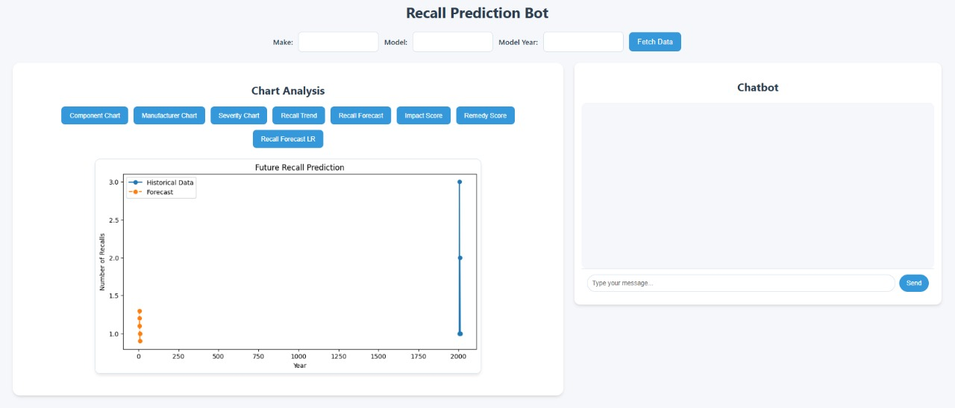

Slide 16
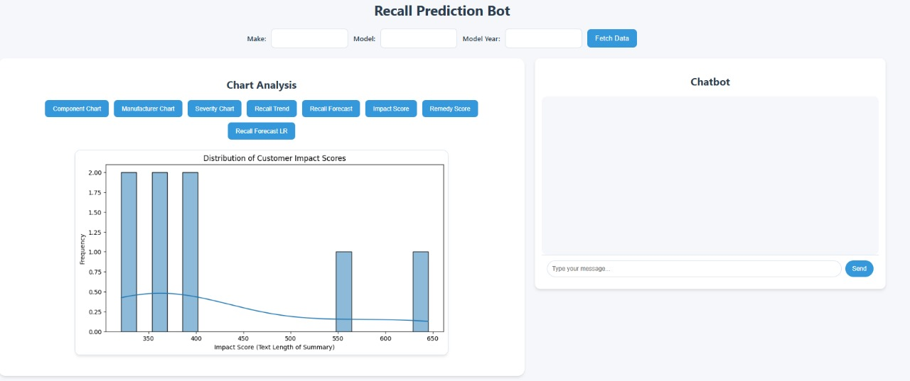

Slide 17
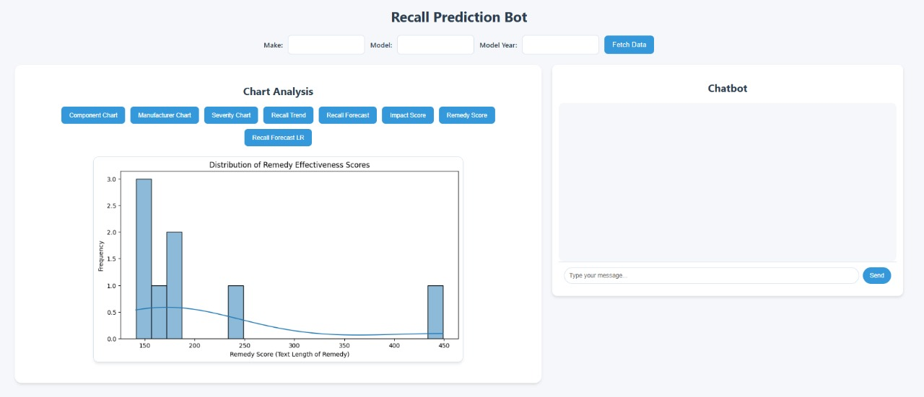

Slide 18
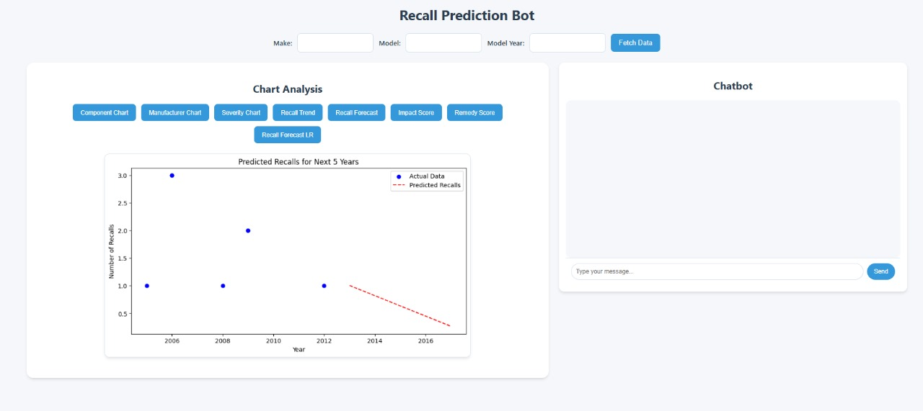

Slide 19
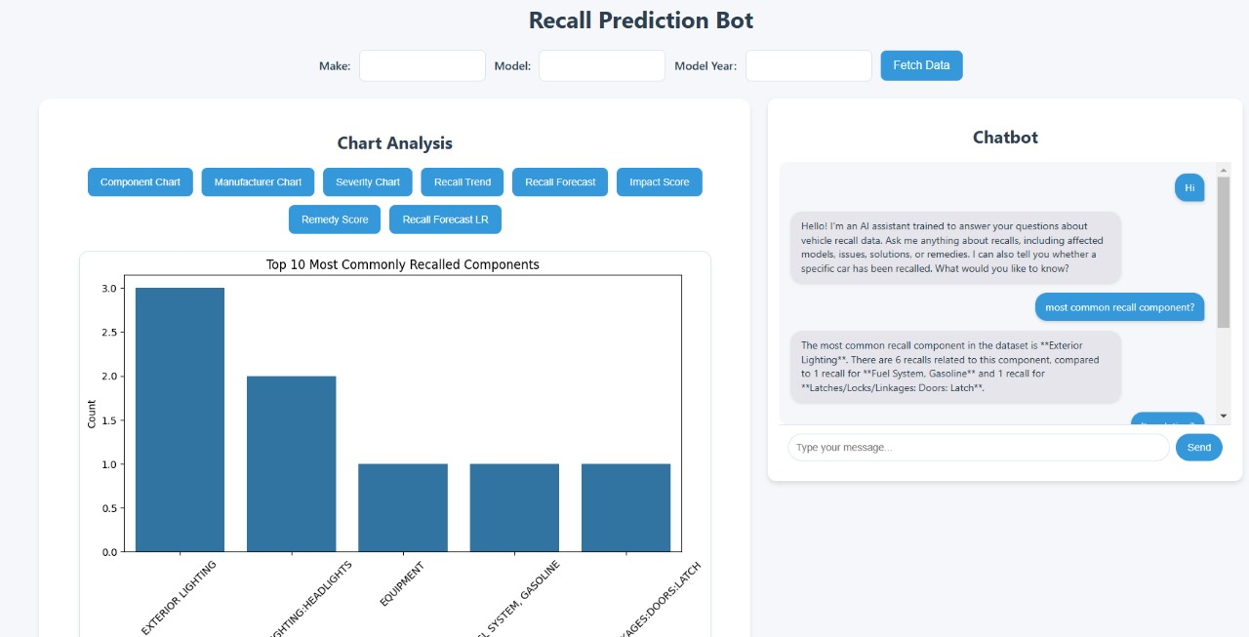

Slide 20
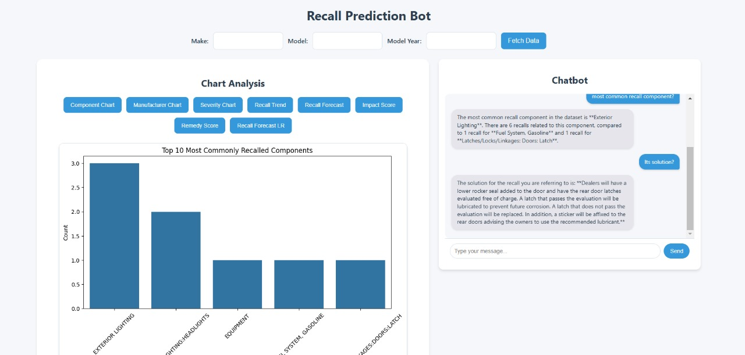

Slide 21
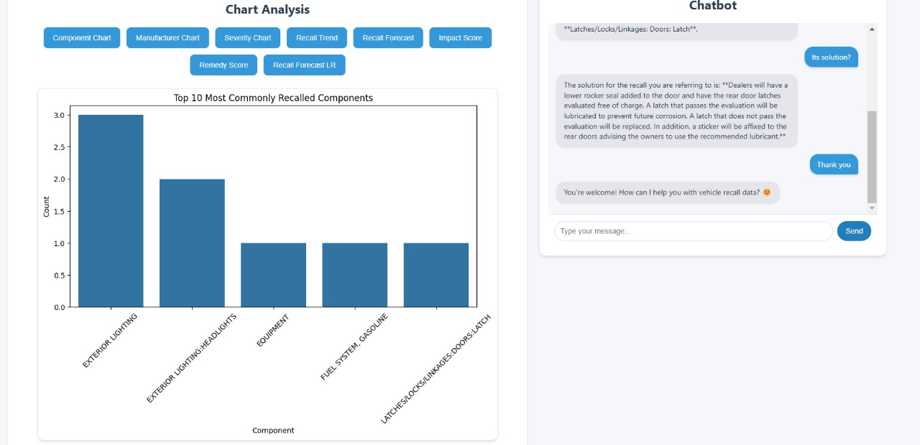

Slide 22
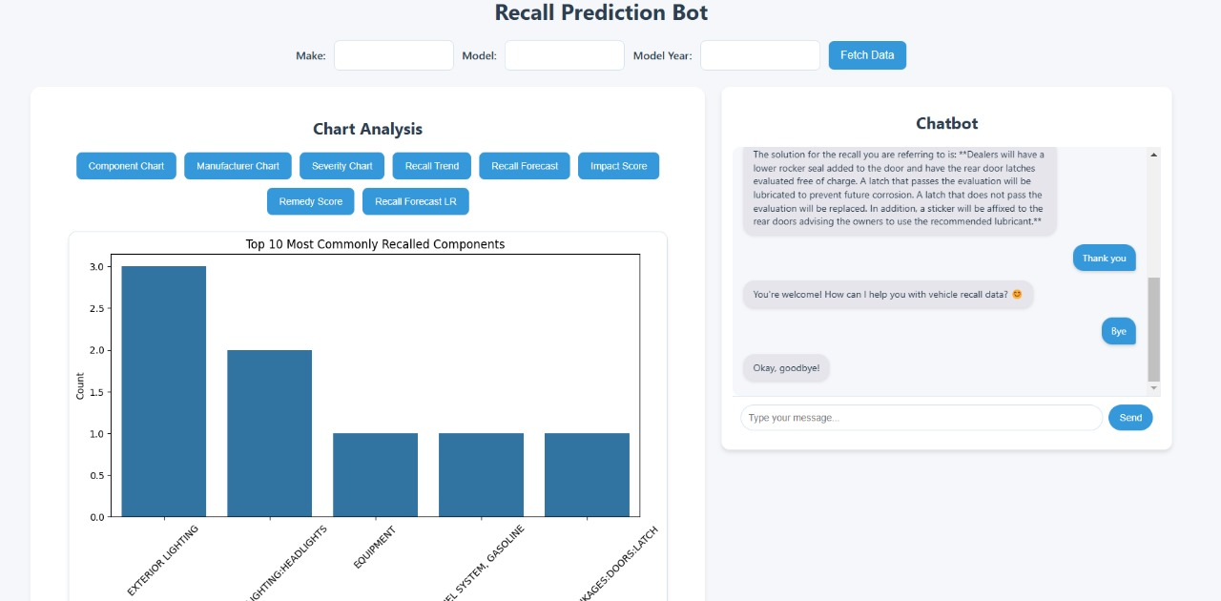

Slide 23
Challenges & Solutions
- API limitations → Optimized calls & error handling
- Data processing issues → Used Pandas
- Visualization complexity → Matplotlib & Seaborn

Slide 24
Future Scope
- Expand chatbot with voice-based interaction
- Implement a database for long-term storage
- Add user authentication & personalized tracking

