Slide 1



RECALL PREDICTION BOT
TEAM DEBUGGERS
Akash raj behera
Aakash kumar
Dev kumar
Madhav
Parthiv sen

Slide 2

CONTENT
Introduction
Technology
Flow Diagram
Exaplanation
ChatBot Implementation
Data Charts

Slide 3
INTRODUCTION
Introduction to the problem statement: "The National Highway Traffic Safety Administration (NHTSA) is responsible for regulating and enforcing safety standards for vehicles in the United States. However, recall issues still occur, resulting in significant costs and safety risks for OEMs and consumers. Our project aims to develop a predictive model that can identify potential recall issues using data from the NHTSA database."
Introduction to the NHTSA database: "The NHTSA database provides a wealth of information on recall notices, vehicle information, and manufacturer data. Our project will utilize this data to develop a predictive model that can identify potential recall issues."
Brief overview of the predictive model and chatbot: Our project will develop a predictive model using machine learning algorithms to identify potential recall issues, and a chatbot that can provide answers to related questions. The chatbot will be integrated with the predictive model to provide a user-friendly interface for OEMs and consumers.

Slide 4
TECHNOLOGY
Backend: Flask, Python
Frontend: HTML, CSS, JavaScript
Data: Pandas, Matplotlib, Seaborn
AI: Google Gemini API
API: NHTSA Recall Data

Slide 5
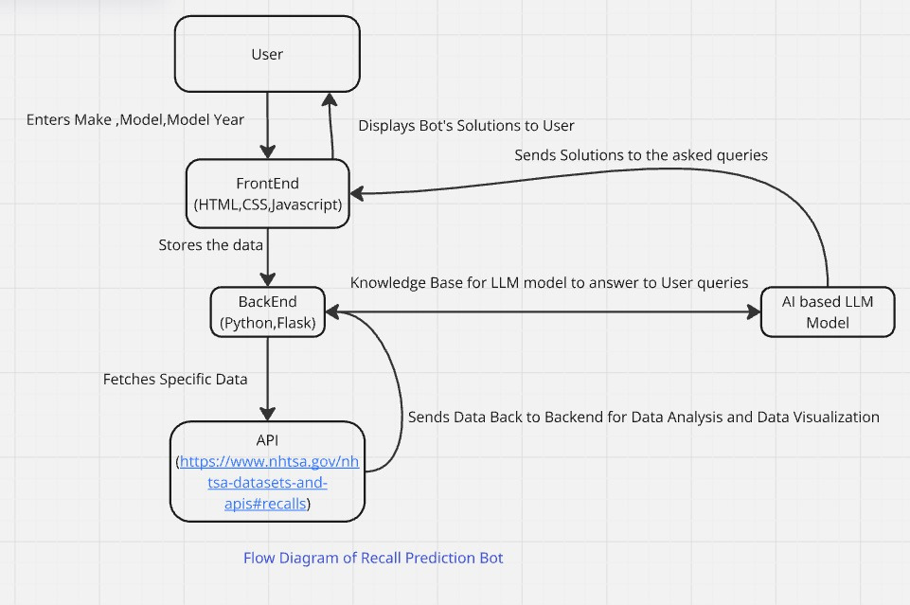
FLOW DIAGRAM

Slide 6
EXPLANATION
Explanation of the Flow Diagram: Recall Prediction Bot
This flow diagram represents the architecture and working of a Recall Prediction Bot that provides users with recall information about vehicles based on their make, model, and model year. It integrates frontend, backend, API calls, data visualization, and an AI-powered LLM model to deliver insights.
Flow Breakdown:
User Interaction:
The user enters the vehicle make, model, and model year.
The input data is processed and passed to the frontend.
Frontend (HTML, CSS, JavaScript):
The frontend captures user input and sends it to the backend for processing.
It also receives and displays the bot's solutions to the user.
Backend (Python, Flask):
The backend stores and processes the user data.
It fetches specific recall data from an external API.
It also interacts with the AI-based LLM model to generate relevant insights and answers.
API (NHTSA Vehicle Recall API):

Slide 7
The backend requests recall information from NHTSA's API.
The API returns recall details about the specified vehicle make, model, and
year.
This data is sent back to the backend for data analysis and visualization.
AI-based LLM Model:
The model serves as a knowledge base to answer user queries.
It provides insights based on recall data and general knowledge.
The backend communicates with the LLM model to generate user-friendly responses.
Data Visualization & Analysis:
The backend processes the recall data.
Insights and graphical representations are generated for better understanding.
The processed data is sent back to the frontend for display.
Final Outcome:
The user receives detailed recall information along with possible solutions.
The system ensures a seamless integration of AI, APIs, and data visualization.
The bot enhances recall awareness and assists users in making
informed decisions about vehicle safety.

Slide 8
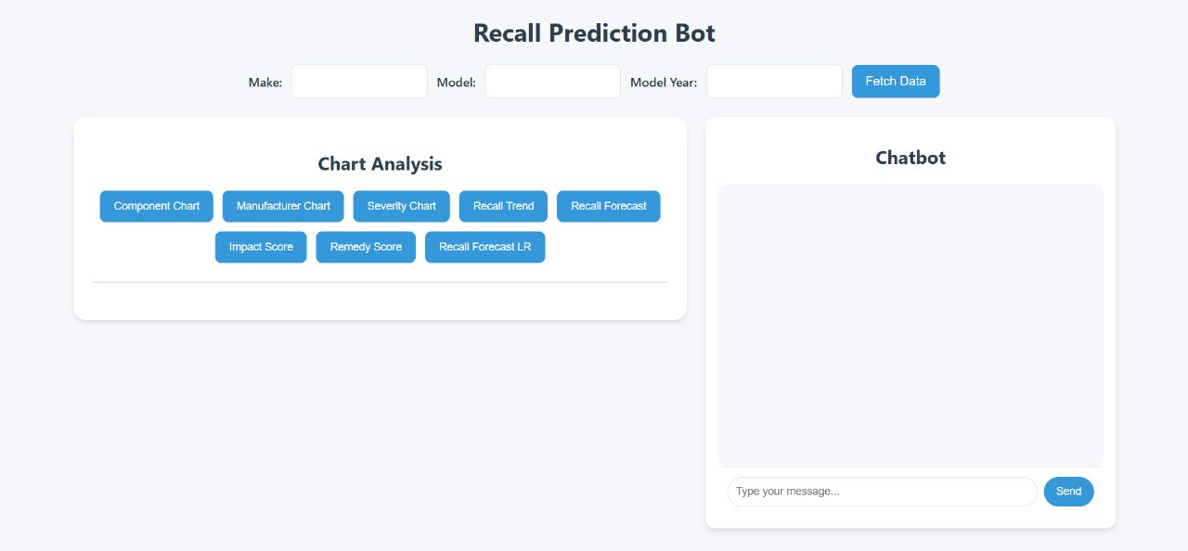
CHATBOT IMPLEMENTATION

Slide 9

RECALL PREDICTION BOT

Slide 10
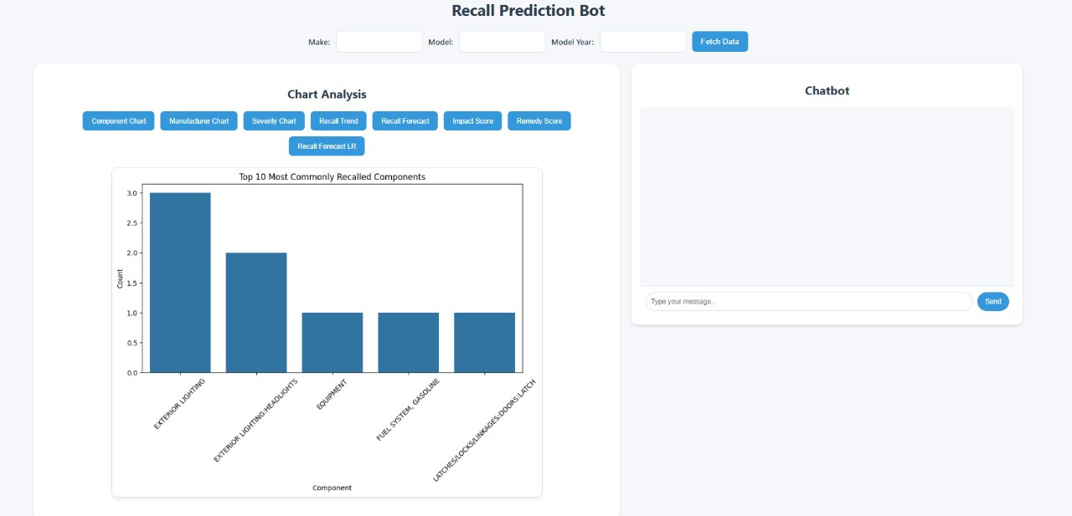
COMPONENT CHART

Slide 11
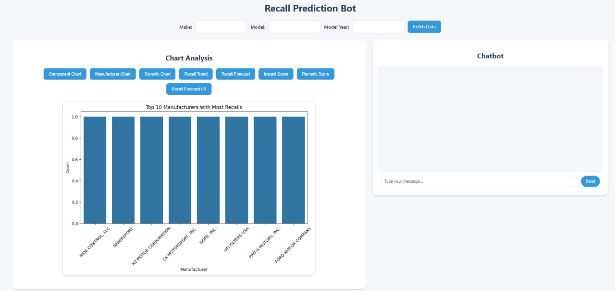
MANUFACTURERS CHART

Slide 12
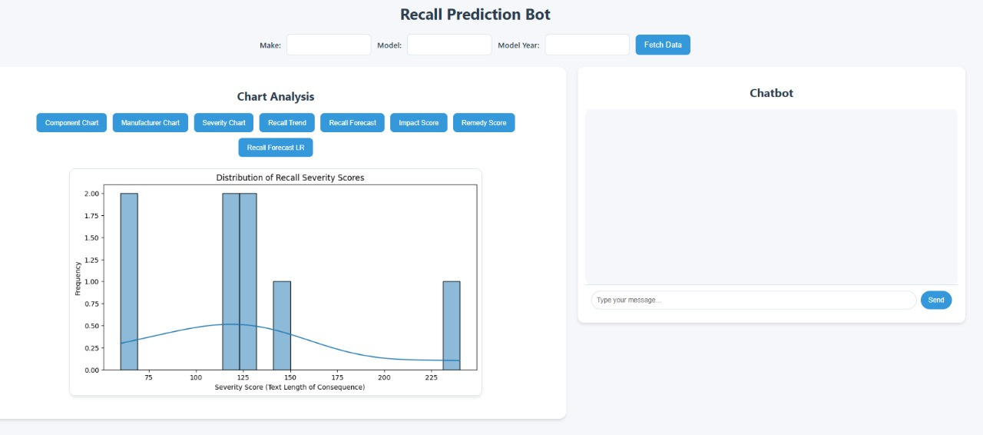
SEVERITY CHART

Slide 13
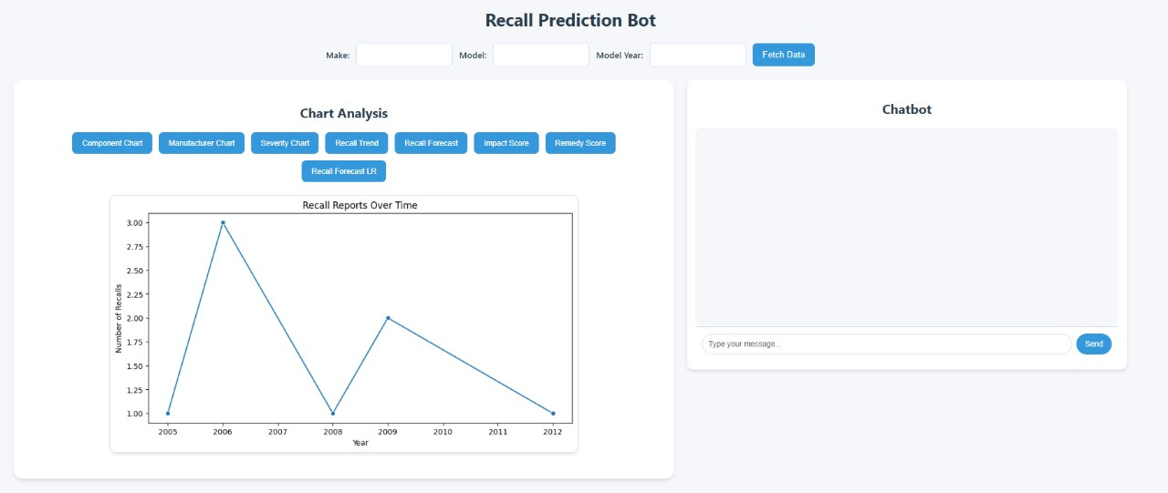
RECALL TREND CHART

Slide 14
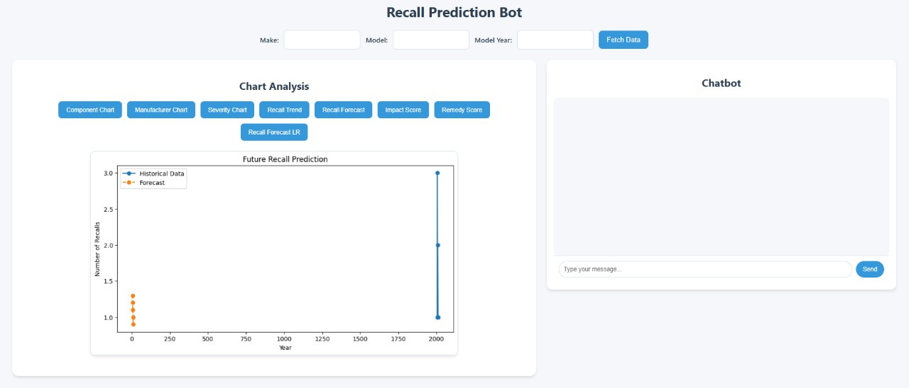
RECALL FORCAST

Slide 15
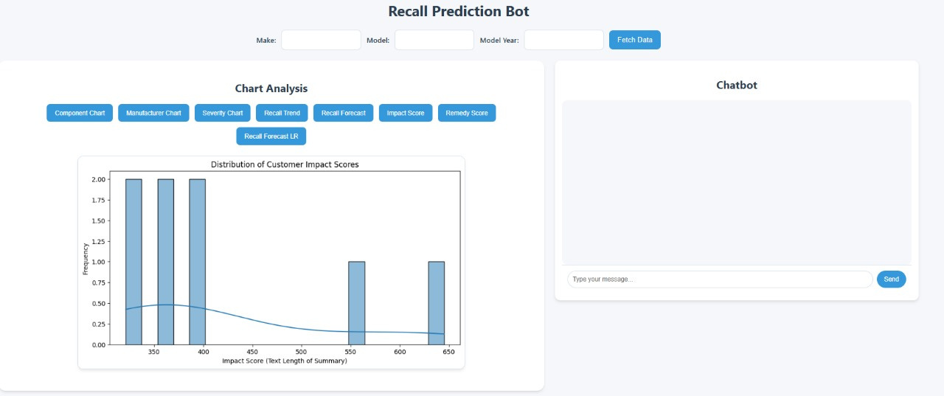
IMPACT SCORE CHART

Slide 16
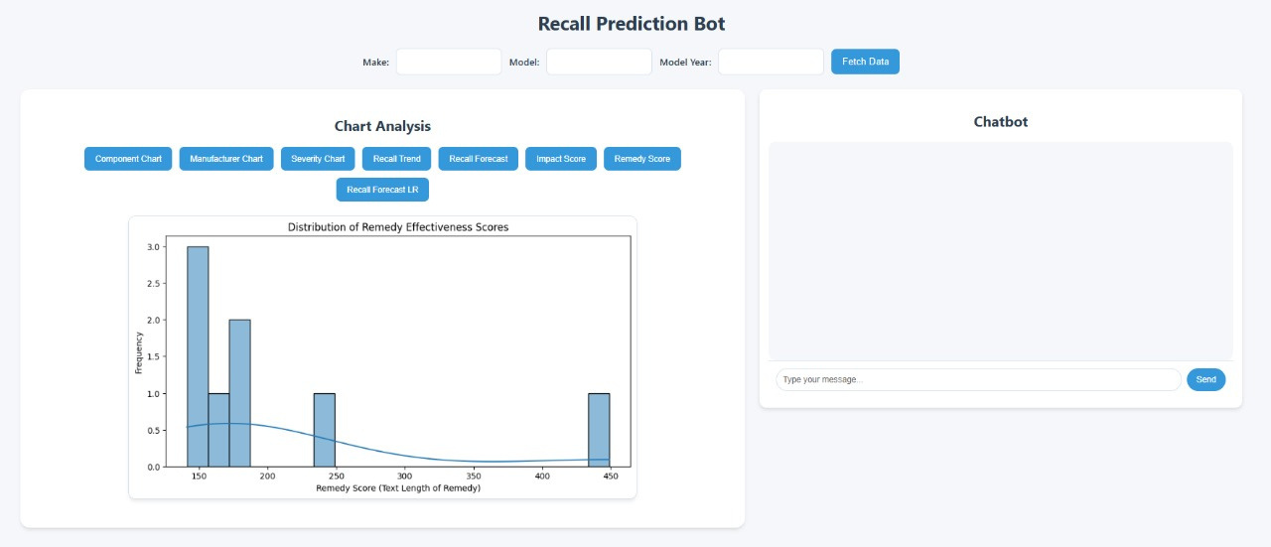
REMEDY SCORE CHART

Slide 17
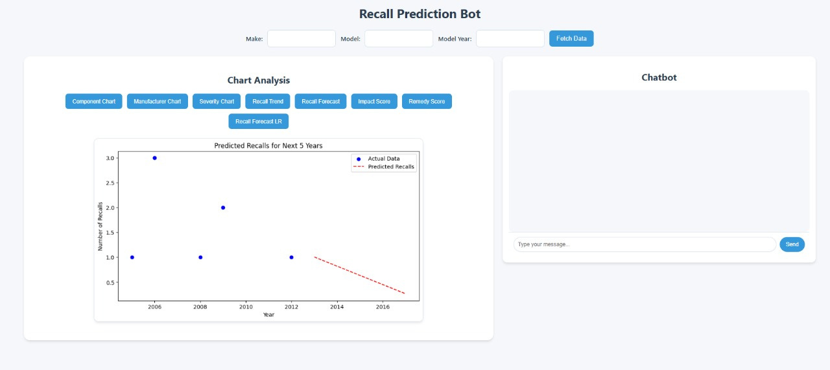
RECALL FORCASR LR CHART

Slide 18
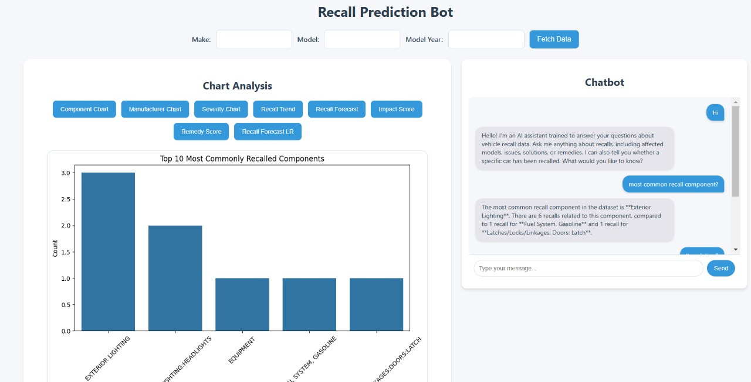
RECALL PREDICTION BOT

Slide 19
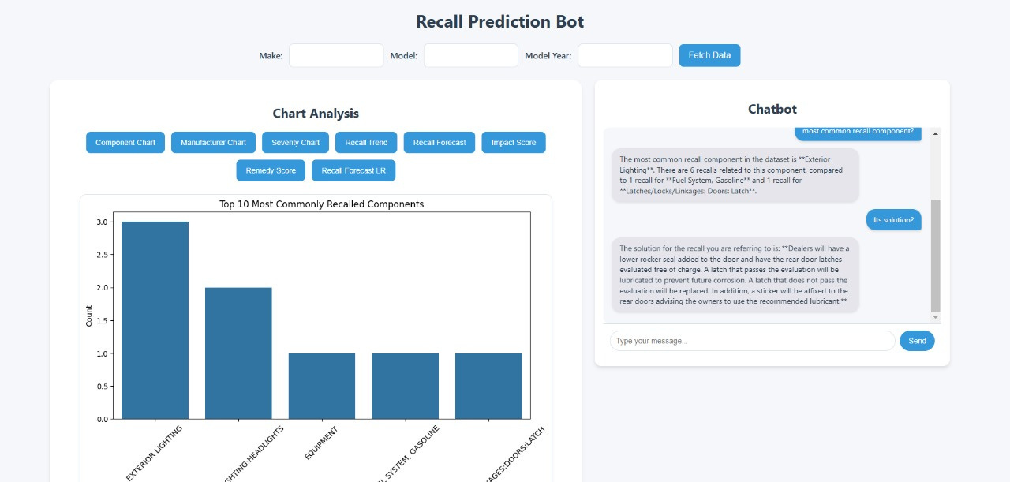
RECALL PREDICTION BOT

Slide 20
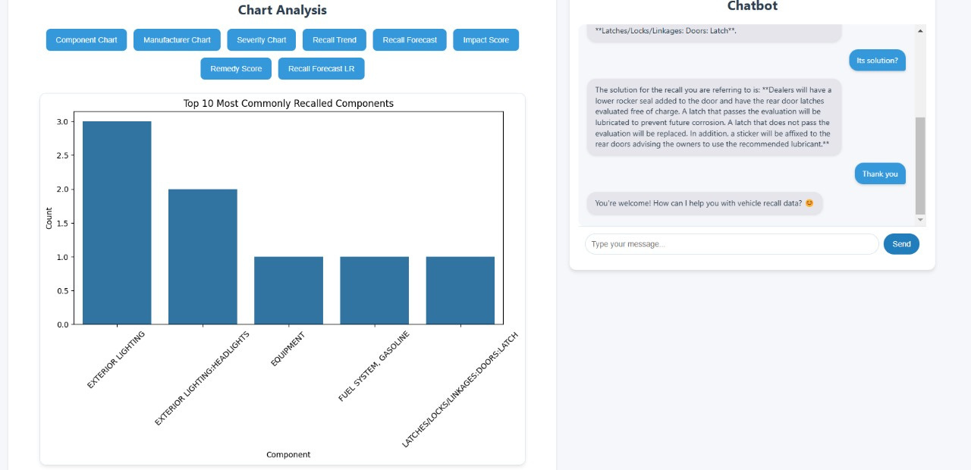
RECALL PREDICTION BOT

Slide 21
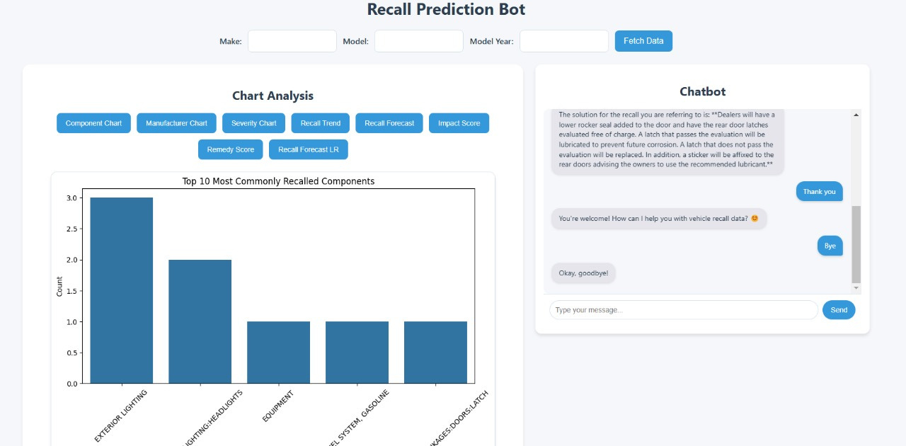
RECALL PREDICTION BOT

Slide 22
THANK YOU

