Slide 1

DATA VISUALIZATION REVIEW -2
01
02
Streaming Content Dashboard
03
Team Members: SAURISH SHARMA (20BCE1370)
RITIK SINGH (20BCE1384)
AKASH RAJ BEHERA (20BCE1829)
04

Slide 2
INTRODUCTION
01
Recommender Systems (RSs) are characterized by the capability of filtering large information spaces and selecting the items that are likely to be more interesting and attractive to a user.
OTT Platforms are the biggest users of recommendation systems. So, in this Project we aim to visualize the content library of top OTT Platforms like Netflix, Disney Plus, Hulu and Amazon Prime. While doing this we will also discover correlations and recurring patterns in the dataset with interesting inferences.
Finally, we will see how the recommendation engine works to deliver similar content as quickly as possible.
02
03
04

Slide 3
ABOUT THE DATASET
01
For this project we will use 4 datasets containing of listings of all the movies and tv shows available on Netflix, Hulu, Disney Plus and Amazon Prime, along with details such as - cast, directors, ratings, release year, duration, etc. In total there are approximately 22k observations. It is obtained from Kaggle Open-Source Dataset Library (Source).
02
03
04

Slide 4
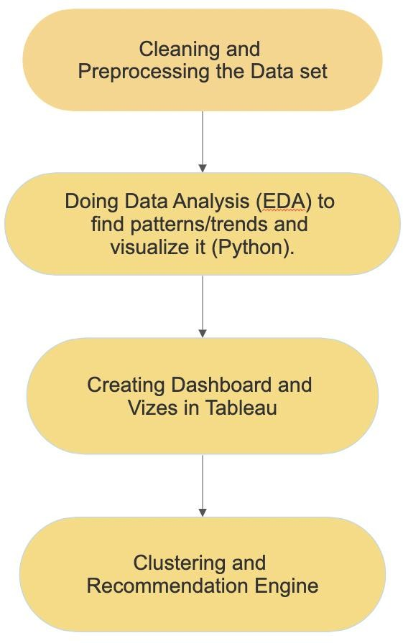
DESIGN AND FLOW OF MODEL
01
02
03
04

Slide 5
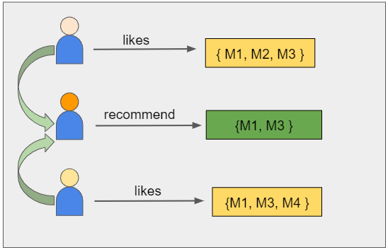
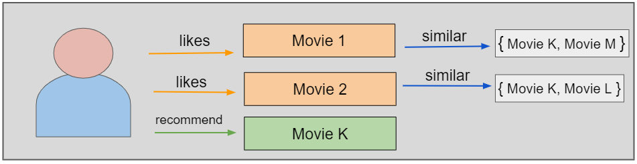
Matrix factorization is a class of collaborative filtering algorithms used in recommender systems. This family of methods became widely known during the Netflix prize challenge due to how effective it was. Matrix factorization algorithms work by decomposing the user-movie interaction matrix into the product of two lower dimensionality rectangular matrices, say U and M. The decomposition is done in such a way that the product results in almost similar values to the user-movie interaction matrix. Here, U represents the user matrix, M represents the movie matrix, n is the number of users, and m is the number of movies.
ARCHITECTURE
For example, if user A watches M1, M2, and M3, and user B watches M1, M3, M4, we recommend M1 and M3 to a similar user C. You can see how this looks in the figure below for clearer reference.

Slide 6
MODULES
01
Module 1: data cleaning and dataset analysis
After Importing the data set, we need to clean it and analyze what data we were able to collect. After this we can easily plan which parameters to visualize.
Module 2: Doing Data Analysis (FDA) to find patterns/trends and visualize it (Python).
The attributes from the obtained data set are compared with each other to find correlations and dependencies and then these are visualized using different types of graphs. We can use these graphs to visualize common trends in the dataset.
Module 3: Creating Dashboard and Vizes in Tableau
We then use Tableau to further Visualize the Dataset and create interactive Dashboards. We found Tableau to be an incredibly versatile and powerful tool for this purpose.
02
03
04

Slide 7

MODULES
Module 4: Clustering and Recommendation Engine
We will use K-Means clustering to cluster similar data. We then append the cluster id generated to the combined dataset to facilitate the recommendation engine
K-means
K-means algorithm is an iterative algorithm that tries to partition the dataset into K pre-defined distinct non-overlapping subgroups (clusters) where each data point belongs to only one group. It tries to make the intra-cluster data points as similar as possible while also keeping the clusters as different (far) as possible.
The way kmeans algorithm works is as follows:
Specify number of clusters K.
Initialize centroids by first shuffling the dataset and then randomly selecting K data points for the centroids without replacement.
Keep iterating until there is no change to the centroids.
Compute the sum of the squared distance between data points and all centroids.
Assign each data point to the closest cluster (centroid).
Compute the centroids for the clusters by taking the average of the all- data points that belong to each cluster.
The objective function is:
01
02
03
04

Slide 8
Recommendation Engine
01
The recommendation Engine takes a Movie or Show Title as an input. It then finds the cluster id of that entry. It uses the cluster id to reduce the search space.
Now it runs a text similarity check between the description of entered show or movie to find similar content from that cluster.
Thus, using K-Means and Text Similarity, it achieves fast and accurate results.
02
03
04

Slide 9
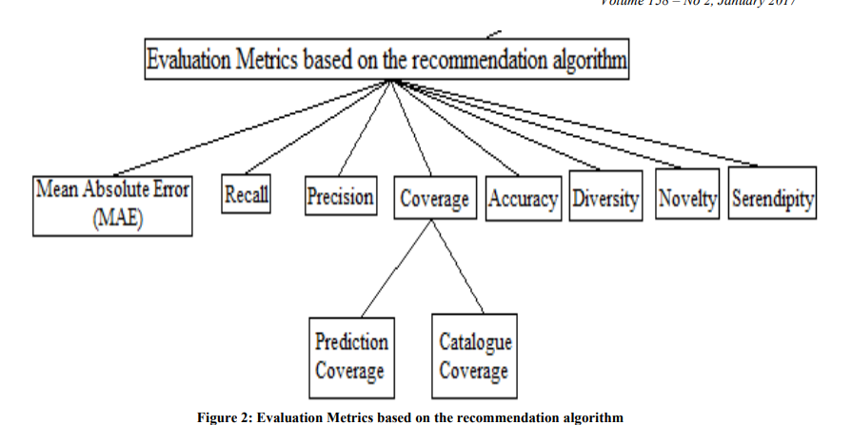
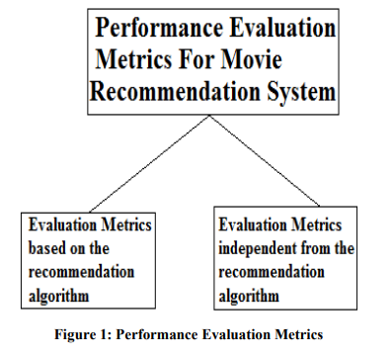
PERFORMANCE METRICS
According to many researches, we come to know that for evaluating performance of a movie recommendation system only accuracy is not the criteria but we should also consider other important parameters. Recommendation quality is also equally significant metric. Performance Evaluation Metrics can be divided into two parts :
• Evaluation Metrics based on the recommendation algorithm
• Evaluation Metrics independent from the recommendation algorithm

Slide 10
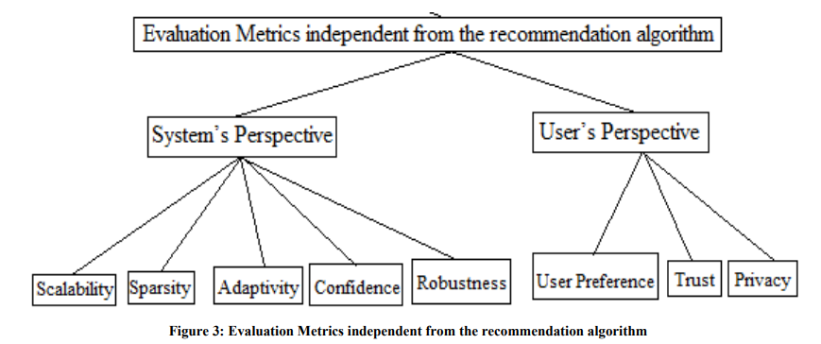
PERFORMANCE METRICS

Slide 11
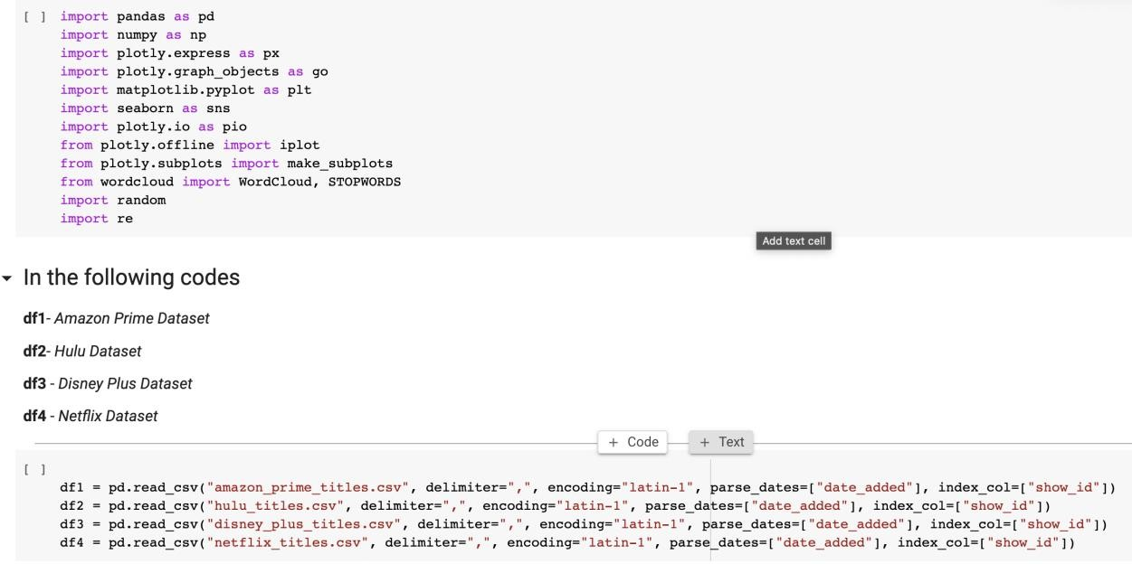
IMPLEMENTATION
1 First we import modules and datasets.
Importing all the libraries and modules
First import the libraries to better analyze the data set. Here matplotlib and plotly are used for visualization and word cloud.
01
02
03
04

Slide 12
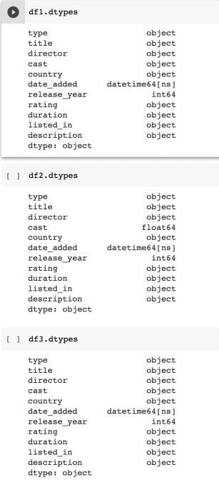
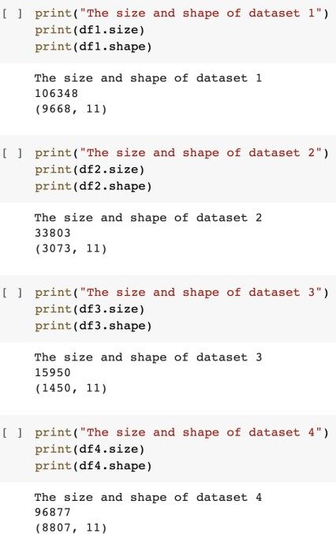
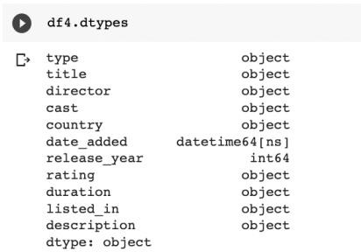
IMPLEMENTATION
2) Dataset Analysis
01
02
03
04
Here we can see the size and attributes of the dataset. All data is in correct form except cast in df2 (Hulu) which is in float64 format. We will resolve that in pre processing

Slide 13
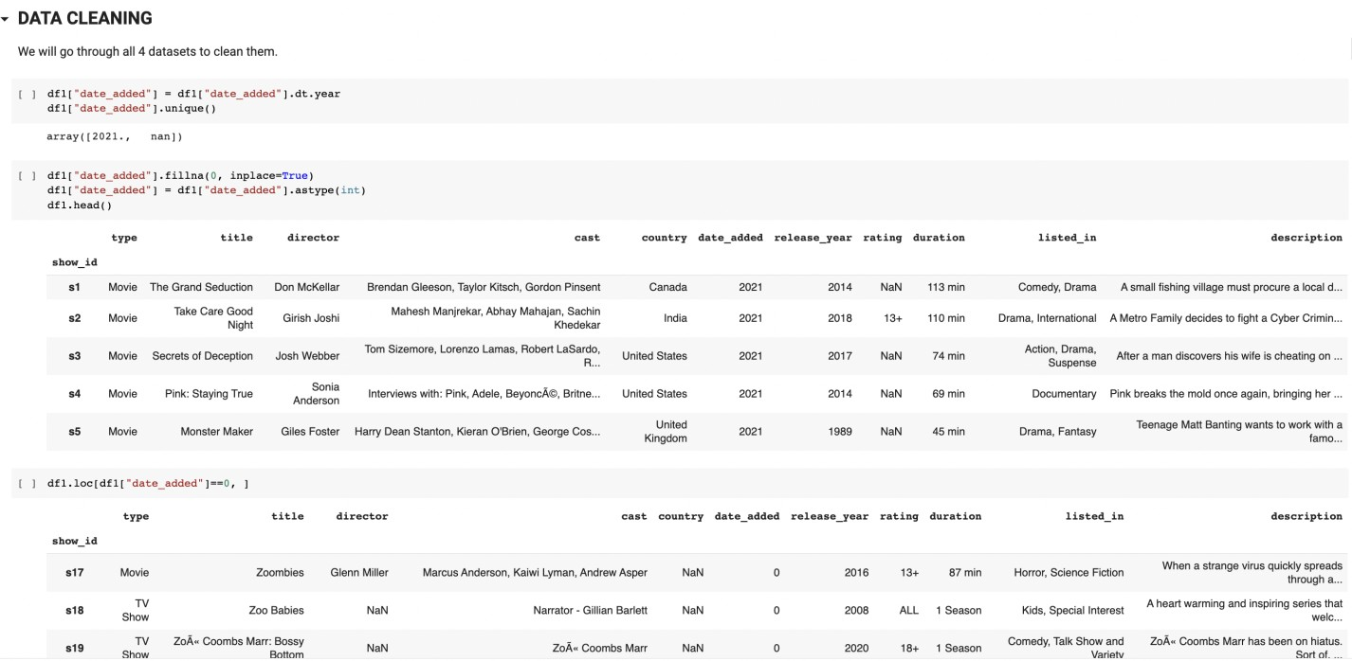
IMPLEMENTATION
01
3)Data Cleaning and Pre-processing
02
03
04
Here we transform the date_added and date_released fields to extract years from it. We also check for and remove Null values. We do the same for all dataset.

Slide 14
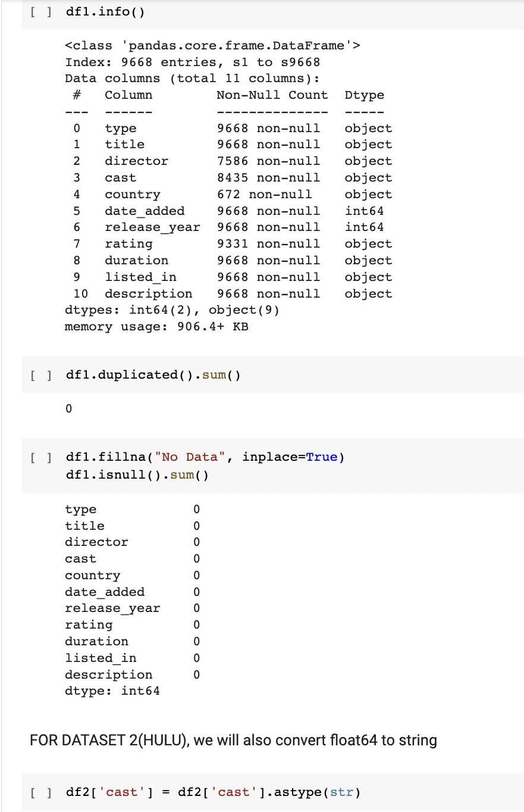
IMPLEMENTATION
01
02
03
04
Here, we check the datasets for null and duplicated values as well as missing data. We also convert the float64 column from Hulu dataset to String format.

Slide 15
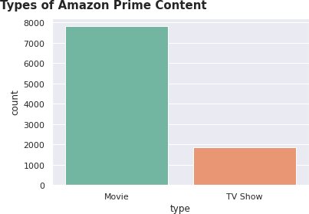
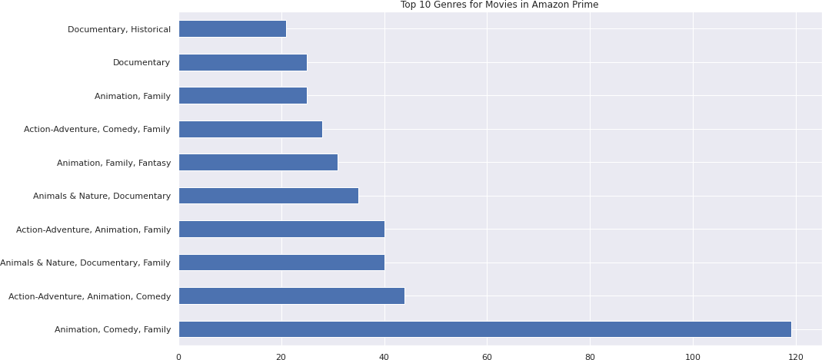
IMPLEMENTATION
4)Visualization of Datasets
01
02
03
04

Slide 16
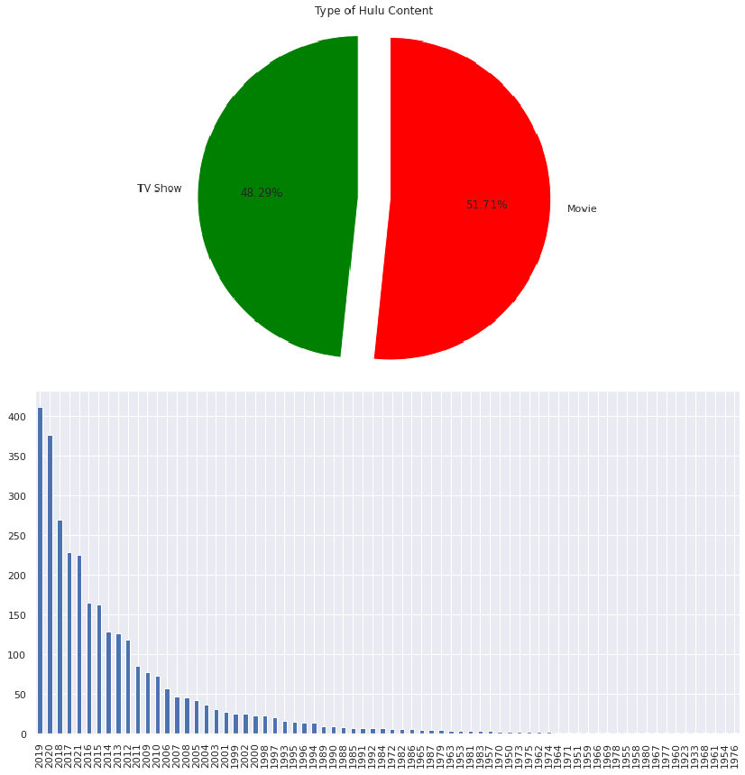
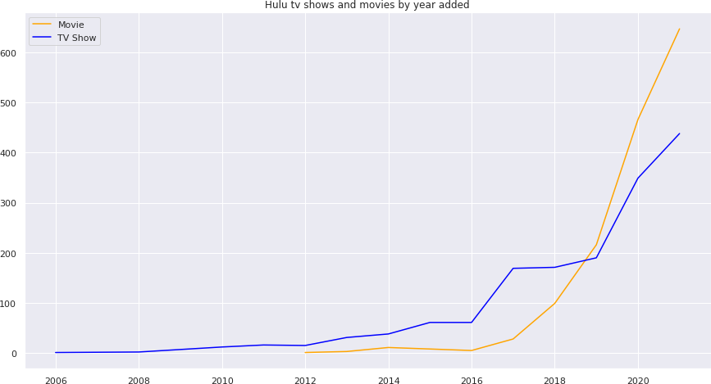
IMPLEMENTATION
4)Visualization of Datasets
01
02
Content by their Release year on Hulu
03
04

Slide 17
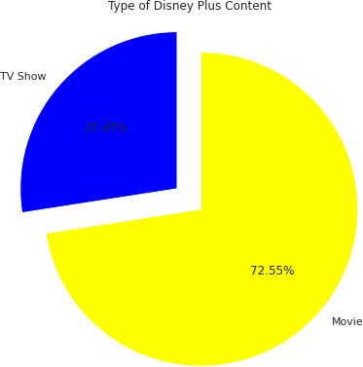
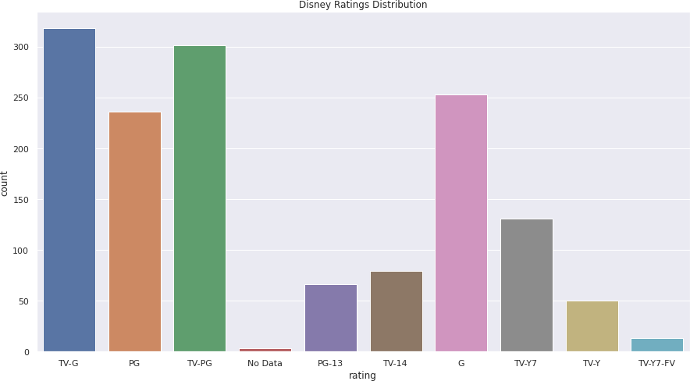
IMPLEMENTATION
4)Visualization of Datasets
01
02
03
04

Slide 18

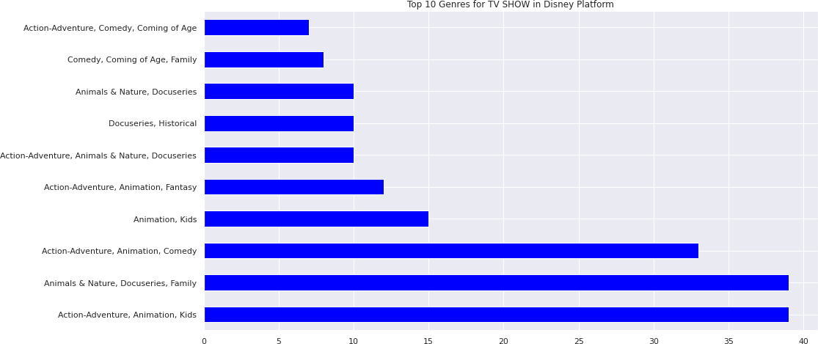
IMPLEMENTATION
4)Visualization of Datasets
01
02
03
04

Slide 19
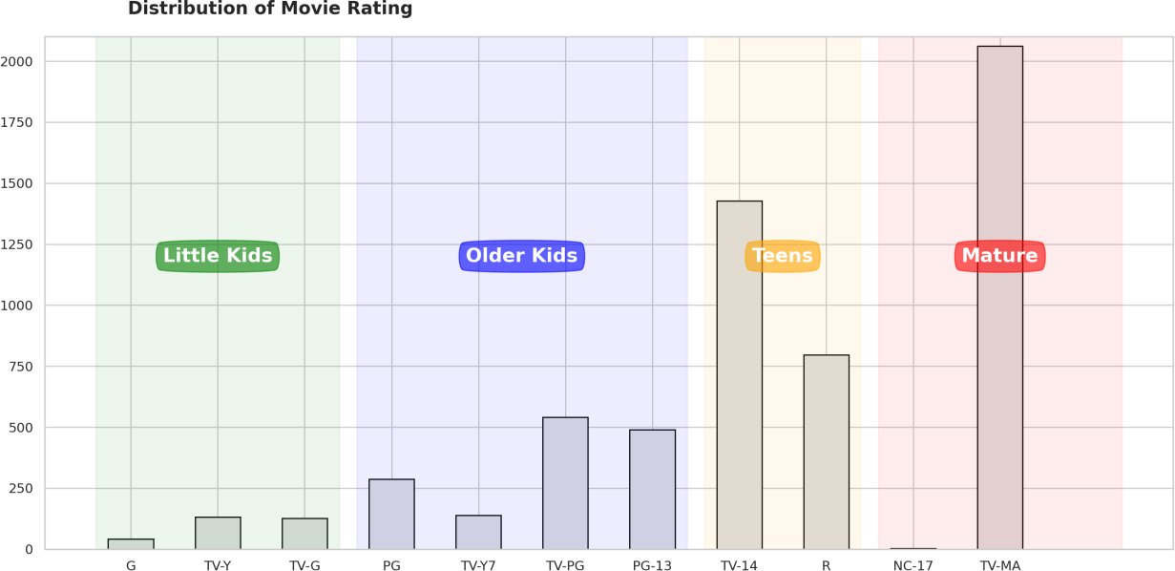
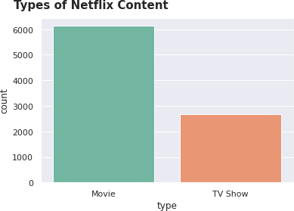
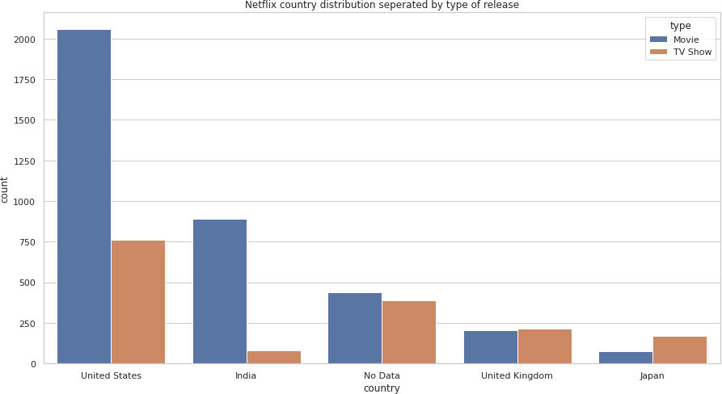
IMPLEMENTATION
4)Visualization of Datasets
01
02
03
04

Slide 20
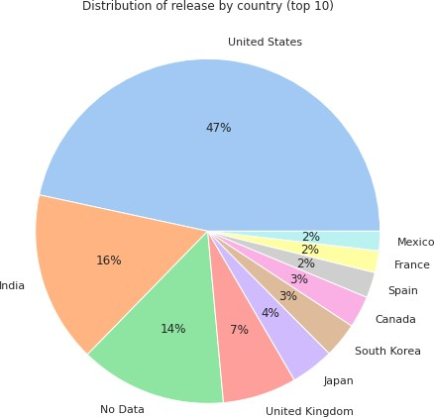
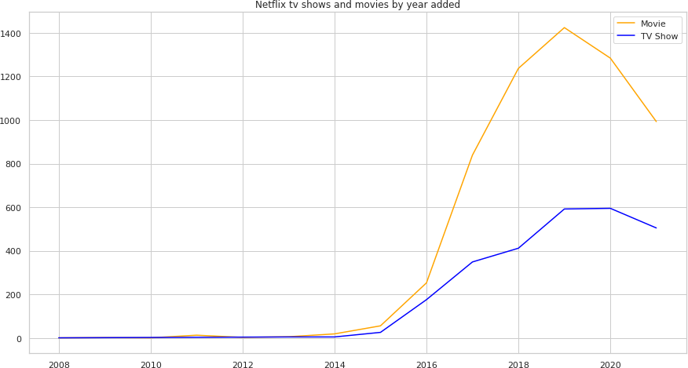
IMPLEMENTATION
4)Visualization of Datasets
01
02
03
04

Slide 21
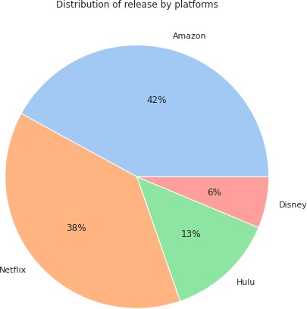
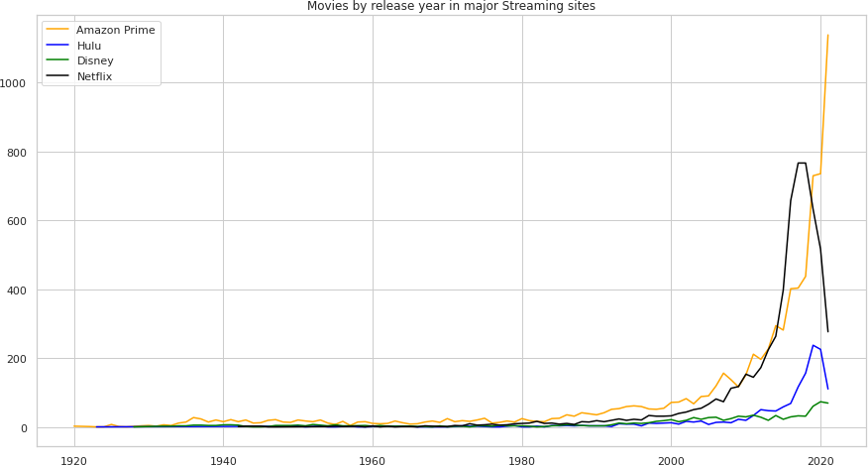
IMPLEMENTATION
5)CREATING ONE UNIFIED DATASET AND VISUALIZING IT
01
02
03
04

Slide 22
REFERENCES
1. https://www.researchgate.net/publication/331966843_Content- Based_Movie_Recommendation_System_Using_Genre_Correlation#:~:text=A%20recommendation%20system%20is%20a,present%20in%20previously%20liked%20movies. 2. https://ieeexplore.ieee.org/document/6382910

Slide 23
THANK YOU !

