Slide 1

DATA VISUALIZATION REVIEW -3
01
02
Streaming Content Dashboard
03
Team Members: SAURISH SHARMA (20BCE1370)
RITIK SINGH (20BCE1384)
AKASH RAJ BEHERA (20BCE1829)
04

Slide 2
WHAT OUR PROJECT CLAIMS?
01
Our project basically is a movie recommendation system where user can get movie recommended from four online movie streaming platforms A.K.A. OTT PLATFORMS such as NETFLIX, HULU, AMAZON PRIME & DISNEY HOTSTAR and the movie is recommended in genres for eg. If a user wants to watch action genre movie, the user can choose the online platform the user can that has the greatest number of action movie which is implemented using tableau visualization will be helpful to find a particular movie according to the mood of the user. We use page rank algorithm model, cluster model , CAR (Credible association rule) , a new method to relate and track documents. The CAR does not use prior knowledge of category structure as compared to other automated procedures. linked textual corpus using the relationship of topics in terms of the distribution and the link distribution , discovered rich patterns of topic evolution within built-in features of time-stamped documents. Instead of analyzing documents on the specific interval, the method focuses and treats topics separately as they appear over time in chronological order , retrieval of temporal and event-based knowledge from a huge collection of historical documents. The method uses temporal text mining (TTM) and Topic detection and tracking (TDT) techniques. highlighted topic evolution in text data as an important task. The Text Flow has been introduced; which studies various patterns that appear from various topics. focused on detecting topics with immense information available over the internet. They introduced a new method by combining Suffix Tree Clustering (STC) and Semantic analysis that approaches the problem in two steps. The semantic analysis is used to add significance to the topics and the significance can be measured by applying filters to the words and analyzing structure of words under a cluster which share the same meaning , news collection should be structured such that topic detection and clustering become easy. The vector space model (VSM) is one of the easiest and productive methods that can be used for the representation of topics, and the Information gain algorithm is used for feature selection. The features, then ranked by assigning a score to each of them.
02
03
04

Slide 3
PERCENTAGE OF COMPLETION:-
01
100% effort, 94% accomplished.
In this project we were able to accomplish 90% of what we thought to accomplish in the beginning. We faced many challenges along our way and were able to find solutions to most of the problems.
02
03
04

Slide 4
PUBLICITY:(GITHUB.COM)
01
akashrajbehera20bce1829/DV-J-COMP (github.com)
SAME LINK FOR ALL CONTRIBUTORS. ( CONTRIBUTORS ARE ADDED FOR THE RESPECTIVE REPOSITORY)
02
03
04

Slide 5
CONTRIBUTION OF THE MEMBERS:-
01
1. Saurish Sharma: literature survey , research , idea generation
2. Ritik Singh : Data visualization and deployment using tableau
3. Akash Raj Behera : Data cleaning , data set analysis , Jupyter notebook .
Documentation for review 1, review 2 and review 3 done in unison.
02
03
04

Slide 6
INTRODUCTION
01
Recommender Systems (RSs) are characterized by the capability of filtering large information spaces and selecting the items that are likely to be more interesting and attractive to a user.
OTT Platforms are the biggest users of recommendation systems. So, in this Project we aim to visualize the content library of top OTT Platforms like Netflix, Disney Plus, Hulu and Amazon Prime. While doing this we will also discover correlations and recurring patterns in the dataset with interesting inferences.
Finally, we will see how the recommendation engine works to deliver similar content as quickly as possible.
02
03
04

Slide 7
ABOUT THE DATASET
01
For this project we will use 4 datasets containing of listings of all the movies and tv shows
available on Netflix, Hulu, Disney Plus and Amazon Prime, along with details such as - cast, directors, ratings, release year, duration, etc. In total there are approximately 22k observations. It is obtained from Kaggle Open-Source Dataset Library (Source).
02
03
04

Slide 8
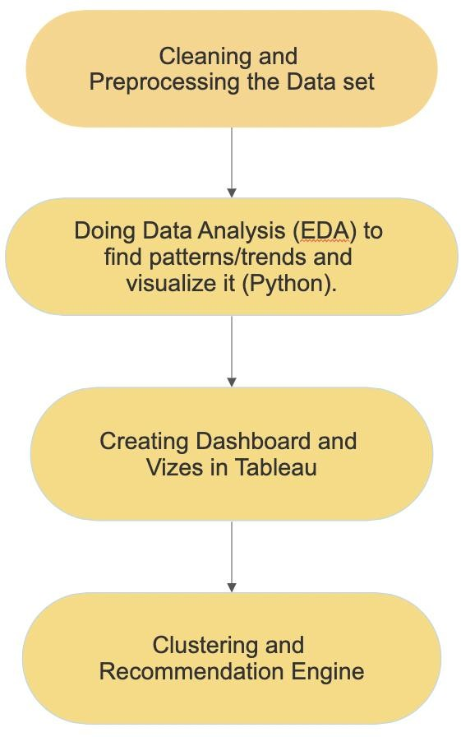
DESIGN AND FLOW OF MODEL
01
02
03
04

Slide 9
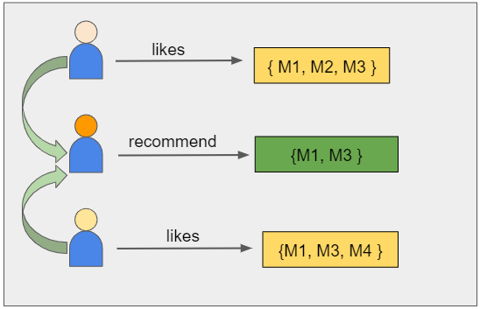
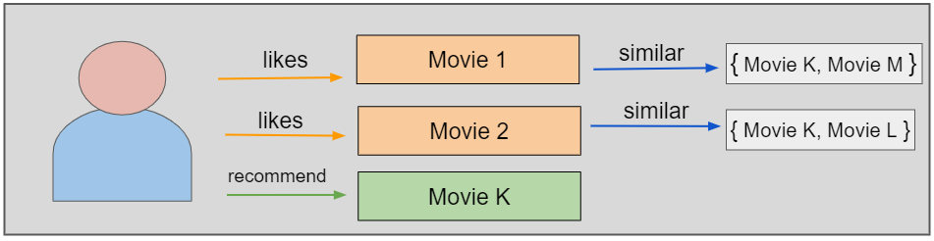
Matrix factorization is a class of collaborative filtering algorithms used in recommender systems. This family of methods became widely known during the Netflix prize challenge due to how effective it was. Matrix factorization algorithms work by decomposing the user-movie interaction matrix into the product of two lower dimensionality rectangular matrices, say U and M. The decomposition is done in such a way that the product results in almost similar values to the user-movie interaction matrix. Here, U represents the user matrix, M represents the movie matrix, n is the number of users, and m is the number of movies.
ARCHITECTURE
For example, if user A watches M1, M2, and M3, and user B watches M1, M3, M4, we recommend M1 and M3 to a similar user C. You can see how this looks in the figure below for clearer reference.

Slide 10
MODULES
01
Module 1: data cleaning and dataset analysis
After Importing the data set, we need to clean it and analyze what data we were able to collect. After this we can easily plan which parameters to visualize.
Module 2: Doing Data Analysis (FDA) to find patterns/trends and visualize it (Python).
The attributes from the obtained data set are compared with each other to find correlations and dependencies and then these are visualized using different types of graphs. We can use these graphs to visualize common trends in the dataset.
Module 3: Creating Dashboard and Vizes in Tableau
We then use Tableau to further Visualize the Dataset and create interactive Dashboards. We found Tableau to be an incredibly versatile and powerful tool for this purpose.
02
03
04

Slide 11

MODULES
Module 4: Clustering and Recommendation Engine
We will use K-Means clustering to cluster similar data. We then append the cluster id generated to the combined dataset to facilitate the recommendation engine
K-means
K-means algorithm is an iterative algorithm that tries to partition the dataset into K pre-defined distinct non-overlapping subgroups (clusters) where each data point belongs to only one group. It tries to make the intra-cluster data points as similar as possible while also keeping the clusters as different (far) as possible.
The way kmeans algorithm works is as follows:
Specify number of clusters K.
Initialize centroids by first shuffling the dataset and then randomly selecting K data points for the centroids without replacement.
Keep iterating until there is no change to the centroids.
Compute the sum of the squared distance between data points and all centroids.
Assign each data point to the closest cluster (centroid).
Compute the centroids for the clusters by taking the average of the all- data points that belong to each cluster.
The objective function is:
01
02
03
04

Slide 12
Recommendation Engine
01
The recommendation Engine takes a Movie or Show Title as an input. It then finds the cluster id of that entry. It uses the cluster id to reduce the search space.
Now it runs a text similarity check between the description of entered show or movie to find similar content from that cluster.
Thus, using K-Means and Text Similarity, it achieves fast and accurate results.
02
03
04

Slide 13
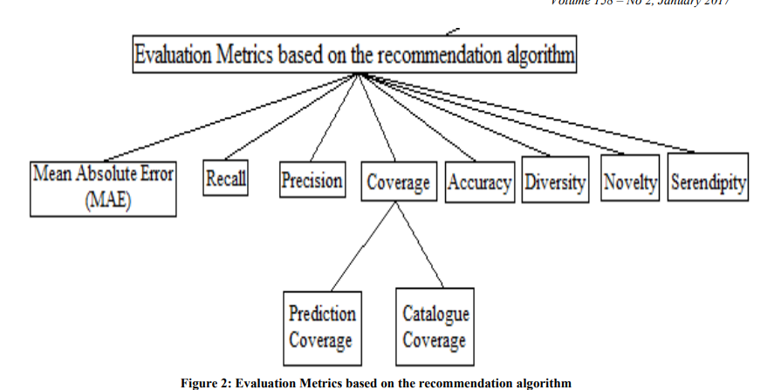
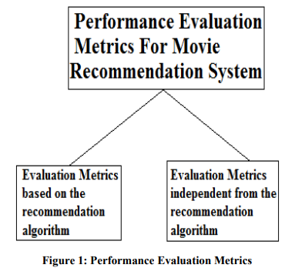
PERFORMANCE METRICS
According to many researches, we come to know that for evaluating performance of a movie recommendation system only accuracy is not the criteria but we should also consider other important parameters. Recommendation quality is also equally significant metric. Performance Evaluation Metrics can be divided into two parts :
• Evaluation Metrics based on the recommendation algorithm
• Evaluation Metrics independent from the recommendation algorithm

Slide 14
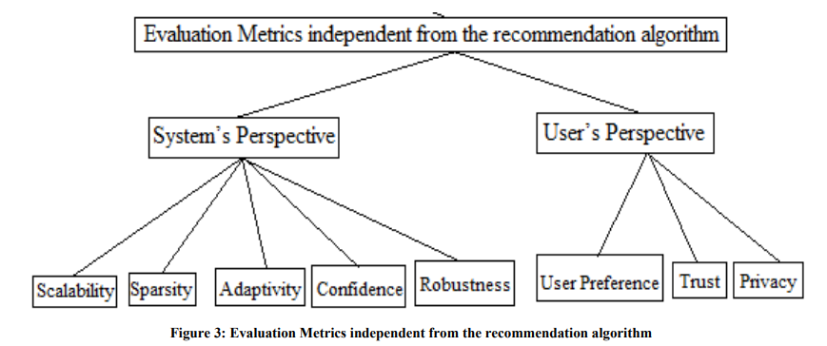
PERFORMANCE METRICS

Slide 15
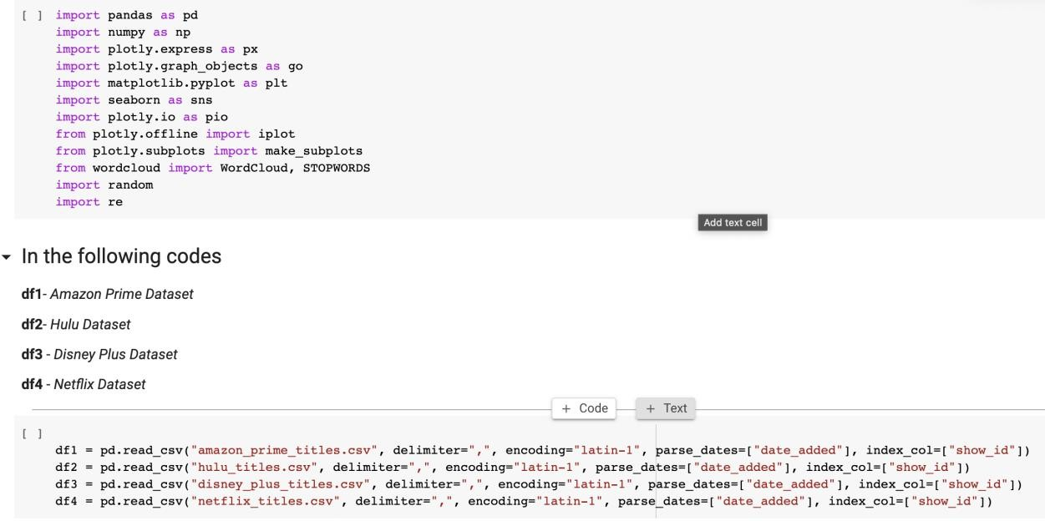
IMPLEMENTATION
1 First we import modules and datasets.
Importing all the libraries and modules
First import the libraries to better analyze the data set. Here matplotlib and plotly are used for visualization and word cloud.
01
02
03
04

Slide 16
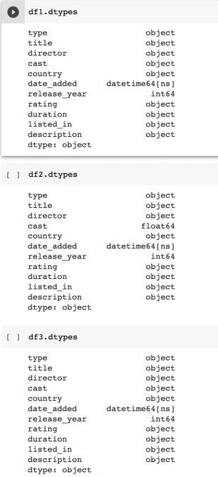
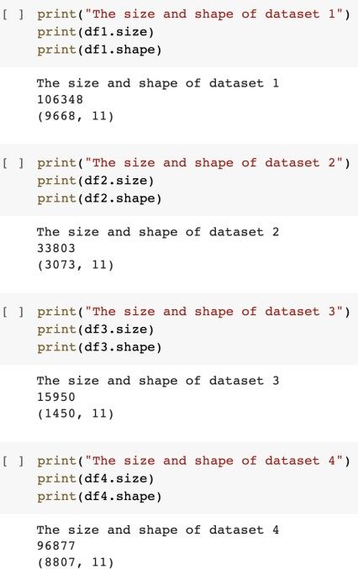
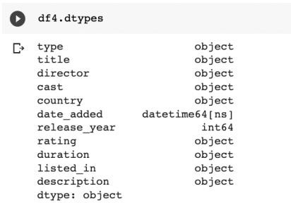
IMPLEMENTATION
2) Dataset Analysis
01
02
03
04
Here we can see the size and attributes of the dataset. All data is in correct form except cast in df2 (Hulu) which is in float64 format. We will resolve that in pre processing

Slide 17
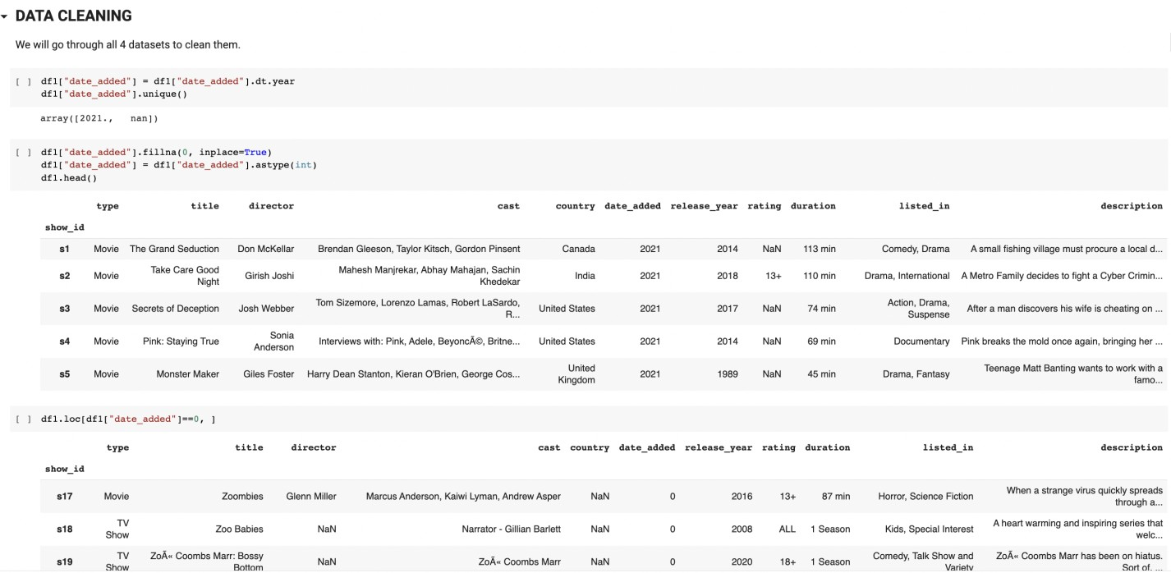
IMPLEMENTATION
01
3)Data Cleaning and Pre-processing
02
03
04
Here we transform the date_added and date_released fields to extract years from it. We also check for and remove Null values. We do the same for all dataset.

Slide 18
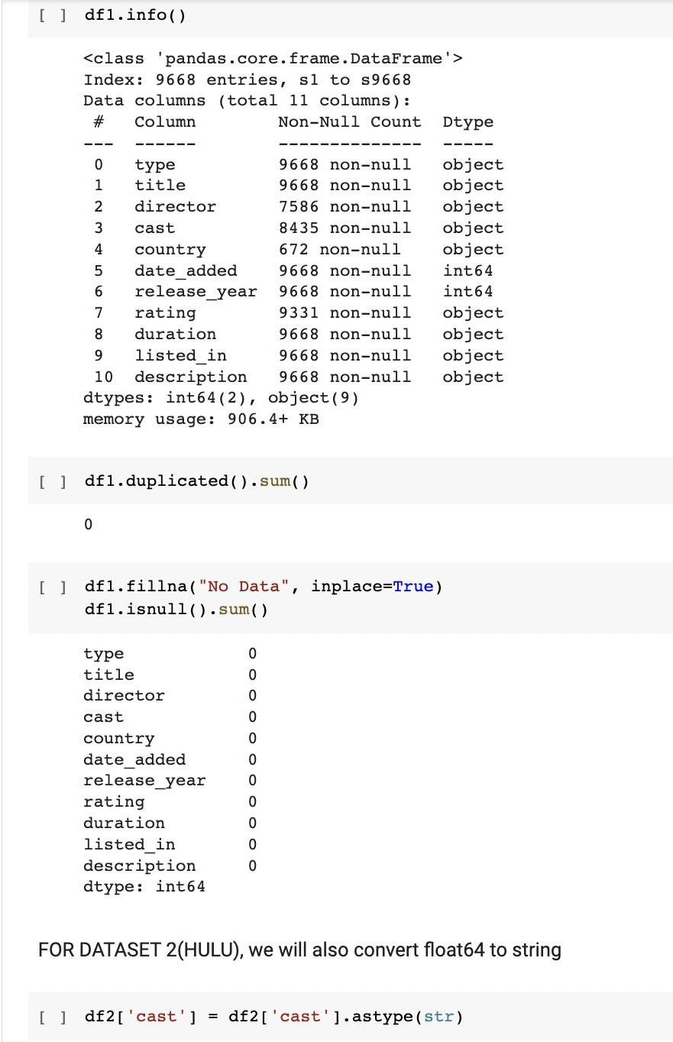
IMPLEMENTATION
01
02
03
04
Here, we check the datasets for null and duplicated values as well as missing data. We also convert the float64 column from Hulu dataset to String format.

Slide 19
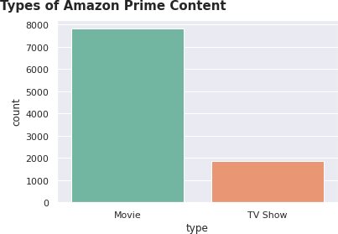
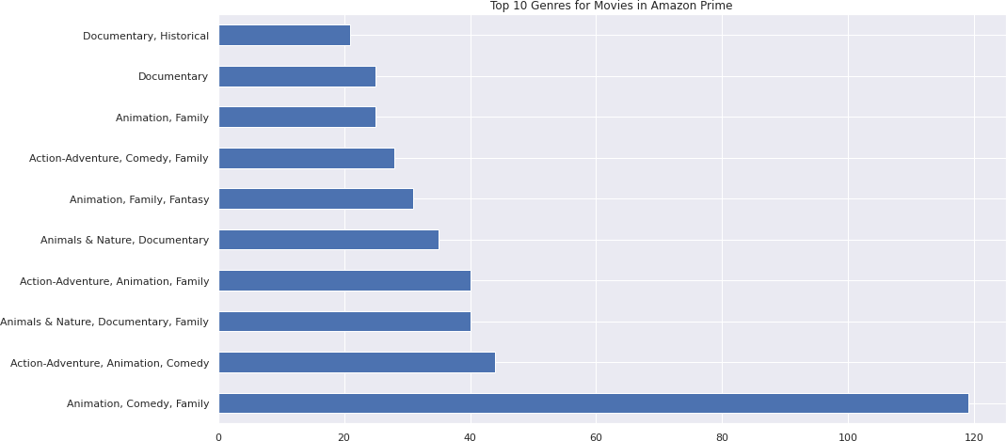
IMPLEMENTATION
4)Visualization of Datasets
01
02
03
04

Slide 20
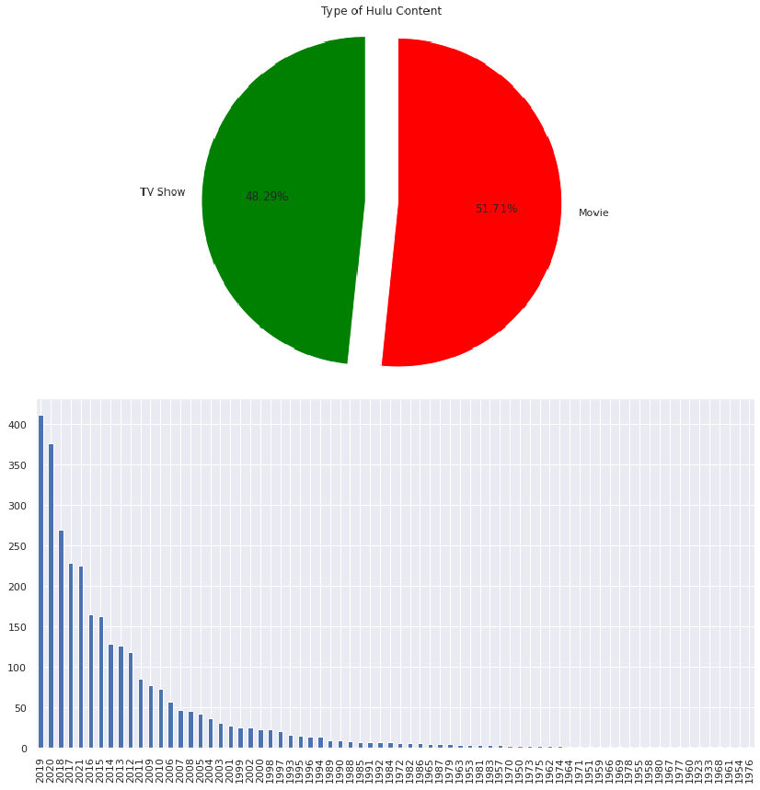
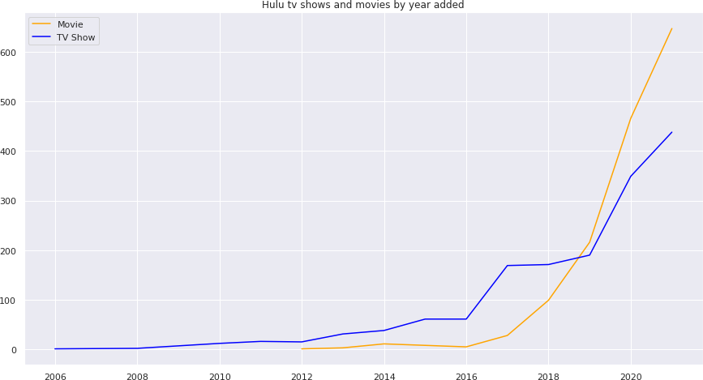
IMPLEMENTATION
4)Visualization of Datasets
01
02
Content by their Release year on Hulu
03
04

Slide 21
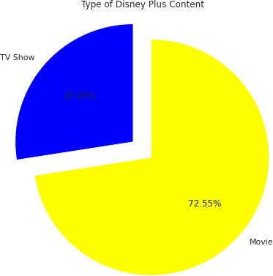
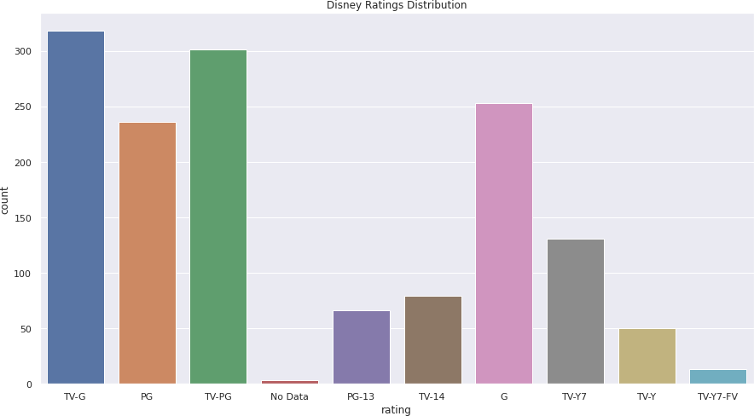
IMPLEMENTATION
4)Visualization of Datasets
01
02
03
04

Slide 22

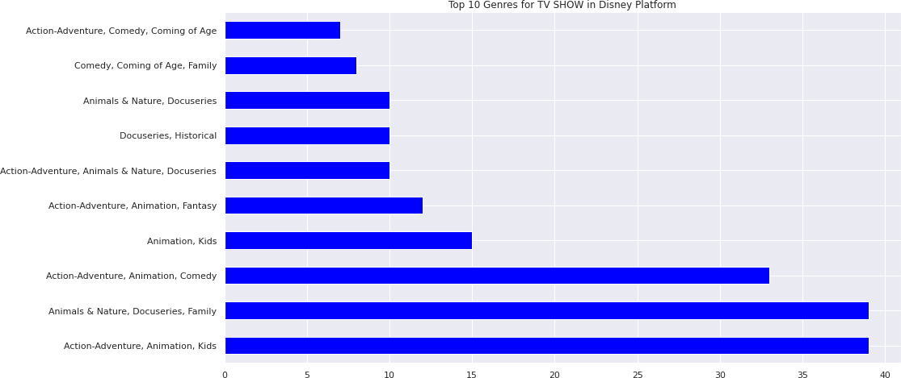
IMPLEMENTATION
4)Visualization of Datasets
01
02
03
04

Slide 23
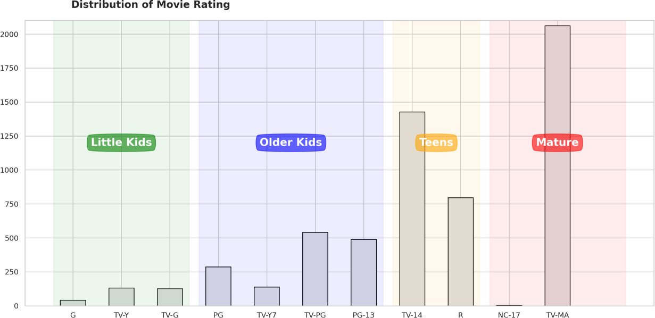
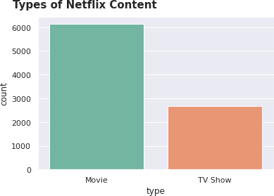
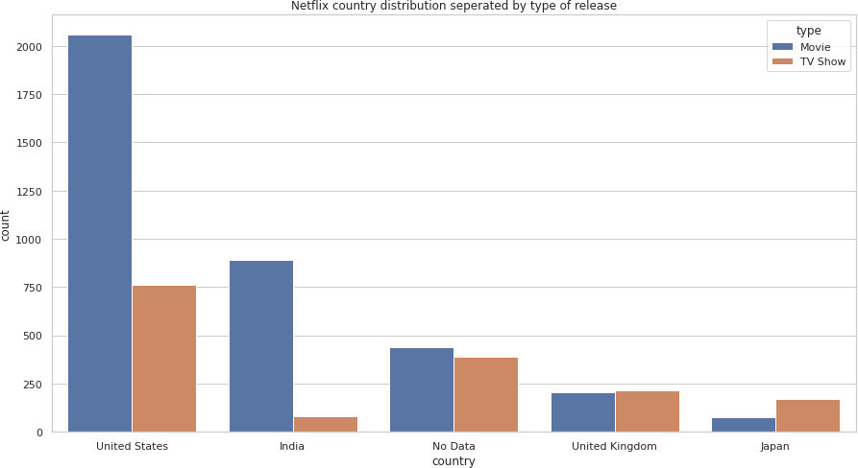
IMPLEMENTATION
4)Visualization of Datasets
01
02
03
04

Slide 24
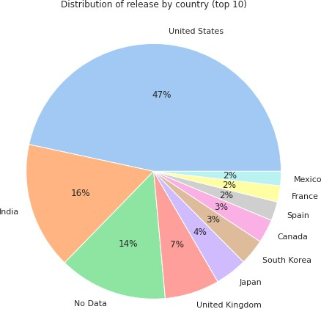
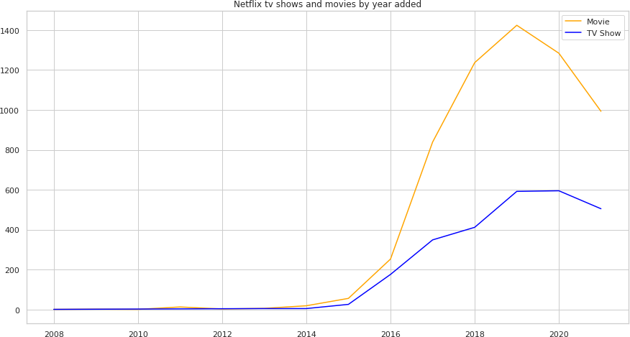
IMPLEMENTATION
4)Visualization of Datasets
01
02
03
04

Slide 25
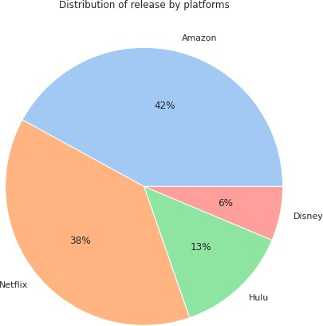
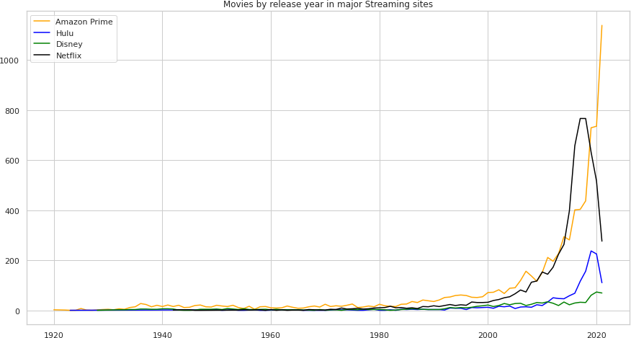
IMPLEMENTATION
5)CREATING ONE UNIFIED DATASET AND VISUALIZING IT
01
02
03
04

Slide 26
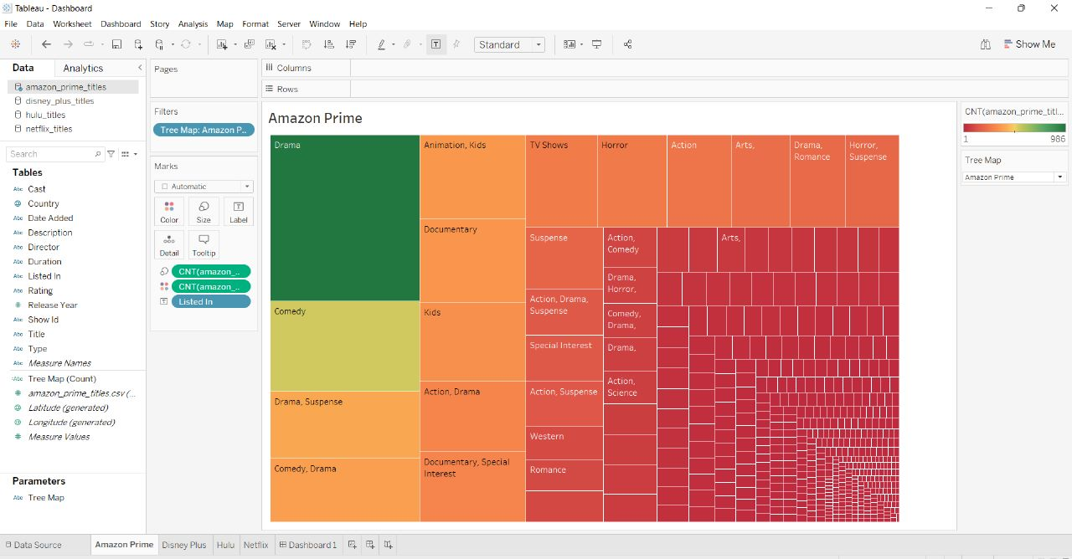
IMPLEMENTATION
6)DEPLOYMENT IN TABLEAU
01
02
03
04

Slide 27
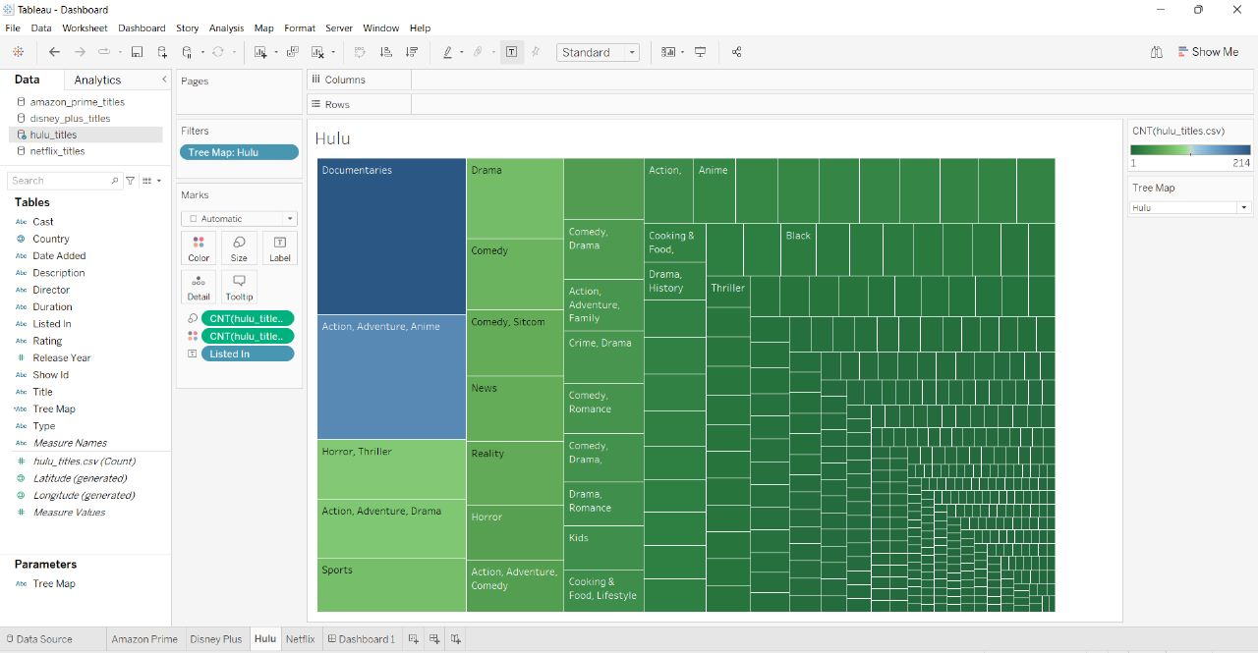
IMPLEMENTATION
6)DEPLOYMENT IN TABLEAU
01
02
03
04

Slide 28
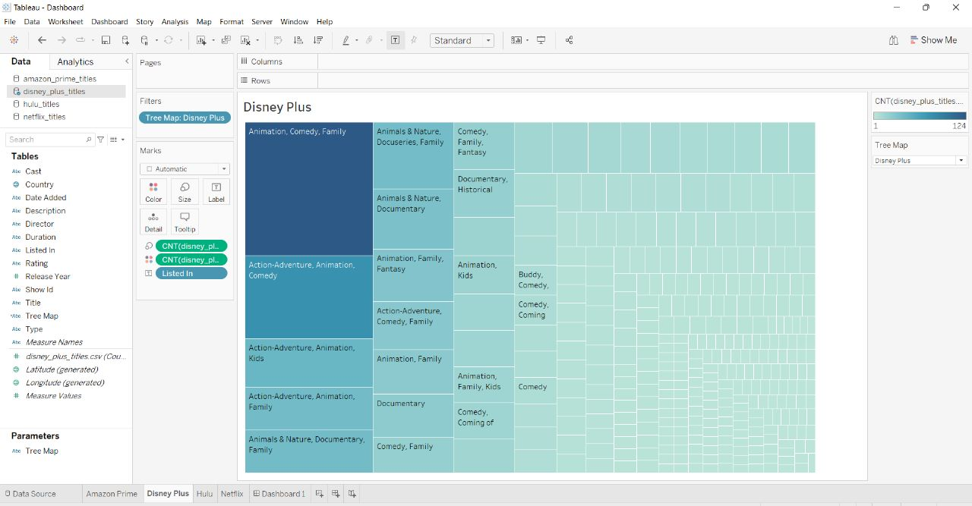
IMPLEMENTATION
6)DEPLOYMENT IN TABLEAU
01
02
03
04

Slide 29
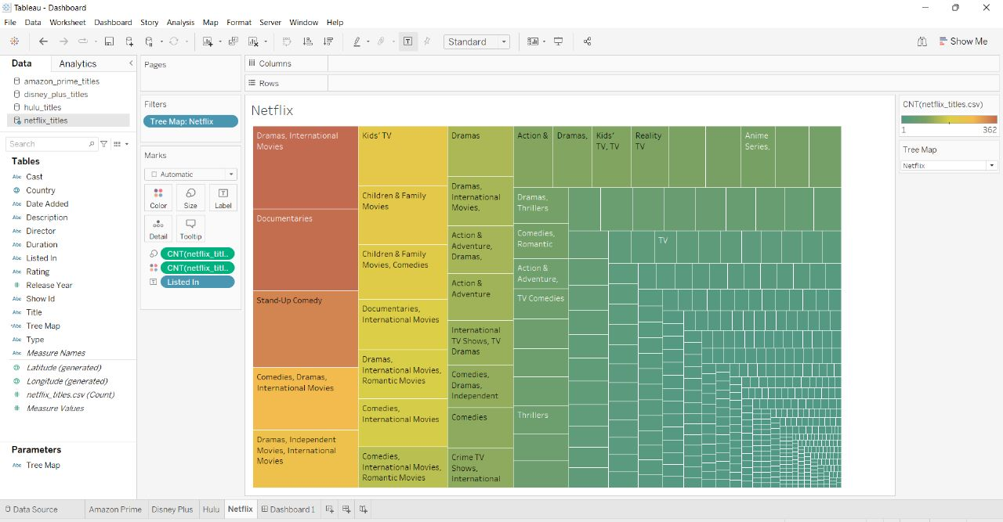
IMPLEMENTATION
6)DEPLOYMENT IN TABLEAU
01
02
03
04

Slide 30
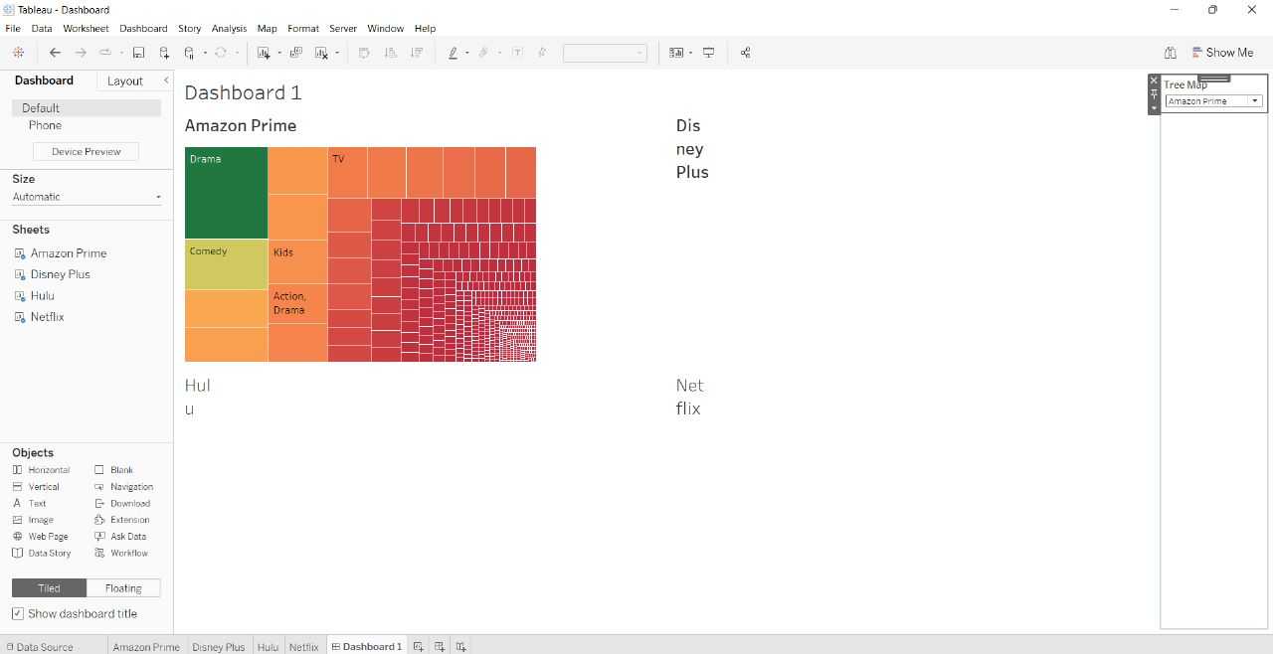
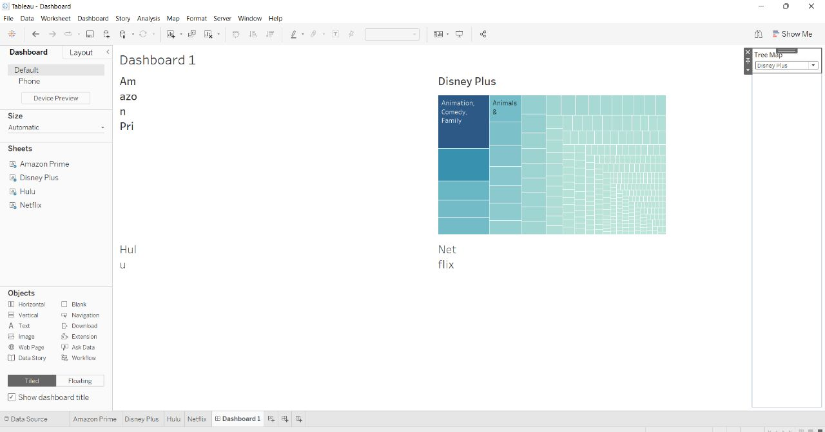
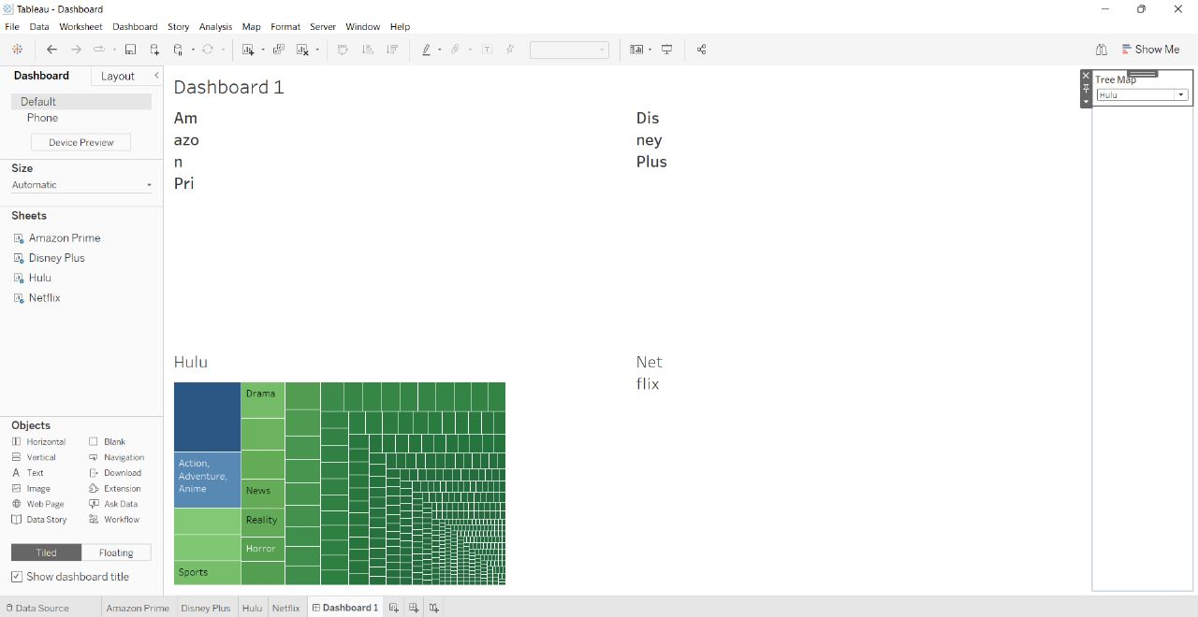
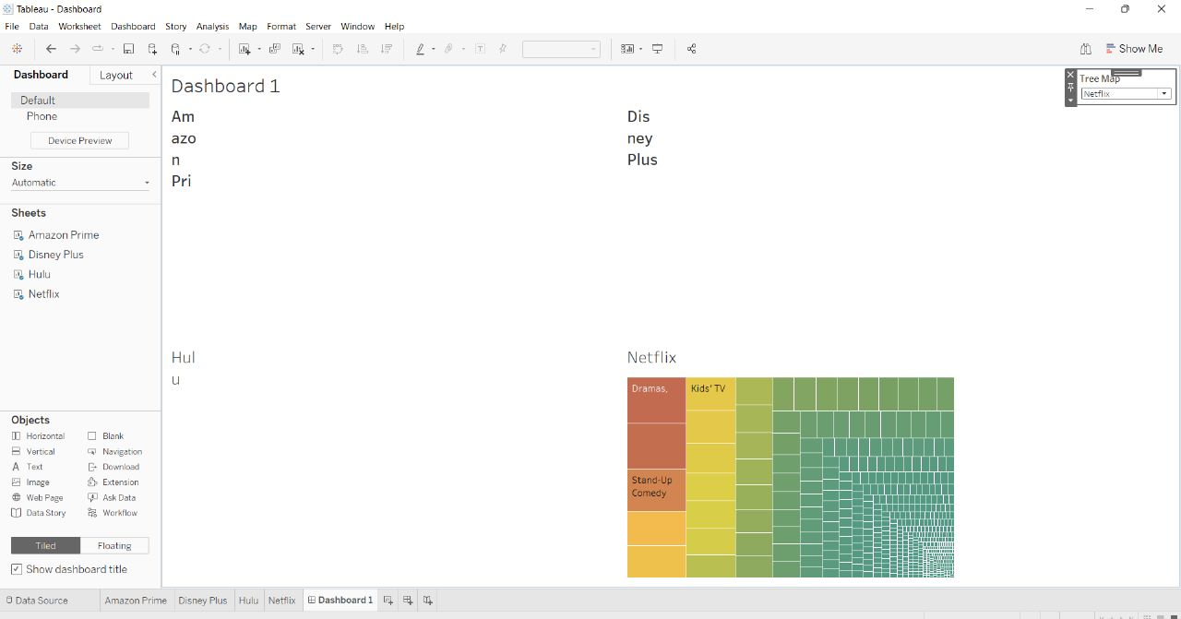
IMPLEMENTATION
6)DEPLOYMENT IN TABLEAU
01
02
03
04

Slide 31
REFERENCES
Rafael A. Irizarry (2019), Introduction to Data Science: Data Analysis and Prediction Algorithms with R
Yixuan Qiu (2017), recosystem: recommendation System Using Parallel Matrix Factorization
Michael Hahsler (2019), recommendationlab: Lab for Developing and Testing recommendation Algorithms. R package version 0.2-5.
Georgios Drakos, How to select the Right Evaluation Metric for Machine Learning Models: Part 1 Regression Metrics
A Matrix-factorization Library for Recommender Systems - https://www.csie.ntu.edu.tw/~cjlin/libmf/↩

Slide 32
CONCLUSION
From the Visualization we gained a lot of Inferences. Like how each platform values movies more than tv shows. We also found that Amazon and Netflix has the biggest content library with Disney & Hulu slowly building their catalogues. We also saw how US is the biggest producer of OTT Content with India coming at a close Second. We also inferred how the growth of OTT Content libraries has been meteoric in recent years, almost growing exponentially. We also saw the rating distribution between the OTTs and how they favor older teens/Adult markets as their main customer segment.
Finally, we created and tested the recommendation engine. We can see how such engines use clustering to reduce runtime dramatically while producing high quality results. This also highlights the importance of clustering data in large corporate environments like multinational OTT providers.
This proves that clustering isn’t just a mere visualization tool but also a very important machine learning implementation that reduces runtimes in such demanding worloads drastically.

Slide 33
THANK YOU !

