Slide 1
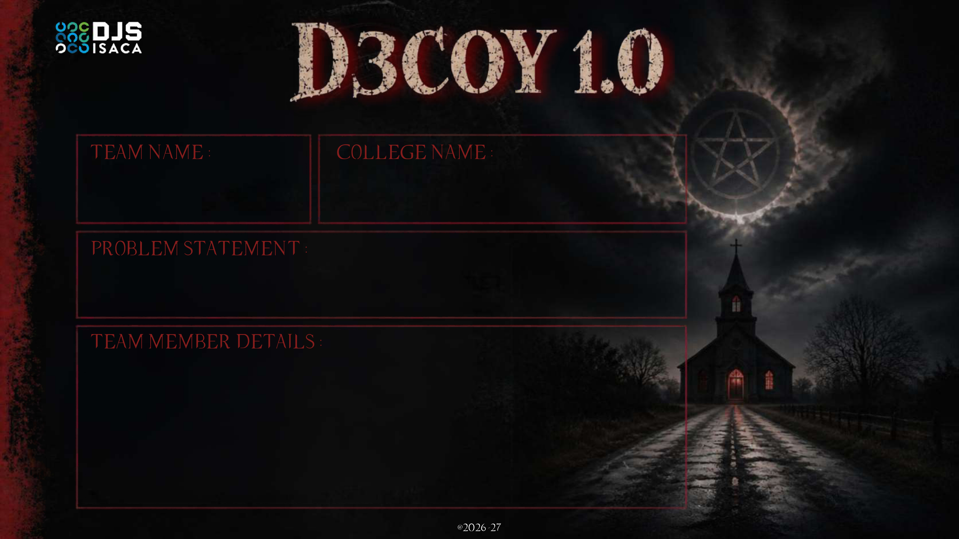
[ADD TEAM NAME HERE]
[ADD COLLEGE NAME HERE]
IDENTITY DRIFT DETECTION IN AUTONOMOUS AI AGENTS
Our answer: SOULPRINT · catches “possessed” AI agents with valid credentials, proven by a Doppelgänger twin
MEMBER 1 NAME : CONTACT NO
MEMBER 2 NAME : CONTACT NO
MEMBER 3 NAME : CONTACT NO
MEMBER 4 NAME : CONTACT NO
Notes:
Title slide. Fill team name, college and members. Problem statement: Identity Drift Detection in Autonomous AI Agents. Our product: SOULPRINT.

Slide 2
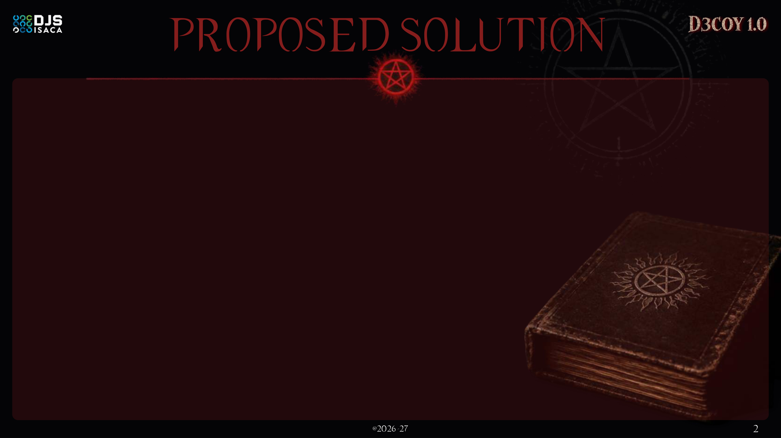




Credentials prove WHO an agent is. SOULPRINT proves it is still WHAT it was built to be.
A behavioral “soul fingerprint” for every AI agent: learned continuously, checked against its declared role, and enforced in real time.
01 LEARN THE SOUL
02 BIND TO ROLE
03 UNMASK WITH TWIN
04 EXPLAIN & EXORCISE
Per-agent baseline of tools, data classes, destinations, timing and who it delegates to.
Declared role compiled into a Role Contract: what it should, and must never, do.
A sandboxed Doppelgänger replays the task minus the untrusted input. Only the live agent goes rogue? Possession proven.
Risk 0–100 with plain reasons, then graduated containment instead of a kill switch.
LIVE CATCH · THE POSSESSED PROCUREMENT AGENT
Normal
Risk 8
Checks supplier prices, raises purchase requests
Reads poisoned PDF
Risk 31
Hidden instruction inside a supplier quote (tainted input)
Opens HR salary files
Risk 74
Off-role data + touches a planted D3COY bait file
POSTs to unknown server
Risk 92
Twin without the PDF never does this: proven
Token valid ✓ IAM passed ✓ Twin proved the PDF · quarantined in seconds
Notes:
Core idea: IAM checks validity, SOULPRINT checks behavior-vs-role. Four steps: learn, bind to role, detect, explain & contain. The PS example (Procurement agent poisoned by supplier PDF) is shown end to end: the risk climbs as the behavior leaves the role, and the agent is contained before exfiltration completes. The unique step is 03: a Doppelgänger twin replays the task without the PDF and stays in role, which proves the PDF caused the hijack. Containment time in the demo is simulated.

Slide 3
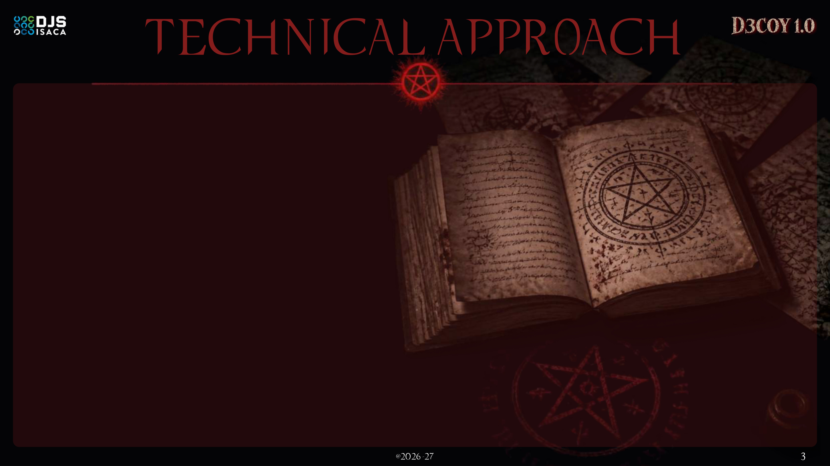








AGENT WORLD
TELEMETRY GATEWAY
SOUL MODEL
5 DETECTORS
PROVE & RESPOND
AI agents
Role Contract
D1
Role-Alignment Gap
DOPPELGÄNGER TEST
LangChain · CrewAI · AutoGen
embedding distance + contract violations
Risk ≥ 40: a sandboxed twin replays the task without the untrusted input. Divergence = injection proven.
Declared role → allowed tools, data classes, egress & rate. LLM-compiled, enforced as OPA policy.
Sequence Surprise
MCP proxy + OpenTelemetry sidecar
D2
Tools & APIs
rare next-action likelihood (Markov)
MCP servers · SaaS APIs
Zero code change in agents
0–39
WATCH
D3
Taint Tracker
log + learn
+ plants role-shaped D3COY baits
untrusted input → privileged action
Untrusted content
Behavior Fingerprint
40–69
STEP-UP
PDFs · email · web pages
Event per action:
agent_id · role · tool
resource · data_class
dest_host · parent
provenance tag
Slow-Drift Monitor
human approves next action
D4
Per-agent baseline. Cold start: role-cohort prior, Bayesian update with each action.
CUSUM + JS-divergence over sliding windows
70–84
SCOPE-SHRINK
Agent → agent calls
least-privilege token
D5
Chain Propagation
85+
QUARANTINE
delegation chains
risk inherited along the delegation graph
sandbox + token revoke
Feedback loop: approved role changes re-version the contract, so legit change is learned
THE POSSESSION SCORE · explainable, top-3 reasons on every alert
BUILT WITH
R = 100 · σ( w₁·Role + w₂·Seq + w₃·Taint + w₄·Drift + w₅·Chain + w₆·Twin − b )
Python · FastAPI
Redis Streams / Kafka
scikit-learn · PyTorch
Weights fit by logistic regression on red-team runs. Hard contract violations and any D3COY bait touch floor the score at 70, so slow mimicry can’t hide below threshold.
Sentence-Transformers
Neo4j delegation graph
Open Policy Agent
React + D3 console
Docker · K8s sidecar
OpenTelemetry · MCP
Notes:
Architecture left to right. Gateway sits in front of tools (MCP proxy) so agents need no changes. Soul model = Role Contract (what it should do) + Fingerprint (what it normally does). Five detectors cover the PS core challenges: valid-credential attacks (role gap), prompt injection (taint), legit change vs drift (feedback loop + contract versioning), no history (cohort prior), chains (propagation), evasion (CUSUM + hard floors). Risk fused into one explainable score; at risk 40+ the Doppelgänger Test replays the task in a sandbox without untrusted input to prove cause before containment. The gateway also plants role-shaped D3COY bait resources.

Slide 4
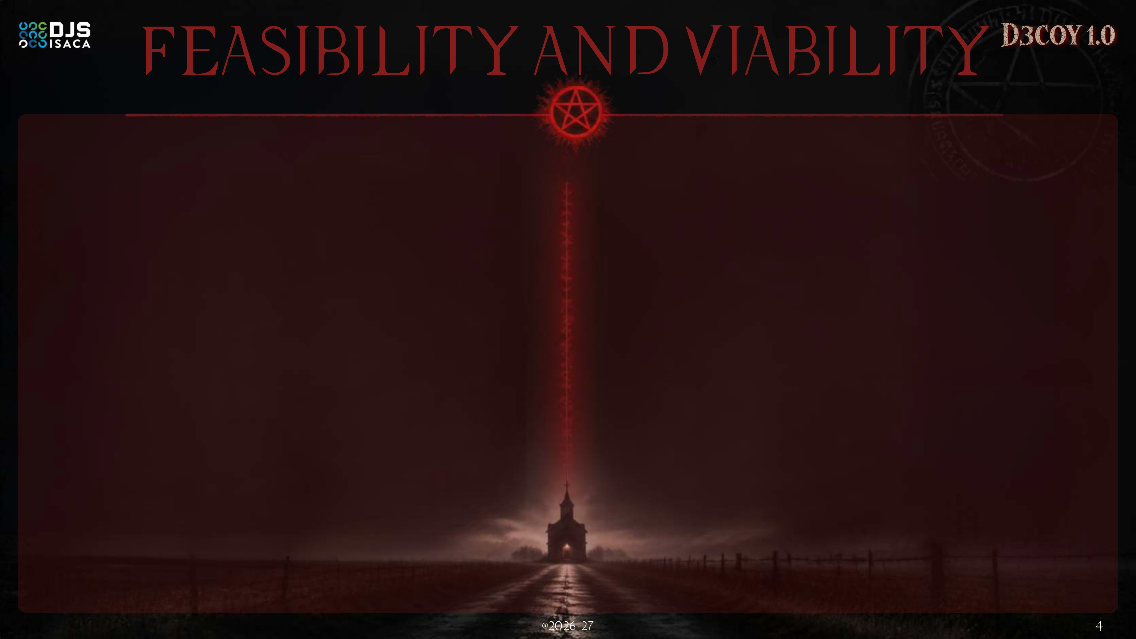
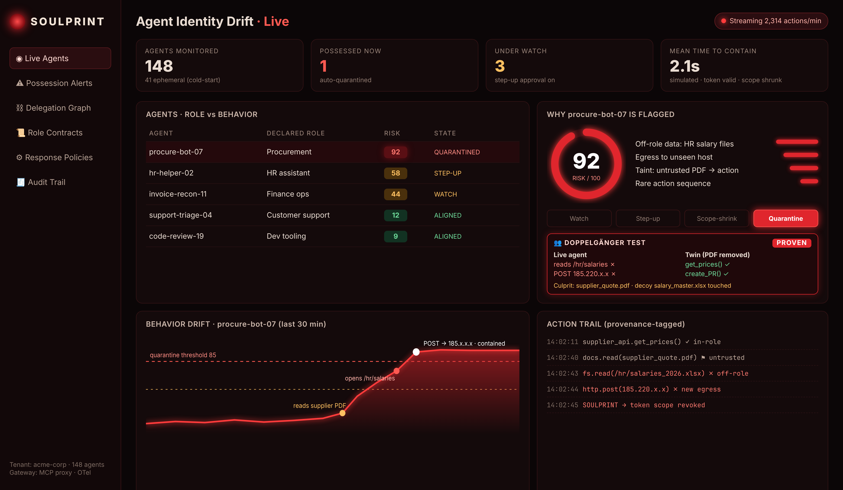


WHY IT IS FEASIBLE TODAY
Technical
Built only on open standards (MCP, OpenTelemetry, OPA) and light models that run on a laptop CPU.
Operational
Starts in shadow mode, then graduated response: no business process is ever hard-stopped by a guess.
Economic
Open-core SDK + SaaS console priced per monitored agent: cheap to try, scales with agent adoption.
RISKS WE PLANNED FOR
Challenge | Mitigation in SOULPRINT
False alarms on legit change | Doppelgänger replay confirms the cause before any block
New / short-lived agents | Role-cohort prior gives a baseline from minute zero
Slow mimicry to evade | CUSUM on long windows + hard contract floors
Privacy of agent data | Hashed resource IDs, no prompt/response payloads
WORKING PROTOTYPE Live demo: raj06872436.github.io/SOULPRINT
0
<50 ms
0 bytes
lines of agent code changed
to score one action
of prompt content stored
drop-in MCP proxy
CPU-only models
metadata-only telemetry
Notes:
Feasibility: prototype exists (see console screenshot and demo site). Uses open standards; models are lightweight. Viability: open-core + per-agent SaaS. Risks and mitigations directly map to the core challenges in the PS. Numbers on stat tiles are prototype design targets.

Slide 5




TODAY · IAM ASKS
WITH SOULPRINT · WE ASK
“Is this identity allowed?”
“Is this identity still itself?”
Hijacked agent = valid token = silent breach. Detected weeks later, if ever.
Possession caught in seconds, explained in plain words, contained without stopping honest work.
Security teams
Businesses
Compliance & audit
Ecosystem
Closes the valid-credential blind spot
Alerts explain themselves: faster triage
Proof, not suspicion: twin names the culprit file
Agents keep working: scope-shrink, not shutdown
Confidence to give agents real autonomy
Stops data leaks before exfiltration
Per-action audit trail for every agent
Maps to India DPDP Act 2023, EU AI Act
Supports ISO/IEC 42001 & NIST AI RMF
Safer adoption of agentic AI at scale
Shareable “possession signatures”
Framework-agnostic, open-core SDK
Notes:
Shift the question from 'is it allowed' to 'is it still itself'. Benefits per stakeholder. Compliance mappings: DPDP Act 2023 (India), EU AI Act, ISO/IEC 42001, NIST AI RMF.

Slide 6
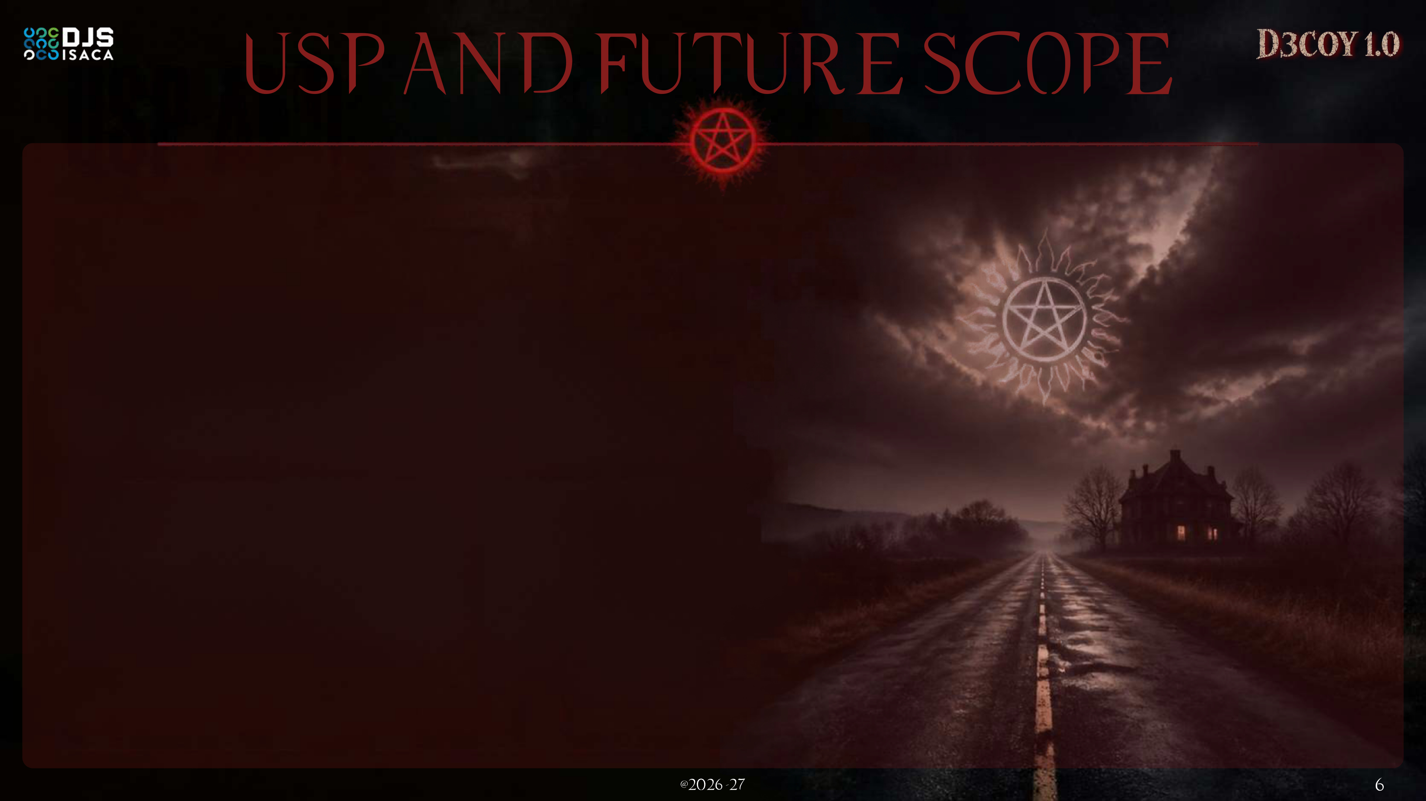

WHAT MAKES SOULPRINT DIFFERENT
THE ROAD AHEAD
The Doppelgänger Test: proof, not suspicion
ONLY IN SOULPRINT
NOW
A sandboxed twin replays the task without the untrusted input. Divergence proves the injection and names the culprit file.
Hackathon MVP
Gateway, 5 detectors, Doppelgänger twin, decoys, live console
Role-shaped D3COY baits
ONLY IN SOULPRINT
Decoy files and keys planted per role that only a possessed agent would touch: alarms with near-zero doubt.
3 MONTHS
Plug & play
LangChain / CrewAI / MCP plug-ins; Splunk & Sentinel export
Role-aware with root cause
Judged against declared purpose; provenance taint links the poisoned input to the bad action.
6 MONTHS
Self-healing agents
Minute-zero & chain-aware
After exorcism, auto-restore the agent from its last clean soul snapshot
Role-cohort priors for new agents; risk flows along agent-to-agent delegation.
12 MONTHS
Explain, then exorcise gently
Possession intel network
Every score has reasons; containment is graduated, so legit work continues.
Federated sharing of attack signatures; open agent-behavior attestation spec
Notes:
Five USPs. Headline USPs: the Doppelgänger Test (counterfactual twin replay proves the injection) and role-shaped D3COY baits. Roadmap along the road: MVP now, plug-ins, self-healing agents, then a federated possession-intel network.

