Slide 1
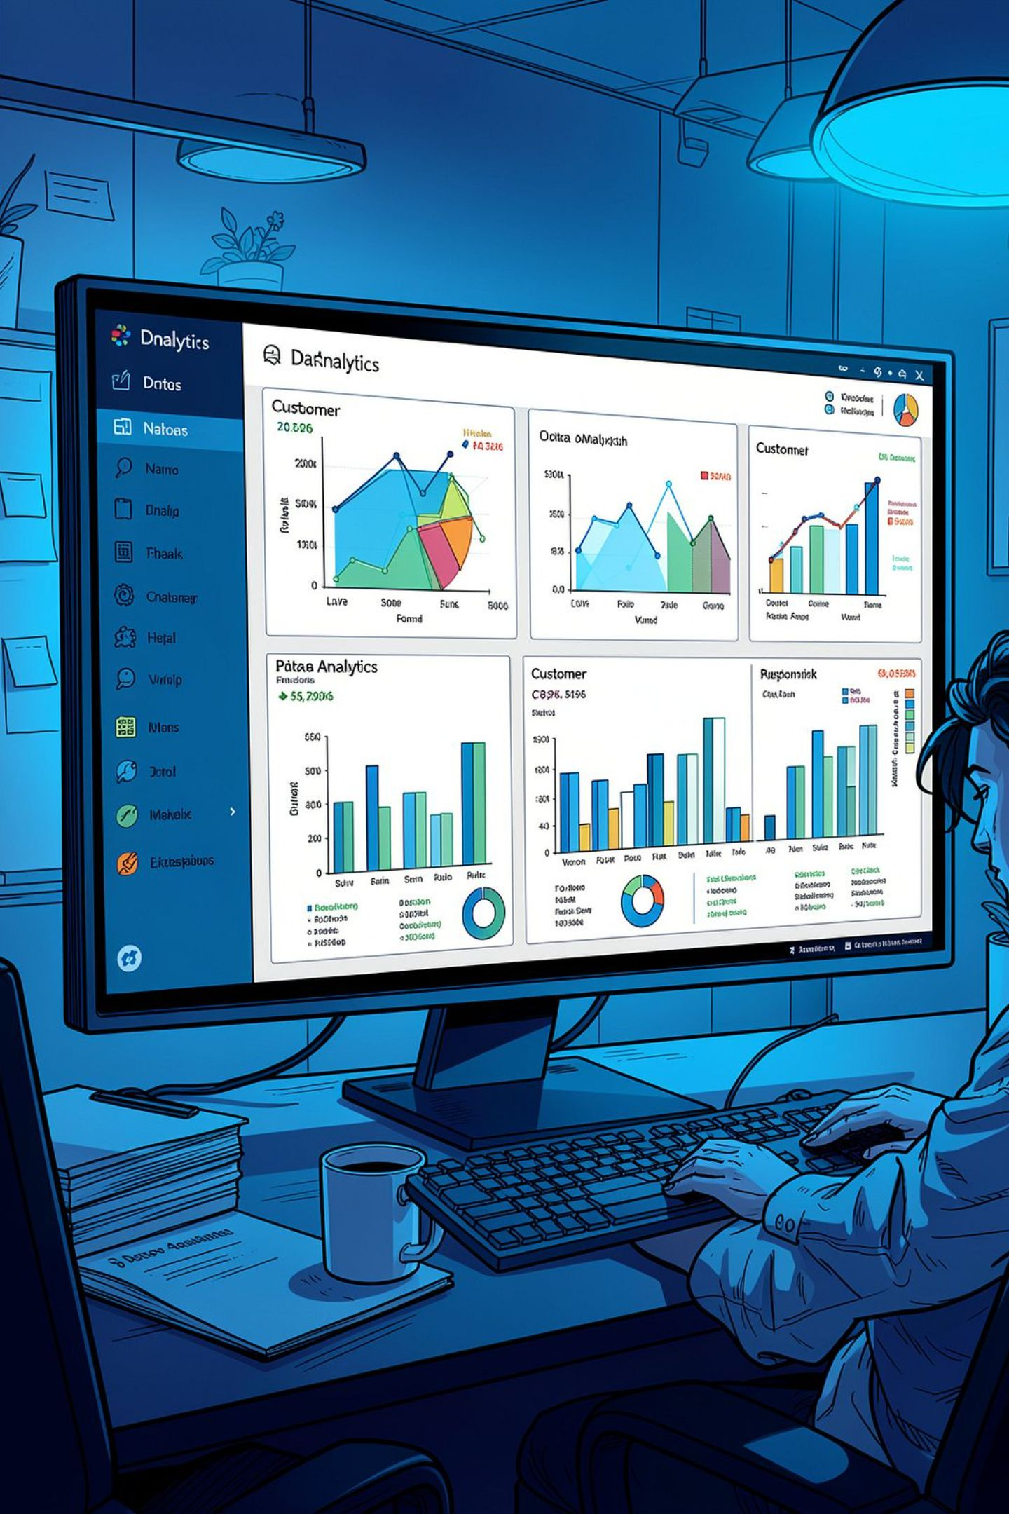
Customer Behavior Analysis
An end-to-end data analytics project examining e-commerce customer patterns, transaction behavior, revenue generation, and churn using Python, SQL, and Power BI.
ROHIT KUMAR | ENROL. NO. 2302161630085
AI & DATA SCIENCE | SESSION 2026–27

Slide 2
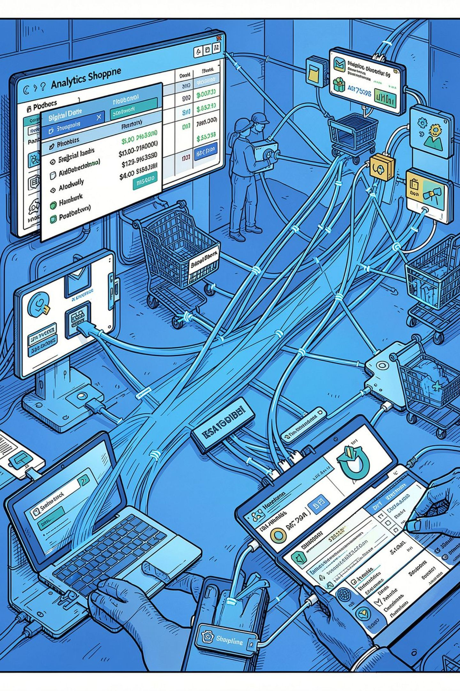
Why Customer Behavior Analysis?
Purchasing Patterns
Identify how frequently customers purchase and how behavior varies across segments.
Valuable Customers
Recognize customers who contribute significantly to overall revenue.
Churn Detection
Identify which customers may discontinue their relationship with the business.
Data-Driven Decisions
KPIs like total customers, revenue, orders, and churn rate support strategic planning.

Slide 3
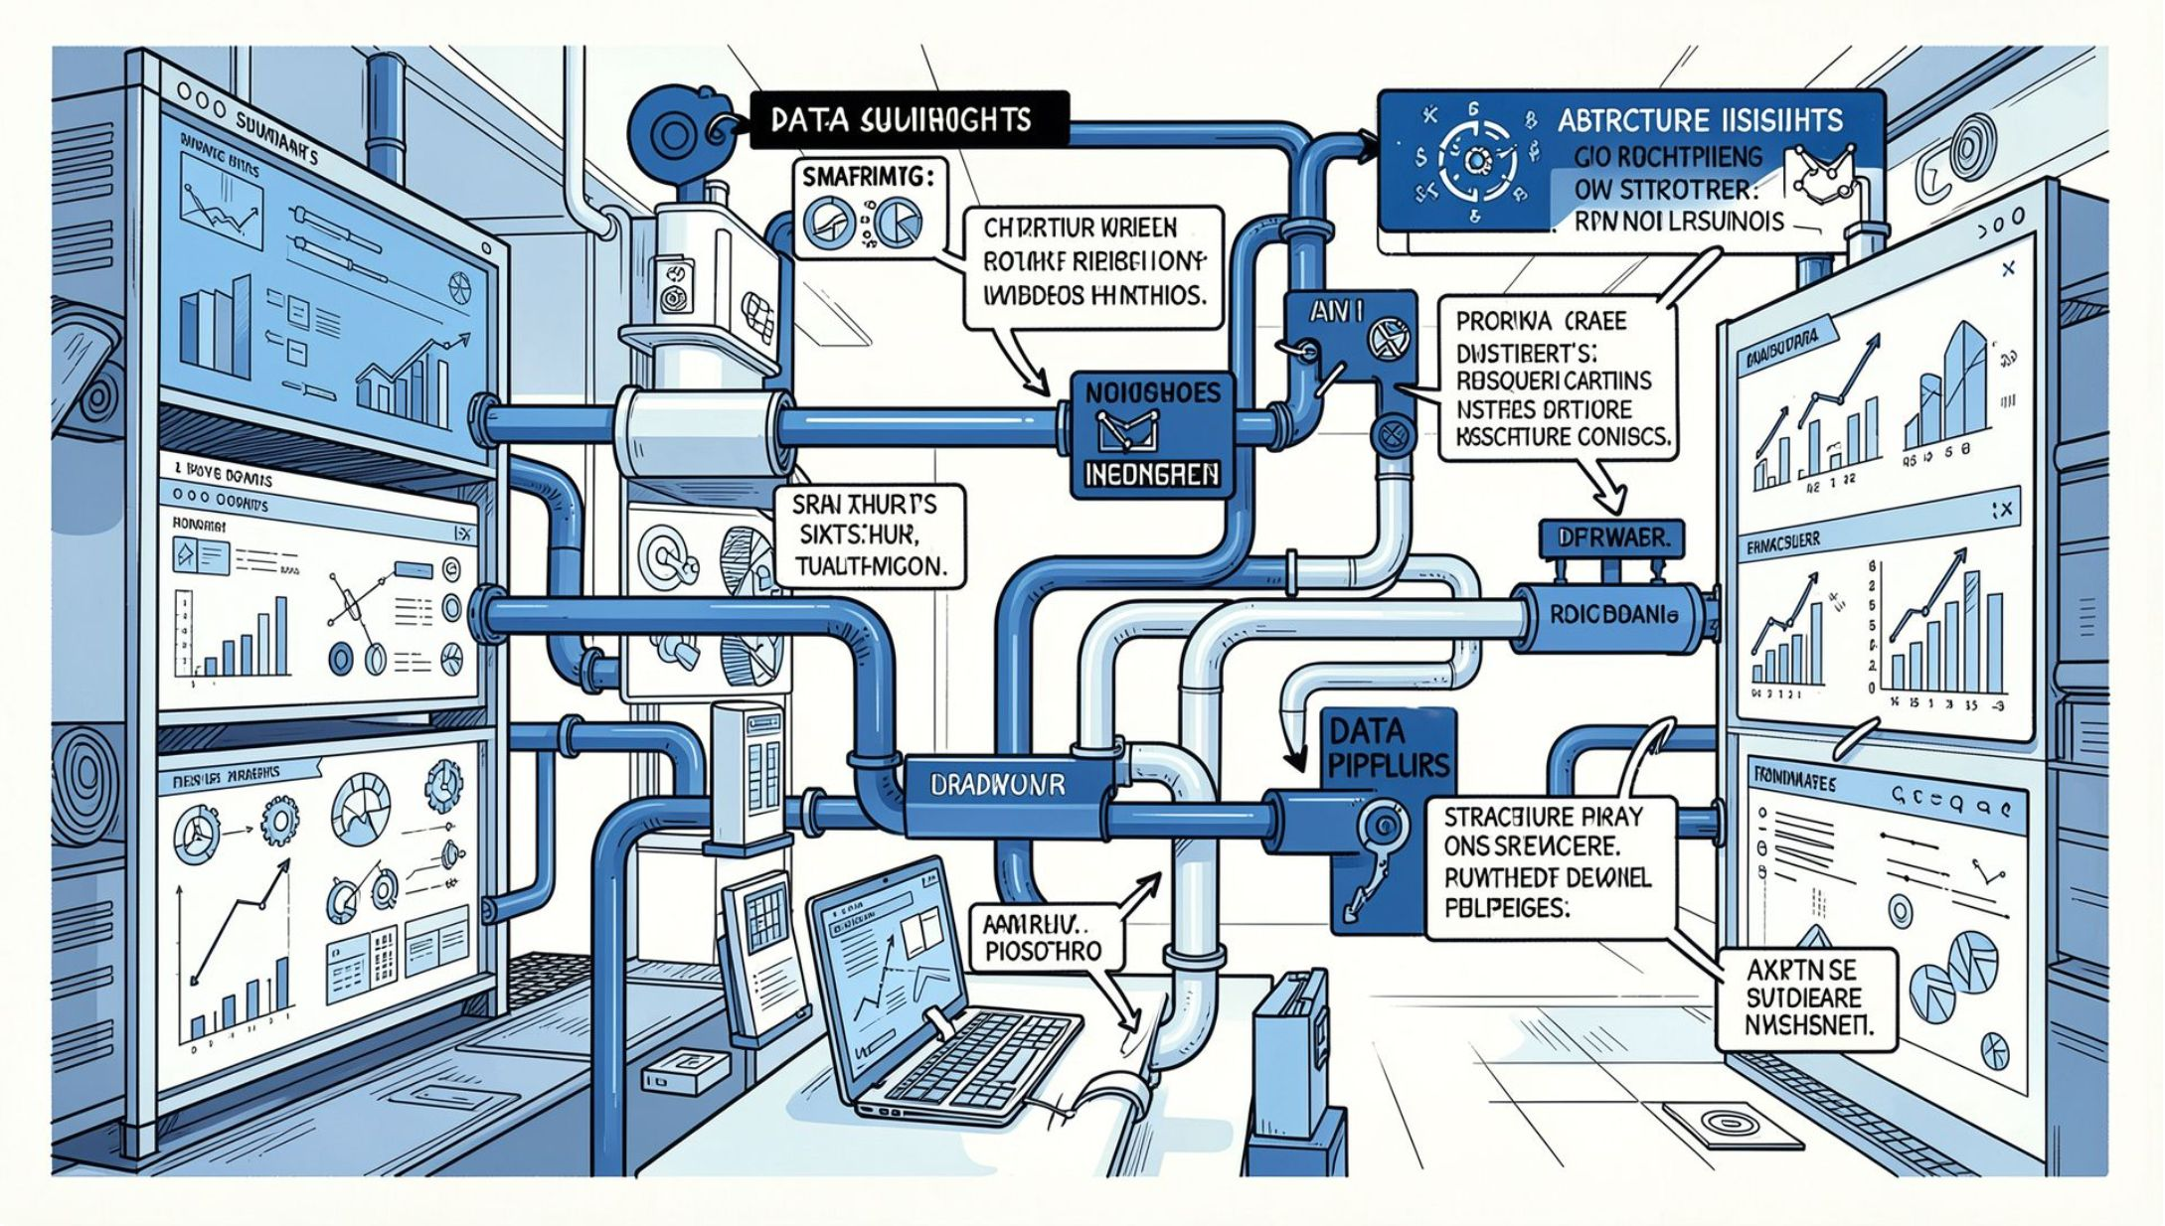
Problem Statement & Objectives
The Problem
E-commerce businesses generate large volumes of customer data, but raw data alone does not reveal purchasing patterns, customer segments, or churn behavior. An integrated analytics solution is needed.
Key Objectives
Clean and preprocess the dataset using Python
Perform EDA to identify patterns and trends
Analyze customer churn using SQL
Derive business insights and KPIs
Build an interactive Power BI dashboard

Slide 4




Tools & Technologies
Python
PostgreSQL
Data preprocessing, cleaning, EDA, and statistical analysis using Pandas, NumPy, Matplotlib, and Seaborn.
Database environment for storing the cleaned dataset and running structured SQL queries for customer, order, revenue, and churn analysis.
Power BI
Jupyter Notebook
Interactive dashboard development with KPIs, charts, and visualizations for business intelligence.
Working environment for Python-based data cleaning, analysis, and experimentation.

Slide 5

Project Methodology
The project follows a structured, end-to-end analytical workflow that transforms raw e-commerce data into actionable business intelligence.
Collect Data
Clean Data
EDA
SQL Analysis
Each stage builds on the previous, ensuring data quality and progressively deeper analytical insight before final visualization.

Slide 6
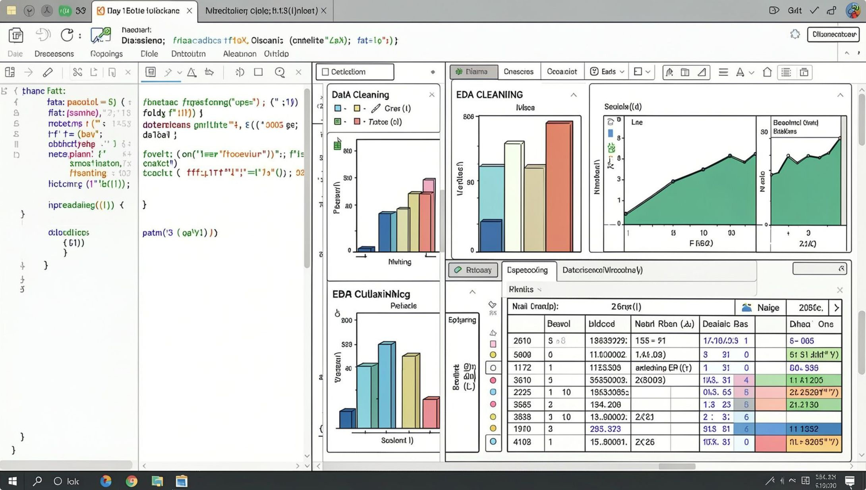
Data Preprocessing & EDA
Preprocessing Steps
Missing Value Analysis — Identified and handled null values across all columns
Duplicate Removal — Eliminated repeated customer and transaction records
Data Type Validation — Ensured correct types for numerical, categorical, and date fields
Categorical Inspection — Checked product category, payment method, and gender values
EDA Focus Areas
Customer characteristics and demographics
Product category and payment method distribution
Numerical variable distributions and relationships
Purchasing behavior patterns

Slide 7
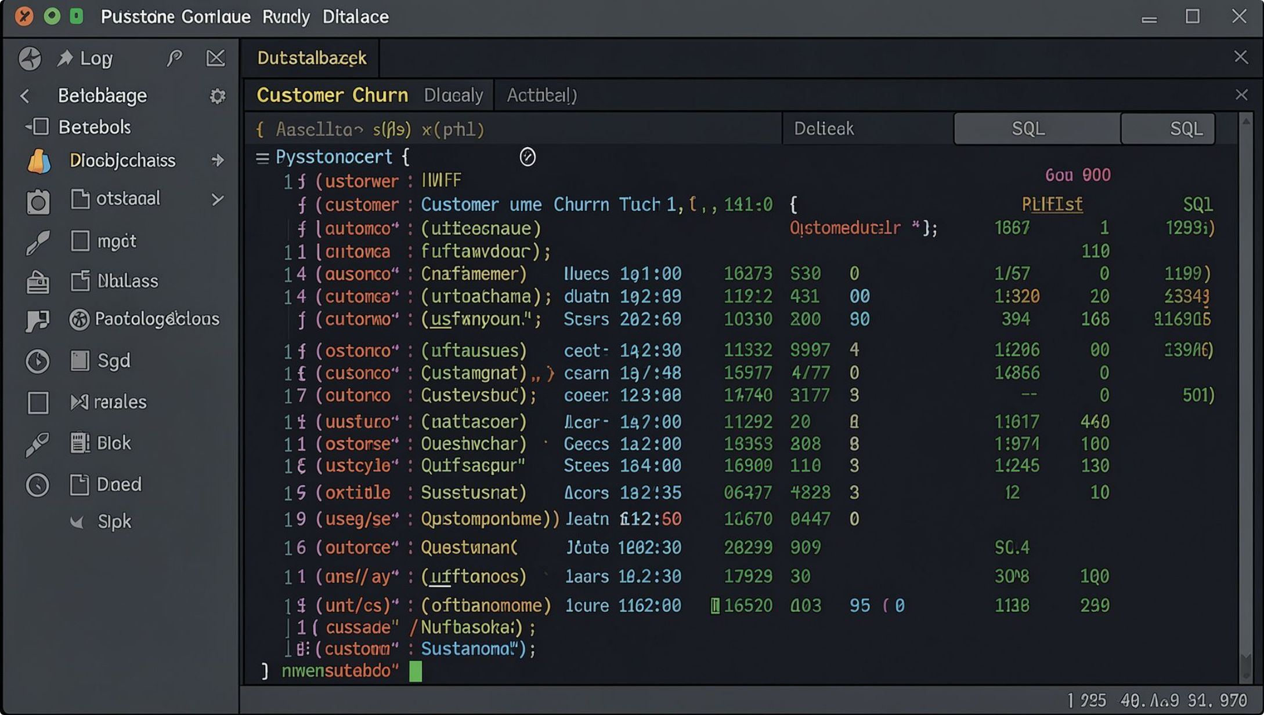
Churn Analysis & Business Insights
Churn Analysis (via SQL)
Customer churn was calculated by comparing churned customers against the total base. Analysis covered:
Overall churn rate
Churn rate segmented by gender
Characteristics of churned customers
Relationship between behavior and churn
Business Insights
SQL queries on the PostgreSQL dataset revealed patterns in revenue, orders, product categories, payment methods, and customer demographics — supporting targeted retention and marketing strategies.

Slide 8

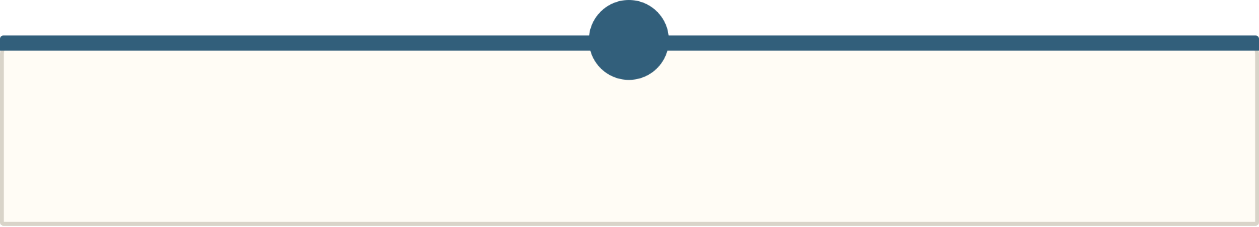




Power BI Dashboard
Total Customers
Shows the complete customer base size.
Total Revenue
Displays total revenue generated across all transactions.
Total Orders
Represents overall order activity in the dataset.
Churn Rate
Percentage of customers classified as churned.
Visualizations include Bar Charts (category analysis), Area Charts (trend analysis), and Scatter Plots (relationship analysis) for an interactive, consolidated business view.

Slide 9
Key Results & Recommendations
Key Findings
Business Recommendations
Total customer base, order activity, and revenue performance identified
Customer purchasing patterns examined across segments
Churn rate and characteristics analyzed via SQL
Results visualized through an interactive Power BI dashboard
Engage churn-prone customers proactively
Focus on high-value, high-revenue customers
Develop targeted marketing based on purchasing patterns
Monitor revenue and order trends regularly
Improve personalized offers and customer engagement

Slide 10

Conclusion & Future Scope
Conclusion
Future Scope
This project demonstrates an integrated analytics workflow — Python for preprocessing and EDA, SQL for churn and business analysis, and Power BI for interactive visualization — converting raw customer data into meaningful, decision-ready insights.
Churn Prediction — ML models to forecast at-risk customers
Advanced Segmentation — K-Means clustering for deeper customer groups
Limitations
Analysis is based on historical data; churn modeling is descriptive, not predictive.
Real-Time Dashboard — Live data feeds in Power BI
Recommendation System — Personalized product suggestions

