Slide 1

Sales Performance Dashboard
Regional, categorical, and product-level analysis of sales and profitability — designed to surface actionable insights for growth.

Slide 2
Key Metrics at a Glance
$2.26M
$226.2K
Total Sales
Total Profit
10.0%
$459
Profit Margin
Avg. Order Value
Four key performance indicators provide a snapshot of overall business health across all regions, categories, and months.

Slide 3
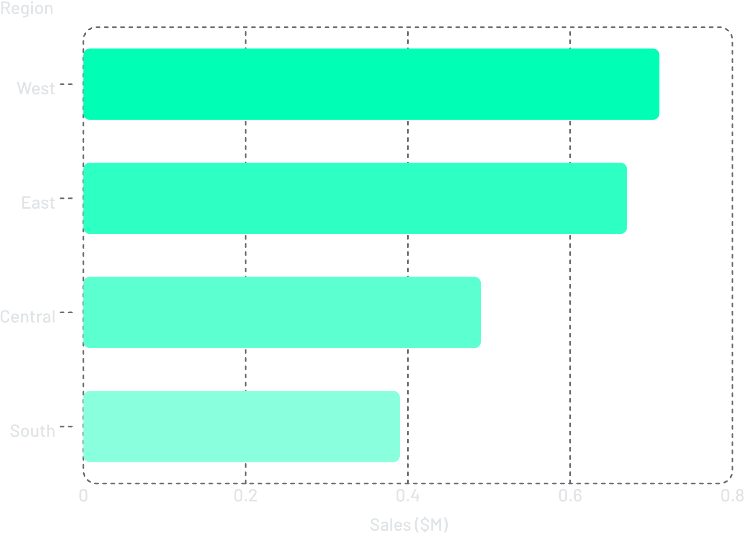
Sales by Region
Regional Sales Breakdown
West and East regions lead, together accounting for over 60% of total revenue. South and Central represent growth opportunities.
West: $0.71M — top performer
East: $0.67M — strong second
Central: $0.49M
South: $0.39M — lowest sales

Slide 4

Profit by Region
Profit Distribution
Profit mirrors sales distribution closely, with West and East generating the highest returns. All regions maintain a consistent ~10% profit margin.
West: $71K profit
East: $67K profit
Central: $49K profit
South: $39K profit

Slide 5
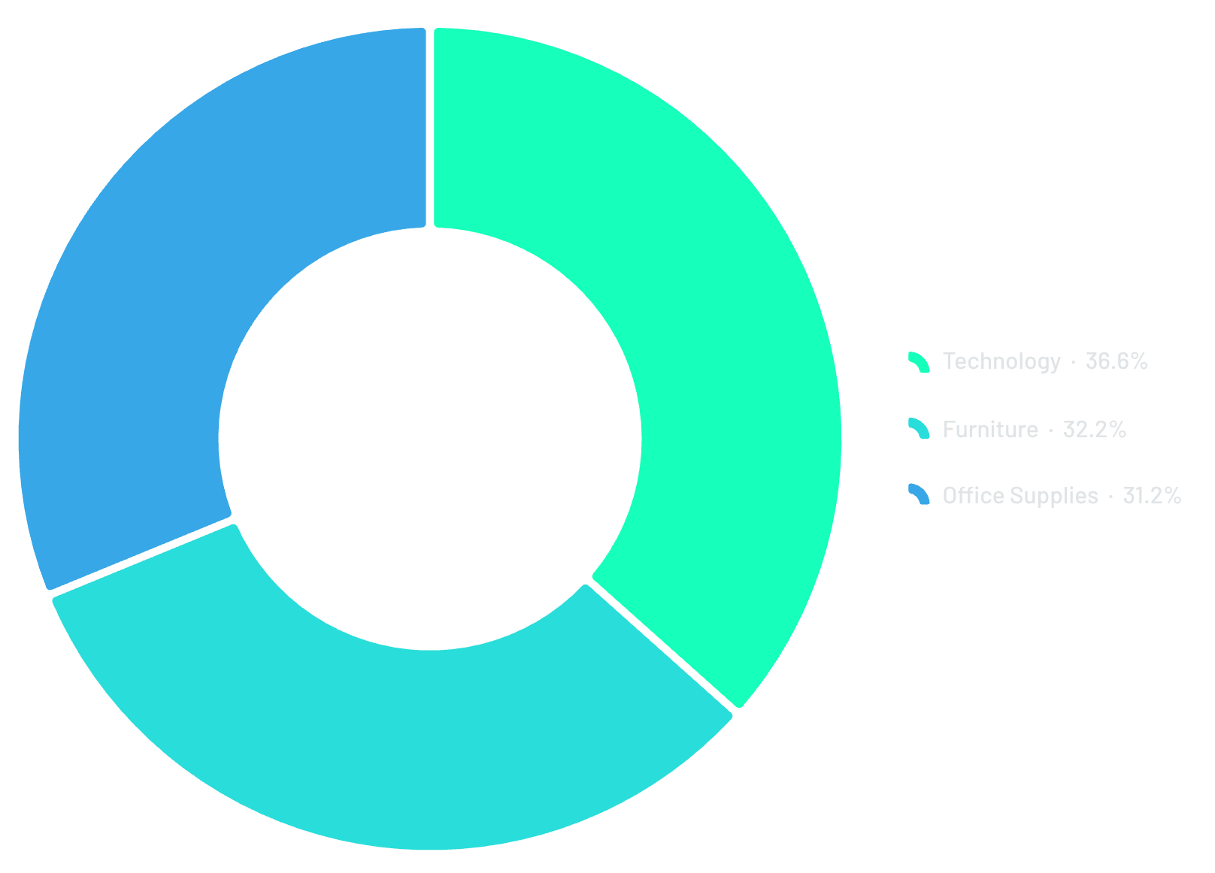
Sales by Category
Category Mix
Sales are evenly distributed across all three categories. Technology leads slightly at 36.6%, but no single category dominates — a sign of a diversified portfolio.
Technology: 36.6%
Furniture: 32.2%
Office Supplies: 31.2%

Slide 6
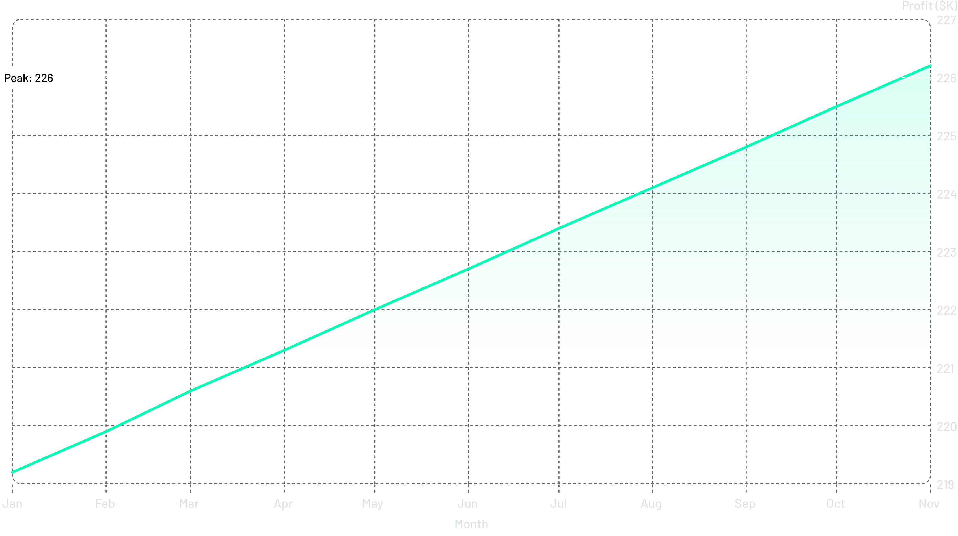
Profit Trend Over Time
Profit grew steadily from $219.2K in January to $226.2K in November 2018 — a consistent upward trajectory throughout the year.

Slide 7
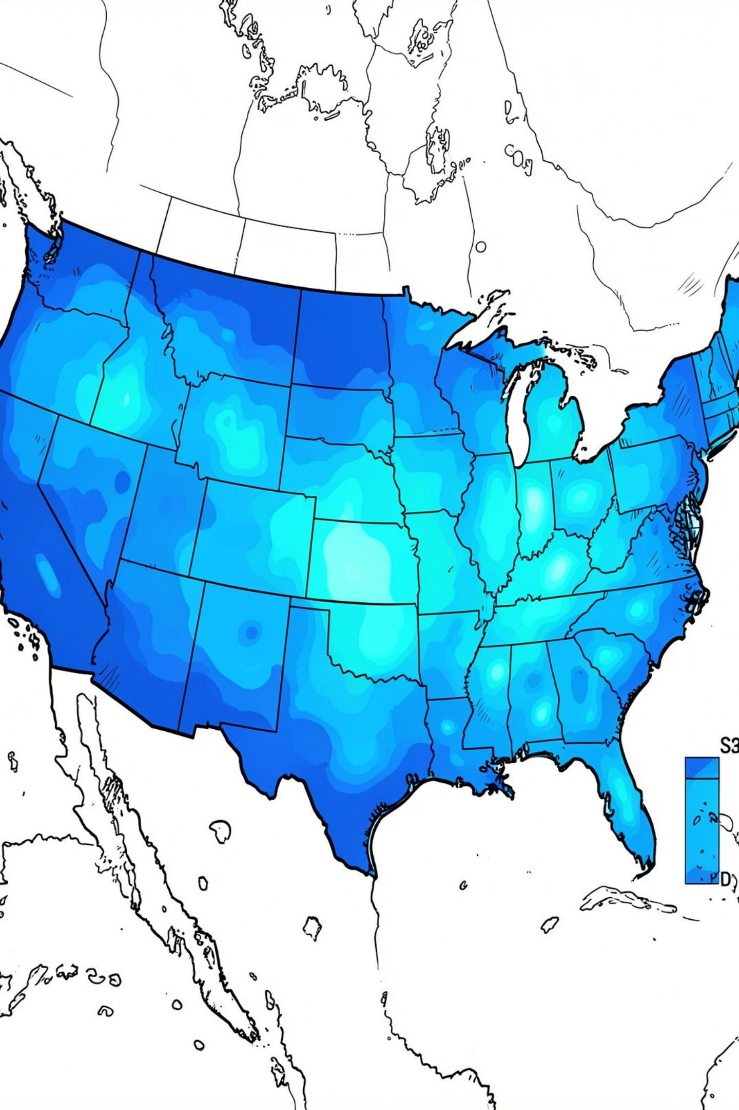
Sales by State
A geographic view of sales distribution across the United States, with states color-coded by sales volume. Regional concentration aligns with West and East dominance seen in regional charts.

Slide 8
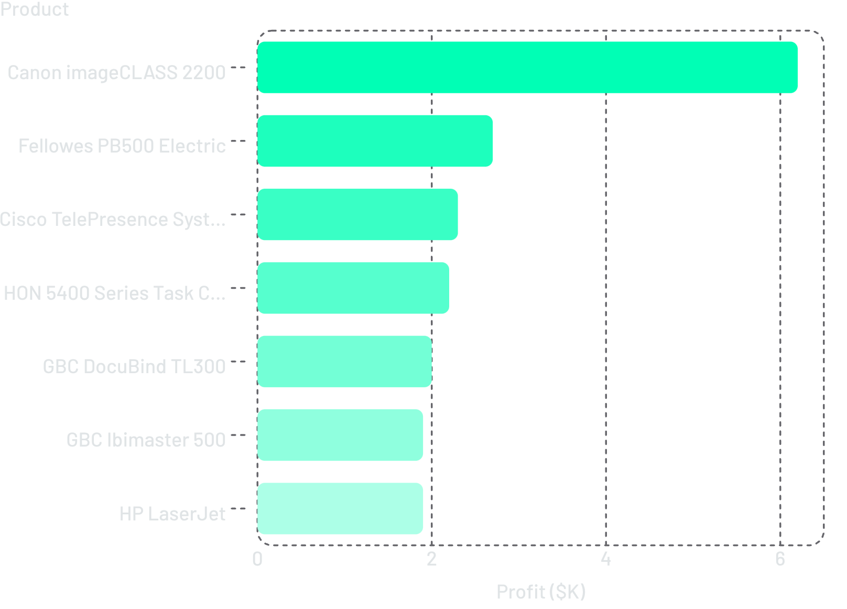

Top Products by Profit
Product Profit Leaders
The Canon imageCLASS 2200 dominates with $6.2K profit — more than double the next product. The top 7 products represent the highest-value items to prioritize in sales and inventory planning.
Canon imageCLASS alone accounts for ~2.7% of total profit.

Slide 9
5 Tactical Recommendations
Focus on High-Performing Regions
1
Double down on West and East, which drive 60%+ of revenue.
Reassess Underperforming Products
2
Review low-margin items to improve or discontinue.
Optimize Discount Strategies
3
Protect the 10% margin by tightening discount policies.
Leverage Seasonal Demand
4
Align promotions and inventory with seasonal profit trends.
Prioritize High-Value Products & Customers
5
Focus on top profit drivers like the Canon imageCLASS 2200.

Slide 10

Conclusion
Data-driven analysis reveals clear opportunities: concentrate resources on West and East regions, protect margins through smarter discounting, and prioritize top-profit products. By acting on these insights, the business can systematically improve sales performance and profitability.
$2.26M Sales
10% Margin
Total revenue baseline
Target to protect & grow
Action Now
Turn insights into results

