Slide 1


Optimizing Instagram Engagement
SQL: Social Media Project
Leveraging User Data for Acquisition, Retention, and Engagement Growth
By- Vishal Raj

Slide 2
Table of Contents
About Meta
Problem Statement
Data Overview
Approach
Engagement Analysis
Users Classification
Content Performance
Advertisement Strategy
Campaigns and Projections
Conclusion

Slide 3
About Meta
Meta, formerly known as Facebook, is a technology company founded by Mark Zuckerberg in 2004. It rebranded to Meta in October 2021 to emphasize its focus on building the "metaverse," a virtual reality space where users can interact in a shared, immersive environment. Meta's ecosystem includes social media platforms like Facebook, Instagram, and WhatsApp, as well as technologies for augmented and virtual reality, such as Oculus. The company's vision is to create a new digital frontier where people can connect, work, and play in virtual worlds that blend seamlessly with the physical world.

Slide 4
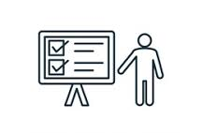
Problem Statement
You are hired as a data analyst at Meta and asked to collaborate with Marketing team. Marketing teams wants to leverage Instagram's user data to develop targeted marketing strategies that will increase user engagement, retention, and acquisition. Provide insights and recommendations to address the following objectives

Slide 5
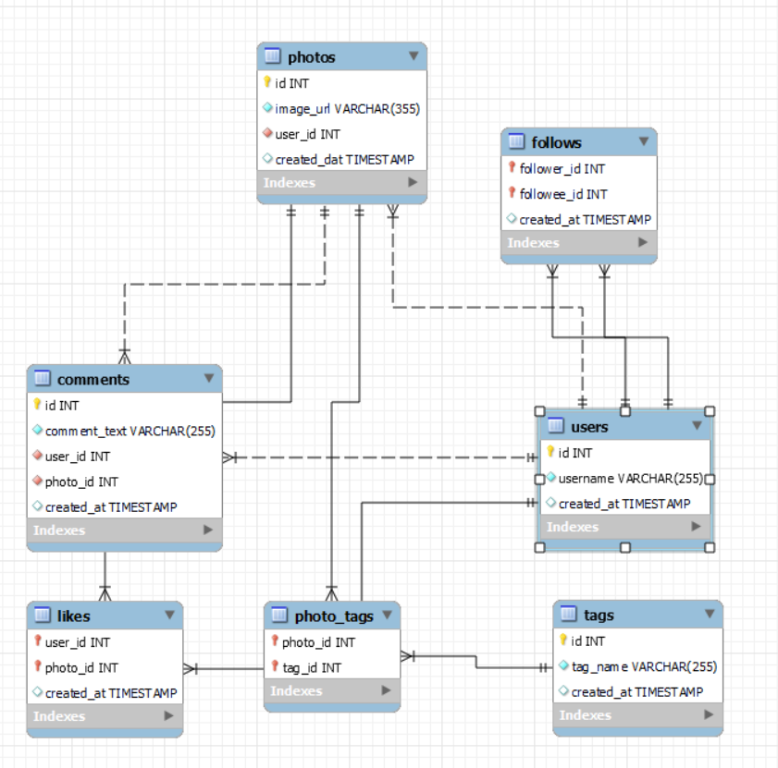
Data Overview
Total 7 Tables are present in the given dataset.
Total number users are 100.
Total number of posts made so far is 257.
Total number of likes posted by the users on posts is 8782.
Total number of comments on all posts are 7488.
Total number of engagement is calculated by adding total likes and total comments by an user.
Engagement rate is calculated by dividing total engagements by number of posts.
Database schema

Slide 6
Approach
Understanding Statistics: Calculated basic statistics like total number of users and respective posts posted, likes, comments achieved
Data Cleaning and Validation: Checked and removed duplicates in the data sets also treated null values.
Analysis: Utilized sql techniques such as Common Table Expressions (CTE), Aggregate Functions:(AVG, COUNT,ROUND, etc), Subqueries, Group By clause, Rank,Window functions.
Data Visualization: Visualized key metrics such as total posts, likes, and comments to provide a clear representation of user activity levels. Created charts and graphs to rank users based on engagement rates and to highlight the most influential hashtags.
Strategy Making: Prepared plans and strategies for increasing user retention and increasing engagement activities.
Implementation-Implementation of the plans and strategy are also discussed for optimised and better results.

Slide 7
User Engagement Classification
Out of 100 users there are only 30% of Active Users.
34 % of users are Moderate Active Users.
Inactive Users are those users who have very low engagement rate and they are 36 %.

Slide 8
New vs Old Users
There are total 100 users.
Users who created their account before 2017 are considered Old Users; otherwise, they are classified as New Users.
65% of users are Old Users and 35 % of users are New Users.

Slide 9
Engagement Analysis
The Engagement Rate is calculated by the sum of Number of Likes and Number of Comments for each User.
Average engagement rate of all users is 65.
Only 31 users have more than average engagement rate and 18 users have more than 100.
We will track their posts that gets most of the likes and comments and promote those kind of content.

Slide 10
Content Performance
Dreamy Tag has the highest likes where as foodie tags has lowest number of likes.
Hashtags with high count of Likes are the popular tags among all.
Popular tags will be promoted and influencers will promote popular tags by using them in their posts.
Contents related to these tags should be frequently shown on explore pages of the users to engage them.
Tags other than dreamy have very much same no. of likes so they should also be optimised.

Slide 11

Recommendation
Re-Engaging user
Personalized Recommendation:
Use Instagram insights of user to analyze interests and interactions.
Create content tailored to specific user groups.
Re-engagement E-mails:
Send personalized emails.
Suggest content, groups, or hashtags.
Hashtag Targeting:
Research popular hashtags.
Identify relevant hashtags
Incorporate hashtags into your content and ads.

Slide 12

Recommendation
Re-Engaging user
Giving Discounts and Gift Card :
This is one of the most popular yet effective ways to honor a valued user.
Collaboration with Influencer:
Look for users with high follower counts.
Prioritize those whose content aligns with brand values and target audience.
Monitor influencer performance
Contests For Users :
Introduce challenges or contests with rewards for the most engaging content or for hitting specific activity milestones

Slide 13
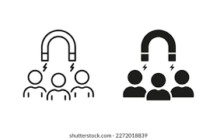
Recommendation
Strategic User Retention
1. Re-Activation Campaigns
Data-Driven Targeting: Identify inactive users and deploy personalized offers.
Visual Re-Engagement: Use Reels and Stories to capture attention in the feed.
2. Frictionless Content Creation
Smart Templates: Provide ready-to-use prompts for user-generated content.
Simplified Sharing: Reduce "creative friction" to encourage more frequent posting and interaction.
3. Loyalty & Community Programs
Gamified Rewards: Integrate Instagram Badges.
Influencer Advocacy: Partner with creators to promote loyalty perks and community meetups.

Slide 14
Recommendation
Strategic User Retention
4. Proactive Community Support
Rapid Response: Utilize automated DM assistants and FAQs to solve user issues instantly.
Safety & Moderation: Maintain a positive environment to ensure users feel secure and valued.
5. Feedback Loops & Co-Creation
User Surveys: Use Story "Polls" and "Questions" to involve users in product decisions.
Beta Access: Grant top-tier users early access to new features in exchange for feedback.

Slide 15
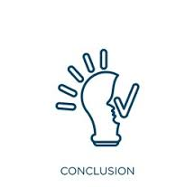
Conclusion
Transforming Insights into Impact
Summary of Insights: Leverage mapped engagement patterns and user segmentation to launch high-precision, actionable campaigns.
Strategic Next Steps: Establish clear instructional pathways and cross-functional collaborations to move from theory to practice.
Data-Driven Methodology: Prioritize analytical decision-making to ensure our tactics remain responsive to shifting user behaviors and needs.
Continuous Optimization (New): Implement iterative testing and feedback loops to refine content performance and maximize long-term ROI.

