Slide 1
Highlights of the course
Co-ordinate Systems
Introduction to Vector Operators
Work , Energy and Conservation laws
Rigid body in motion
Oscillations and Waves
Quantum Physics

Slide 2
Chapter 1
Co-ordinate Systems
Introduction to
DIFFERENT CO-ORDINATE SYSTEMS
INFINITESIMAL LINE, AREA AND VOLUME ELEMENTS

Slide 3
Outline
Choice of Co-ordinate systems
Cartesian Co-ordinates: Vector, unit vectors, Infinitesimal line, area and volume element
Plane-Polar Co-ordinates: Vector, unit vectors, transformations, Rate of change, velocity and acceleration, Infinitesimal line, area element
Cylindrical Co-ordinates: Vector, unit vectors and its transformations, Rate of change, velocity and acceleration, Infinitesimal line, area and volume element
Spherical Polar Co-ordinates: Vector, unit vectors and its transformations, Rate of change, velocity and acceleration, Infinitesimal line, area and volume element

Slide 4


Why do we need different coordinate system?

Slide 5
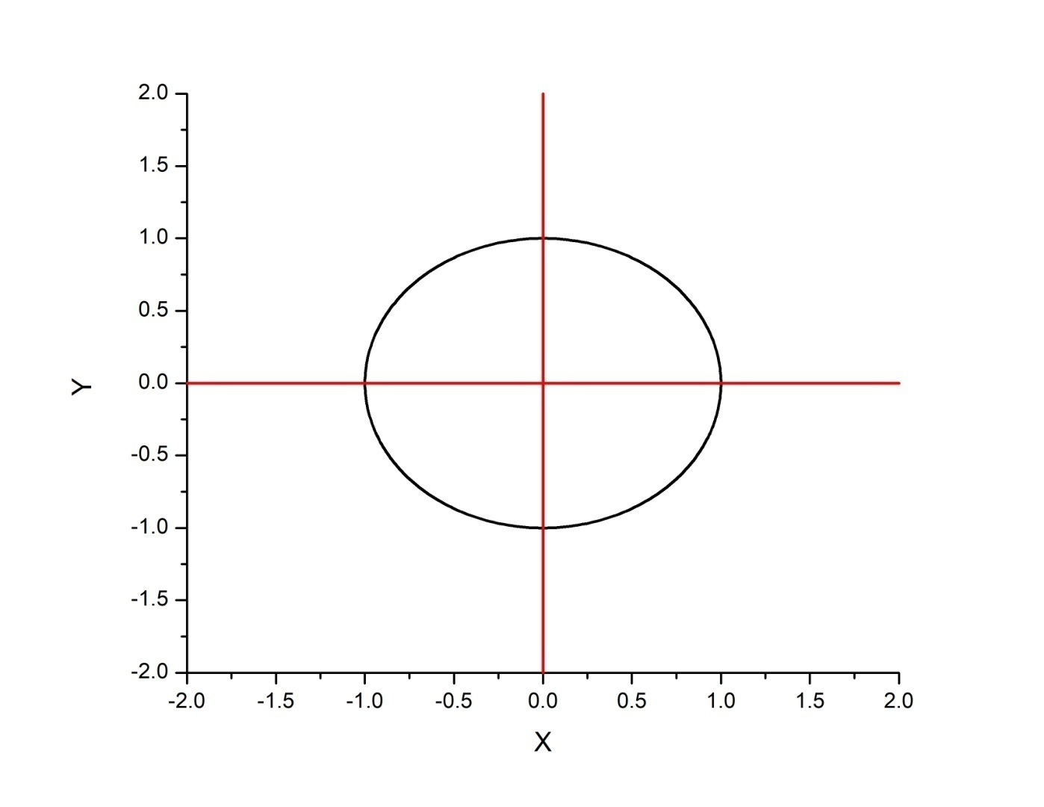
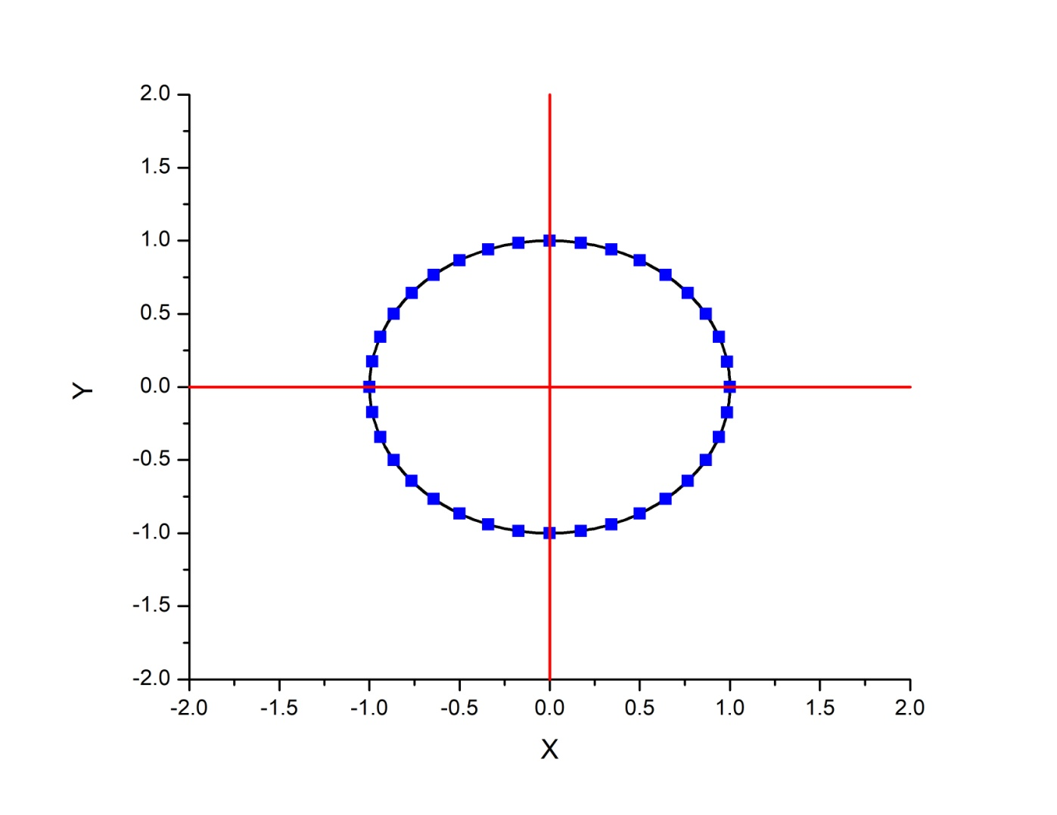
Why do we need different coordinate system?
X | Y
1 | 0
0.9397 | 0.34201
0.76606 | 0.64277
0.50003 | 0.86601
0 | 1
r
r
1 | 0
1 | 20
1 | 40
1 | 60
1 | 90
Proper choice of a
coordinate system can
vastly simplify a problem

Slide 6
Representing a vector in Cartesian Co-ordinate system

Slide 7
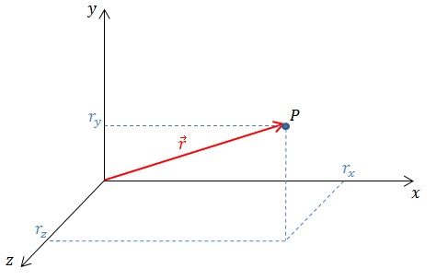
Cartesian Co-ordinates
A coordinate system consists of four basic elements:
Choice of origin (2) Choice of axes (3) Choice of positive direction for each axis (4) Choice of unit vectors for each axis

Slide 8
Infinitesimal (very small) line element in Cartesian Co-ordinate system

Slide 9
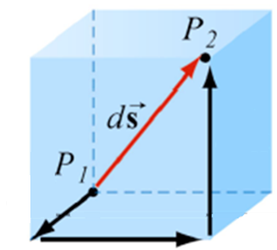
Cartesian Co-ordinates
y
Infinitesimal line element
x
z

Slide 10
Infinitesimal Area element in Cartesian Co-ordinate system

Slide 11
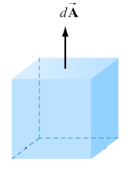
Cartesian Co-ordinates
Infinitesimal Area element
y
dz
dx
x
z
Notes:
Vector sign should be added for dx and dy

Slide 12
Infinitesimal Volume element in Cartesian Co-ordinate system

Slide 13
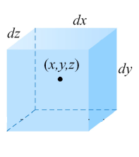
Cartesian Coordinates
Infinitesimal Volume element
y
x
z

Slide 14
Polar co-ordinate system

Slide 15
Representation of a vector and unit vector transformations in polar co-ordinates

Slide 16


Representation of a Vector in Polar Coordinates
Y
$${\hat{e}}_{r}$$
r
What is unit vector
${\hat{e}}_{r}$?
X

Slide 17

Unit vector representation in Polar Coordinates
e_{y}
e_{r}
Y
-e_{x}
(x,y)
e_{x}
r
e_{r}
X
What is and in terms of and ?
e_{x}
e_{y}
Verify that
$\hat{e}$_{ϴ}.$\hat{e}r$
= 0
Above vector in Polar Co-ordinates is
represented as
e_{x}
e_{y}
e_{r}
What is and in terms of and ?

Slide 18
Motion in polar co-ordinates, velocity and acceleration

Slide 19
Motion in Plane Polar Coordinates
e_{y}
Y
e_{y}
e_{r}
e_{r}
e_{x}
(x₁,y₁)
e_{x}
(x₂,y₂)
r₂
r₁
X
Cartesian coordinate system: Constant unit vectors
Plane polar coordinate system: Varying unit vectors

Slide 20
Velocity and acceleration in polar co-ordinates

Slide 21
Velocity in Polar Coordinates
Velocity in Cartesian Coordinates:
?
Velocity in Polar Coordinates:
?

Slide 22
Through a geometrical consideration
Y
e_{r2}
e_{r1}
-e_{r1}
(x1,y1)
(x2,y2)
r₂
r₁
X
Notes:
-er1 should be placed close to the blue vector.

