Slide 1
Deployment
you are upgrading application from v1 to v2
1.upgrade with zero downtime?
2.upgrade sequentially, one after the other?
3.pause and resume upgrade process?
4.rollback upgrade to previous stable release ?

Slide 2
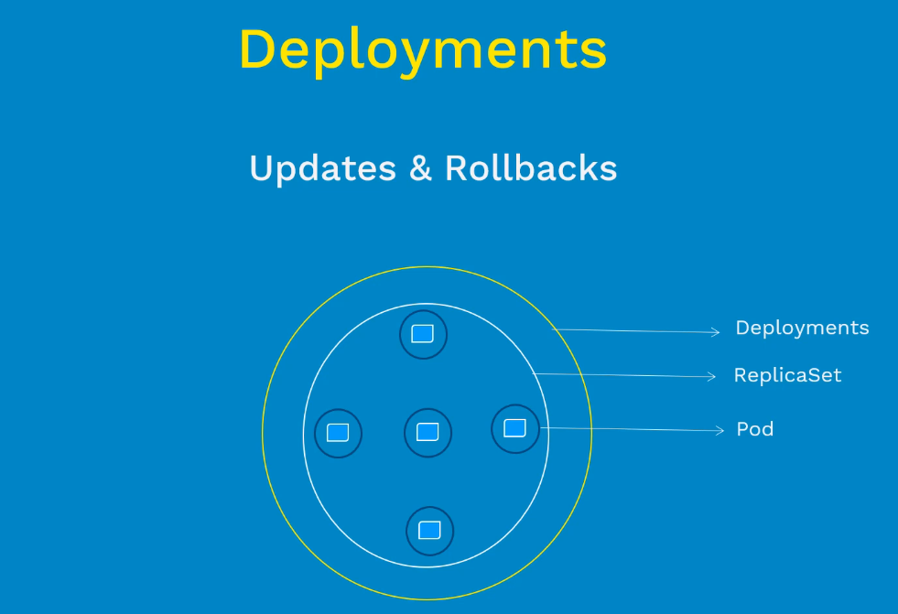

Slide 3
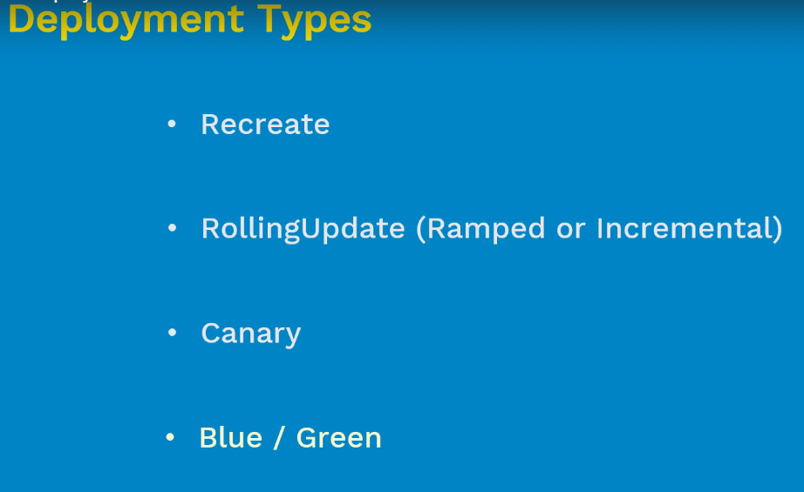

Slide 4
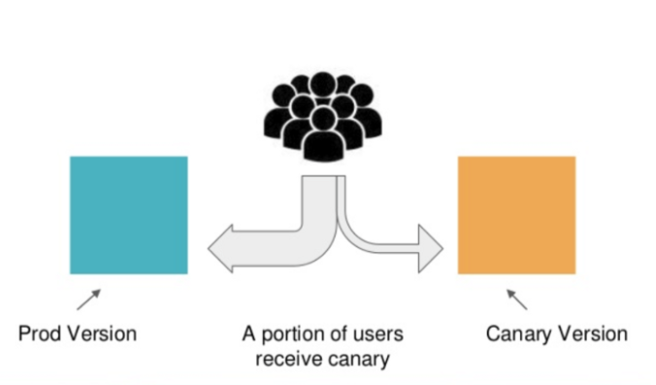
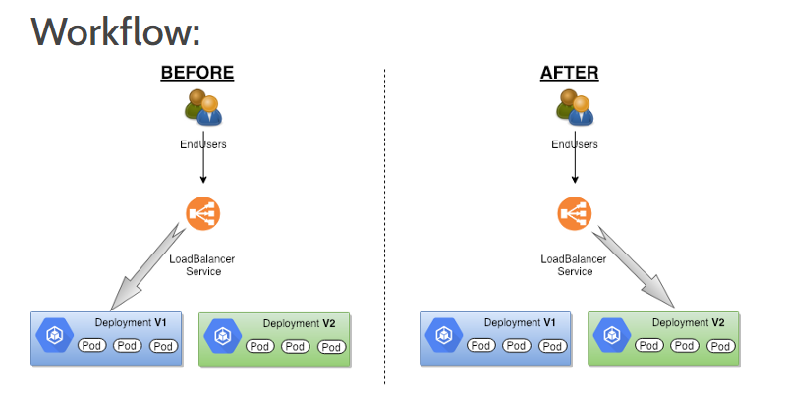

Slide 5
links
https://kubernetes.io/docs/concepts/workloads/controllers/deployment/

