Slide 1
How can you ensure there are at least 3 pod instances are always available running at point in time?

Slide 2
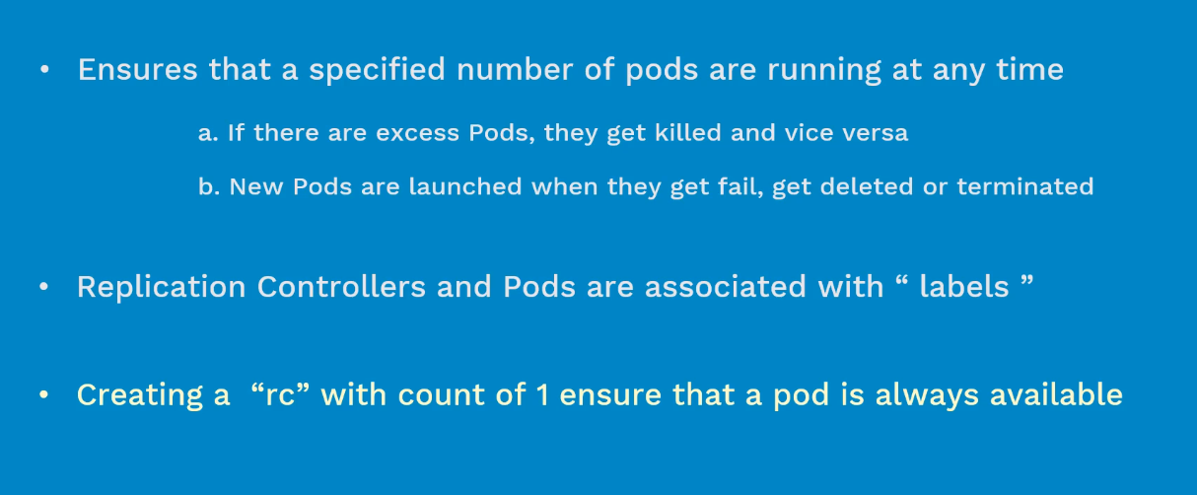

Slide 3
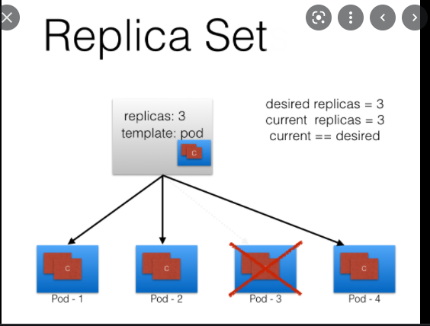
1. High availability
2. Load balancer

Slide 4
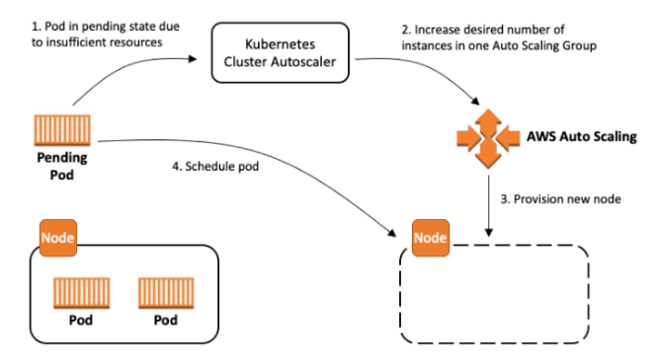
kubectl create configmap special-config –from-literal=special.how=2GB
https://kubernetes.io/docs/tasks/inject-data-application/distribute-credentials-secure/

Slide 5
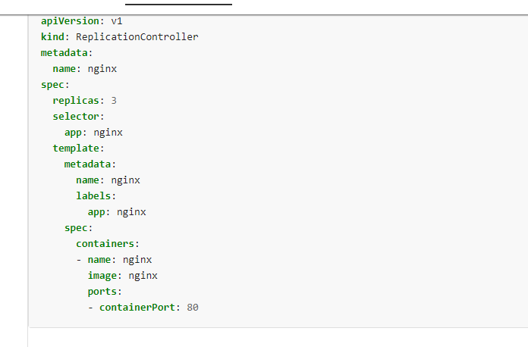
- {key: app, operator: In, values: [nginx, nginx2]}
- {key: teir, operator: NotIn, values: [production]}

Slide 6
