Slide 1
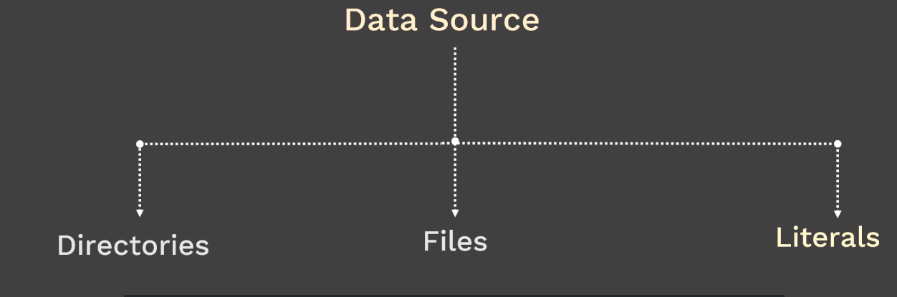
1. Kubernetes object to handle small amount of sensitive data
* password, Token. or keys
2. Not more than 1mb
3.Reduces risk of exposing sensitive data
4.created outside of pods
5.Stored inside ETCD database on kubernetes master
6. used in two ways --> volumes or ENV variable

Slide 2
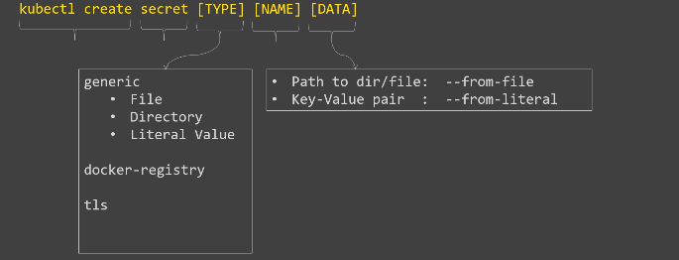

Slide 3
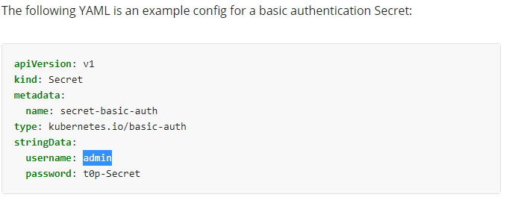

Slide 4
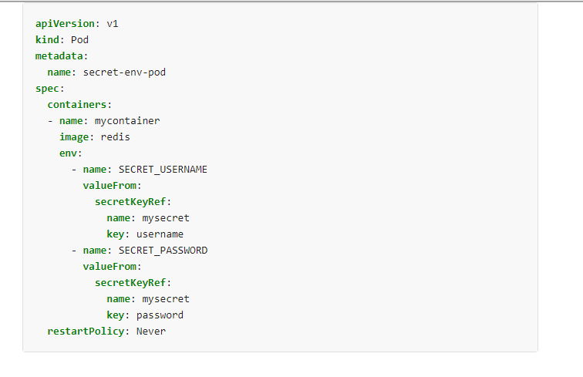
kubectl create configmap special-config –from-literal=special.how=2GB
https://kubernetes.io/docs/tasks/inject-data-application/distribute-credentials-secure/

