Slide 1
Welcome to www.sundakkai.com

Slide 2
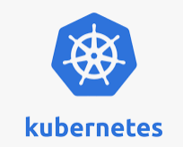
What is kubernetes?
“Kubernetes, or k8s, is an open source platform that automates Linux container operations
Should I choose k3s or k8s?
Why kubernetes is best?
Manages containerized apps at large scale
Google donated kubernetes to cncf.
Symbol

Slide 3
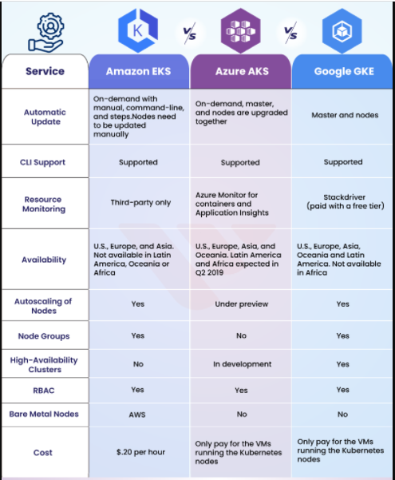

Slide 4
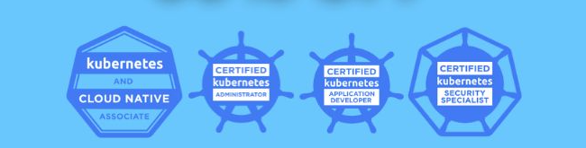

Slide 5
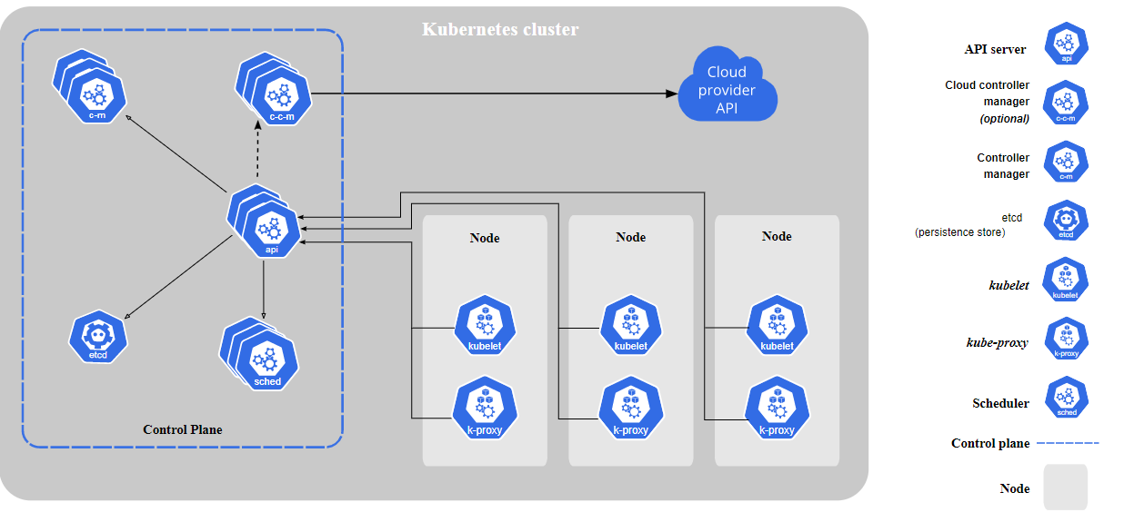

Slide 6
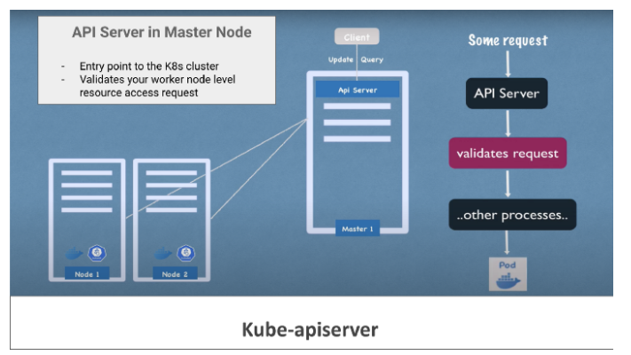
kube-apiserver is designed to scale horizontally — that is, it scales by deploying more instances. You can run several instances of kube-apiserver and balance traffic between those instances

Slide 7
kube-scheduler
The key Control plane component that keep a watch for newly created Pods with no assigned worker node, and selects a worker node for them to be scheduled and run on.
Key deciding factors regarding pod schedule include:
Hardware/Software/Policy constraints
Node affinity and anti-affinity specifications,
kube-controller-manager(Kubelet):
It is one of the critical processes in a master node that monitors the status of any worker node level failures. It keeps a close watch over the event like Crashing of any pods in the worker node and, requests the scheduler to restart or reschedule any dead /failed pods, after detecting such event.

Slide 8
Node controller: Responsible to respond when any worker node goes down
Replication controller: It ensures that the request to maintain the correct replica count of any pod deployment is always taken care
Endpoints controller: Populates the Endpoints object viz. Joins, Services & Pods
etcd in K8s Master Node:
etcd in the master control plane is responsible to store every kind of cluster-level change in the form of key-value pairs.
Some Of The Key K8s components Are :
Pods: Smallest unit of k8s, which is an abstraction of the container application
Services & Ingress: To manage external communication between nodes and internal pod level communication
ConfigMaps: used to store non-confidential data in key-value pairs.
Secrets: To keep app-level passwords and secret keys securely using based64 encoding
Volume: For Persistent data storage
Deployments: To deploy create replicas & manage stateless apps
Statefulsets: For stateful apps and databases.

Slide 9
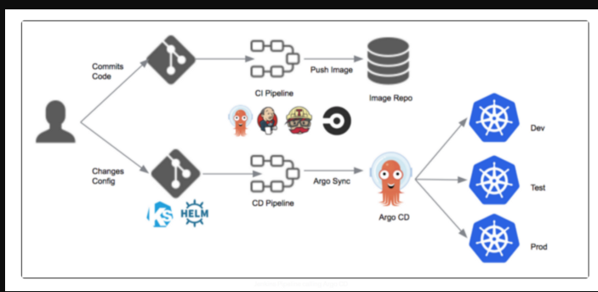

Slide 10
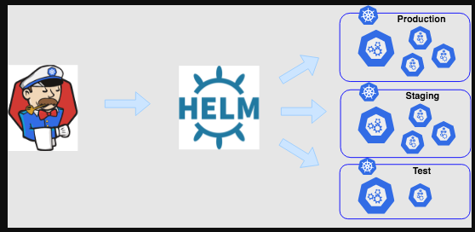

Slide 11
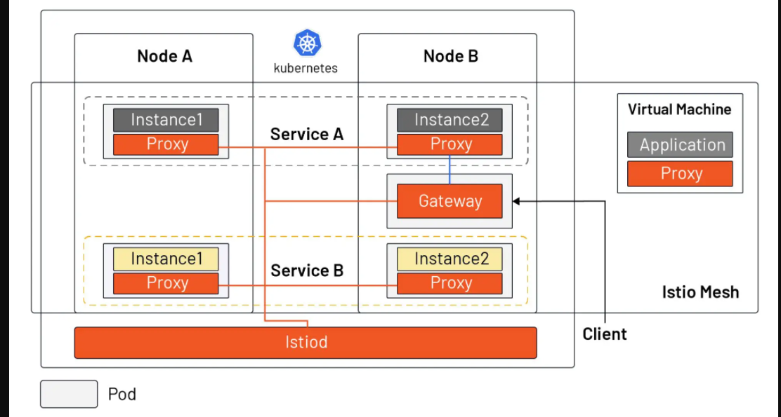
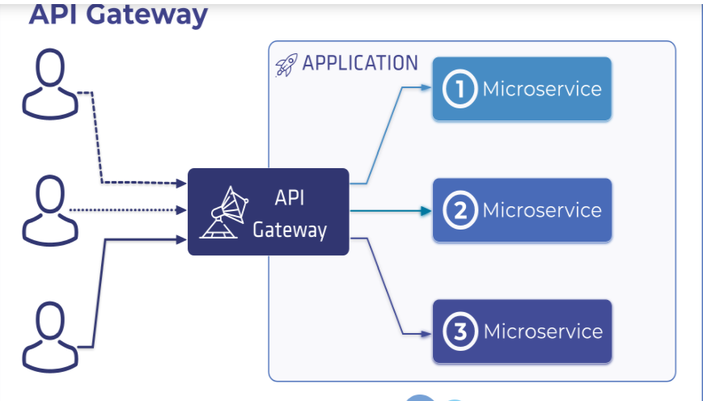

Slide 12
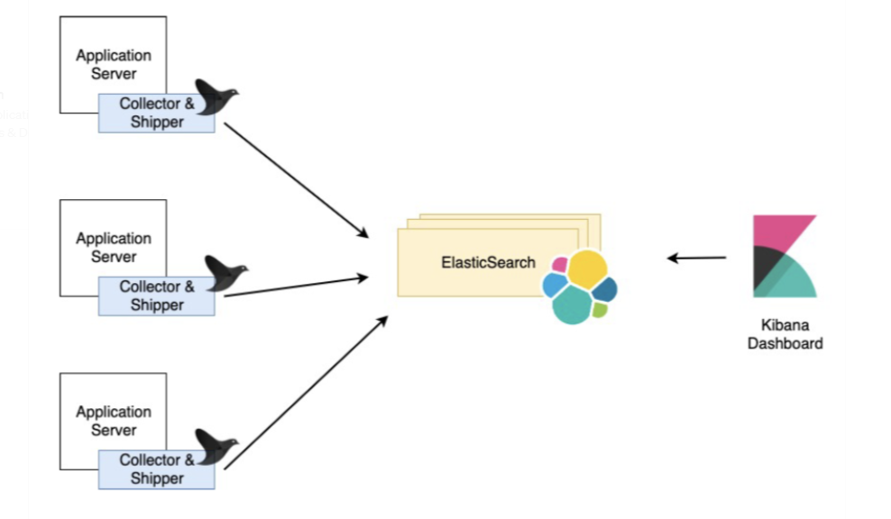

Slide 13
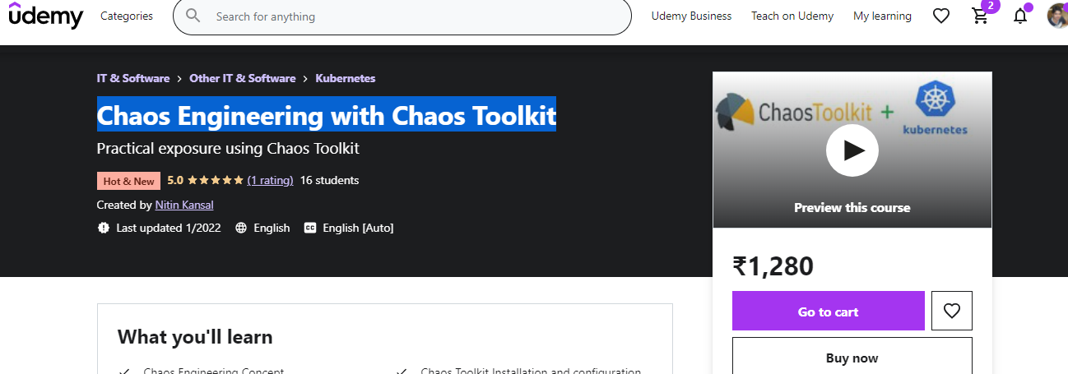
Chaos Engineering with Chaos Toolkit

Slide 14
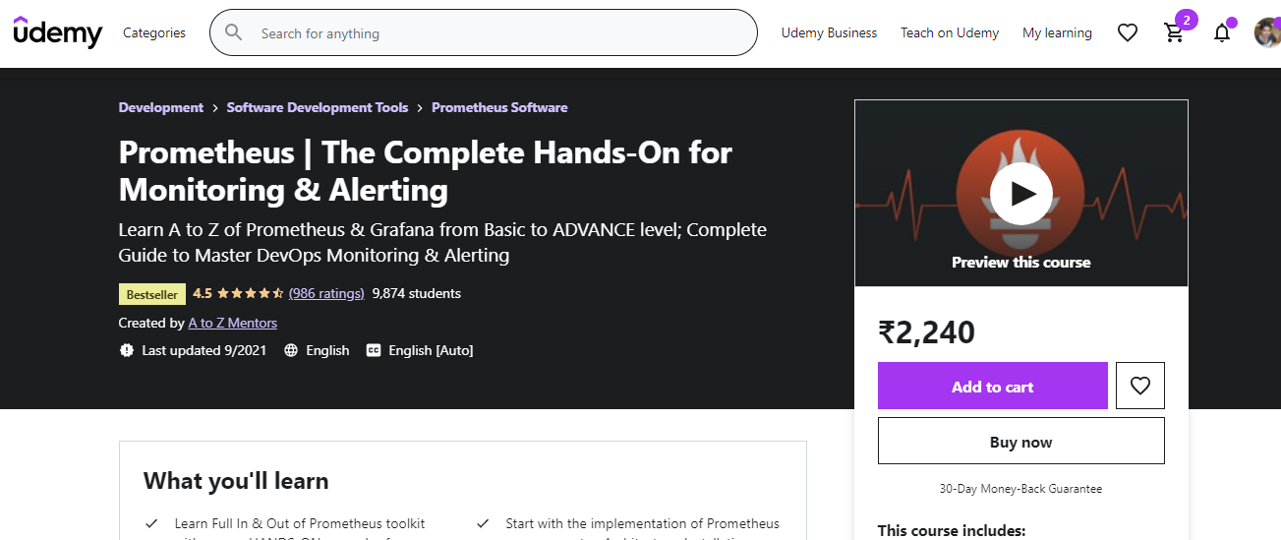
Chaos Engineering with Chaos Toolkit

