Slide 1
Welcome to www.sundakkai.com

Slide 2
Setup Kubernetes Cluster
Bootstrapping clusters with kubeadm
Installing Kubernetes with kops
Installing Kubernetes with Kubespray
Setup Kubernetes Cluster Using Kubeadm --> cluster in less time.
What is Kubeadm?
Kubeadm is a tool to set up a minimum viable Kubernetes cluster without much complex configuration.
Kubeadm makes the whole process easy by running a series of prechecks to ensure that the server has all the essential components and configs to run Kubernetes.

Slide 3
Kubeadm Setup Prerequisites
Following are the prerequisites for Kubeadm Kubernetes cluster setup.
Minimum two Ubuntu nodes [One master and one worker node]. You can have more worker nodes as per your requirement.
The master node should have a minimum of 2 vCPU and 2GB RAM.
For the worker nodes, a minimum of 1vCPU and 2 GB RAM is recommended.
10.X.X.X/X network range with static IPs for master and worker nodes. We will be using the 192 series as the pod network range that will be used by the Calico network plugin. Make sure the Node IP range and pod IP range don’t overlap.

Slide 4
All the steps given in this guide are referred from the official Kubernetes documentation
Install container runtime on all nodes- We will be using Docker.
Install Kubeadm, Kubelet, and kubectl on all the nodes.
Initiate Kubeadm control plane configuration on the master node.
Save the node join command with the token.
Install the Calico network plugin.
Join worker node to the master node (control plane) using the join command.
Validate all cluster components and nodes.

Slide 5
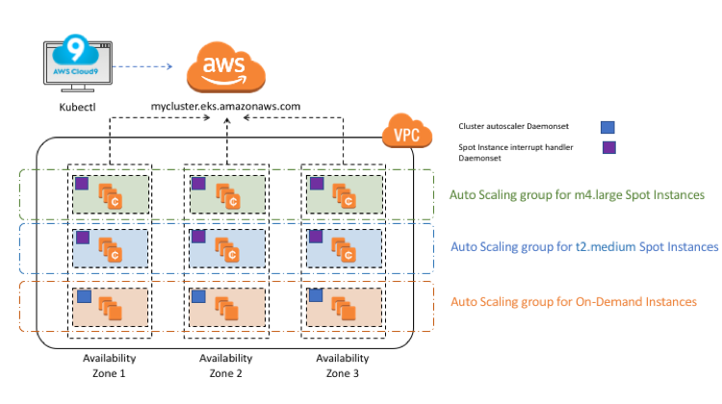

Slide 6
