Slide 1
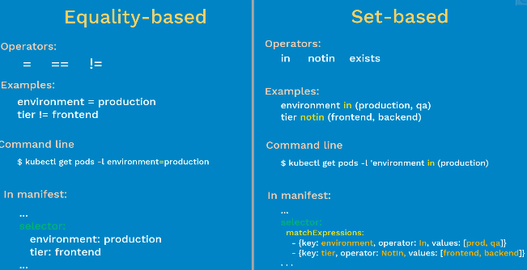
How can you ensure there are at least 3 pod instances are always available running at point in time?
Set-based Supports: Job, Deployment, Relica set and Damoset
Equality-based Supports: Services, Replication controller

