Slide 1
Upgrading app from v1 to v2
Upgrade sequentially, one after the other?
Pause & resume upgrade process?
Rollback upgrade to previous stable release?

Slide 2
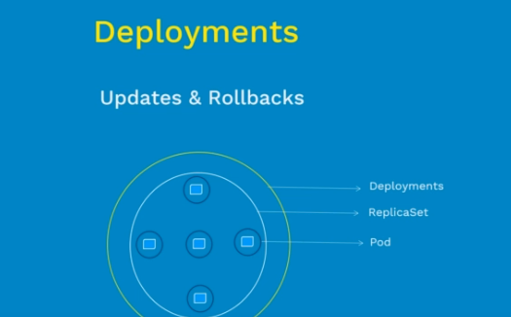

Slide 3
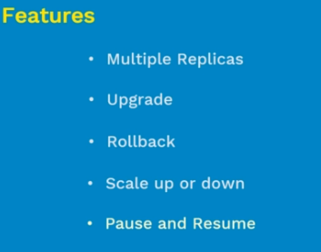

Slide 4
