Slide 1
Coursera Capstone Project
Coursera IBM Data Science Certification
Raj Kishore Sharma
13-Nov-20

Slide 2
Report Contents
Introduction Section
The “business problem” to be solved by this project and who may be interested
Data Section
Describe Data requirements and Sources needed to solve the problem
Methodology section
Main component of the report - Execute data processing, describe/discuss any exploratory data
analysis and/or inferential statistical testing performed, and/or machine learnings used.
4. Results section
Discussion of the results and finding of answer
Discussion section
Discussion of observations noted and any recommendations
6. Conclusion section
Answer chosen and conclusions.

Slide 3
Introduction
The purpose of this Capstone Project is to help people in exploring better facilities around their neighbourhood. It will help people making smart and efficient decision on selecting great neighbourhood out of numbers of other neighbourhoods in Scarborough, Toranto.Lots of people are migrating to various states of Canada and needed lots of research for good housing prices and repeated schools for their children. This project is for those people who are looking for better neighbourhoods. For ease of accessing to Cafe, School, Supermarket, medical shops, grocery shops, mall, theatre, hospital, likeminded people, etc.
This Capstone Project aim to create an analysis of features for a people migrating to Scarborough to search a best neighbourhood as a comparative analysis between neighbourhoods. The features include median housing price and better school according to ratings, crime rates of that area, road connectivity, weather conditions, good management for emergency, water resources both freash and wastewater and excrement conveyed in sewers and recreational facilities.
It will help people to get awareness of the area and neighbourhood before moving to a new city, state, country or place for their work or to start a new fresh life.

Slide 4
Data Section
Datalink: https://en.wikipedia.org/wiki/List_of_postal_codes_of_Canada:_M
Will use Scarborough dataset which we scrapped from Wikipedia on Week 3. Dataset consisting of latitude and longitude, zip codes.
Foursquare API Data:
We will need data about different venues in different neighborhoods of that specific borough. In order to gain that information we will use “Foursquare” locational information. Foursquare is a location data provider with information about all manner of venues and events within an area of interest. Such information includes venue names, locations, menus and even photos. As such, the foursquare location platform will be used as the sole data source since all the stated required information can be obtained through the API.After finding the list of neighborhoods, we then connect to the Foursquare API to gather information about venues inside each and every neighborhood. For each neighborhood, we have chosen the radius to be 100 meters. The data retrieved from Foursquare contained information of venues within a specified distance of the longitude and latitude of the postcodes.
The information obtained per venue as follows:
Neighbourhood
Neighbourhood Latitude
Neighbourhood Longitude
Venue
Name of the venue e.g. the name of a store or restaurant
Venue Latitude
Venue Longitude
Venue Category

Slide 5
Methodology section
Clustering Approach:
To compare the similarities of two cities, we decided to explore neighbourhoods, segment them, and group them into clusters to find similar neighbourhoods in a big city like New York and Toronto. To be able to do that, we need to cluster data which is a form of unsupervised machine learning: k-means clustering algorithm.
Using K-Means Clustering Approach | Most Common Venue
Most Common Venues near Neighbourhood | Using Clustering
Workflow:
Using credentials of Foursquare API features of near-by places of the neighbourhoods would be mined. Due to http request limitations the number of places per neighbourhood parameter would reasonably be set to 100 and the radius parameter would be set to 500.would be set to 500.

Slide 6
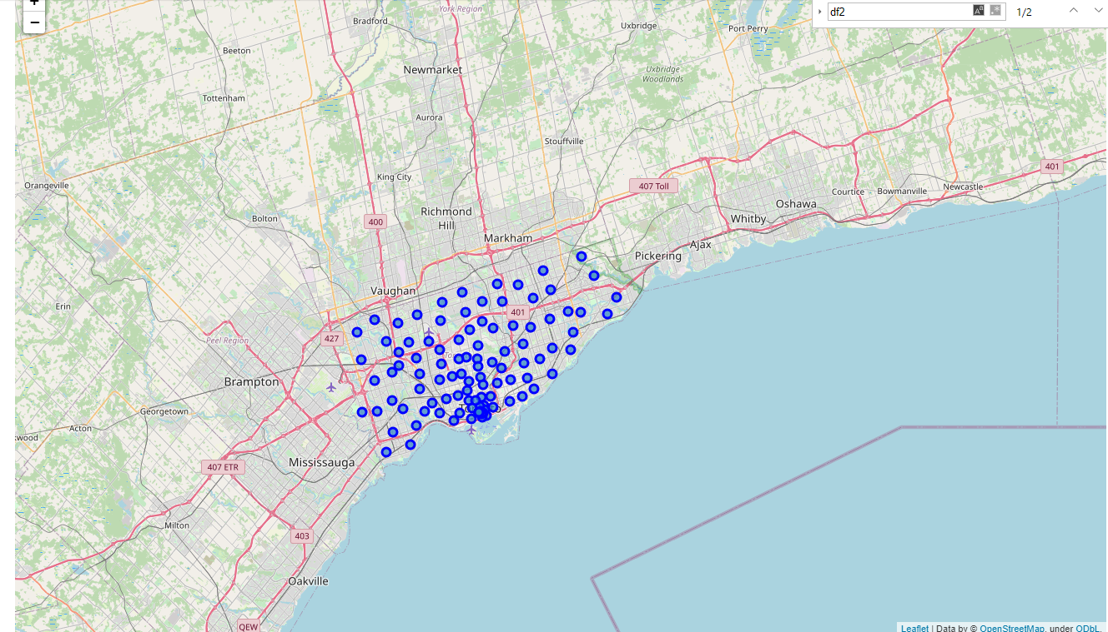
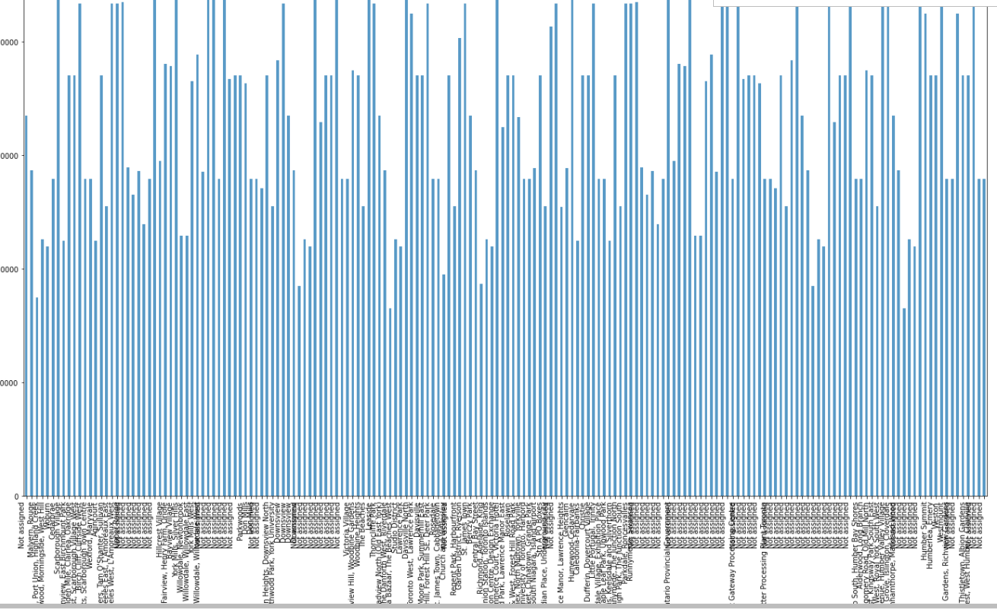
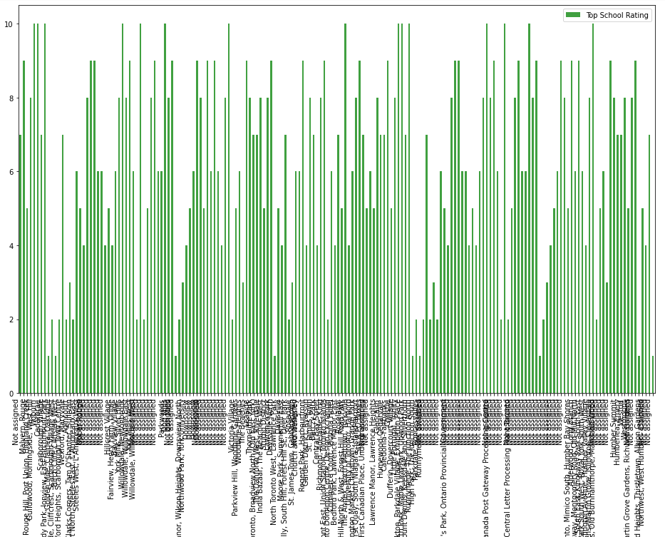
Result Section
Map of Clusters in Scarborough | Average Housing Price | Top School Ratings

Slide 7
Discussion section
Problem Which Tried to Solve:
The major purpose of this project is to suggest a better neighbourhood in a new city for the person who are shifting there. Social presence in society in terms of likeminded people. Connectivity to the airport, bus stand, city centre, markets and other daily needs things nearby.
Sorted list of houses in terms of housing prices in a ascending or descending order
Sorted list of schools in terms of location, fees, rating and reviews

Slide 8
Conclusion section
In this Capstone project, using k-means cluster algorithm I separated the neighbourhood into 10(Ten) different clusters and for 103 different latitude and longitude from dataset, which have very-similar neighbourhoods around them. Using the charts above results presented to a neighbourhood based on average house prices and school rating have been made.
I feel rewarded with the efforts and believe this course with all the topics covered is well worthy of appreciation. This project has shown me a practical application to resolve a real situation that has impacting personal and financial impact using Data Science tools.
The mapping with Folium is a very powerful technique to consolidate information and make the analysis and decision better with confidence.
Future Works:
This Capstone project can be continued for making it more precise in terms to find best house in Scarborough. Best means on the basis of all required things (daily needs or things we need to live a better life) around and also in terms of cost effective.
Libraries Which are Used to Develop the Project:
Pandas: For creating and manipulating dataframes.
Folium: Python visualization library would be used to visualize the neighbourhoods cluster distribution of using interactive leaflet map.
Scikit Learn: For importing k-means clustering.
JSON: Library to handle JSON files.
XML: To separate data from presentation and XML stores data in plain text format.
Geocoder: To retrieve Location Data.

