Slide 1
Session 4 – Foundational R Programming - II Assignment – 3
Problem Statement
States = rownames(US Arrests)
USArrests
States = rownames(USArrests)
States
[1] "Alabama" "Alaska" "Arizona" "Arkansas" "California"
[6] "Colorado" "Connecticut" "Delaware" "Florida" "Georgia"
[11] "Hawaii" "Idaho" "Illinois" "Indiana" "Iowa"
[16] "Kansas" "Kentucky" "Louisiana" "Maine" "Maryland"
[21] "Massachusetts" "Michigan" "Minnesota" "Mississippi" "Missouri"
[26] "Montana" "Nebraska" "Nevada" "New Hampshire" "New Jersey"
[31] "New Mexico" "New York" "North Carolina" "North Dakota" "Ohio"
[36] "Oklahoma" "Oregon" "Pennsylvania" "Rhode Island" "South Carolina"
[41] "South Dakota" "Tennessee" "Texas" "Utah" "Vermont"
[46] "Virginia" "Washington" "West Virginia" "Wisconsin" "Wyoming"

Slide 2
Get states names with ‘w’.
States[grep("w", States)]
[1] "Delaware" "Hawaii" "Iowa" "New Hampshire" "New Jersey"
[6] "New Mexico" "New York"
Get states names with ‘W’.
States[grep("W", States)]
[1] "Washington" "West Virginia" "Wisconsin" "Wyoming"

Slide 3
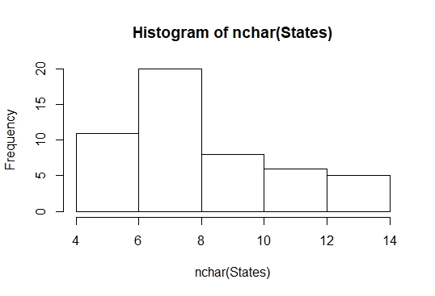
2. Prepare a Histogram of the number of characters in each US state.
df <- nchar(States)
df
hist(nchar(States))

Slide 4
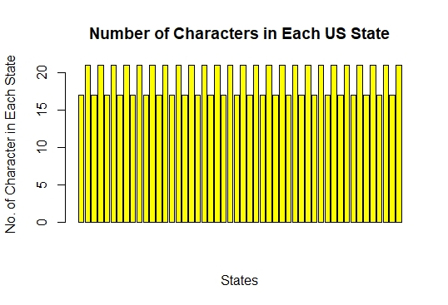
States <- rownames(USArrests)
No_of_Char <- nchar(x)
df <- data.frame(States, No_of_Char)
df
barplot(df$No_of_Char, main = "Number of Characters in Each US State",
xlab = "States", ylab = "No of Character in Each State",
col = "yellow", axes = TRUE
)

