Slide 1

IILM UNIVERSITY, GREATER NOIDA
School of Computer Science and Engineering
Data Science Internship
at SkillCraft Technology
Exploratory Data Analysis, Visualization & Predictive Modelling using Python
STUDENT
ROLL NUMBER
PROGRAM & SEMESTER
ORGANIZATION
Raj Vardhan
25SCS1003000502
B.Tech CSE, 3rd Semester
SkillCraft Technology

Slide 2
OVERVIEW
Internship Snapshot
ROLE
DURATION
MENTOR
LOCATION
Data Science Intern
20 Jul 2026 – 20 Aug 2026 (1 Month)
Pranav Bansal, Tech Lead
Vashi, Navi Mumbai
About the Internship
FOUR CORE TASKS
As part of the B.Tech CSE curriculum at IILM University, I completed a one-month Data Science internship at SkillCraft Technology. The program followed a task-based, mentorship-driven model, in which I worked through four progressively challenging real-world data problems covering visualization, exploratory data analysis, predictive modelling and applied analytics — building a practical, project-based portfolio using Python.
01
Population Distribution Visualization
02
Titanic Dataset — Cleaning & EDA
03
Decision Tree Classifier — Bank Marketing
04
Traffic Accident Data Analysis
2

Slide 3

ORGANIZATION PROFILE
Who is SkillCraft Technology?
SkillCraft Technology is a technology-driven organization offering structured, mentorship-based internship programs to students and early-career professionals in domains such as Data Science, Web Development and Software Engineering — with the goal of bridging the gap between academic learning and industry-relevant skills.
SkillCraft Technology
1
Task-Based Learning Model
Interns progress through a series of real-world tasks of increasing difficulty.
MSME-registered technology organization — Vashi, Navi Mumbai
2
Mentor-Led Guidance
Every intern is supported by an experienced Tech Lead throughout the program.
3
Industry-Aligned Datasets
Tasks are built around publicly available, real-world datasets (Kaggle, UCI).
4
Portfolio-Focused Outcome
Interns leave with a practical, demonstrable project portfolio.
skillcrafttech.com
3

Slide 4
THE CHALLENGE
Problem Statement & Objectives
PROJECT WORKFLOW
PROBLEM STATEMENT
Raw data rarely offers direct insight on its own — it must be cleaned, explored, visualized and, where applicable, modelled before it can support real decisions. This internship addressed four such real-world problems, spanning demographic visualization, survival analysis, customer-behaviour prediction and road-safety analytics.
1
Data Collection
2
Cleaning & Preprocessing
3
Exploratory Analysis
OBJECTIVES
4
Visualization
Apply the complete data science workflow: collect, clean, explore, visualize, model.
Build clear visualizations to communicate distributions and trends.
5
Modelling & Evaluation
Perform structured EDA to uncover relationships in real datasets.
6
Insight Generation
Build and evaluate a decision tree classification model.
Translate raw accident data into actionable safety insights.
4

Slide 5
TOOLKIT
Technologies & Tools Used
1
2
3
Python 3
Pandas & NumPy
Matplotlib & Seaborn
Core programming language for all tasks
Data loading, cleaning & transformation
Static visualization — charts & heatmaps
4
5
6
Scikit-learn
Jupyter / Google Colab
Kaggle & UCI Repository
Building & evaluating the decision tree model
Interactive development environment
Public real-world dataset sources
5

Slide 6
TASK 01
Population Distribution Visualization
Objective: Create a bar chart / histogram to visualize the distribution of a categorical or continuous variable — such as the age-wise distribution of a population.
APPROACH
• Loaded age-wise population data using Pandas.
• Built a labelled bar chart using Matplotlib/Seaborn across three age bands.
• Interpreted the chart to highlight the working-age majority.
KEY INSIGHT
57% of the population falls in the 21–64 working-age band, versus 36% under 20 and 7% above 65 — a demographic skew with major implications for workforce and policy planning.
6

Slide 7
TASK 02
Titanic Dataset — Cleaning & Exploratory Data Analysis
Objective: Perform data cleaning and EDA on the Titanic dataset (Kaggle) to explore relationships between variables and identify patterns in passenger survival.
APPROACH
• Identified and handled missing values in Age, Cabin, Embarked.
• Generated summary statistics for key variables.
• Explored survival vs. sex, class & age using count plots and a correlation heatmap.
KEY INSIGHT
Survival was strongly linked to gender and class — female and first-class passengers had markedly higher survival rates, reflecting the era's evacuation priorities.
7

Slide 8
TASK 03
Decision Tree Classifier — Bank Marketing Dataset
Objective: Build a decision tree classifier to predict whether a customer will purchase a product/service, based on demographic and behavioural data (UCI Bank Marketing dataset).
MODEL STRUCTURE (ILLUSTRATIVE)
Call Duration > 5 minutes?
APPROACH
Yes
No
• Encoded categorical variables; split data into train/test sets.
Prior Outcome = Success?
Age Under 30?
• Trained a Decision Tree Classifier using Scikit-learn.
• Evaluated with accuracy, confusion matrix & precision/recall.
Purchase: Yes
Purchase: No
Purchase: Yes
Purchase: No
KEY INSIGHT
MODEL EVALUATION
Call duration and prior campaign outcome emerged as the most influential features in predicting purchase decisions.
Evaluated using Accuracy, Confusion Matrix, and Precision / Recall to validate the classifier's predictive reliability on held-out test data.
8

Slide 9
TASK 04
Traffic Accident Data Analysis
Objective: Analyze traffic accident data to identify patterns related to road conditions, weather and time of day, and visualize accident hotspots and contributing factors.
APPROACH
• Explored accident frequency across weather and time-of-day.
• Visualized hotspots and contributing factors with bar charts and heatmaps.
• Summarized findings into road-safety-relevant insights.
KEY INSIGHT
Accident frequency peaked during evening rush hours and under wet/low-visibility weather — pointing to targeted enforcement and signage during these windows.
9

Slide 10
TAKEAWAYS
Key Learnings & Skills Gained
1
2
Technical Proficiency
End-to-End Workflow
Hands-on fluency in Python, Pandas, NumPy, Matplotlib, Seaborn and Scikit-learn for real analytical work.
Practical experience across the full data science lifecycle — from raw data to actionable insight.
3
4
Analytical Thinking
Communicating Insights
Sharper ability to frame problems, question data quality, and validate findings critically.
Learned to translate technical results into clear, decision-relevant visual insights.
10

Slide 11
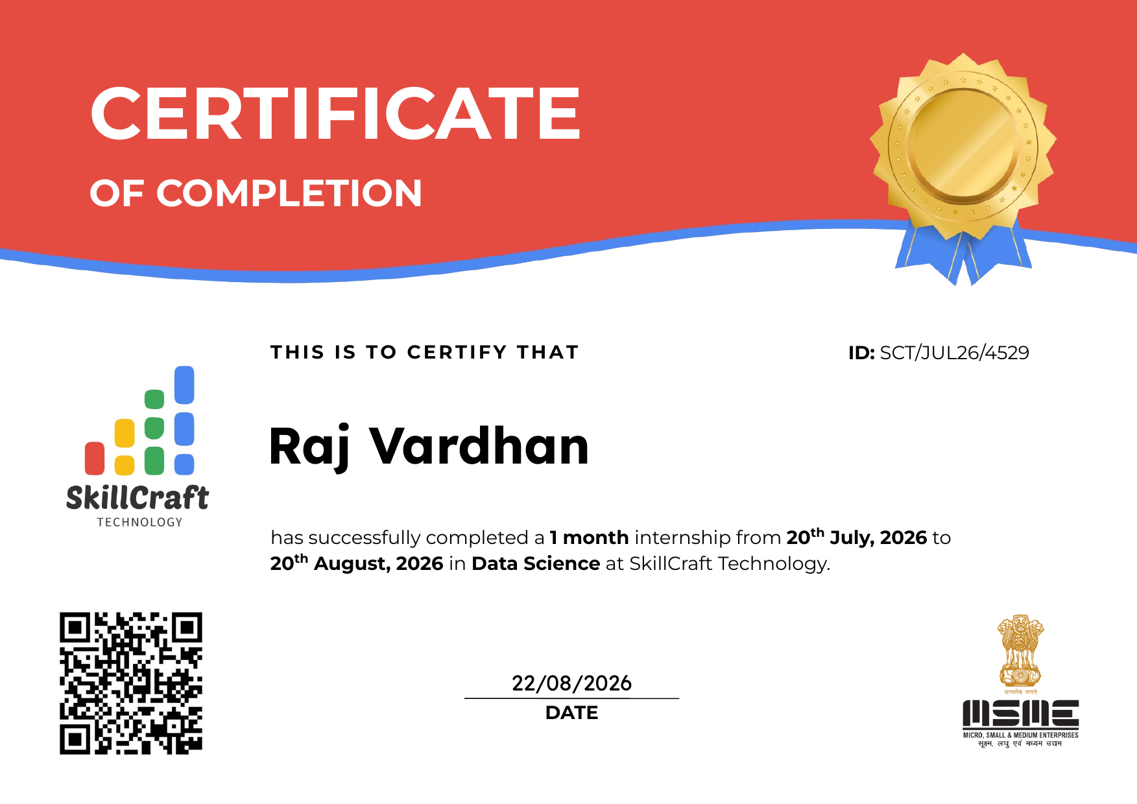
PROOF OF COMPLETION
Internship Completion Certificate
11

Slide 12
Thank You
Questions & Discussion
Raj Vardhan | B.Tech CSE, IILM University | Data Science Intern, SkillCraft Technology

