Slide 1
ECONOMICS
EASE OF DOING BUSINESS
TEAM MEMBERS:
SHUBHAM RAJ (CE19B030 )
TALHA SHAMIM (CS19B050)
SANTOSH KUMAR (ME19B038)
RAJENDRA KUMAR (CS19B034)
VIKAS MEENA (CE19B032)

Slide 2
Contents :
What is Ease of Doing Business ?
What is Ease of Doing Business Score ?
How Do We Calculate EODB ?
Why Do We Need EODB ?
Where Do We Stand In EODB ?
EODB Of Various States In India .
What Is BRAP ?
EODB In 2019 V/s 2020 .

Slide 3
What is Ease Of Doing Business ?
It is a joint initiative by the Department for Promotion of Industry and Internal Trade (DPIIT) and the World Bank to improve the overall business environment in the States.
Economies are ranked on their ease of doing business, from 1–190. A high ease of doing business ranking means the regulatory environment is more conducive to the starting and operation of a local firm. The rankings are determined by sorting the aggregate scores on 10 topics, each consisting of several indicators, giving equal weight to each topic.

Slide 4
What is Ease Of Doing Business Score ?
The ease of doing business score helps assess the absolute level of regulatory performance over time.
It captures the gap of each economy from the best regulatory performance observed on each of the indicators across all economies in the Doing Business sample since 2005.
One can both see the gap between a particular economy’s performance and the best performance at any point in time and assess the absolute change in the economy’s regulatory environment over time as measured by Doing Business.
An economy’s ease of doing business score is reflected on a scale from 0 to 100, where 0 represents the lowest and 100 represents the best performance.

Slide 5
For example, an ease of doing business score of 75 in Doing Business 2019 means an economy was 25 percentage points away from the best regulatory performance constructed across all economies and across time.
A score of 80 in Doing Business 2020 would indicate the economy is improving

Slide 6
How Do We Calculate EODB Score ?
We Measure EODB Score On Basis of These 10 Parameters :
1. Starting a Business,
2. Dealing with Construction permits,
3. Electricity availability,
4. Property registration,
5. Credit availability,
6. Protecting minority Investors,
7. Paying Taxes,
8. Trading across borders,
9. Contracts enforcement, and
10. Resolving Insolvency.

Slide 7
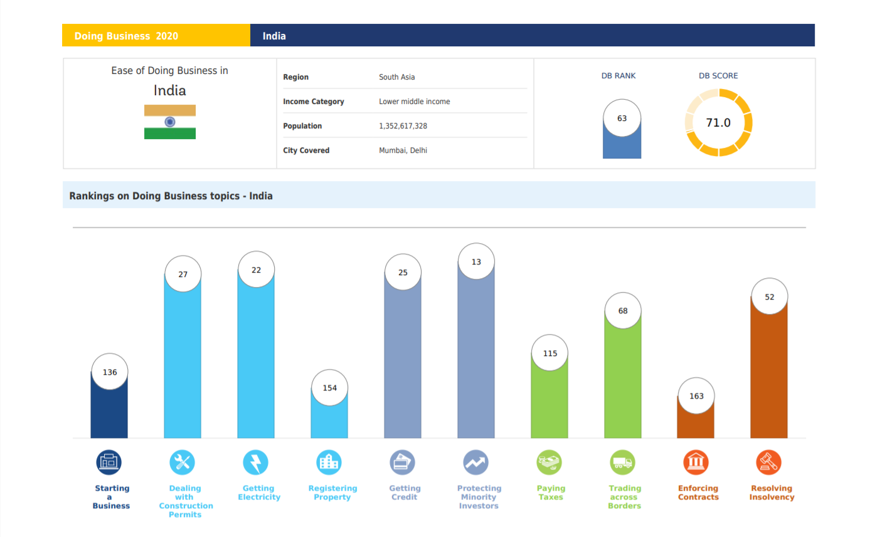
Where Do We Stand In EODB ?
The Picture Clearly Depicts We Stand In Rank 63 With A Score of 71.0

Slide 8
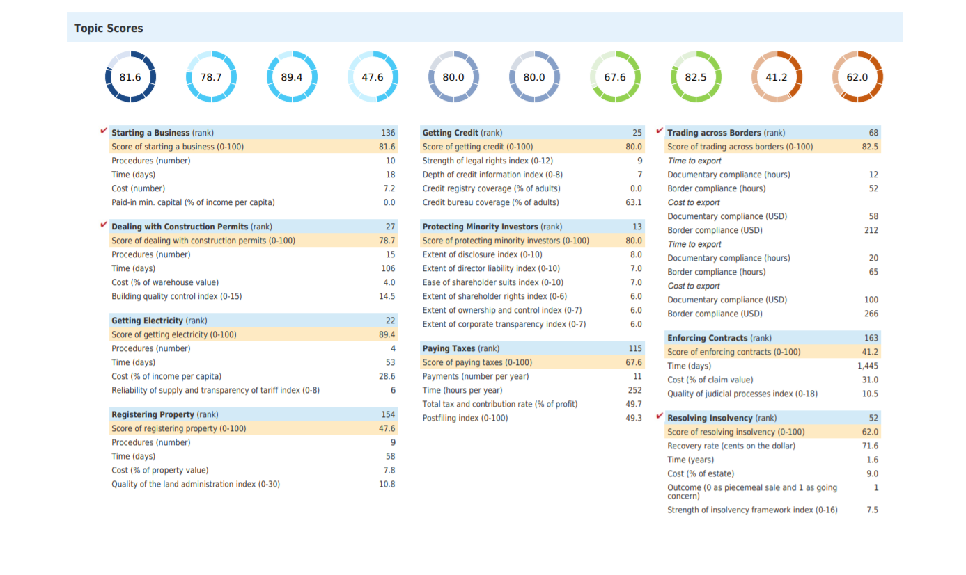
This Picture Depicts the Score of Various Parameters While Calculating EODB Score

Slide 9
EODB In Various States Of India
State | Rank
Andhra Pradesh | 1
Uttar Pradesh | 2
Telangana | 3
Madhya Pradesh | 4
Jharkhand | 5
Chhattisgarh | 6
Himachal Pradesh | 7
Rank | State
8 | Rajasthan
9 | West Bengal
10 | Gujrat
11 | Uttarakhand
12 | Delhi
13 | Maharashtra
14 | Tamil Nadu
State | Rank
Lakshadweep | 15
Haryana | 16
Karnataka | 17
Daman and Diu | 18
Punjab | 19
Assam | 20
Jammu & Kashmir | 21

Slide 10
The Department for Promotion of Industry and Internal Trade (DPIIT), Ministry of Commerce and Industry released the 4 edition of Ease of Doing Business Rankings based on the State Business Reform Action Plan (State BRAP).
Andhra Pradesh has topped the rankings followed by Uttar Pradesh,
Telangana, Madhya Pradesh and Jharkhand.
Tripura, Sikkim, Odisha were among the worst performers
Andhra Pradesh has achieved 100% compliance with BRAP:
~ It is the first State to take measures to revive the economy hit by the global pandemic and revive
the small and medium scale industries with a RESTART package.
~ The RESTART package includes the payment of sanctioned incentives, working
capital loans, preferential market access etc. to MSME units.

Slide 11
What Is BRAP ?
Business Reform Action Plan (BRAP):
~ It was launched in 2015.
~ BRAP 2019 contains a list of 80 reforms (187 reform action points) to be implemented by 19 State
departments.
~ These reforms cover 12 business regulatory areas such as Access toInformation, Single Window System,
Labour , Environment Etc.
Objectives :
~ It was introduced to encourage a healthy competition between states.
~ This would help in attracting investments and increasing Ease of Doing Business in each State.

Slide 12
EODB 2018 VS 2019 !
India was placed at 63 position this time (2019) out of 190 countries marking an improvement of 14 places from its 77 rank in 2018.
India’s score improved from 67.23 (2019) to 71.0 (2020).
India for the third consecutive year was present in the list of 10 economies where the business climate has improved the most.
India continues to maintain its first position among South Asian countries. It
was 6 (in 2014).
The World Bank will now include Kolkata and Bengaluru, besides Delhi and Mumbai, for preparing ease of doing business report, in order to provide a holistic picture of the business environment of the country.

Slide 13
The essential features of India's performance this year are:
India’s ranking improved basically on four parameters:
Starting a Business- India made starting a business easier by fully integrating multiple application forms into a general incorporation form,
Dealing with Construction Permits- For example, building a warehouse cost around 4% of the warehouse value as compared to 5.7% in the previous year,
Trading across Borders- with a single electronic platform- improved electronic submission methods for documents and upgrades to port infrastructure, import and export process became easier, and
Resolving Insolvency- Recovery rate under resolving insolvency has improved significantly from 26.5% to 71.6%. Also, the time taken for resolving insolvency has also come down significantly from 4.3 years to 1.6 years.

