Slide 1
Project Preservation
Team members :
Talha Shamim
Shubham Raj
Saurav Gwalia
Naman Sharma
Rajendra Kumar
P. Auraag Reddy
V. V.S Reddy
Deepika
Navjot

Slide 2

MERN STACK

Slide 3
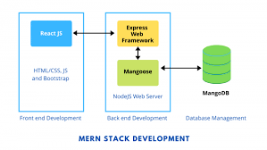
MERN STACK CONTROL FLOW

Slide 4
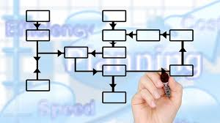
TREE DIAGRAM

Slide 5
Tree Diagram in our project This section shows the interdependency of humans and environment only with the help of pictures. Animated text on hovering makes it attractive and is quite easy to understand about the consequences of bad environmental practices.

Slide 6
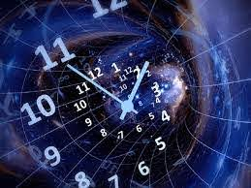
Time Machine

Slide 7
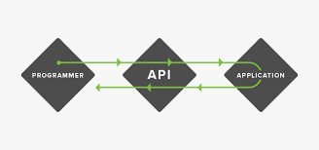
API

Slide 8
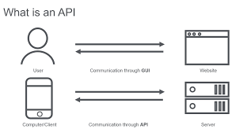

Slide 9
Time Machine in our project In this section user can check the condition of the earth, of any past year by entering the year in the box. This can be used to check for few individual parameters including : CO2 emission Global Temperature rise

Slide 10
API We have used Application Programming Interface to have a real time data at global and local level At global level we have api NO2, CO2, CH4 At local and global we have api for temp Also we have api for Air Quality Index(AQI)

Slide 11
Which Api where??? To calculate the carbon footprint of a particular place: Api of CH4,CO2,NO2 To calculate the Tempeature for a place: Api of local temp To calculate Air quality of a place: Api of Air quality Index

Slide 12
Usage of Api in our project We have used AQI for showing precautionary measures accordingly for any place We have used temp data to calculate the difference between temp of a place with global temperature and calculated the loss of crop yield and rise in sea level of a place We have used CO2,NO2,CH4 for calculating the world’s carbon footprint of a day

Slide 13
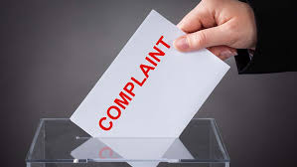
Complaint

Slide 14
Complaint Section We have a complaint section where users can register there complaint which after our approval will be send to Local Municipal corporation which will be then processed by them.

Slide 15

Sustainable Development Goals

Slide 16
Sustainable Development goals This section comprises of all the SDG with illustrative pictures , animation and covers all the aims related to that goals. The aims are written in simple language so that it becomes easier for even younger generation and common people.

Slide 17

Resources

Slide 18
Resources Section This section contains all the common resources which we use in day to day life. It contains pros and cons for those resources and also the alternative for them. It covers : Renewable Resources Non Renewable Resources

Slide 19
Contribution Frontend and backend – Talha , Shubham ,Rajendra Frontend -Saurav Backend – Anuraag Api – Naman ,Deepika Content – Navjot,vikas,Varun,Saurav

Slide 20


