Slide 1
Predicting Loan Delinquency using “Social Trust” Score -Team Phoenix-
January 2019

Slide 2
Predicting Loan Delinquency using “Social Trust” Score
Objective
Problem Statement
Business Area
Technology Stack
Architecture Diagram
Interaction Diagram
Trust Score Categorization
Business Use Case 1
Business Use Case 2
Business Use Case 3
Business Use Case 4
Team Members

Slide 3
Predicting Loan Delinquency using “Social Trust” Score
Objective
Use AI/ML to devise a “Social Trust” score by analyzing the individuals non-financial transactions to help loan underwriting.

Slide 4
Predicting Loan Delinquency using “Social Trust” Score
Problem Statement
For Lenders, the only way to predict if the borrower would be able to pay back is by looking into the individuals financial transactions and credit score. But for thin borrowers, it becomes difficult for making a decision even if the individual has sufficient income to payoff what has been borrowed. The lender doesn’t have any means to take into account any other factors based on which they can lend with better risk analysis.

Slide 5
Predicting Loan Delinquency using “Social Trust” Score
Business Area
For borrowers “credit score” has been the only guide for loan performance. Credit score along with “social trust” score can provide better accuracy in the loan underwriting. The social trust score is based on the Individuals non financial transactions like social media activities, user cookies, app use and geo location data.

Slide 6
Predicting Loan Delinquency using “Social Trust” Score
Technology Stack
AWS
Angular 7
Java 8
Tensor Flow
H2 DB

Slide 7
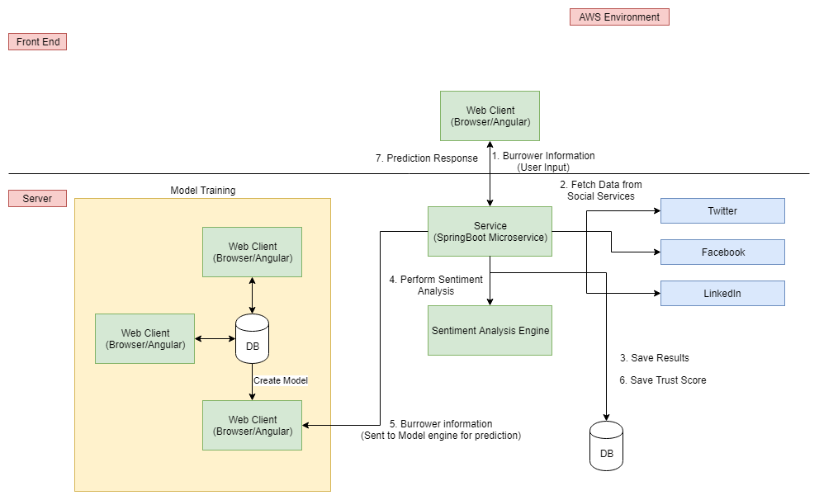
Predicting Loan Delinquency using “Social Trust” Score
Architecture Diagram

Slide 8
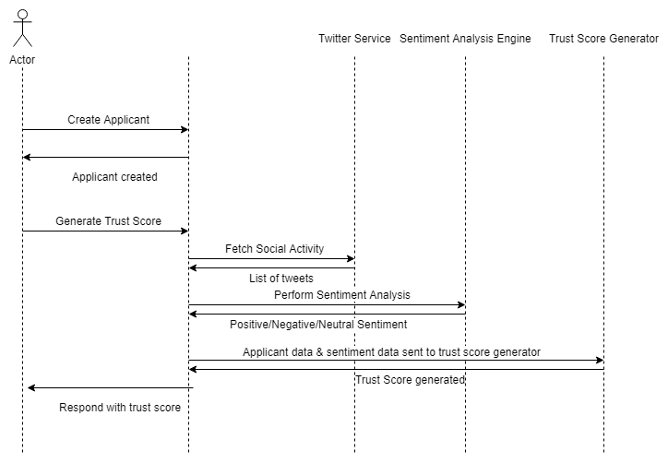
Predicting Loan Delinquency using “Social Trust” Score
Interaction Diagram

Slide 9
Predicting Loan Delinquency using “Social Trust” Score
Trust Score Categorization
Predictive value “r” is classified and identified as color:
Red: r < 6
Yellow: 6 <= r < 8
Blue: 8 <= r < 9
Green: r >= 9

Slide 10
Predicting Loan Delinquency using “Social Trust” Score
Business Use case 1: Lending Platforms
The lending platforms often have a huge number of low credit score applicants. The social trust score can be another parameter which can add some insight to each applicant’s probability of being delinquent in future.

Slide 11
Predicting Loan Delinquency using “Social Trust” Score
Business Use case 2: Educational Institutions
Educational Institutions often end up with seats not filled up because they don’t have enough students with the desired cutoff grades. Because of which they end up lowering the cutoff to intake more students. This could cause dilution in the quality of students joining the institution. Social trust score would showcase the attitude of each student and along with the grades can help institutes find right students to fill up the seats with more confidence.

Slide 12
Predicting Loan Delinquency using “Social Trust” Score
Business Use case 3: Recruitment
Its always better to have a good team player then a professional who can’t work in a team. This recruitment team can evaluate the candidates professional qualifications, however its really tough to find out how the candidate will fit in the culture of the workplace. Social trust score can help recruiters categorize candidates and get some idea about the candidates fitment in the workplace.

Slide 13
Predicting Loan Delinquency using “Social Trust” Score
Business Use case 4: Firearms Acquiring Eligibility
With increasing gun problems through out the world there is a need for Gun sellers to find out if a person should be sold a gun or not. Merely being eligible based on age and medical accounts isn’t enough. The social trust score can make a difference in the decision by identifying if the buyer is troubled or stable.

Slide 14
Predicting Loan Delinquency using “Social Trust” Score
Team Members
Deepak Mohanty (Team Lead)
Naveen Matta
Rajeev Chaudhary
Siraj Kizhakkekkara Ali

Slide 15
Predicting Loan Delinquency using “Social Trust” Score
Questions ?

Slide 16

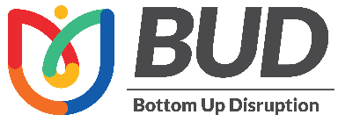
Stay connected through the Hexaware Mobile App
Watch the Innovation Value-Adds of our Bottom Up Disruption (BUD) Champs!

