Slide 1

Coffee Sales
Analysis

Slide 2
How do sales vary by hour of the day

Slide 3
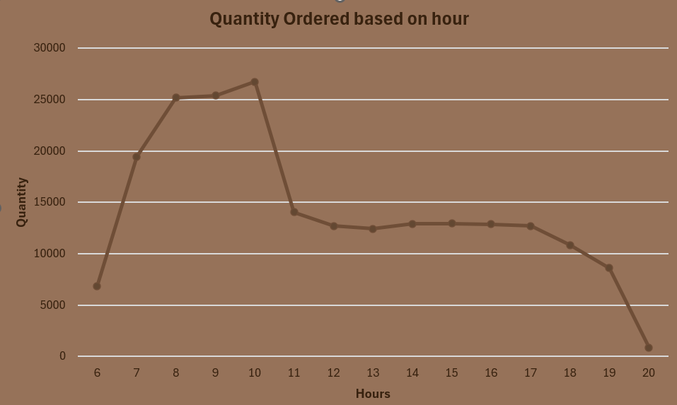

Slide 4
Coffee sales are maximum in morning time from 7 to 10
And
Lowest at 8’o clock in the evening

Slide 5
How do sales vary by day of the week

Slide 6
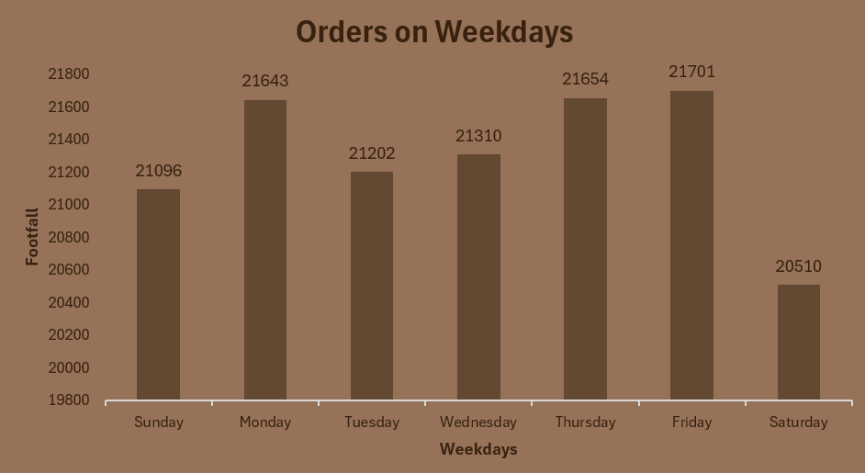

Slide 7
Orders number are similar for all the days of week except for Sunday which has the lowest number of order

Slide 8
Morning 10’o clock
is peak time

Slide 9
Sales vary
across different locations

Slide 10

Average price and order are
4.69 and 1.44 per person respectively

