Slide 1
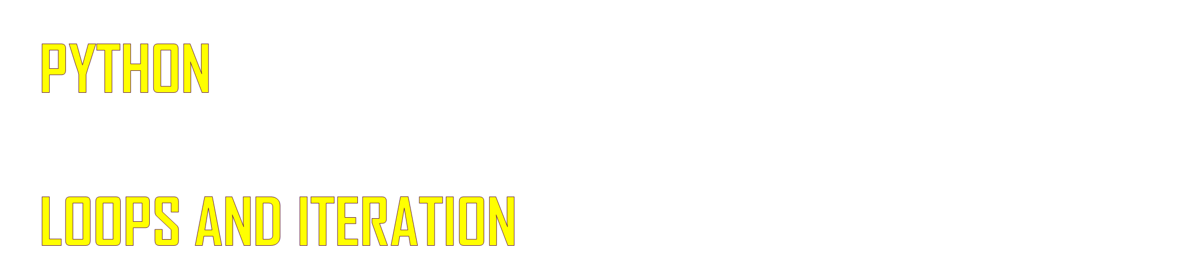
©DTA-Rajneesh Kumar

Slide 2

n = 5
No
Is n>0 ?
Yes
Program:
n = 5
while n>0 :
print(n)
n = n–1 #n-=1
print('Blastoff!')
print(n)
Output:
5
4
3
2
1
Blastoff!
0
print n
n = n -1
print 'Blastoff'
Loops (repeated steps) have iteration variables that change each time through a loop. Often these iteration variables go through a sequence of numbers.
©DTA-Rajneesh Kumar

Slide 3

n = 5
No
n > 0 ?
Yes
print 'Lather'
n = 5
while n > 0 :
print('Lather‘)
print('Rinse‘)
print('Dry off!‘)
print 'Rinse'
print 'Dry off!'
What is wrong with this loop?
©DTA-Rajneesh Kumar

Slide 4

The break statement ends the current loop and jumps to the statement immediately following the loop
while True:
line = input('> ')
if line == 'done' :
break
print(line)
print 'Done!'
> hello there
hello there
> finished
finished
> done
Done!
©DTA-Rajneesh Kumar

Slide 5
No
True ?
Yes
....
while True:
line = input('> ')
if line == 'done' :
break
print(line)
print 'Done!'
break
print(‘...’)
print 'Done'
©DTA-Rajneesh Kumar

Slide 6
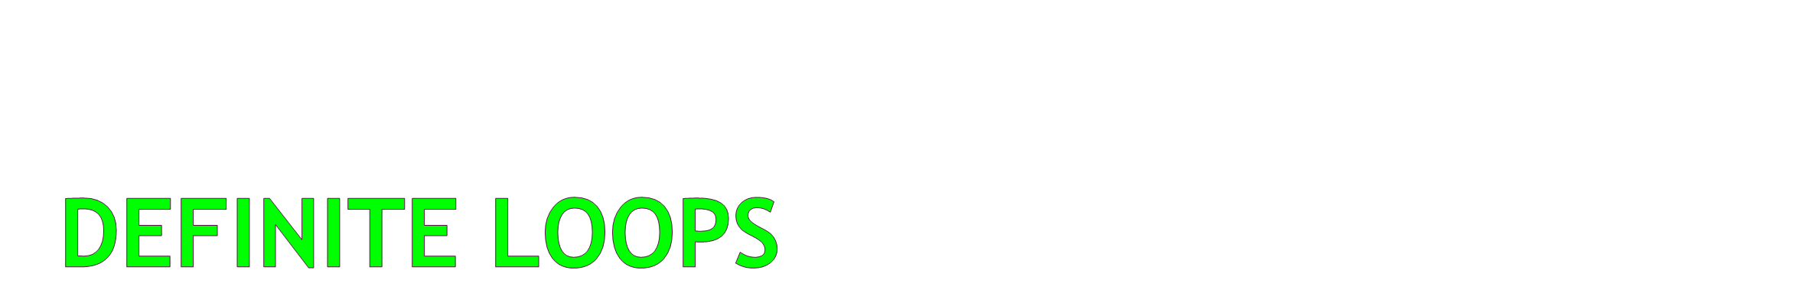
Quite often we have a list of items of the lines in a file - effectively a finite set of things
We can write a loop to run the loop once for each of the items in a set using the Python for construct
These loops are called "definite loops" because they execute an exact number of times
We say that "definite loops iterate through the members of a set"
©DTA-Rajneesh Kumar

Slide 7

4
1
3
2
1
Blastoff!
for i in [4, 1, 3, 2, 1]:
print(i)
Print('Blastoff!‘)
©DTA-Rajneesh Kumar

Slide 8
friends = ['Joseph', 'Glenn', 'Sally']
for friend in friends :
print('Happy New Year: ', friend)
print('Done!‘)
Happy New Year: Joseph
Happy New Year: Glenn
Happy New Year: Sally
Done!
©DTA-Rajneesh Kumar

Slide 9
The range() function (revisited)
range() is a built-in function that allows you to create a sequence of numbers in a range
Very useful in “for” loops which are discussed later in the Iteration chapter
Takes as an input 1, 2, or 3 arguments. See examples.
x = range(5)
print(x)
[0, 1, 2, 3, 4]
x = range(3, 7)
print(x)
[3, 4, 5, 6]
x = range(10, 1, -2)
print(x)
[10, 8, 6, 4, 2]
©DTA-Rajneesh Kumar

Slide 10
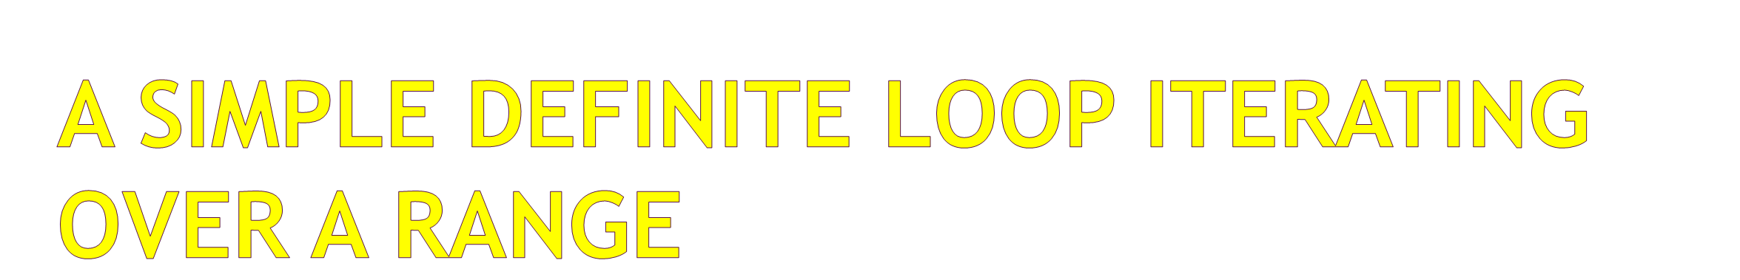
7
6
5
4
3
2
1
Blastoff!
for i in range(7, 0, -1) :
print(i)
print 'Blastoff!'
©DTA-Rajneesh Kumar

Slide 11
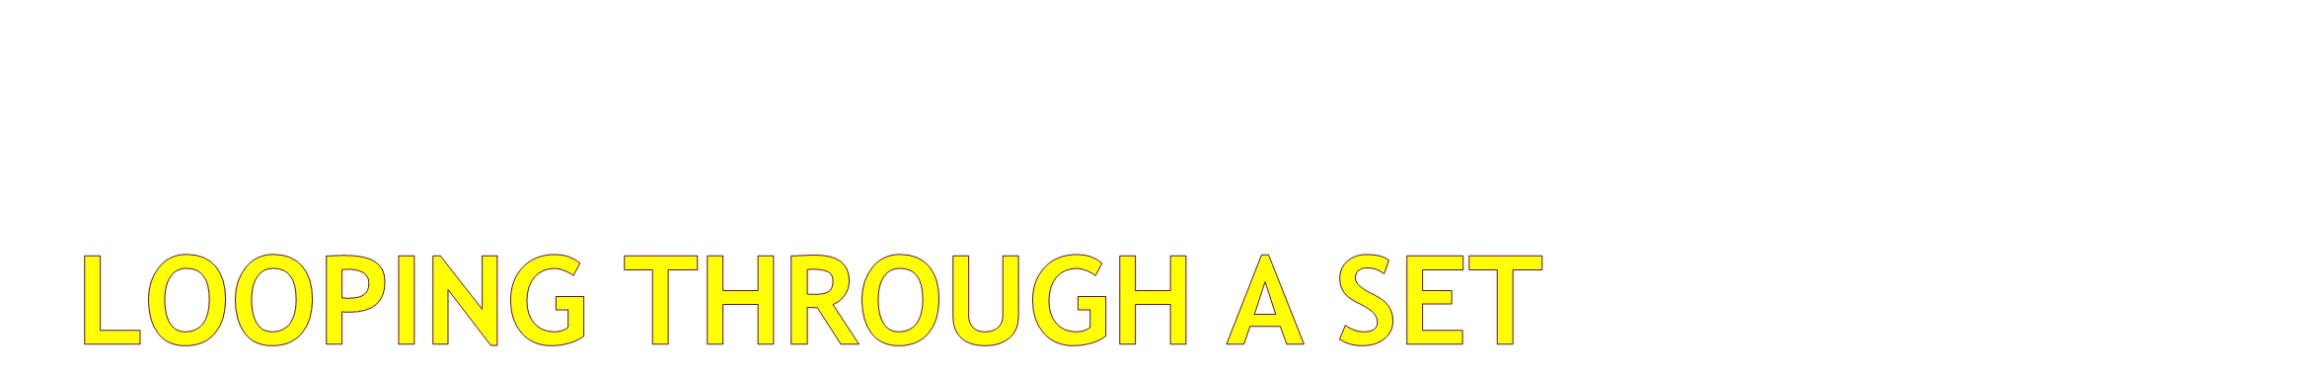
Before
9
41
12
3
74
15
After
print 'Before'
for thing in [9, 41, 12, 3, 74, 15] :
print(thing)
print 'After'
©DTA-Rajneesh Kumar

Slide 12

Before 0
1 9
2 41
3 12
4 3
5 74
6 15
After 6
zork = 0
print ( 'Before', zork )
for thing in [9, 41, 12, 3, 74, 15] :
zork = zork + 1
print(zork, thing)
print('After', zork)
To count how many times we execute a loop we introduce a counter variable that starts at 0 and we add one to it each time through the loop.
©DTA-Rajneesh Kumar

