Slide 1

COLLECTION DATATYPE
Operations

Slide 2
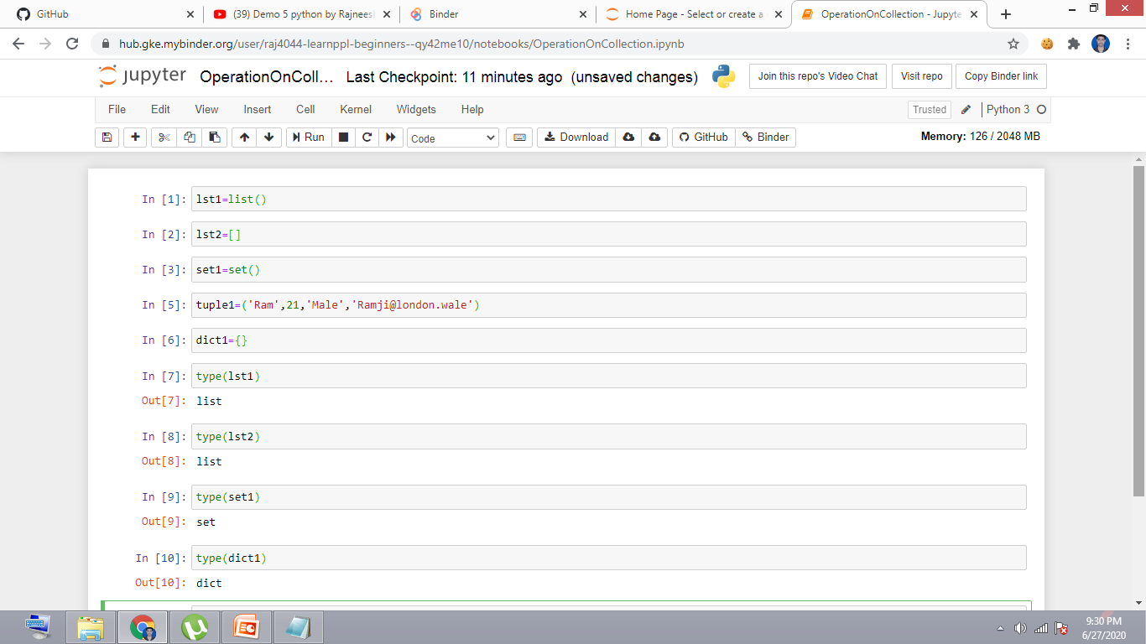
Declare some collections & check their datatypes

Slide 3
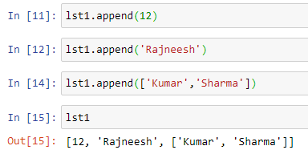
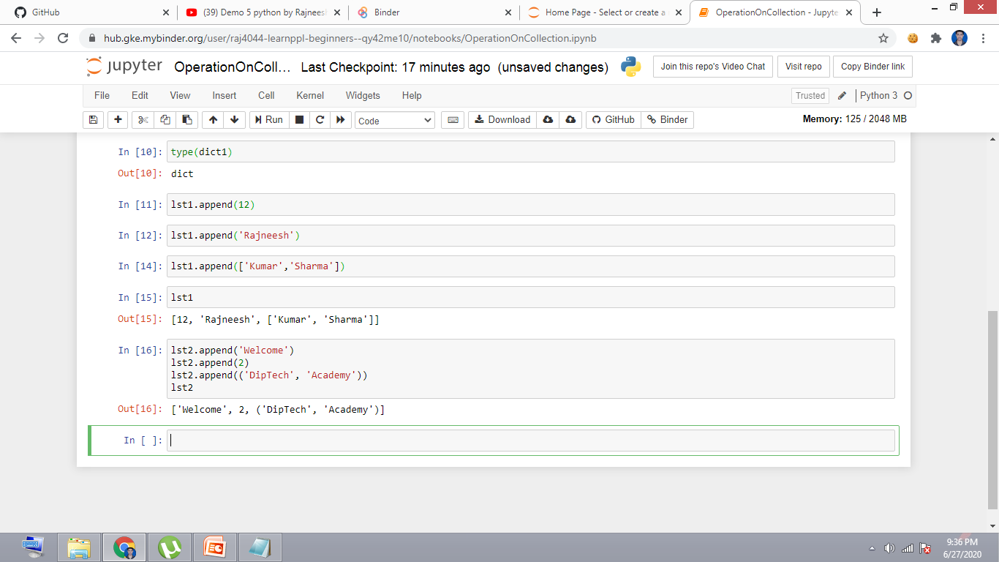
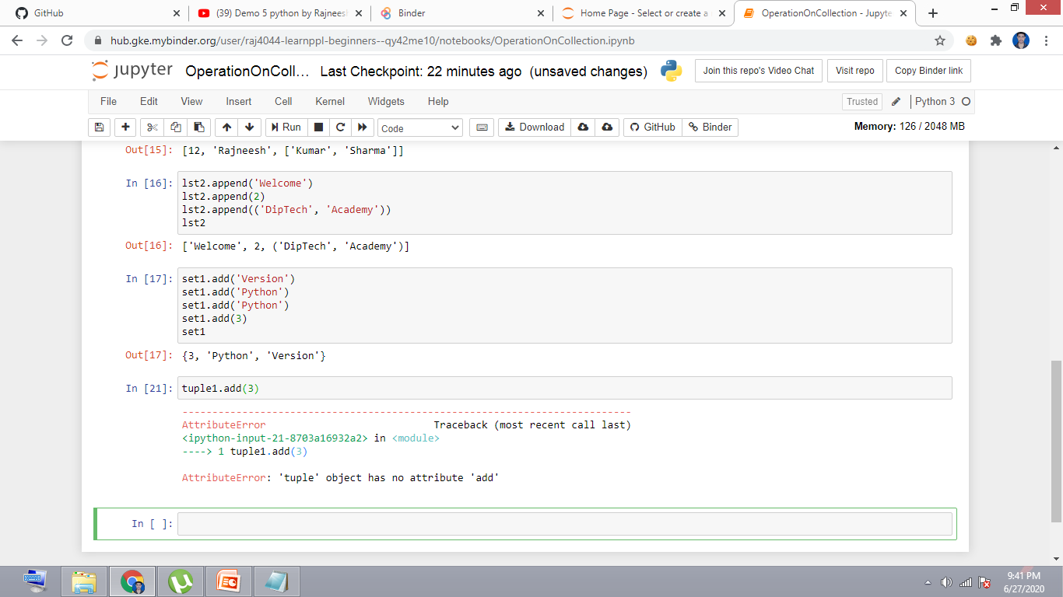
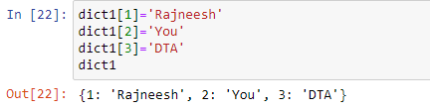
Add elements in Collections

Slide 4
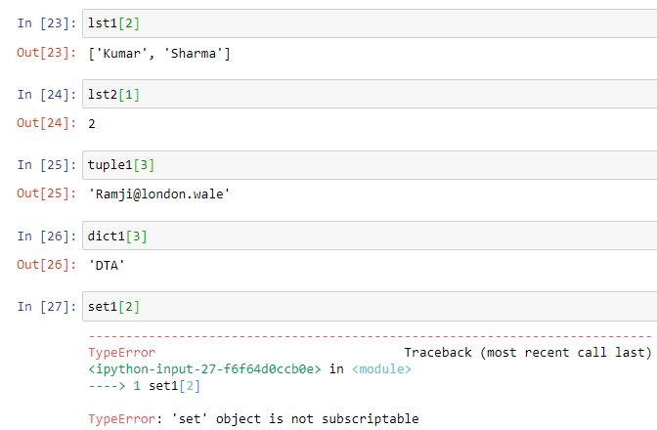
Retrieve Elements from Collections

Slide 5
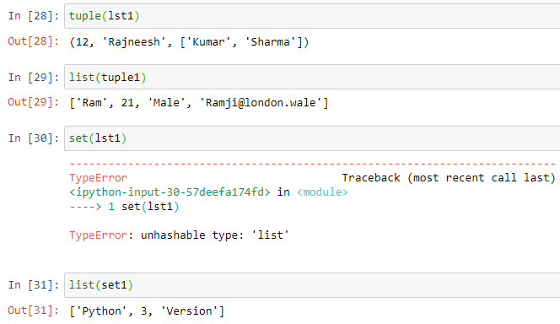
Conversions

Slide 6
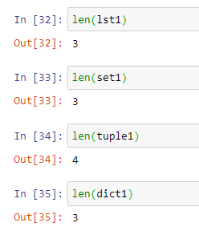
len Operations

Slide 7
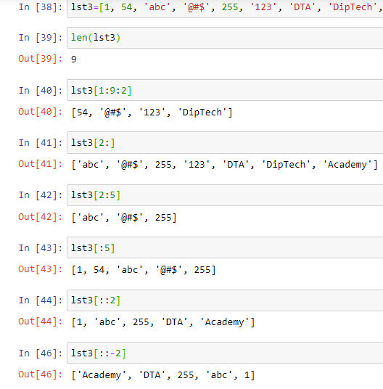
Slicing of lists and tuples

Slide 8
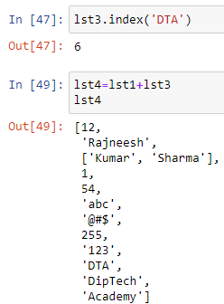
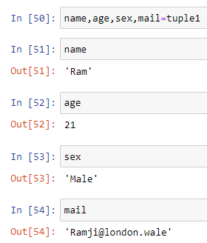
Special Operations

Slide 9
Tell us
Do you know some Python loops?
If yes:
Comment below
If no:
Wait for the next lecture
Subscribe

