Slide 1


Used
Car Price Prediction
BRAND
Model
Location
Fuel
Gear
Year
Distance
Predicted Price

Slide 2
Objective:
Predict the price of used car.
Data Source: Scraped the details of cars from “Cardekho” website.
File format -> .csv
File size -> 12070 rows x 11 columns (1,005kb)

Slide 3
Features:
Kind of Data
Data Type
Body type
Location
Brand
Model
Version
Year
Fuel type
Transmission type
Distance driven
Price
Categorical
Categorical
Categorical
Categorical
Categorical
Categorical
Categorical
Categorical
Continuous
Continuous
Object
Object
Object
Object
Object
Object
Object
Object
int
float

Slide 4
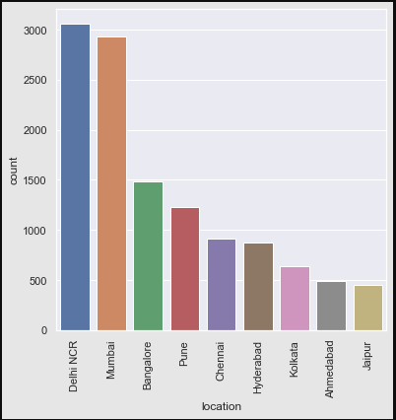
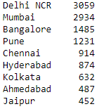
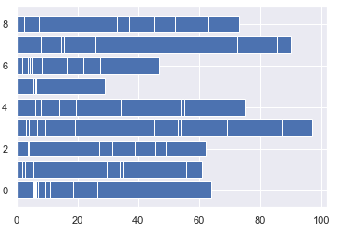
Number of cars present in our data
with respect to different locations.
Different Locations : 9
Ahmedabad
Bangalore
Chennai
Delhi
Jaipur
Kolkata
Mumbai
Pune
Price

Slide 5
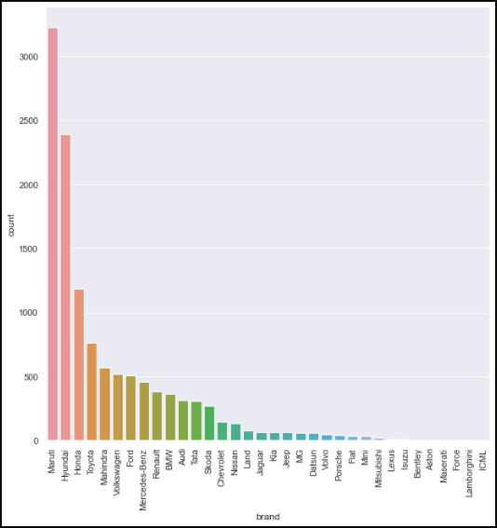
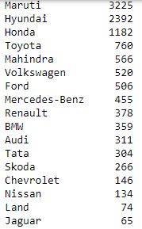
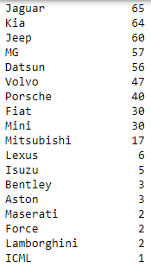
Number of cars present in our data
with respect to different Brands.
Different Locations : 34

Slide 6
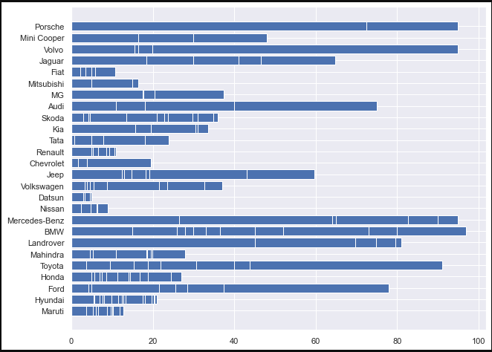
Price of car
Based on the Brand
Price in lakhs

Slide 7
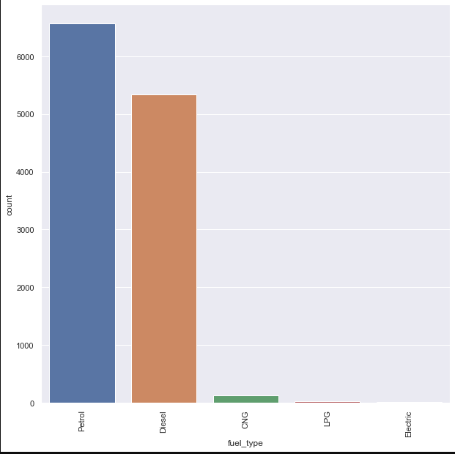

Number of cars present in our data
with respect to different fuel type.
Different Fuel types : 5
Petrol
Diesel
CNG
LPG
Electric

Slide 8
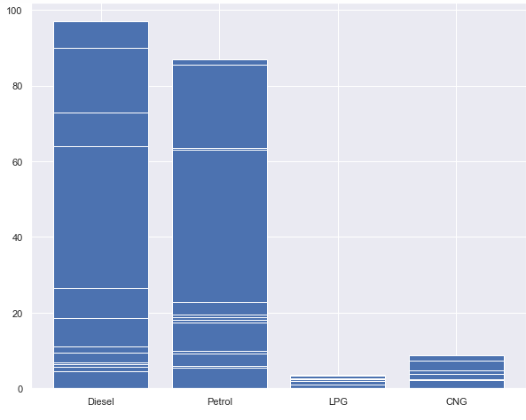
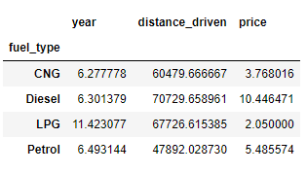
Price of car
Based on the Fuel Type
Price in lakhs
Average values based on fuel type

Slide 9
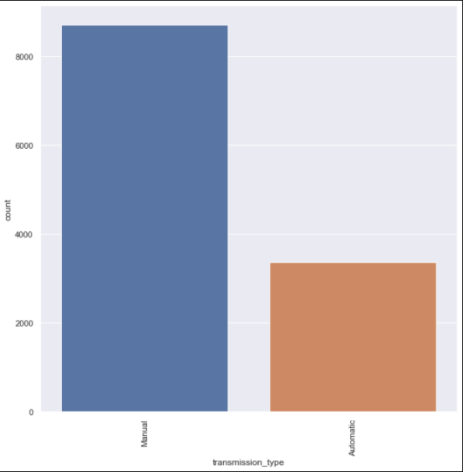
Number of cars present in our data
with respect to different
transmission type.
Different Fuel types : 2
Manual
Automatic

Slide 10
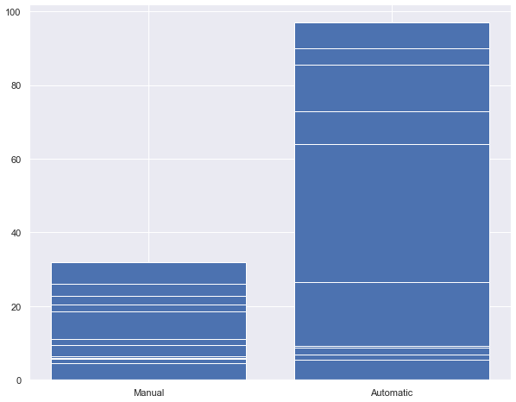
Price of car
Based on the
Transmission Type
Price in lakhs

Slide 11
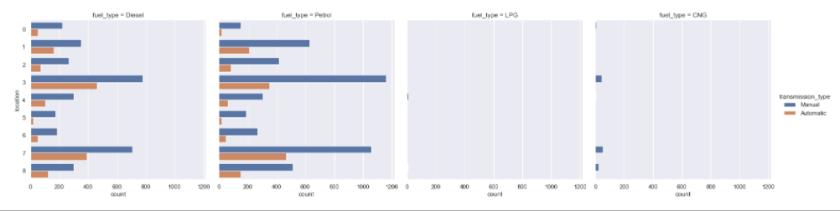
Number of cars
Present in different locations
w.r.t to type of fuel

Slide 12
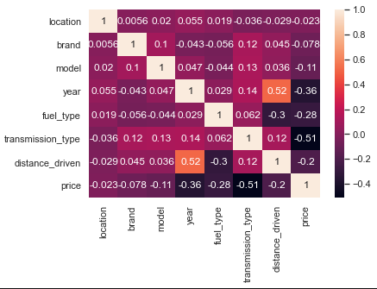
Correlation

Slide 13
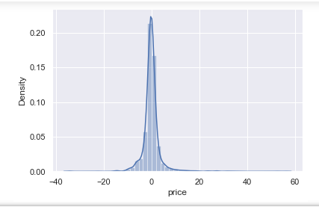
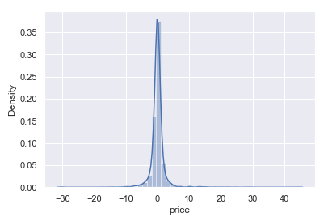


Distribution plot of ml model
Distribution before tuning
Distribution after tuning
Accuracy improved to 90%

