Slide 1
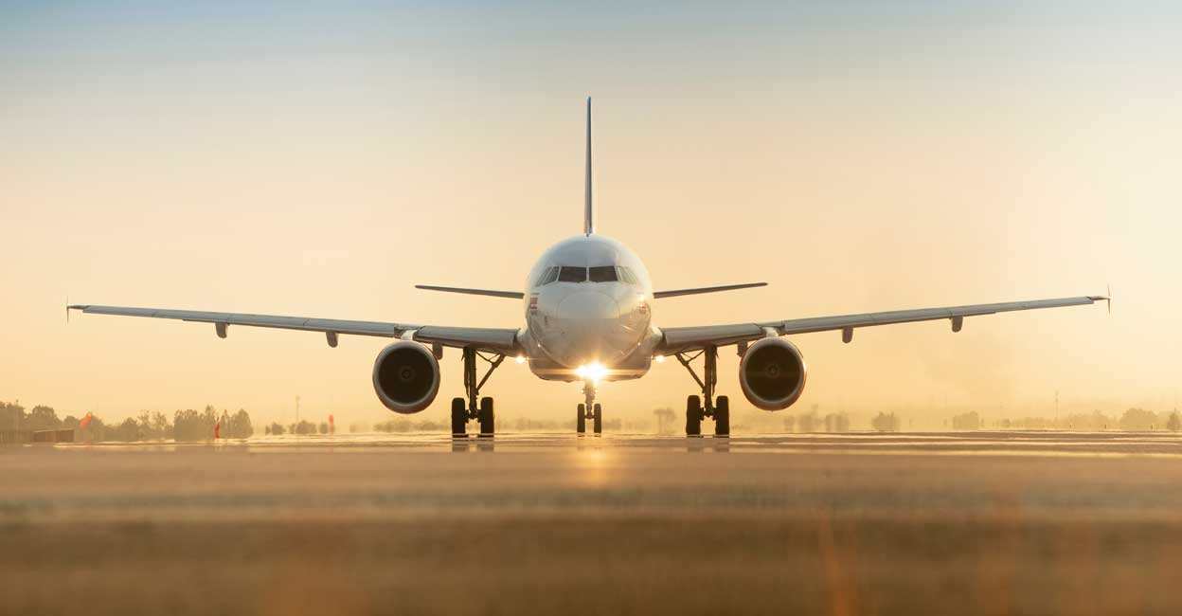
FLIGHT TICKET PRICE PREDICTION

Slide 2
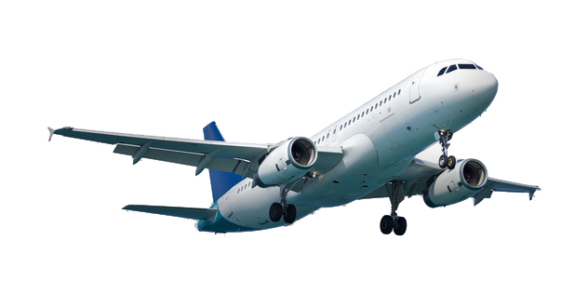
Problem Statement:
The airline industry is considered as one of the most sophisticated industry in using complex pricing strategies. Nowadays, ticket prices can vary dynamically and significantly for the same flight, even for nearby seats. Anyone who has booked a flight ticket knows how unexpectedly the prices vary. The cheapest available ticket on a given flight gets more and less expensive over time. This usually happens as an attempt to maximize revenue based on
1. Time of purchase patterns (making sure last-minute purchases are expensive)
2. Keeping the flight as full as they want it (raising prices on a flight which is filling up in order to reduce sales and hold back inventory for those expensive last-minute expensive purchases)

Slide 3
Objective:
To predict the price of flight ticket.
Project Phases:
Data Collection
Data Analysis
Model Building

Slide 4
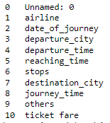
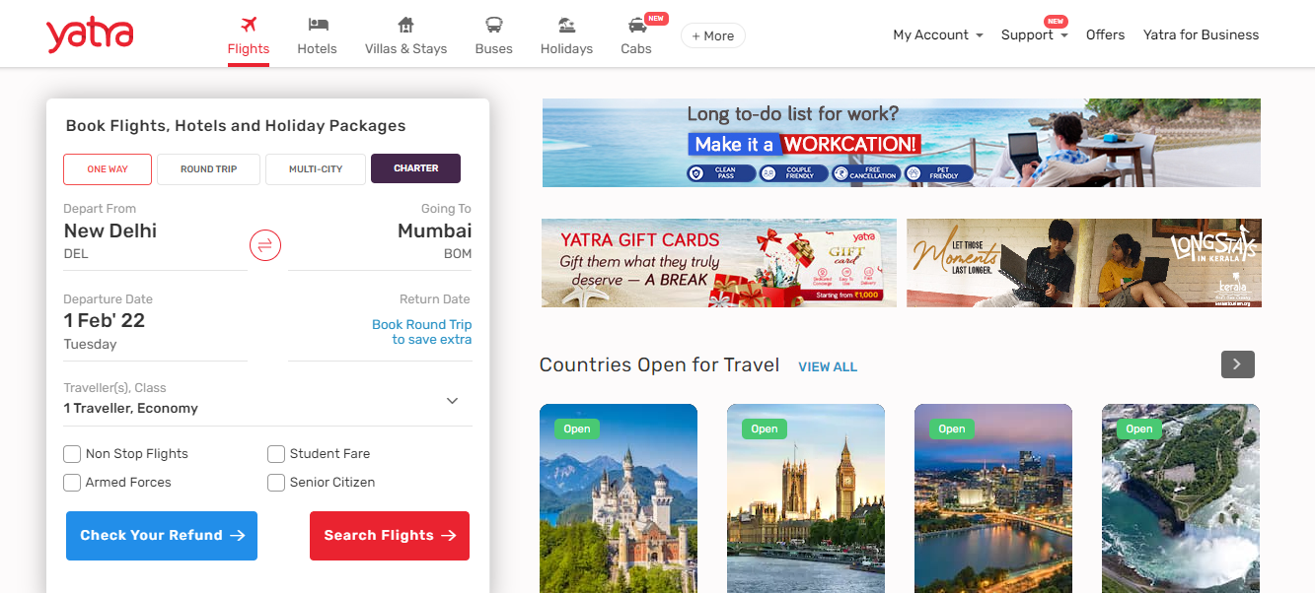
Data Collection:
Data is collected from the website www.yatra.com
Data collected: 2913 rows with 11 columns
File format - csv
Details collected are: Only domestic flights(India)

Slide 5
Column details:
-
Service Provider
Journey date
Source city from where the flight starts
Time at which the flight departs
Time at which the flight reaches destination
Number of stops in between source and destination
The destination city
Duration of flight from source to destination
Other details of flight
Price of ticket

Slide 6
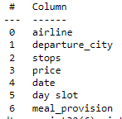
Data Analysis:
Data collected is pre-processed and only the required information columns are considered
Various pre-processing steps are done like changing datatype, drop un necessary columns,
Make new columns which required, from the existing data etc.
EDA process and Visualizations are made to observe insights of data
Final columns derived by EDA and insights, that considered to predict the price of ticket
Service Provider
Source city from where the flight starts
Number of stops in between source and destination
Price of ticket
Journey date
Time at which the flight departs (Morning or Afternoon or Evening or Early hours)
Whether meal is provided or not

Slide 7
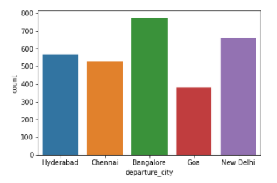
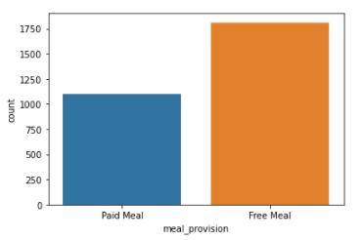
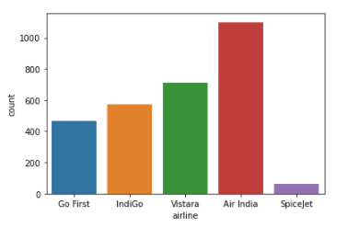
Visualizations:
Air India having more flights to Mumbai
More flights are there from Bangalore
Nearly 50% of flights are not providing free meal

Slide 8
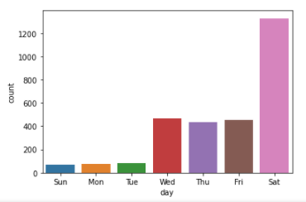
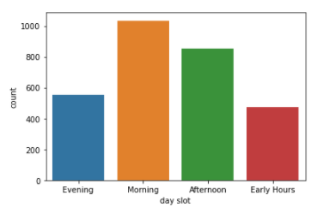
Visualizations:
Number of flights less, with nearer the journey date.
More flights are on Saturday.
Most of the flight timings are of morning (6.00 AM to 12.00PM)
Less flights during early hours (00.00AM to 6.00AM)

Slide 9
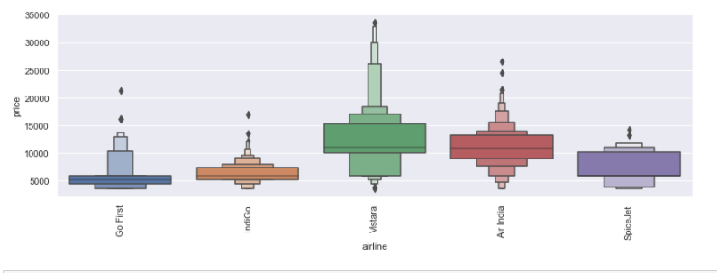
Visualizations:
Ticket fare based on airline service provider
Vistara is charging the highest ticket fare
Gofirst is charging the least ticket fare

Slide 10
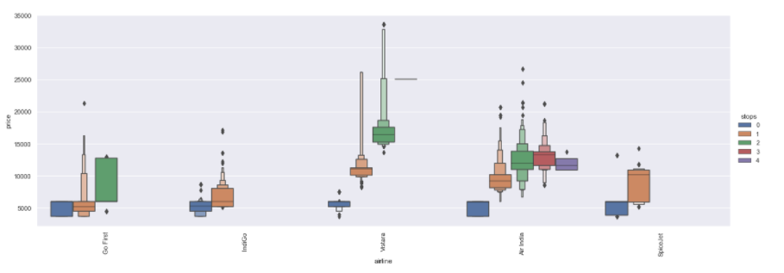
Visualizations:
Ticket fare based on airline service provider and number of stops
Except Air India all other airlines are having max. of 2 stops.
Air India is having more stops upto 4
Price of ticket is less with 0 stops

Slide 11
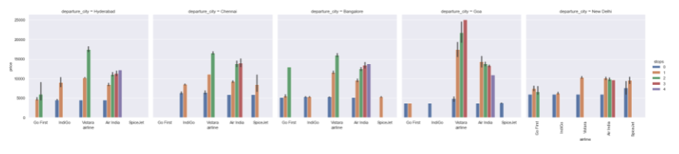
Visualizations:
Ticket fare based on airline service provider and number of stops from different cities

Slide 12
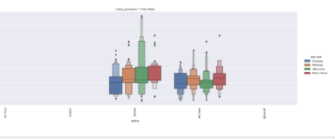
Visualizations:
Price w.r.t to provision of meal, service provider & time of day:

Slide 13
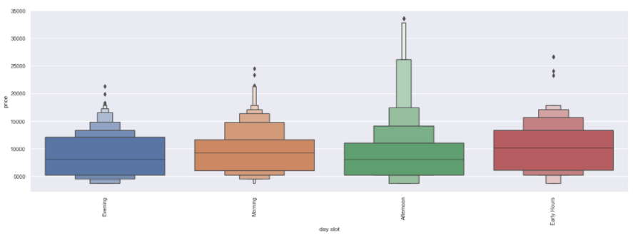
Visualizations:
Price w.r.t to time of day:
Morning flight prices are high

Slide 14
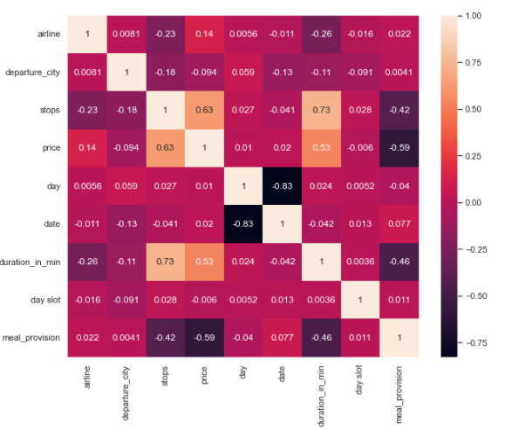
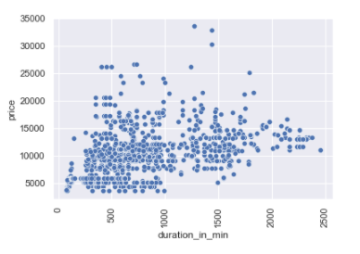
Visualizations:
Price w.r.t to journey time:
Price is high with increase in flight duration
Price is highly correlated and increases with increase in no. of stops, duration

Slide 15
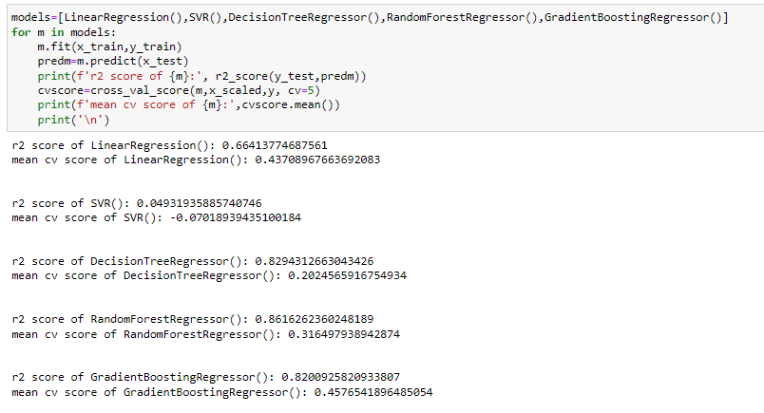
Model Building:
Different Regression models are built and metrics observed.

Slide 16
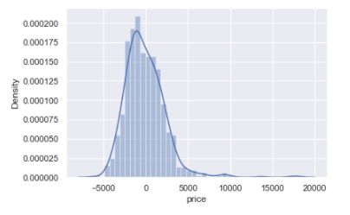
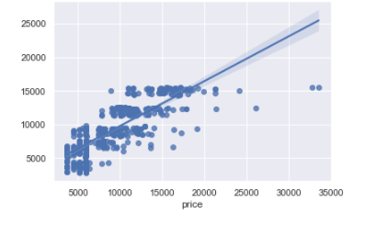
Model Building:
Linear Regression is observed to be best model of all based on metrics.
The final model is 66% accurate.

